Slide 1

Management Team Meeting Performance Update
Data: 01 April – 31 December 2016 Date: Wednesday 4 January 2017 Author: 4736 Becki BROOKES, Intel Analyst PSD
Agenda No.4

Slide 2

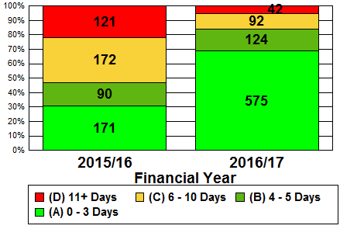
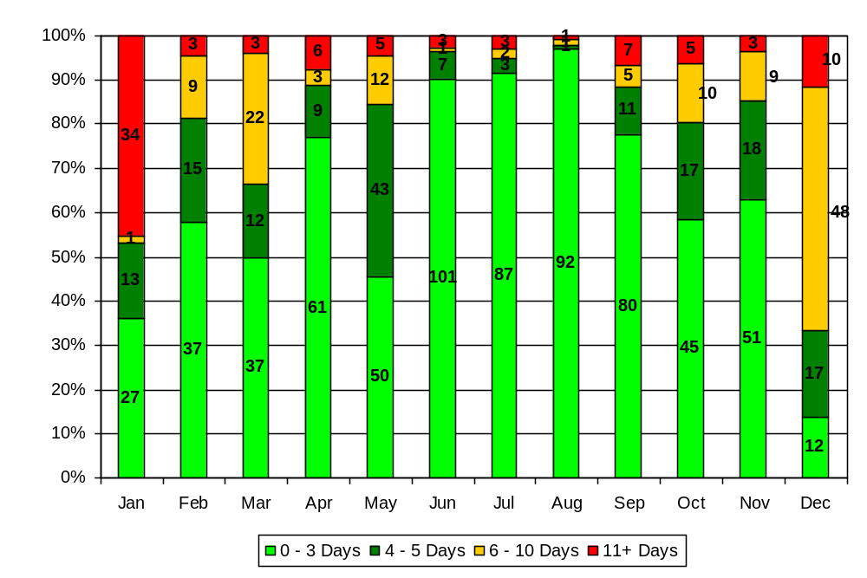
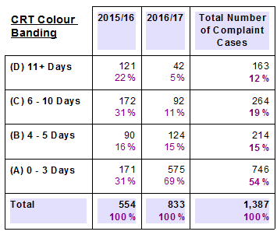
Complaint Cases Recorded & Timeliness

Slide 3
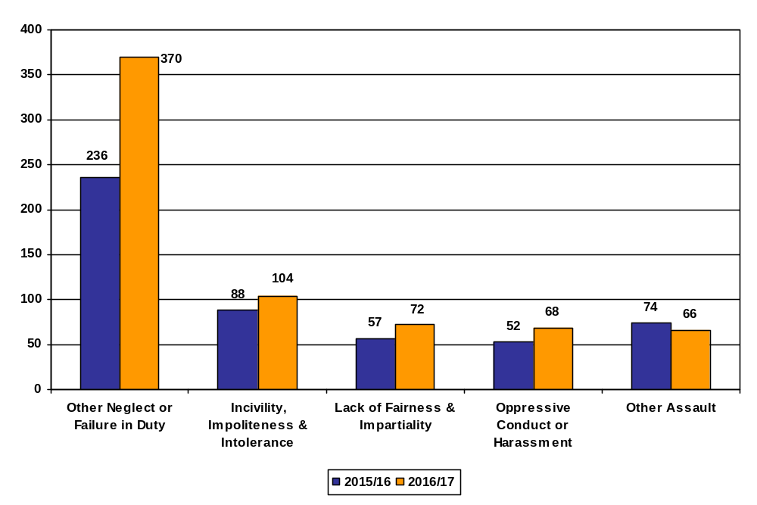
Complaint Allegations Recorded – Top 5

Slide 4
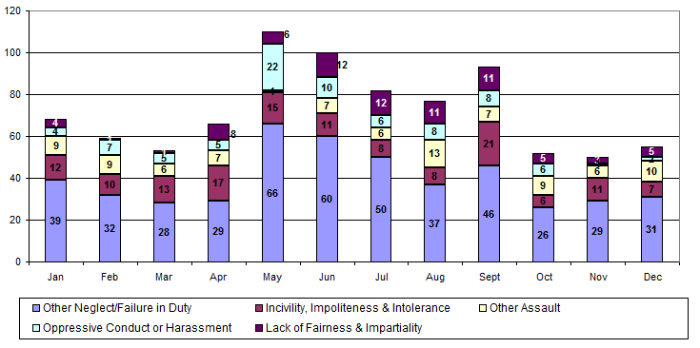
Complaint Allegations Recorded – Top 5

Slide 5
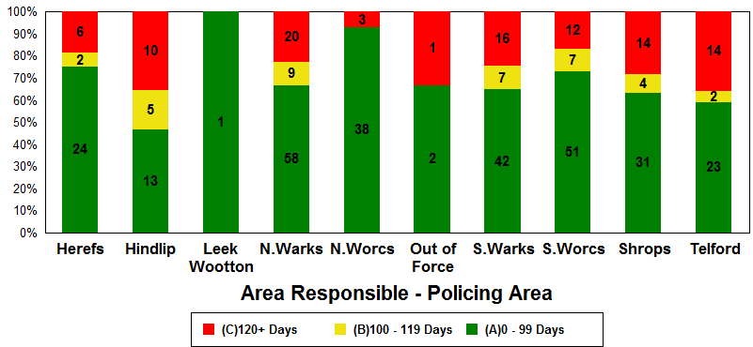
Live Complaints
415 LIVE cases (as on 04/01/2017)
The number in () denotes the previous quarters red figure

Slide 6
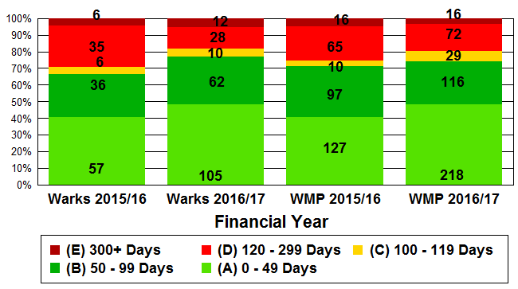
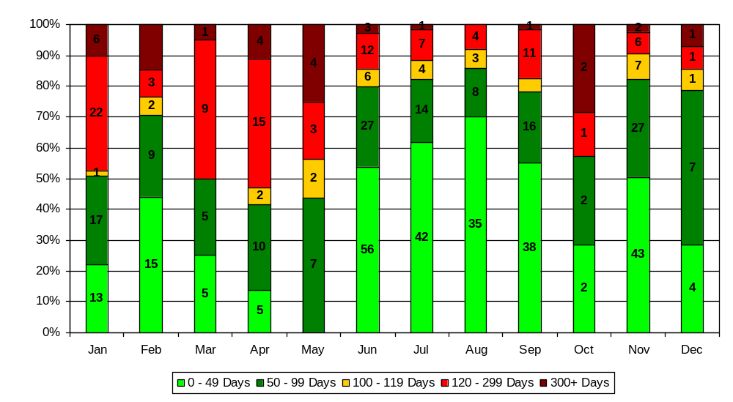
Complaint Cases Finalised
2015/16 Vs 2016/17 Difference
Warks: 55% increase WMP: 43% increase

Slide 7
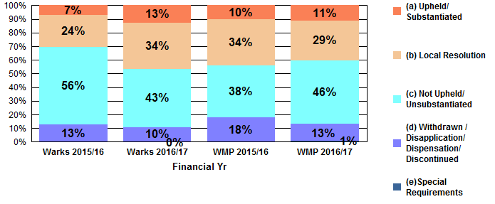
Complaint Allegations Finalised

Slide 8
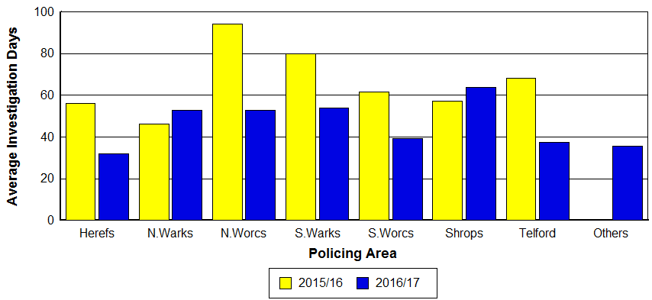
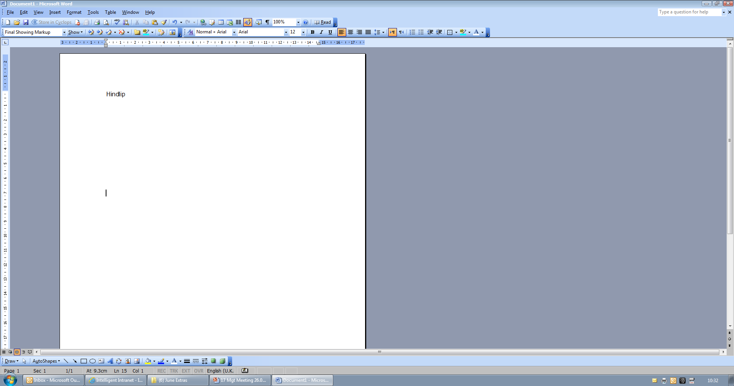
Complaint Allegations Finalised: LR Timeliness
28 day LR target
At Alliance level, 46% (92) of all LR’s were finalised within 28 days in 2016/17

Slide 9
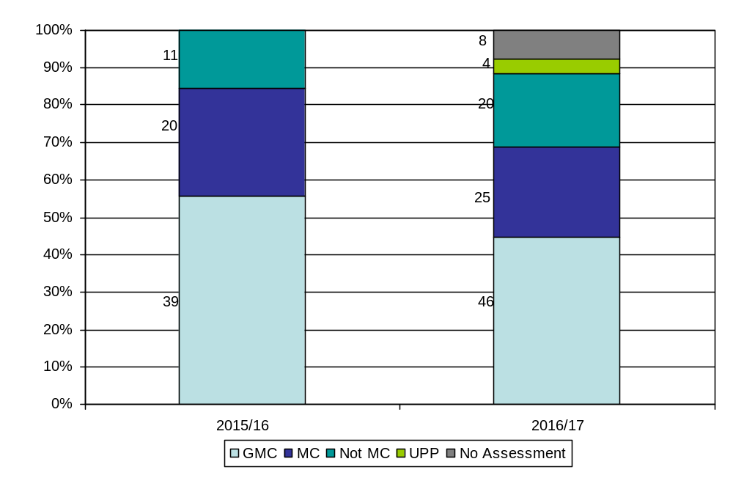
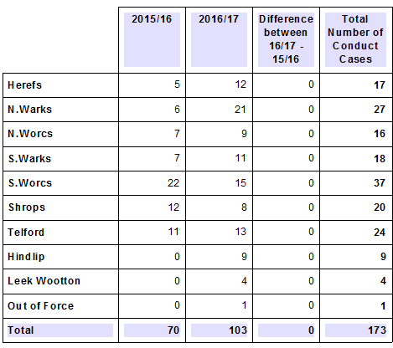
Conduct Cases Recorded

Slide 10
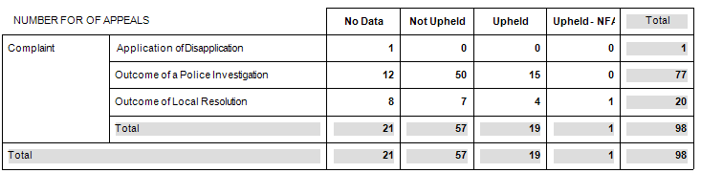
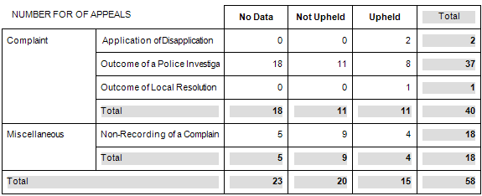
Appeals
This data covers the period 01/04/2016 – 31/12/2016 for the Alliance.
Force Appeals
IPCC Appeals

