Slide 1


West Mercia Police
Quarterly Report
Q1 Apr – Jun 2021
Purpose
The purpose of this product is to provide a quarterly overview of current and emerging performance issues relating to West Mercia.
GSC Level | Official
Date of publication | July 2021
Product Reference | SPI/2021/170
Version | Final
Purpose | Overview of Force Performance for April to June 2021
Author | Strategy, Planning and Insight
Owner | DCC J. Moss
Handling Instructions:
This document must be handled and stored according to the Government Security Classifications guidance.
Neither the document nor any of its contents may be disseminated further without the permission of the Information Asset Owner.

Slide 2


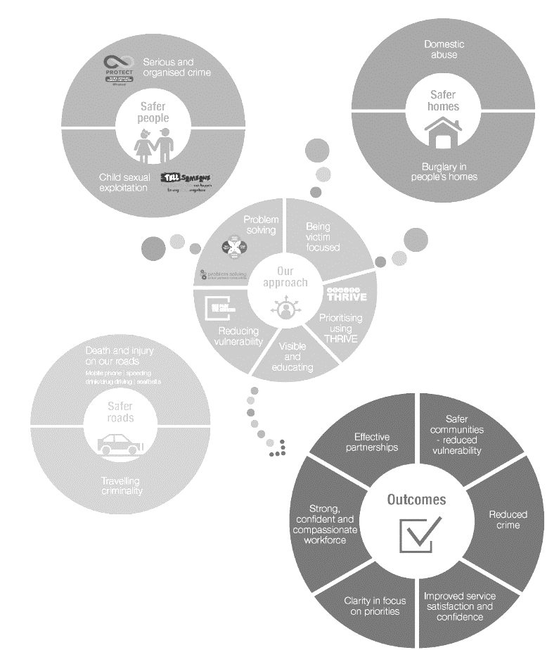

GOLD
Our values drive our approach
Introduction
This is the Q1 Performance Report reviewing activity between April to June 2021. The purpose of this report is to inform the Force Delivery Group meeting on 27th July with a force wide picture of performance, however this report is looking to draw particularly on the keys issues faced by the force, particularly in relation to force priorities and key practices.
This report focusses on Gold level Key Performance Indicators (KPI), however, there are also some measures included at a Silver level to create a comprehensive picture across the force. The number of measures in this report will continue to be refined to ensure that they are key performance indicators.
Crime and disorder in the last quarter continues to increase in most areas as anticipated with further lockdown restrictions being eased.
The OCC performance in relation to 999 and 101 call handling increased consistently.
Due to the impact of COVID-19 on crime in 2020/21, the upper and lower control limits for 21/22 are set against 19/20 figures. It is intended that this will provide more realistic limits than if the normal practise of the previous financial year was used.
Projections have been included in this report, however, it should be noted that due to their basis on volumes in previous years the impact of COVID-19 is likely to distort the projections. Factoring the impact of COVID-19 within projections continues to be reviewed.

Slide 3

GOLD
Gold Balanced Scorecard
2021-2022
1. Delivering a high quality, consistent service to the public
2. Delivering an
efficient service
3. Delivering an ethical service
OUTCOMES
1.1 Delivering
victim
satisfaction
1.2 Creating
public
confidence
2.1 Delivering our
service within
budget
3.1 Delivering our
service legally and
within regulations
3.2 Meeting our corporate environmental responsibility
CONTROLS
4. Delivering innovative, problem-solving practices and processes
ACTIVITIES
4.1 Delivering effective core practices
4.2 Managing demand
4.3 Innovating and improving
5. Delivering a skilled, sustainable workforce in a constantly learning and improving environment
ASSETS
5.1 Establishing a skilled,
flexible workforce
5.2 Establishing high quality,
accessible knowledge
5.3 Establishing appropriate,
available tools
Public First Courage Compassion Ownership

Slide 4
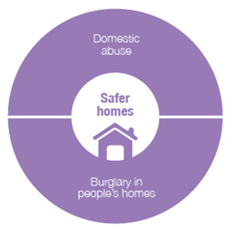
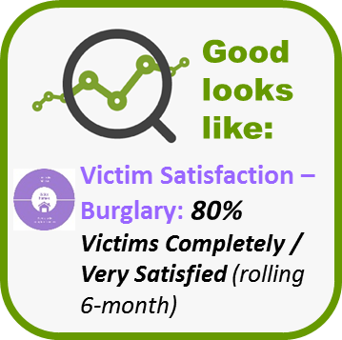
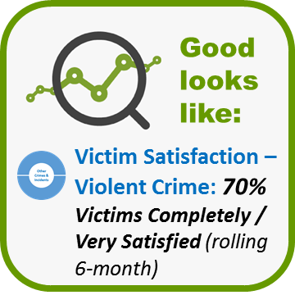


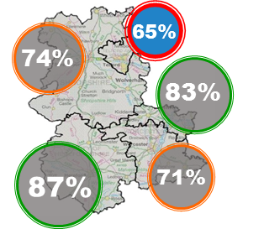
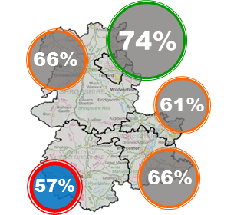
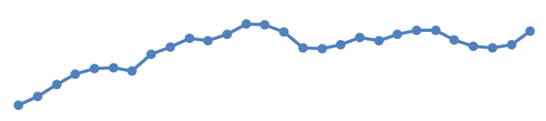
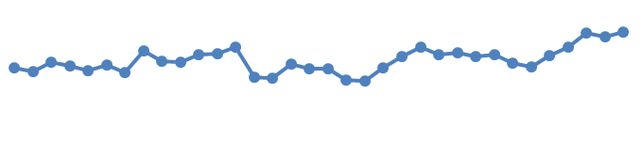
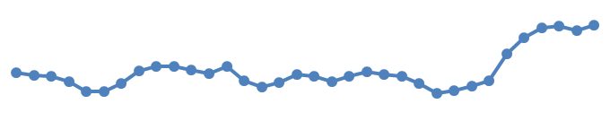
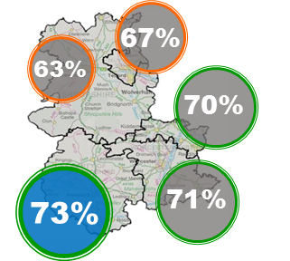
Delivering a high quality, consistent service to the public
1.1 Delivering victim satisfaction: Burglary, Violent, Hate
*Change in satisfaction is not statistically significant
**Change is statistically significant
Number of victims spoken to:
Survey targets were not met during Quarter 1 due to staff abstractions; this is expected to continue until September 21. This adversely affects the statistical validity of the results.
Burglary
Violent
Hate
Rolling 6-months (Jan – Jun 21)
Rolling 6-months (Jan – Jun 21)
Rolling 12-months (Jul 20 – Jun 21)
(Completely or very satisfied)
(Completely or very satisfied)
1%*
- With a latest figure of 73%, Herefordshire has seen marked increases** in satisfaction since the dip seen in May-July 20 and is, therefore, an area of focus.
74%
5%*
65%
2%*
66%
74%
76%
83%
- Recent research in SP&I has identified the : following factors as contributing to this increase: a period of reduced demand, likely as a result of COVID, and so enabling officers to spend more time on victim care / quality investigations; a change in the survey profile – reflecting changes in the offence profile – resulting in reduced proportions of surveys of ABH victims; an improvement in the Treatment service stage, reassurance drivers and keeping victims updated; the change in the role of the IPT to provide greater support patrol teams.
61%
76%
2%*
64%
2%*
Satisfied
Satisfied
(Previous (Oct 20 – Mar 21): 74%)
87%
71%
7%*
(Previous (Apr 20 – Mar 21): 62%)
57%
66%
5%*
4%*
76%
64%
74%
2%*
69%
53%
11%**
Trend:
62%
7%**
Trend:
Apr-Sep 19
Jan-Jun 21
Trend:
Apr 18-Mar 19
Jul 20-Jun 21
- With a latest figure of 65%, Telford is an area of focus, increasing only marginally since last Quarter*.
Apr-Sep 19
Jan-Jun 21
- With a latest figure of 57%, Herefordshire Local Policing Area (LPA) is an area of focus, although satisfaction has increased by 5%* since last Quarter.
(Completely or very satisfied)
3%*
- Previous research in SP&I has identified the following factors as causing low burglary satisfaction: low satisfaction with speed of arrival times / poor expectation management; low satisfaction for those dealt with over the phone; gaps in service provision in terms of: officers’ ‘softer skills’, follow up and perceived quality of investigations.
6%*
63%
- SP&I are undertaking analysis to explore the reasons for Herefordshire’s lower levels of satisfaction with a number of hypotheses being tested as part of this; some of these are outlined, below.
Lower levels of satisfaction are due to: the impact of vexatious repeat victims; the impact of higher (relative to other LPAs) / increasing proportions of neighbour dispute incidents comprising the survey sample; the effect of a gap in service provision relating to a service stage or demographic group.
69%
70%
Satisfied
- The possible causes of Telford’s continuing lower satisfaction will be explored by SP&I with similar hypotheses to those above being tested.
(Previous (Oct 20 – Mar 21): 69%)
73%
71%

Slide 5







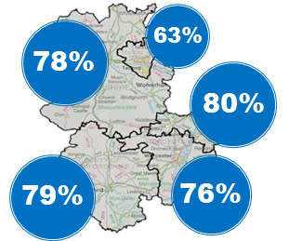


Delivering a high quality, consistent service to the public
1.1 Delivering victim satisfaction: Domestic Abuse (DA)
Good looks like:
80%
DA surveys were suspended from April 20 due to Covid and did not resume until April 21. Due to the break in data, results are presented as a new dataset from April 21.
Number of victims spoken to:
Previous Quarter:
NA
Satisfaction by Service Stage
Qtr 1
115
Target:
168
Quarter 1’s Performance (completely or very satisfied)
(Completely or very satisfied)
Rolling 3-months
(April-June 21)
What went well…
75%
I was really impressed with how they followed it up and cared
about my wellbeing. I feel they valued my safety, I couldn't have asked for anything more. Also I received a personal alarm, and a window and door alarm from the Victim Advice Line which have made me feel safer as I wasn't sleeping.
Satisfied
DA Service Measures
I had regular contact throughout, I was told what they (police) were doing and when they would be doing it. PC *** called me one evening I didn't answer as I had gone to bed so PC *** came round to the house to see if I was ok which I thought was amazing.
(April – June 2021)
Victim felt SAFER as a result of contacting the police? (% Yes, fully)
71%
Victim felt that the police CARED about them?
(% Yes, fully)
77%
What could be better…
Victim would feel CONFIDENT about contacting police again? (% Yes, fully)
83%
I have called the police many times and am often ignored. I am a 15 stone man so feel I was treated differently. I don't feel safe. The suspect will do something else to me or get someone else to do it .
If something similar happened to someone you know, would you RECOMMEND for them to contact the police? (% Yes, fully)
88%
I am totally dissatisfied no one has been in touch to update me. I have tried contacting the officer direct and through the incident room. I’m frightened and have additional information if the officer gets in touch. I need to know if the suspect has been spoken to. I presume he has not spoken to them; I don't know what's going on and should I still be looking over my shoulder? I have not heard anything at all.
Good looks like:
Victim Satisfaction – Domestic Abuse: 80% Victims Completely / Very Satisfied (rolling 6-month)

Slide 6

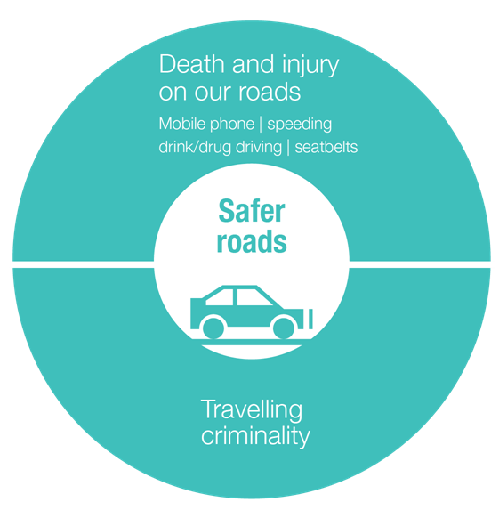
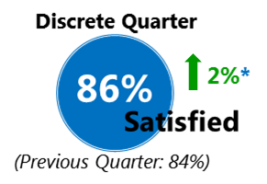

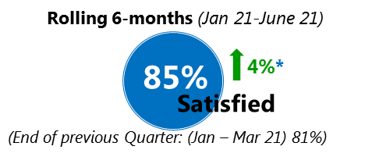





Delivering a high quality, consistent service to the public
1.1 Delivering victim satisfaction: Road Traffic Collision (RTC)
Quarter 1’s Performance
(Completely or very satisfied)
Quarter 1’s Performance by Service Stage
(completely or very satisfied: rolling 6-months)
Victims spoken to:
Qtr 1
Previous Quarter: 99
Initial Report
152
91
Target:
99
91%
Satisfaction
27
Potential ‘eligible’ slight injury RTC incidents where police attended
Initial Actions
125
88%
Incidents excluded as missing contact details for 1 or more listed ‘involved parties’
Satisfaction
Number of RTC incidents identified as suitable for surveying
Follow-up
67%
What went well…
What could be better…
Satisfaction
“They did their job, they organised the traffic so there were no hold ups…It was reassuring to know they were there as I was in shock. When something like that happens you need someone to be in charge, to take control.”
“...the police didn't do any breath tests. I would have preferred it if the other driver, who was responsible, was given a breath test. I found witnesses myself after the incident.
Investigation
64%
“The officer at the scene said she would send me details of where the car was recovered to, but she didn't send them to me…so I tried to find out through 101…I got a letter from the traffic department with the details, but that came too late…
Satisfaction
“I told them that I was dyslexic…they explained things to me slowly and took their time without making me feel foolish.”
Treatment
“They made us feel at ease in a bad situation, especially the children. It was good that they phoned me a few hours later to see if we were OK.”
90%
“…I didn't know what was going on between receiving the first letter and the outcome letter...”
Satisfaction
“They have kept me informed all the way through and I know what is going on with the case.”
“One officer kept laughing saying things like "he (perpetrator) was probably on drugs" and things like that, which I didn't think was funny.
Whole Experience
“the officers were very sympathetic they were concerned for everyone. The officers took me and my two dogs to the service station to be picked up.”
“I would like some form of update even if it is to tell me that there is nothing to update just so I know where the case is at.
85%
Satisfaction

Slide 7
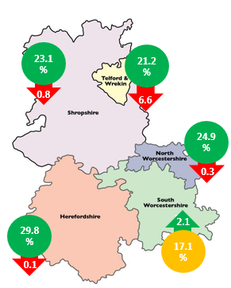
Delivering a high quality, consistent service to the public
1.1 Delivering victim satisfaction
Good looks like:
Victims’ Code Compliance
Referrals: 25%
VAL referrals are an identified priority for Local Policing. The Delivery Plan sets out to increase referrals to 25% of victim-based crime by April 2021.
Previous month’s referral rate: 22.6%
LPA | April | May | June | Year to Date ‘21/22
S. Worcs | 22.3% | 15.0% | 17.1% | 18.1%
N. Worcs | 29.2% | 25.2% | 24.9% | 26.2%
Herefs | 31.0% | 29.9% | 29.8% | 30.2%
Shrops | 25.1% | 23.9% | 23.1% | 24.0%
Telford | 26.7% | 27.8% | 21.2% | 25.1%
Force | 26.4% | 23.7% | 22.6% | 24.2%
Key:
20-30%
15-20%
Under 15%
Key Points
Minimal change in performance this month,
Marginally below WGLL at Force level despite exceeding this level in April
S Worcestershire is currently the outlier

Slide 8
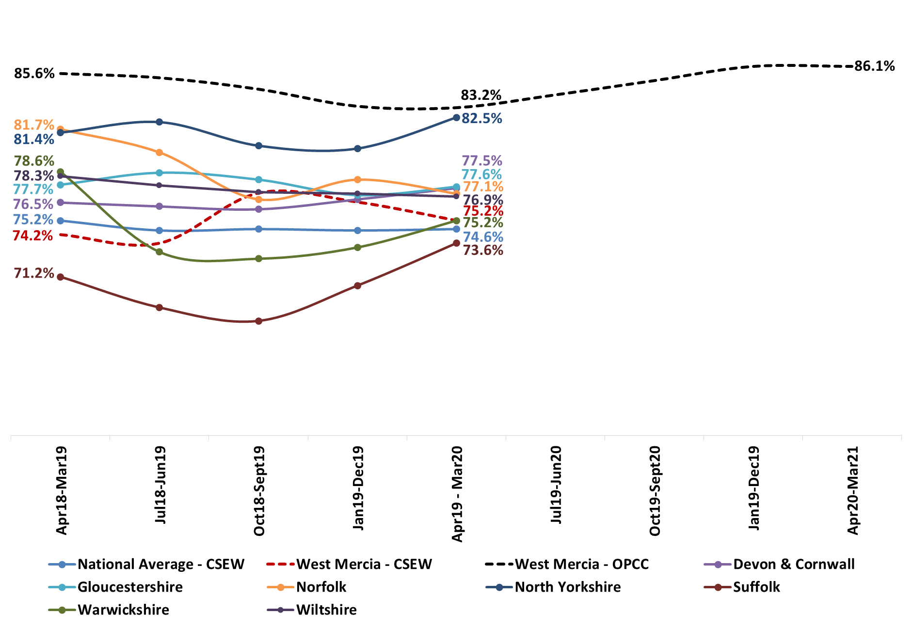
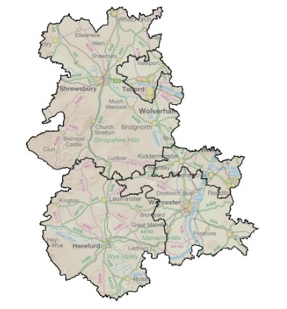
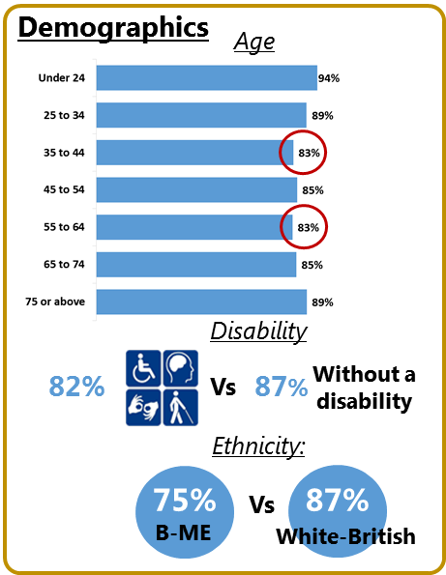
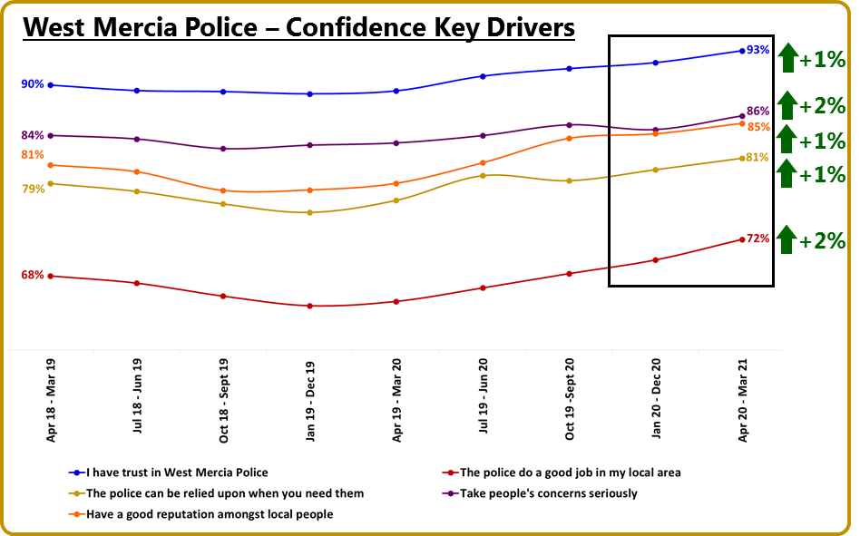
Delivering a high quality, consistent service to the public
1.2 Creating public confidence
Good looks like:
88%
Legitimacy – Requires Improvement
HMICFRS
27 Sept 2019
Confidence (Strongly Agree or Tend to Agree)
West Mercia data presented uses WMOPCC Perception Survey (rolling 12-months unless otherwise stated)
Trend Data
Discrete Quarter (Q4)
Rolling 12 months (Mar 21)
85%
The Crime Survey England & Wales survey has been suspended since March 20 due to Covid.
85%
86%
0% change
86%
+1%
Confident
Confident
87%
(Previous Quarter (Q3): 84%)
(Previous period: 86%)
85%
87%
Public Confidence and the Local Policing Charter
In Quarter 2, SP&I will be identifying the Safer Neighbourhood Areas (SNAs) having consistently high public confidence and those having consistently low public confidence. Learning will be identified from the high performing SNAs and applied – alongside other targeted activity – to the low confidence SNAs with changes in confidence evaluated from Quarter 3 onwards.
In Quarter 2, SP&I will be carrying out analysis to explore possible causes of the lower than average levels of public confidence seen with people in the mid-age categories, those with a disability and B-ME individuals..
The driver analysis will be used to inform the targeted activities recommended for the low confidence SNAs (see box above).

Slide 9

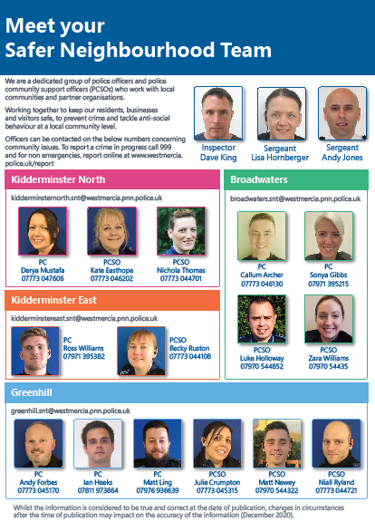


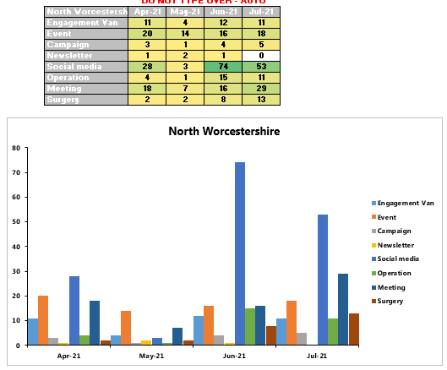



Delivering a high quality, consistent service to the public
1.2 Creating public confidence
LP Charter Development
Neighbourhood Matters information is available on the intranet
#policingpromise has been set up for use for any relevant social media content
Some metrics, such as an events calendar per local policing are in the early stages of being produced
Team posters for police station noticeboards are available on the intranet
Neighbourhood Matters went live at the end of June. Training underway.

Slide 10
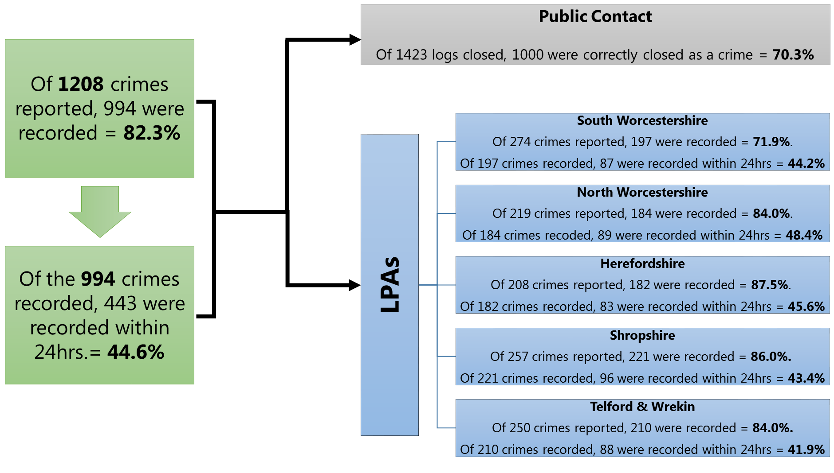
3. Delivering an ethical service
3.1 Delivering our service legally and within regulations
Audit, Risk & Compliance
CDI audits - 01/04/20 to 31/03/21
Key Points
Of 1208 crimes reported, 17.7% (214) crimes were determined to be missing.
If this was an HMIC inspection this compliance rate may result in a grading of inadequate or requires improvement.
Crime Data Integrity (CDI) training is made available to all officers and crime recording staff.

Slide 11
4. Delivering innovative, problem-solving practices and processes
4.1 Delivering effective core practices
Delivering strategic requirements
Strategic Policing Requirement
National Crime and Policing Measures
1 drug-related
1 drug-related
Key priorities: murder, serious violence, domestic abuse, neighbourhood crime and drug supply/county lines
Not numerical targets but key indicators to show improvement against; expectation of significant improvements within 3 years
Measure | Source | Change | Comment | Lead
Reduce murder and homicide | Police Recorded Crime |  | Increasing volumes | ACC C&V
Reduce serious violence | National Health Service and PRC |  | 8 offences involving discharge of a firearm in 2020-21 (most 2 a month) Hospital admissions for assault with a sharp object are fewer than 8 each month – only detail shared. Six of these months have had none (last 2 years) | ACC C&V
Disrupt drug supply and county lines | PRC and Public Health England |  | 2 drug-related homicides in last two years | ACC C&V
Reduce neighbourhood crime | Crime Survey England and Wales |  | All crimes are reducing in last two years (burglary - domestic and commercial, robbery, vehicle crime, theft from person) Data is currently from PRC as the CSEW data does not offer enough detail | ACC LP
Improve satisfaction among victims, with a particular focus on victims of domestic abuse | CSEW |  | Whole experience satisfaction is improving Satisfaction with the police among victims of domestic abuse is stable with follow-up consistency lower than other areas of the victim journey | ACC LP
Tackle cyber crime | DDCMS |  | The data from the Dept. for Digital, Culture, Media and Sport is not available. Further police held proxy measures are being developed | ACC C&V

Slide 12
4. Delivering innovative, problem-solving practices and processes
4.1 Delivering effective core practices
Delivering strategic requirements
Strategic Policing Requirement
The Strategic Policing Requirement sets out the threats that require a co-ordinated national policing response. The delivery of our response to this requirement to work collaboratively, and with other partners, to ensure such threats are tackled effectively, is collated and summarised below.
 |  | Capacity and Contribution | Capability | Connectivity
National Threats | Terrorism | Staffing gaps are minor as possible losses are projected and planned for. Small issues with security of supply due to time taken for vetting and training, however projection of vacancies and supply of assets from region help reduce impact. | Optimum training levels with surge capability if required. | Collaboration with partners is vital to enable West Mercia to deliver under the four P's detailed in the CONTEST Strategy and Action Plan. Relationships are maintained through regular contact, meetings and sharing of information.
 | Serious and Organised Crime | Some concerns surrounding the levels of staffing and time taken to train individuals, particularly within SOCU however, this impact is often limited due to the provision of the ROCU and the forces ability to prioritise resource. | Issues exist with limited surveillance capability. | With offenders active across borders it is vital West Mercia continue communications with partners/agencies not just across the UK but overseas as well. The force works closely with a number of agencies such as Gain, HMRC, airlines and Border Force to ensure intelligence and information is shared accordingly. The Force has an embedded Serious and Organised Crime Joint Action Group (SOCJAG) structure which brings together a host of partners on a regular basis to work to tackle Serious and Organised Crime collectively. The CPS is also a crucial partner who the force work closely with on a regular basis.
 | National Cyber Security Incident | The Cyber Crime Unit (CCU) has optimum staffing levels to enable response to cyber security incidents. | The CCU is fit for purpose and capability is constantly improving within the team to maintain good standards. Additional vehicles however are required. | The force work closely with the West Midlands regional Cyber Crime Unit along with all of the regional Cyber Crime Units. Also linked into the National Cyber Security Centre and the National Cyber Crime Unit to enable partnership working across the UK. Regular contact is established with National Fraud Intelligence Bureau (NFIB), Action Fraud and Get Safe Online.
 | Threat to Public Order and Public Safety | Optimum levels of staff with well above the nationally-specified number of trained officers. | Some issues may exist in the accreditation of roles in 2020, however officers are currently trained in line with national requirements. | For events, the force works with a variety of partners depending on the event taking place. For example, frequently events planners and coordinators will be in contact with safety advisory groups, local councils, sporting clubs and other event organisers.
 | Civil Emergencies | Number of resources are sufficient to maintain business as usual and respond to major emergencies, however in the event of a significant incident some BAU demand is disrupted due to low staffing levels. | Issues with equipment exist which limits capability when connecting and sharing information with partners. | Local Resilience Forums (LRFs) ensure collaborative working and are an integral part of the process in ensuring the production of contingency plans and individual agency plans for mitigation and response. The LRFs are a significant and vital element of working in partnership and taking a multi-agency approach to action.
 | Child Sexual Abuse (CSA) | Due to a recent uplift in resources there are optimum staffing levels available for contribution. | Issues exist with some interview locations and medical facilities not being fit for purpose. There are a limited number of fully trained and accredited investigators. | Problem Solving Hubs and Harm Assessment Units aim to support colleagues and external partners in reducing harm and risk through problem solving. The officers engage in partnership working using innovative and child-centred policing to proactively provide early intervention.

Slide 13
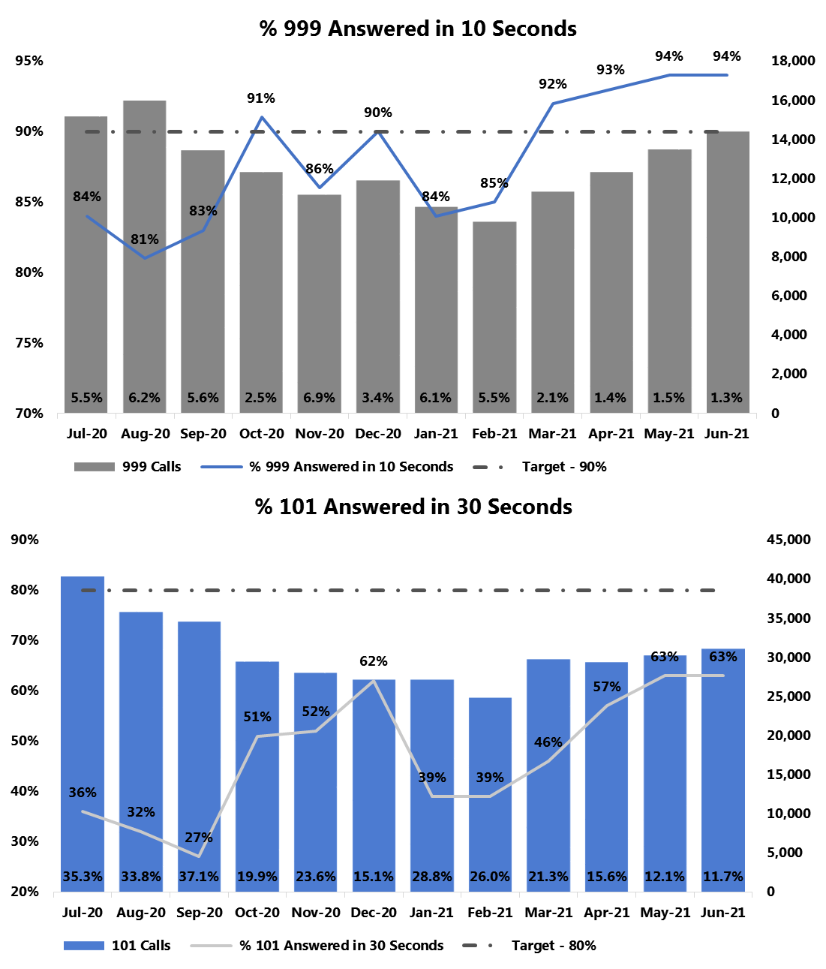
4. Delivering innovative, problem-solving practices and processes
4.1 Delivering effective core practices
Good looks like:
Response to calls for service
999 performance: 90% answered within 10 seconds
999 volumes: Maintain current levels in light of increasing national levels
101 wait times: 80% answered within 30 seconds
101 volumes: Continued sustained increase of online reporting on Single Online Home and an increase in website traffic to advice and information
Introduction
999 Performance
999 demand increased 27% when compared to the previous quarter, and increased 42% compared to the same quarter last year.
Despite the increase in demand, the statutory 999 target was met in April (93%), May (94%) and June (94%). 999 performance has now consistently stabilised as a result of improved staffing levels.
This has resulted in a further decline in 999 abandonment volumes during the last quarter – ending at 1.26% in June 2021.
101 Performance
In the last quarter there has been a 6% reduction in call demand compared to the same quarter last year, but an 11% increase on the previous quarter. Call demand has continued to be unpredictable.
The OCC presented a substantial increase in performance in April (57%), May (63%) and June (63%).
101 abandoned rates have decreased further, to 11.7% in June.

Slide 14
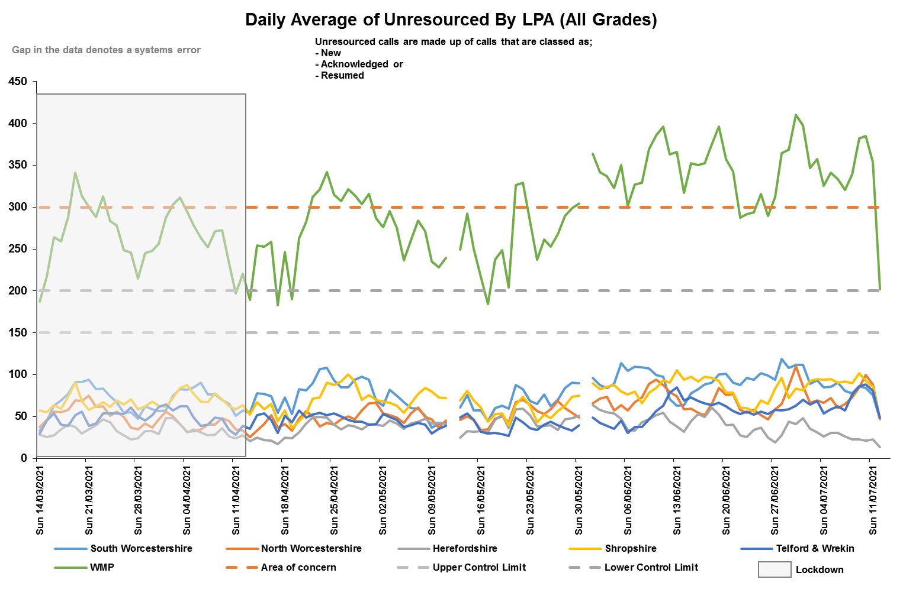
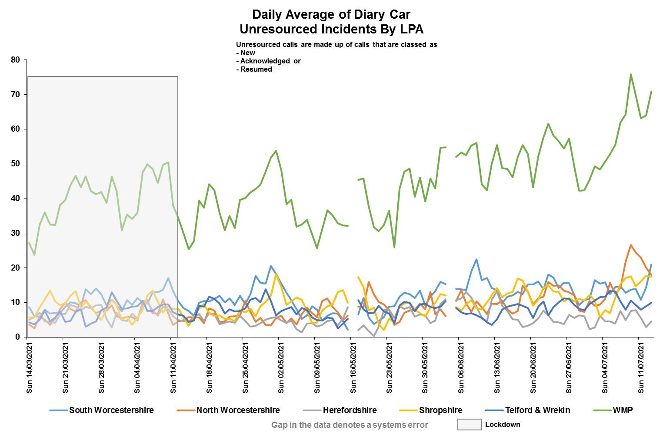
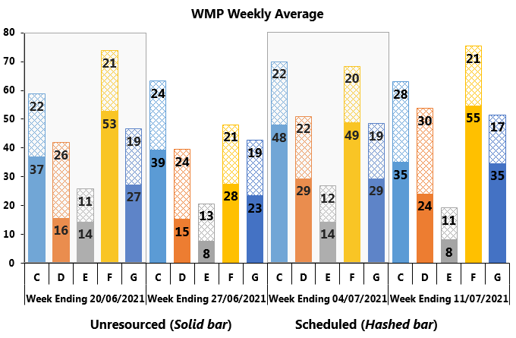
4. Delivering innovative, problem-solving practices and processes
4.1 Delivering effective core practices
Good looks like:
Unresourced: between 150-200 unresourced calls
Response to calls for service
As anticipated as we have moved further out of lockdown, experienced some seasonal good weather along with the Euro’s and several high resource intensive incidents unresourced levels are high.
It highly probable that volumes will rise further n the coming months across all policing areas due to progression through the ‘Road Map’ laid out by the Government.
The way that this data is reported on is under review and we are currently in the process of moving to a new style of reporting as is currently shown in the Weekly Briefing Assessment, below.
As more data is collated we will review how this data is presented as well as ‘What Good Looks Like’.
A plan around Emergency Response times is being progressed.

Slide 15
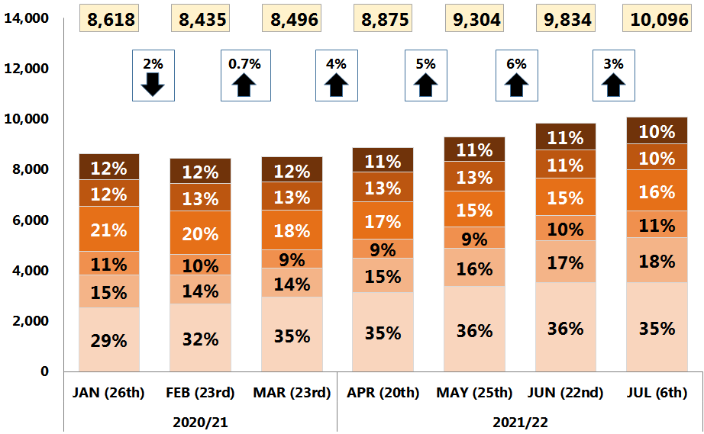
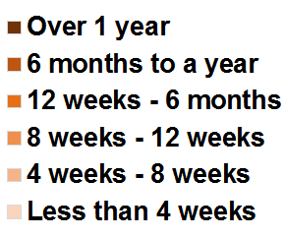
4. Delivering innovative, problem-solving practices and processes
4.1 Delivering effective core practices
Effectiveness – Requires Improvement
HMICFRS
27 Sept 2019
Crime Management
Key Points
Open investigations increased by 14% compared to the previous point in time.
Drivers are new recording practises and turnover of staff in key roles.
10,096 Open Investigations (O.I.s) consisting of notifiable offences, fraud offences and crimed incident investigations sit within 1,798 OIC crime baskets.
14% increase compared to the previous point-in-time in April (8,875). 35% (3,575) of O.I.s consist of violence with/without injury, stalking and harassment offences.
Key drivers behind increase in O.I.s.
Continuous month-on-month increases in crime recording since March 2021.
Increase in crime recording is partially linked to the reinforced recording practice of ‘Course of Conduct offences’ in relation to domestic abuse for recording both an harassment and a stalking offence - Two crimes per investigation with different requirements to prove and outcome.
  Out of 494 ‘course of conduct’ O.I stalking/ harassment offences, 398 (81%) were recorded within the last 3 months.
From 1st April 2021, CPS started enforcing the new disclosure guidelines leading to significant amount of additional work for most files, even on patrol. During this quarter, a reduction in Action Taken outcomes is expected due to returns from CPS for not abiding by the new legislation.
More PCDA student officers at the front end and a turnover in Sergeants/newly promoted also impacts on investigations and outcome timeliness. New officers will tend to over investigate if not confident to outcome in a proportionate manner and new Sergeants may also feel less comfortable and may require additional work being completed before they will authorise filing.
Open Investigations – Age Profile (point-in-time view)
Age Profile
Bandings
Good looks
like:
In development.
An ‘optimum’ band is thought to be around 8,000-10,000 open investigations at current recording volumes. However, to avoid an incentive simply to close crime this marker would need to be hidden until further work is done to filter out:
1. ‘Normal’ volume of open investigations awaiting closure with the Designated Decision Makers (DDMs) (currently 5-600)
2. Complex crime types with long average timeliness
A better “temperature gauge” of force crime is anticipated to come from combining some metrics: Open crime/ Volume in “baskets”/ Suspects outstanding/ “attrition” rates to some outcomes. This is to avoid over-focus on timeliness at the expense of quality investigations.

Slide 16
4. Delivering innovative, problem-solving practices and processes
4.1 Delivering effective core practices
Key Points
Work is in place to address key issues.
Despite this it is probable that Open Investigations volumes will increase in the coming months due to an increase in crimes being recorded
Crime Management
Activity underway since April 2021
Continued to drive and embed the Suspect Management process to ensure fully and consistent application.
At present compliance rates are;
South Worcestershire - 97%
Herefordshire - 96%
Shropshire - 89%
North Worcestershire - 85%
Telford & Wrekin - 85%
All Wanted Suspects to PNC are now managed through Athena. Through PNSB weekly, this new process ensures better scrutiny around attached files and their supervision with old Wanted files being quality checked and STEPS packages being closed down, managed or transferred into the new process.
  Only 4% of our Current Wanted have yet to make it to PNC and these are around administration issues.
Reviews on our investigations not being completed or direction given has again been picked up by HMICFRS. This is linked to new T/Sgt’s in role and their understanding of what is needed.
  Work is underway with L&D to capture all requirements into a training package before commencement of acting/temp duties.
  It is highly probable that Open Investigations volumes will increase in the coming months due to an increase in crime recording, set against the backdrop of the removal of Covid restrictions and the warmer Summer weather encouraging outdoor socialising.

Slide 17
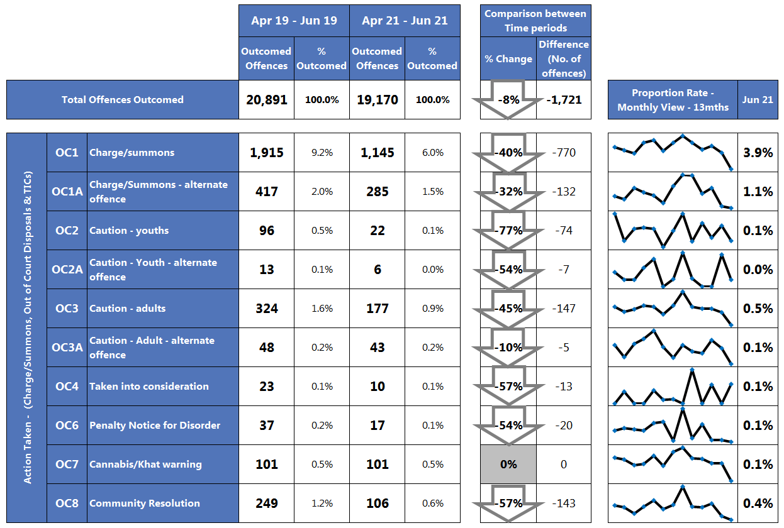
4. Delivering innovative, problem-solving practices and processes
4.1 Delivering effective core practices
Outcomes
Total Outcomed offences
regardless of when recorded:
‘Action Taken’:
Good looks like:
In development.
However, thought needs to be given around the balance of which outcomes are being applied and if applied appropriately in the circumstance
Key Points
41% reduction in offences assigned Action Taken Outcome
From 1st April 2021, CPS started enforcing the new disclosure guidelines leading to significant amount of additional work for most files. A reduction in ‘Action Taken’ outcomes was anticipated.
Due to the higher percentage of student officers in the force, there is less experience and knowledge of how to investigate crime proportionately, set against a backdrop of an increase in volume and complexity of incident and crime recording levels as Covid-19 restrictions continue to ease.
A turnover in Sergeants/newly promoted also impacts on investigations and outcome timeliness.
Factor in force staff attrition through training, annual leave and sickness.

Slide 18
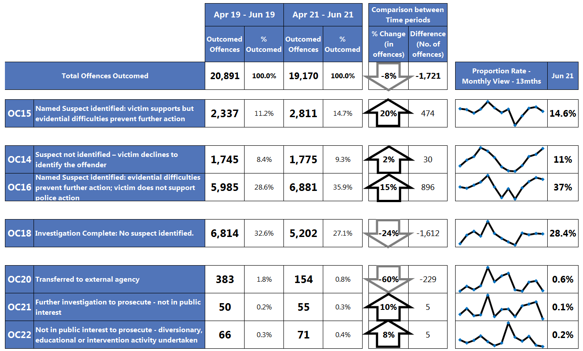
4. Delivering innovative, problem-solving practices and processes
4.1 Delivering effective core practices
Outcomes
Key Points
Outcome 16 represents 36% of all outcomed offences in the last 3 months.
15% increase on the same period two years ago despite educational material sent out.
Evidential Difficulties (suspect identified; victim supports action):
Evidential Difficulties (victim does not support action):
‘Investigation Complete – No Suspect’:
‘Other’ Outcome results:
Minor growth encountered with ‘Prosecution prevented or not in the Public interest’ outcome grouping (+21 offences), with the increase driven by Outcome 17 - Prosecution time limit expired: Suspect identified.
Despite communication messages and educational material, 36% (6,881) of all outcomed offences have been assigned Outcome 16, with a 15% increase in the last 3 months compared to the same period two years ago (29%, 5,985).
  This increase is also seen with domestic abuse outcomed offences and is possibly linked to the reinforced recording initiative around ‘Course of Conduct’ offences.
  This is to be raised within the new Outcomes meeting for targeted exploration amongst stakeholder representatives.
It is highly probable that ‘high volume/ low harm’ crime recording will increase which will then influence and dampen outcoming levels based on observations seen so far, as lockdown restrictions continue to ease, the full return of the night time economy and the holiday season (local and foreign travel) coupled with good seasonal weather.

Slide 19
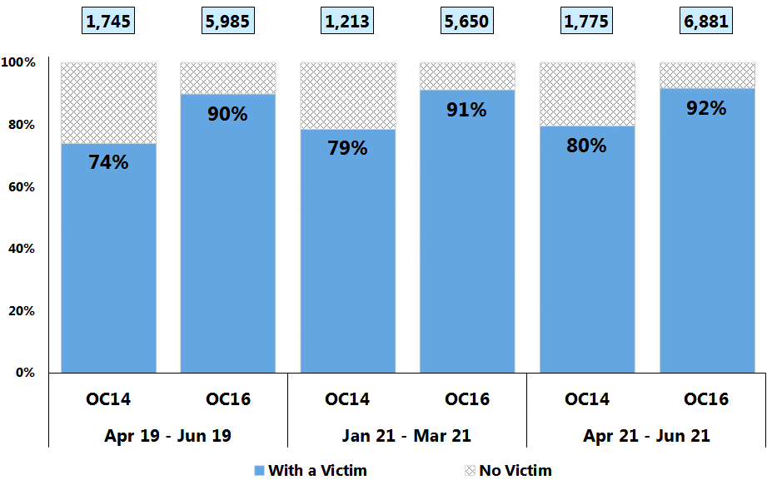
4. Delivering innovative, problem-solving practices and processes
4.1 Delivering effective core practices
Good looks like:
100% of Outcome 14 and 16 offences should have a victim linked to the offence.
Outcomes
Outcome 14 – Evidential Difficulties Victim Based – Named suspect not identified: Victim either declines/ or is unable to support further police investigation
Key Points
Whilst there is a slight improvement, neither outcome 14 or 16 offences have a victim assigned 100% of the time.
Outcome 16 – Victim does not support action
Based on Offences outcomed during the 3 month periods regardless of when they were recorded
Outcome 14
The proportion rate of Outcome 14 offences in Apr 21 – Jun 21 that have a Victim linked to the offence, has exceeded 80% for the first time since reporting began and is an improvement against the two previous 3 month time periods.
Outcome 16
A gradual improvement in the proportion rate of Outcome 16 offences in Apr 21 – Jun 21 (92%) that have a Victim linked to the offence, has been seen when compared to the two previous 3 month time periods.
Higher % is better

Slide 20
4. Delivering innovative, problem-solving practices and processes
4.2 Managing demand – policing priorities
Key Points
Crime types whose volumes are shown in a grey box have exceeded the upper control limit and will feature later in the report.
All Crime
Does not directly relate to crime recorded in the quarter.
Does not directly relate to crime recorded in the quarter.

Slide 21
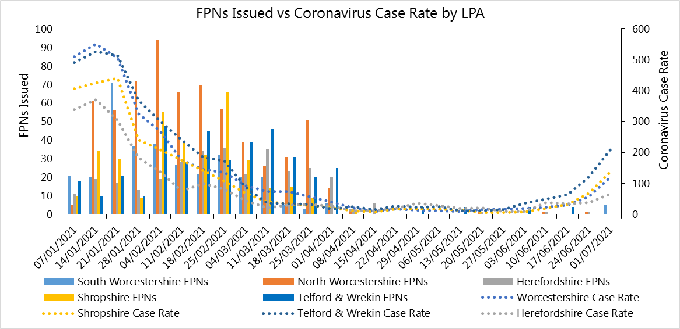
4. Delivering innovative, problem-solving practices and processes
4.2 Managing demand – policing priorities
Key Points
Given the low numbers of FPN’s issued the last quarter and the move to the final phase of unlocking it is proposed that this will not feature in future reports.
COVID-19 Related Fixed Penalty Notices (FPNs)
“FPNs issued vs Coronavirus Case Rate by LPA” gives an indication of the activity of each LPA while considering the prevalence of coronavirus within each area. Following a period of low case rates as a result of lockdown and the vaccination programme, case rates have increased significantly in every LPA. FPNs issued have not increased substantially in response, however risk to public health is now significantly lower than in previous waves due to the vaccination program.

Slide 22
4. Delivering innovative, problem-solving practices and processes
4.2 Managing demand – policing priorities
Key Points
The Policing Priorities are reported on as standard each month and quarter.
They are reported on in further detail on following slides.
Overall most crime volumes increased as anticipated moving further out of lockdown.
It is probable that volumes in the next month and quarter will increase further due to the national lockdown easing and improved seasonal weather.
The upper and lower control limits are derived by calculating 2 points of Standard Deviation from the mean. The mean is fixed for the year and is based on volumes recorded in the previous financial year.
denotes above the upper control limit. denotes below the lower control limit.

Slide 23
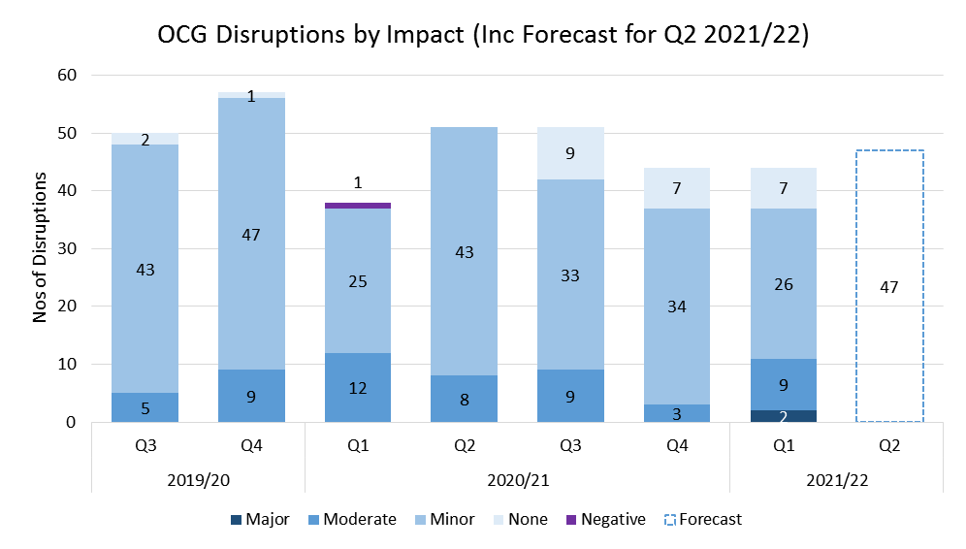

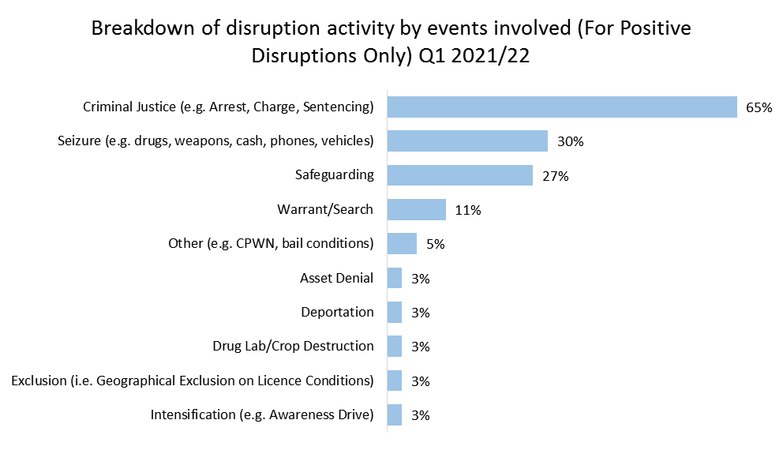

4. Delivering innovative, problem-solving practices and processes
4.2 Managing demand – policing priorities
Key Points
Q1 2021/22 - 44 Disruptions. Please note that the figures claimed this quarter were impacted by a change in recording practice by the ROCTA meaning that disruptions for Q1 were cut off on the 25th June.
84% Positive disruptions – Of note, two MAJOR disruptions recorded.
Disruptions for Q1 2021/22 have driven in the main by activity occurring in Telford & Wrekin and South Worcestershire.
Serious Organised Crime
Introduction
Safeguarding
8 Adults Safeguarded
3 Children Safeguarded
Criminal Justice / Offender Management
24 Arrests
2 Charges
6 Convictions (Totalling 15 yrs)
0 SCPOs obtained
6 Other ancillary orders obtained

Slide 24
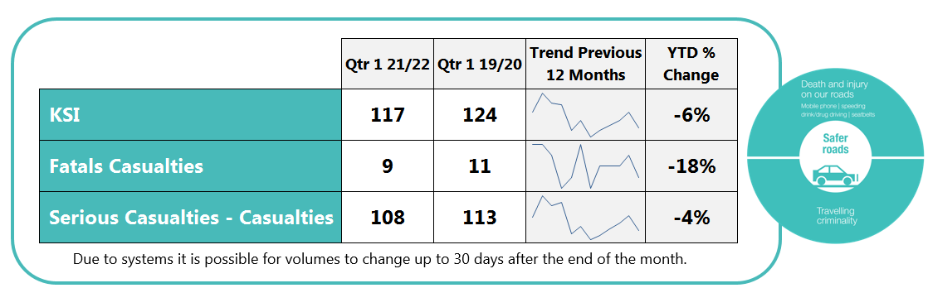
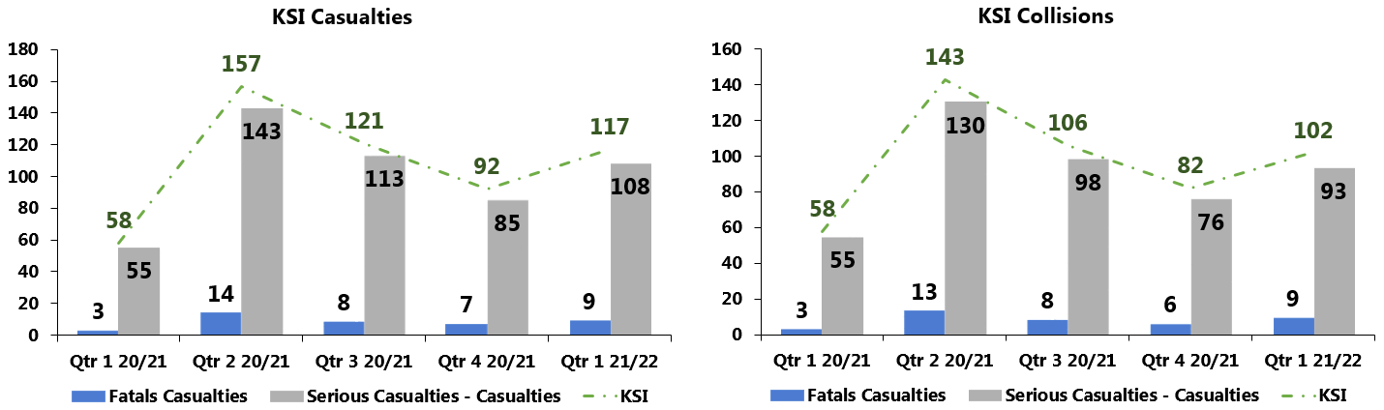


4. Delivering innovative, problem-solving practices and processes
4.2 Managing demand – policing priorities
Good looks like:
KSI: A sustained 20% reduction on 19/20
Safer Roads
Key Points
In the last quarter, Killed or Seriously Injured (KSI) casualties saw a 6% (7) decrease compared to the previous quarter two years ago.).
However, it is highly probable that KSI volumes will increase over the coming months
Pedal cyclist casualties continue to remain an area of concern due to an increase in new/inexperienced cyclists in the last 16 months and potentially in to the summer. It is expected that as new cyclists gain more experience, there will be a decline in collisions.
Op Close Pass and will continue to engage with cyclists to press home safety messages with them.
Upcoming Campaigns: July – August 2021
National NPCC
campaigns
Time period covering
communications
and enforcement
July
National Speed Operation:– 19th July – 8th August
August
Drug Driving Week:- 16th – 29th August
West Mercia Initiatives
Education & Training
Green Light – recommencing with physical delivery for June.
Year 6 - completion of ‘Safe Zone’ website with H&W Fire & Rescue to replace Year 6 delivery.
Powered 2 Wheels – continue physical courses for Biker Down and Bike Safe. Take Control training.
Operations
Op Close Pass and Op Snap - ongoing support.
A449 Communications roll out.
Public Access System roll out.

Slide 25
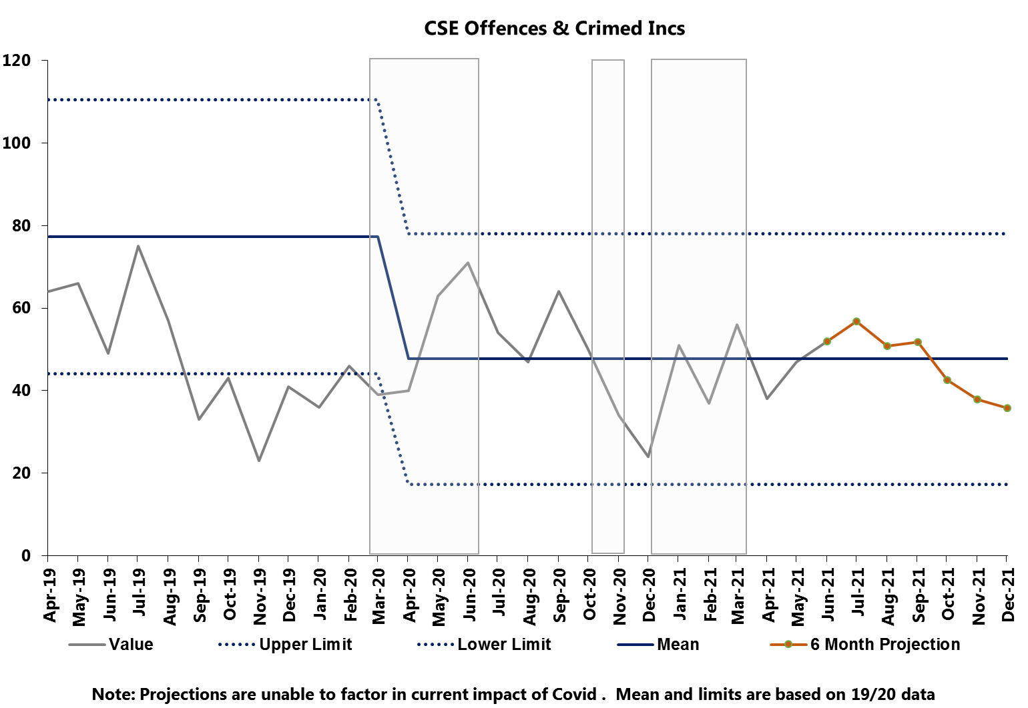
4. Delivering innovative, problem-solving practices and processes
4.2 Managing demand – policing priorities
Key Points
Overall there was a 7% (9) increase in CSE related offences and crimed incidents compared to the previous quarter and an 23% (42) decrease on the same quarter two years prior.
Child Sexual Exploitation
This data is generated from Athena where a ‘CSE’ crime keyword has been applied.
Following the relaxation of lockdown restrictions and the introduction of the government NSPCC helpline on 1st April, volumes were expected to increase – month on month marginal increases in volumes have been observed since this date. It is anticipated that volumes will continue to increase in the coming months.
Good looks like:
CSE: Increased reporting*
We also need to use the correct markers to ensure the right people are directed to these jobs and so dealt with appropriately
The ongoing exploitation training should continue to see an increased recognition and reporting of CSE by all partners and agencies who have undertaken this training.
*Note: with the change in use of CSE marker (end of 2019), it is not possible to make valid comparisons between the previous 12 months.
The upper and lower control limits are derived by calculating 2 points of Standard Deviation from the mean.

Slide 26
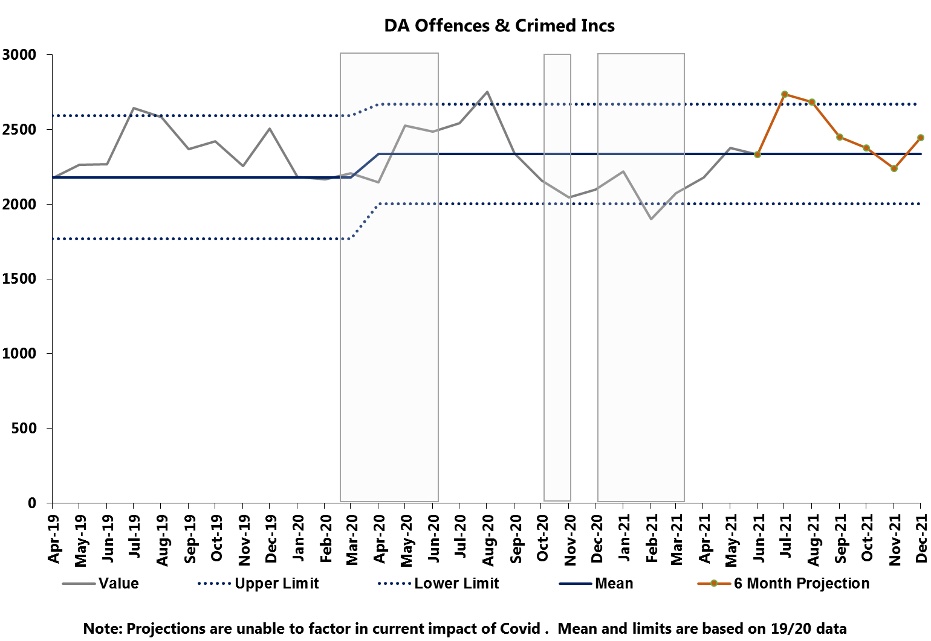
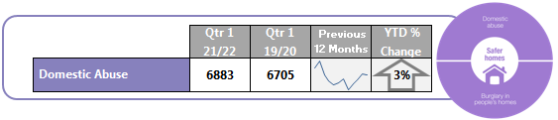
4. Delivering innovative, problem-solving practices and processes
4.2 Managing demand – policing priorities
Domestic Abuse:
Increased reporting; A reduction in DA repeat victims
Provide a timely response to all reports of DA.
Domestic Abuse
Good looks like:
“Good” is better protection from harm, coupled with the best service we are able to achieve for victims of DA. Therefore, every DA report must be encouraged.
We will monitor repeat DA and, through intervening quickly, making proactive arrests as often as possible, using stringent bail and charge rather than DVPNs, should see a reduction in this metric.
Key Points
Domestic abuse crimes and crimed incidents saw a 3% (178) increase on the same quarter two years prior and a 11% (700) increase on the previous quarter.
Domestic Abuse Delivery Group (DADG) continues to drive the response to the DA Delivery Plan which is linked to the National Vulnerability Action Plan (NVAP) perennial issues. The overarching approach to NVAP will sit and report to Crime and Vulnerability and escalate to SIB to drive whole system approaches.
Strategic Vulnerability and Safeguarding maintain oversight of DA performance following Domestic Abuse Reality Testing (DART), via the DADG.
Performance will be assessed through policy compliance, practice and in the developing the culture of positive action through the local policing delivery.
It is highly probable that volumes have increased as a result of further easing of Covid restrictions specifically, with outdoor hospitality re-opening on 12th April. Increased alcohol consumption is likely to have contributed to an increase in incidents.
The start of Euro 2020 in June will also have contributed to increased volumes. Going forward into Q2 2021/22, it is anticipated that figures will increase further in response to:
Relaxation of Covid restrictions - full lifting of the majority of restrictions on 19th July.
Warm Summer weather
Continued recovery of night time economy
School holidays beginning in Mid July.
This data is generated from Athena where a ‘Domestic Abuse’ crime keyword has been applied.

Slide 27
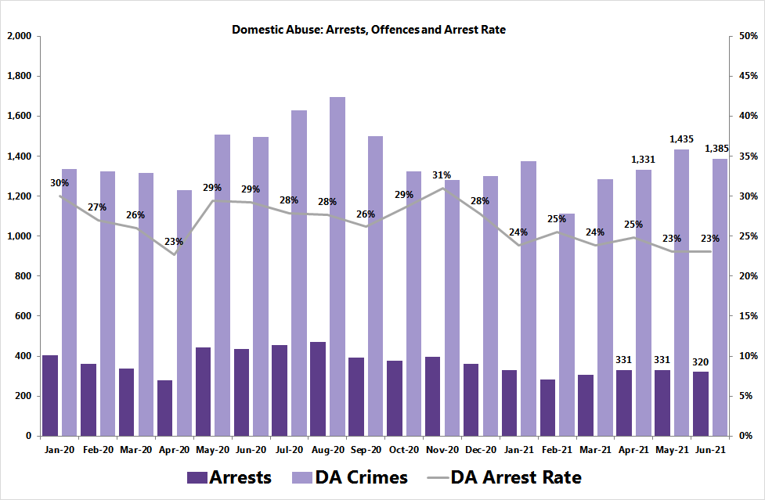
4. Delivering innovative, problem-solving practices and processes
4.2 Managing demand – policing priorities
Key Points
Increase on DA offences in the last quarter however a stable proportion when looking at arrest rates.
Domestic Abuse Crime offences - Arrest Rates
There has been 3 months of upward trend growth in DA offences, with volumes increasing at a sharper rate than the number of DA arrests reported. However, the DA arrest rate has been on a downward trend since November 2020.
This is an area of concern and was raised at the recent Quarterly Performance Reviews.
As Covid restrictions relax further, warm summer weather, continued recovery of night time economy and School holidays beginning in Mid July, it is highly probable that DA crime recording will increase which will then increase DA arrest rates.
N.B. Key custody blocks were closed for periods in 2020
This data is generated from Athena where a ‘Domestic Abuse’ crime keyword has been applied.
27

Slide 28
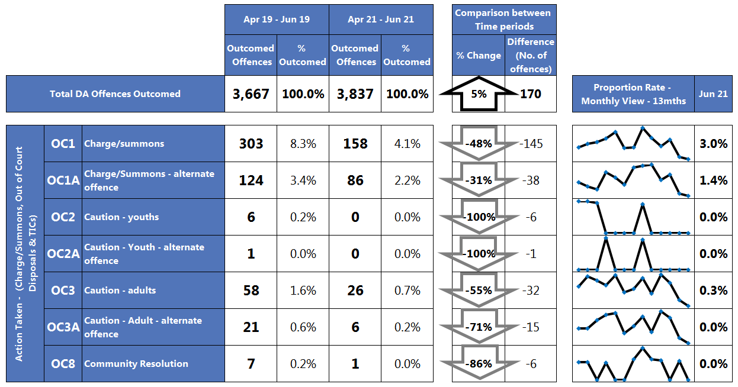
4. Delivering innovative, problem-solving practices and processes
4.2 Managing demand – policing priorities
Key Points
47% reduction in offences assigned Action Taken Outcome results
Downward monthly trend for Charge/Summons outcomes
Domestic Abuse Outcomes
Volume and Proportion of total outcomed DA offences by Outcome result
(regardless of when they were recorded)
‘Action Taken’:
Key Issues raised:
From 1st April 2021, CPS started enforcing the new disclosure guidelines leading to significant amount of additional work for most files. A reduction in ‘Action Taken’ DA outcomes was anticipated.
Due to the higher percentage of student officers in the force, there is less experience and knowledge of how to investigate crime proportionately, set against a backdrop of an increase in volume and complexity of incident and crime recording levels as Covid-19 restrictions continue to ease.
A turnover in Sergeants/newly promoted also impacts on DA investigations and DA outcome timeliness.
Factor in force staff attrition through training, annual leave and sickness.
This data is generated from Athena where a ‘Domestic Abuse’ crime keyword has been applied.

Slide 29
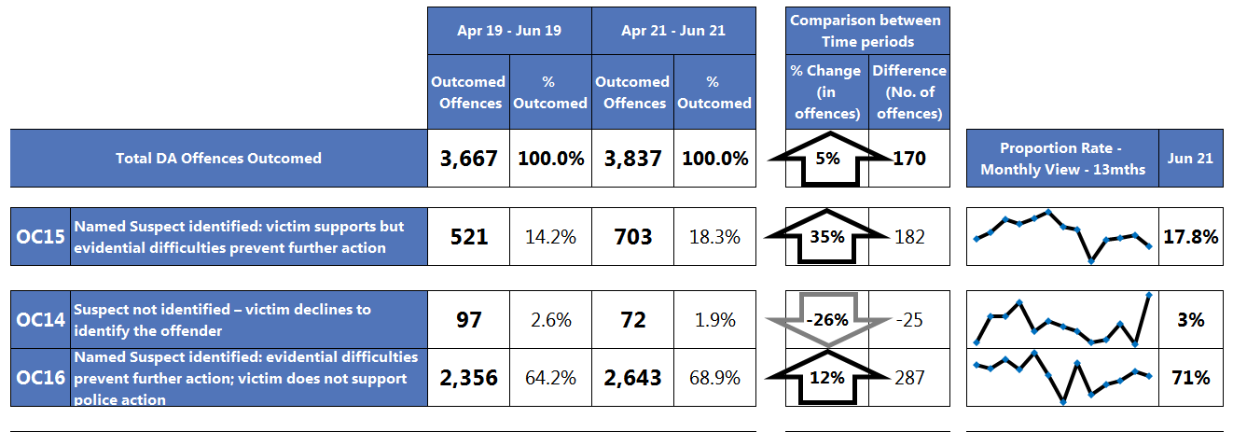
4. Delivering innovative, problem-solving practices and processes
4.2 Managing demand – policing priorities
Key Points
Outcome 16 represents 69% of all outcomed DA offences in the last 3 months (up 5 percentage points).
12% increase on the same period two years ago.
Domestic Abuse Outcomes
Volume and Proportion of total outcomed DA offences by Outcome result
(regardless of when they were recorded)
Evidential Difficulties (suspect identified; victim supports action):
Evidential Difficulties (victim does not support action):
Minor growth encountered with ‘Prosecution prevented or not in the Public interest’ outcome grouping (+26 offences), with the increase driven by Outcome 17 - Prosecution time limit expired: Suspect identified.
Sustained reduction in Outcome 20 – Transferred to External Agency as a consequence of Covid-19 pandemic.
Despite communication messages and educational material, 69% (2,643) of all outcomed offences have been assigned Outcome 16, with a 12% increase in the last 3 months compared to the same period two years ago (64%, 2,356).
Key Issue - The reinforced recording initiative of ‘Course of conduct’ offences will cause multiple DA offences as leads to the recording of both an harassment and a stalking offence - Two crimes per investigation with different requirements to prove and outcome. The SP&I Performance team to spend time with Crime Bureau to understand this issue.
With the full return of the night time economy, the holiday season and approaching the end of the furlough scheme there is likely to be financial and economic implications for people. It is probable that DA crime recording will increase however, we are likely to see a reduction in outcome rates based on observations seen so far.
This data is generated from Athena where a ‘Domestic Abuse’ crime keyword has been applied.

Slide 30
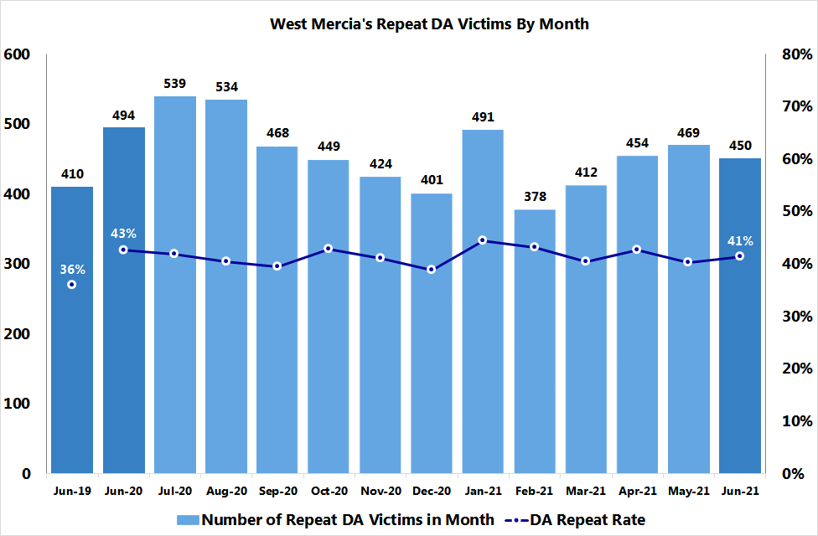
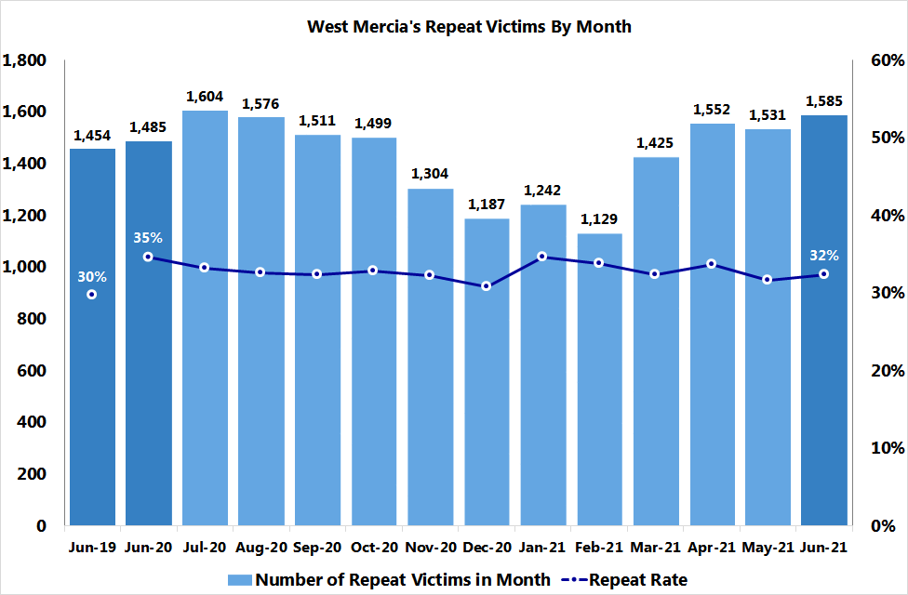
4. Delivering innovative, problem-solving practices and processes
4.2 Managing demand – policing priorities
A repeat victim is defined as an individual recorded as a victim in the current reporting month that has had at least one other offence in the preceding 12 months.
Domestic Abuse – Repeat Victimisation
Repeat Domestic Abuse Victims per Month
Key Points
As anticipated, repeat victim volumes for total recorded crime and domestic abuse have show an upward growth trend during Q1 2021/22 following the end of full lockdown restrictions.
It is highly probable that the easing of restrictions, reopening of the Night time economy and major events such as Euro 2020 have increased repeat victimisation volumes.
DA repeat rate - 40% to 43%.
TRC repeat rate – 32% to 34%
These repeat victims have generally been linked Assault with or without Injury, Stalking & Harassment, Criminal Damage & Arson and Public order offences.
It is highly probable that repeat volumes will increase in the coming months due to the easing of Covid restrictions driving up crime reporting committed during the lockdown period.
The reinforced recording of ‘Course of conduct’ offences will cause multiple offences for repeat nominals, as leads to the recording of both an harassment and a stalking offence - Two crimes per investigation. The SP&I Performance team to spend time with Crime Bureau to understand this issue.
Repeat Victims per Month
This data is generated from Athena where a ‘Domestic Abuse’ crime keyword has been applied.
Good looks like:
Repeat TRC & DA Victims:
A reduction in ‘high frequency/ high severity’ repeat victims and a decrease in repeat rates

Slide 31
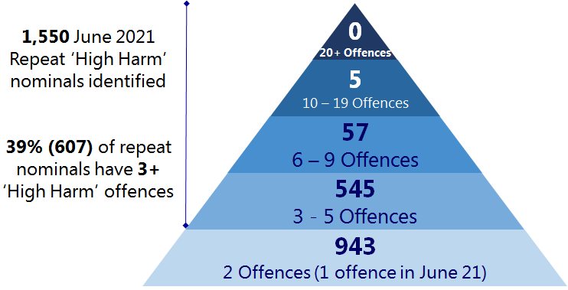
4. Delivering innovative, problem-solving practices and processes
4.2 Managing demand – policing priorities
Good looks like:
Repeat TRC & DA Suspects:
Less serial/ repeat DA offenders.
Decrease in ‘recurring’ repeat TRC suspects
Decrease in repeat rates
Domestic Abuse – Recidivism
A monthly breakdown of repeat nominals of high harm offences, with/ without a domestic abuse indicator, across a three month rolling time period.
This information is circulated across Problem solving teams and Local Policing commanders.
High harm offences include: violence against the person, with or without injury, rape and other sexual offences, homicide, malicious communication and stalking and harassment.
Key Points
607 repeat nominals (3+ high harm offences) identified in the June 21 cohort, 13% increase on last month’s figure, n= 539, with a 14% increase in repeat nominals (+3) with ‘10-19 high harm offences’ each.
67% of June 2021’s 3+ high harm offence repeat nominals have been linked to DA offences over the last three months.
It is highly probable that ‘high harm’ repeat volumes will increase over the coming months due to an increase in crime recording.
Force View
It is highly probable that ‘high harm’ repeat volumes will increase over the coming months due to an increase in crime recording, set against the backdrop of:
Continued easing of Covid restrictions, with potential full lifting of the majority of restrictions on 19th July.
Warmer Summer weather encouraging outdoor socialising.
School Summer holidays beginning in Mid/Late July.
Approaching the end of the Furlough scheme – with financial and economic implications for businesses and employees.

Slide 32
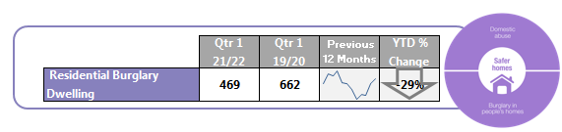
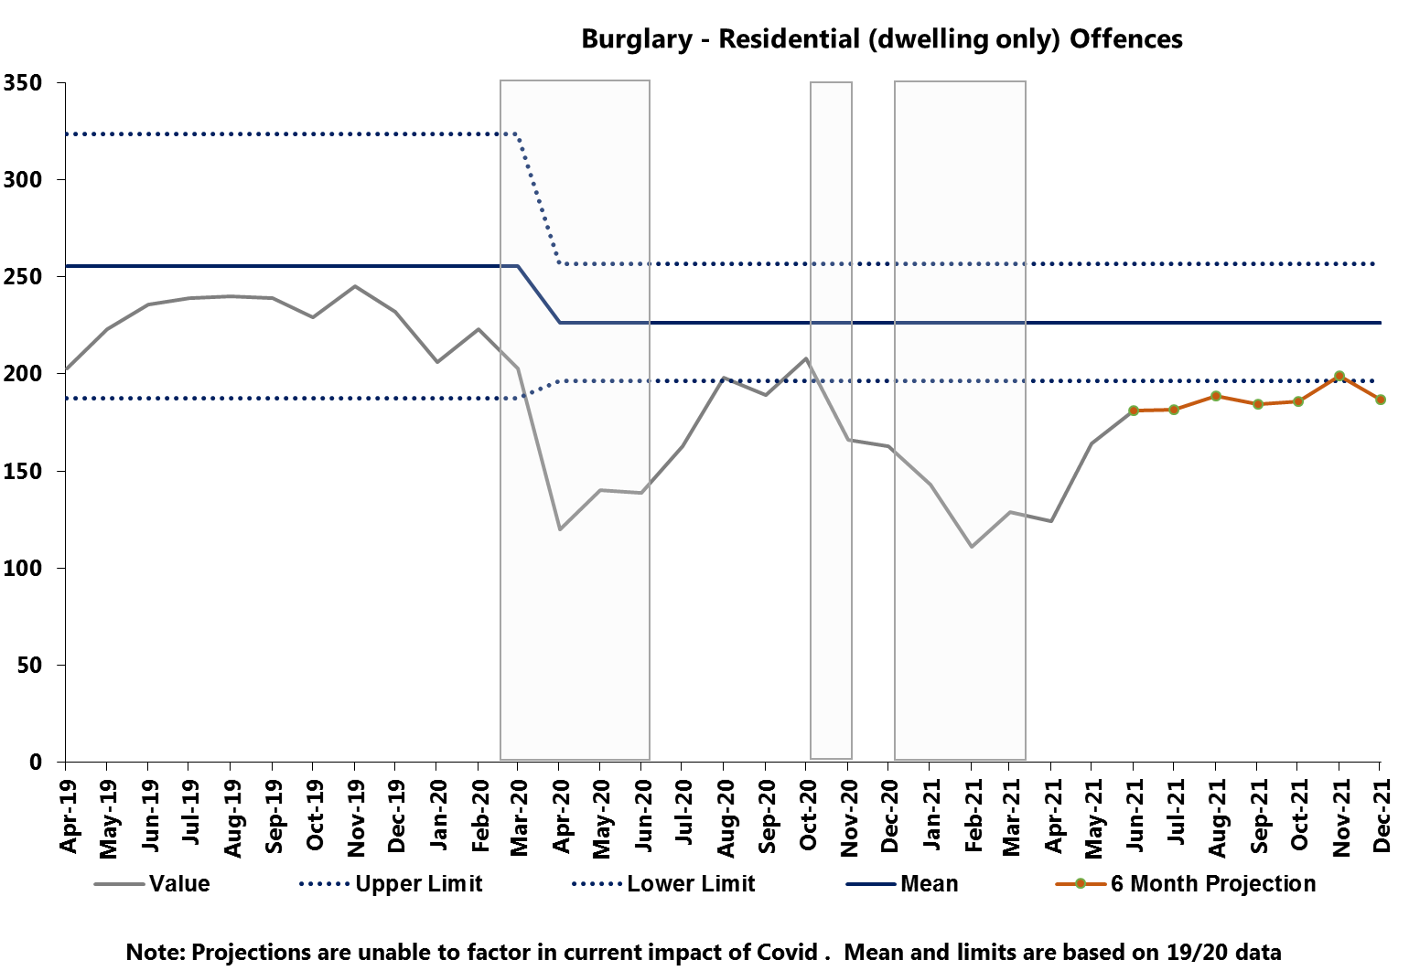

4. Delivering innovative, problem-solving practices and processes
4.2 Managing demand – policing priorities
Residential Burglary (Dwelling)
Key Points
Residential Burglary Dwelling features despite being below the lower control limit due to being a Policing Priority.
Volumes in Residential Burglary – (Dwelling) increased by 27% (101) compared to the previous quarter but remains 29% (193) lower than the same quarter two years ago.
It is probable that an increase in volumes will be observed in during Q2 2021/2022 due to many returning to the office, alongside continued working from home.
Good looks like:
Residential Burglary Dwelling:
25% reduction in a post-Covid operating environment
The upper and lower control limits are derived by calculating 2 points of Standard Deviation from the mean.

Slide 33
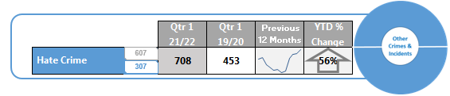
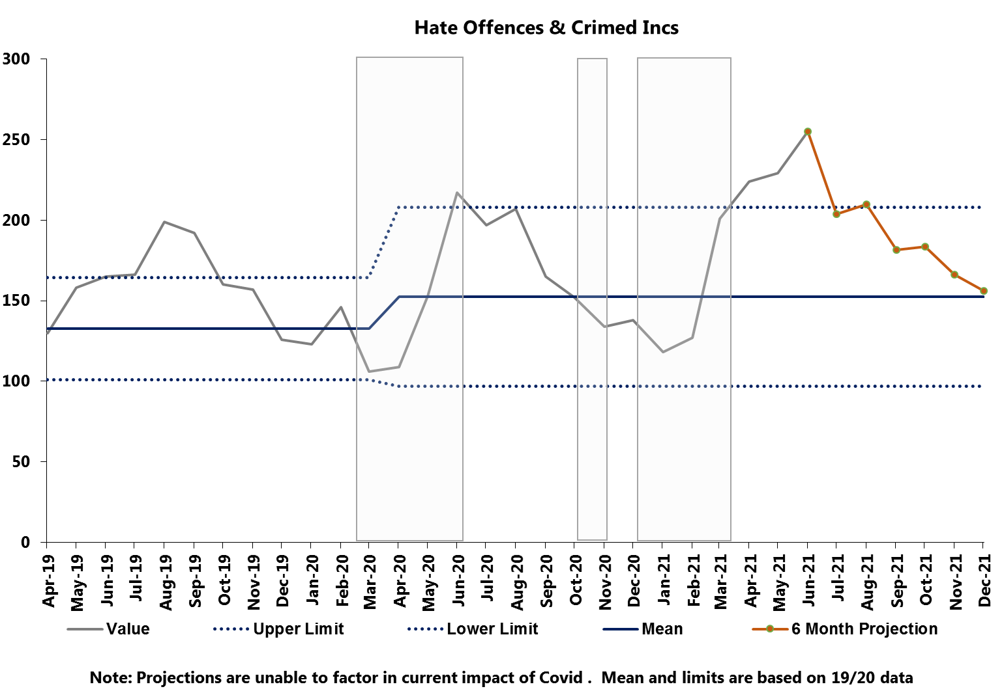
4. Delivering innovative, problem-solving practices and processes
4.2 Managing demand – policing priorities
Hate Crime & Crimed Incidents
Key Points
Volumes of Hate Crime and Crimed Incidents saw a 57% (257) increase on the previous quarter and a 56% (255) increase on the same quarter two years prior, exceeding the upper control limit.
June represented a high volume month, likely as a result of two factors mentioned in the May Monthly Report– Euro 2020 starting in early June, and the impact of the Delta (previously “Indian”) variant in furthering restrictions.
It is highly probable that as the impact of these factors subside, a reduction in volumes will be observed.
Good looks like:
Hate Crimes & Crimed Incidents: Increased reporting
We also need to use the correct markers to ensure the right people are directed to these jobs and so dealt with appropriately
This data is generated from Athena where a hate crime keyword has been applied.
The upper and lower control limits are derived by calculating 2 points of Standard Deviation from the mean.

Slide 34
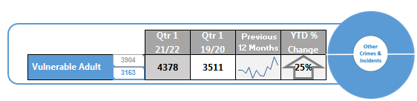

4. Delivering innovative, problem-solving practices and processes
4.2 Managing demand – policing priorities
Vulnerable Adult Crimes & Crimed Incidents
Key Points
Vulnerable Adult crimes and crimed incidents saw an 11% (450) increase on the previous quarter and a 25% (867) increase on the same quarter 2 years prior and exceed the upper control limit.
Projections indicate a decrease in coming months, however it is probable that volumes will remain above the mean.
Good looks like:
Vulnerable Adult Crimes & Crimed Incidents: Increased reporting
We also need to use the correct markers to ensure the right people are directed to these jobs and so dealt with appropriately.
Demand work and significant efforts to manage partners and other professional bodies who create demand, alongside problem solving hubs, a centre of excellence and greater emphasis and resources put into tackling mispers and mental health issues will all contribute towards a reduction in incidents and demand.
However, a move towards dynamic and immediately accessible social media platforms by June 2021, on which contact can be made, will likely see a rise in demand.
This data is generated from Athena where a “vulnerable” keyword has been applied.
The upper and lower control limits are derived by calculating 2 points of Standard Deviation from the mean.

Slide 35


4. Delivering innovative, problem-solving practices and processes
4.2 Managing demand – policing priorities
Child At Risk Crimes & Crimed Incidents
Key Points
Volumes have increased 20% (1056) compared to the same period two years prior, as anticipated as a result of coming out of lockdown. They currently exceed the upper control limit. Shropshire makes up 22% (1406) of total crimes and crimed incidents, and South Worcestershire is also responsible for 22% (1387), while North Worcestershire and Telford & Wrekin are responsible for 21% (1372) and 20% (1320) respectively. Herefordshire makes up 15% (960).
Leading offence category descriptions are Assault without Injury, Assault With Injury and Malicious Communications. 15% (980) offences were classified as non-recent.
It is probable that volumes will decrease in the coming months as restrictions are lifted and the school holidays.
Good looks like:
Child At Risk Crimes & Crimed Incidents: Increased reporting
We also need to use the correct markers to ensure the right people are directed to these jobs and so dealt with appropriately
This data is generated from Athena where a keyword marker has been applied. This can relate to any crime type where a child is present
The upper and lower control limits are derived by calculating 2 points of Standard Deviation from the mean.

Slide 36


4. Delivering innovative, problem-solving practices and processes
4.2 Managing demand
This data is generated from Athena where the keyword “cyber-enabled” has been applied. We saw a significant increase in 2019/20 compared to 2018/19, and this trend continues.
Other Sexual Offences
Cyber Crimes and Crimed Incidents Offences
71% (1013) of all offences relate to violence without injury, in line with the previous 2 quarters.
This is driven by malicious communication which account for 63% (634) of Violence without Injury Cyber Crimes and Crimed Incidents offences, and 45% of overall Cyber offences. This is consistent with reporting in previous quarters.
As restrictions are removed in the coming months it is highly probable that volumes will increase. As reported previously, the National Crime Agency advises that “Cyber Criminal are likely to look to exploit the lifting of lockdown restrictions…”
The appropriate application of markers is being reviewed along with how this data is reported on moving forward. This will be reported on at FDG.
32% (212) of all offences relate to Sexual Assault on a Female Aged 13 and Over, with a further 19% (124) related to Sexual Activity Involving a Child Under 13.
A significant proportion of offences at 44% (285) of all OSO are non-recent. This was anticipated in previous monthly and quarterly reports, and is likely to be a result of historic offences over the lockdown periods being reported.
As restrictions continue to be removed, it is likely that offences will be sustained at current levels above exceptional as historic offences continue to be reported at high rates as well as the full opening of the night time economy.
The upper and lower control limits are derived by calculating 2 points of Standard Deviation from the mean.

Slide 37

4. Delivering innovative, problem-solving practices and processes
4.2 Managing demand
Miscellaneous Crimes Against Society
Volumes saw a 13% (48) increase last quarter and a 29% (95) increase compared to the same period two years prior.
Obscene Publications, Etc. And Protected Sexual Material offences remain the main driver in this crime category and account for 48% (200) of the offences.
Attempting to Pervert the Course of Justice accounts for the second largest category accounting for 13% (53) of the offences.
Misc. Crimes Against Society is made up of 21 sub categories
The upper and lower control limits are derived by calculating 2 points of Standard Deviation from the mean.

Slide 38



4. Delivering innovative, problem-solving practices and processes
4.3 Innovating and improving
HMICFRS Inspections
Number of Recommendations
Number of Areas for Improvement
Number of Causes of Concern
Monthly Point-in-Time Readings
Age of West Mercia’s Recommendations, AFIs and Causes of Concern (Mar 21)
Key Points
This month has seen an increase in the number of open Recommendations for the force.
The result of the publication of reports on the policing of domestic abuse during the pandemic and an interim report on how the police engage with women and girls.
However, these are thematic reports, as the increases have been mirrored at a national and MSG level and the force remains below the average for both across all areas.
17 Recommendations originate from the 2014 Inspection of Undercover Policing report. An independent undercover policing enquiry was established to look at these findings and as such they are awaiting review and do not require any force action.

Slide 39





5. Delivering a skilled, sustainable workforce in a constantly learning and improving environment
5.1 Establishing a skilled, flexible workforce
Key Points
19.1% (437) of all Police Officers have less than 2 Years Service.
Officer and Staff Demographics
West Mercia female representation exceeds the national average (31%) with 33.3% female police Officers.
The Ranks of Constable, Superintendent and Chief superintendent all exceed the national average of female representation at these ranks.
Whilst West Mercia (2.9%) has a substantially lower rate the national BAME Police Officer average (7.3%) , but is in line with the MSG (2.8%). BAME population % stands at 13% nationally and 3.8% within West Mercia Communities.
West Mercia has a higher attrition rate than the national average for Officers;
Police Officers WMP - 6.5% National Ave – 5.8%
Police Staff WMP- 10.0% National Ave- 10.5%
In 2021/2022
Officers Retired
Officers Resigned
Officers Joined*
PCSO 12 month attrition rates stands at 9.6%, substantially lower than the 16.9% national average.
19
42
22
* These Officers will not have policed a full night time economy or without any COVID-19 restrictions
Good looks like:
All figures based on national average
Under national average
Under 10% for PCSOs

Slide 40

5. Delivering a skilled, sustainable workforce in a constantly learning and improving environment
5.1 Establishing a skilled, flexible workforce
Vaccinations recorded as at 6th July 2021
Force Wide | 1st Dose % Vaccinated | 2nd Dose % Vaccinated
Recorded Vaccination | 51.2 | 20.5
Employee Type | 1st Dose % Vaccinated | 2nd Dose % Vaccinated
Officer | 47.5 | 16.0
Staff | 54.5 | 26.4
Special | 8.8 | 6.2
Key Points
As it stands, 20.5% of all officers and staff will not be required to self isolate following contact with somebody who tests positive post 16th August 2021
Age Band | 1st Dose % Vaccinated | 2nd Dose % Vaccinated
25 and under | 31.8 | 8.8
26 – 40 | 41.8 | 12.3
41 – 55 | 57 | 25.2
Over 55 | 60.1 | 35.7

Slide 41

Please forward any feedback in relation to this report to SPIPerformance@westmercia.pnn.police.uk

