Slide 1


West Mercia Police
Quarterly Report
Q2 Jul – Sept 2021
Purpose
The purpose of this product is to provide a quarterly overview of current and emerging performance issues relating to West Mercia.
GSC Level | Official
Date of publication | October 2021
Product Reference | SPI/2021/225
Version | Final V2
Purpose | Overview of Force Performance for Jul – Sept 2021
Author | Strategy, Planning and Insight
Owner | DCC J. Moss
Handling Instructions:
This document must be handled and stored according to the Government Security Classifications guidance.
Neither the document nor any of its contents may be disseminated further without the permission of the Information Asset Owner.

Slide 2


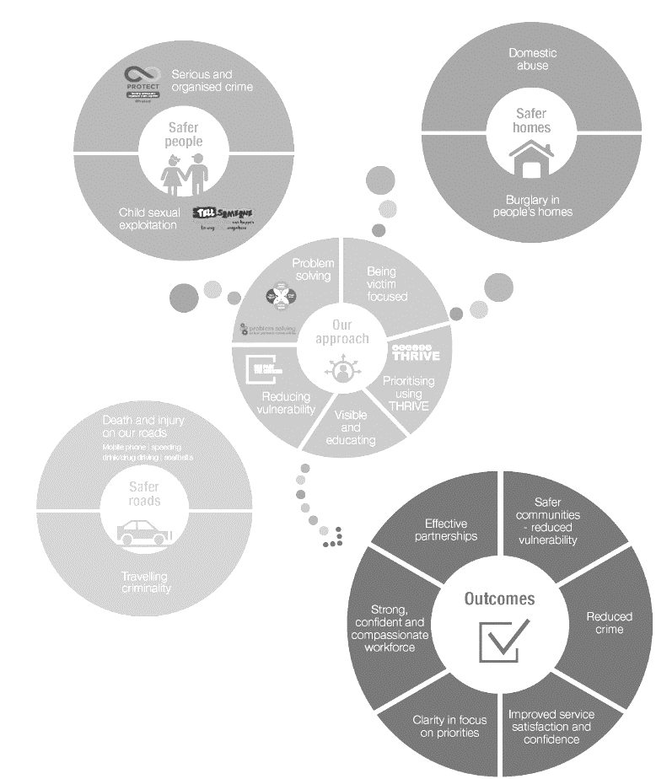

GOLD
Our values drive our approach
Introduction
This is the Q2 Performance Report reviewing activity between July to Sept 2021. The purpose of this report is to inform the Force Delivery Group meeting on 3rd November with a force wide picture of performance, however this report is looking to draw particularly on the keys issues faced by the force, particularly in relation to force priorities and key practices.
This report focusses on Gold level Key Performance Indicators (KPI), however, there are also some measures included at a Silver level to create a comprehensive picture across the force. The number of measures in this report will continue to be refined to ensure that they are key performance indicators.
Overall crime offences have stabilised in the previous 3 months although there has still be a 5% (1091) increase on the previous quarter and a 7% decrease on the same quarter in 2019/20.
The OCC performance has decreased in the previous quarter partly driven by ICT and power failures rendering core OCC systems inoperable.
Due to the impact of COVID-19 on crime in 2020/21, the upper and lower control limits for 21/22 are set against 19/20 figures. It is intended that this will provide more realistic limits than if the normal practise of the previous financial year was used.
Projections have been included in this report, however, it should be noted that due to their basis on volumes in previous years the impact of COVID-19 is likely to distort the projections. Factoring the impact of COVID-19 within projections continues to be reviewed.

Slide 3

GOLD
Gold Balanced Scorecard
2021-2022
1. Delivering a high quality, consistent service to the public
2. Delivering an
efficient service
3. Delivering an ethical service
OUTCOMES
1.1 Delivering
victim
satisfaction
1.2 Creating
public
confidence
2.1 Delivering our
service within
budget
3.1 Delivering our
service legally and
within regulations
3.2 Meeting our corporate environmental responsibility
CONTROLS
4. Delivering innovative, problem-solving practices and processes
ACTIVITIES
4.1 Delivering effective core practices
4.2 Managing demand
4.3 Innovating and improving
5. Delivering a skilled, sustainable workforce in a constantly learning and improving environment
ASSETS
5.1 Establishing a skilled,
flexible workforce
5.2 Establishing high quality,
accessible knowledge
5.3 Establishing appropriate,
available tools
Public First Courage Compassion Ownership

Slide 4
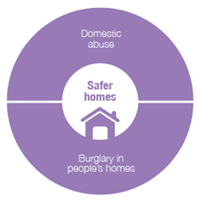
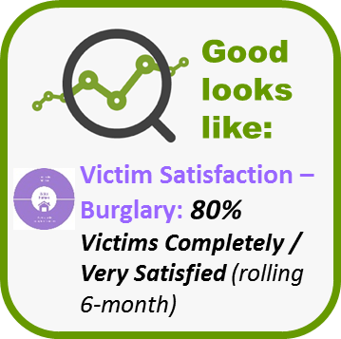
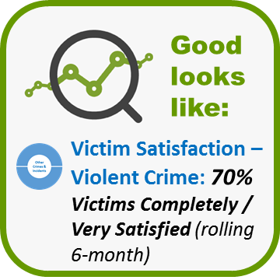

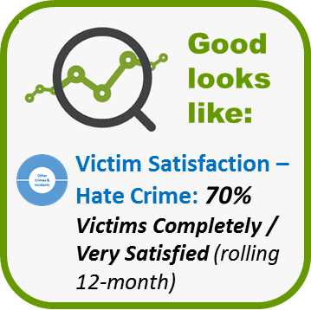
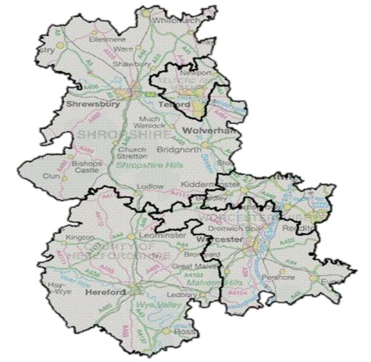
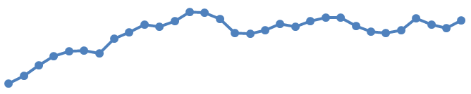
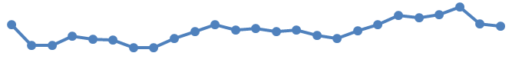
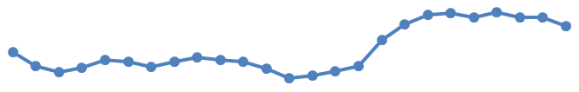
Delivering a high quality, consistent service to the public
1.1 Delivering victim satisfaction: Burglary, Violent, Hate
*Change in satisfaction is not statistically significant
**Change is statistically significant
WDGLL has been reviewed and agreed by the subject lead.
Number of victims spoken to:
Survey targets were not met during Quarter 2 due to staff abstractions. This adversely affects the statistical validity of the results.
Burglary
Violent
Hate
Rolling 6-months (Apr– Sep 21)
Rolling 6-months (Apr – Sep 21)
Rolling 12-months (Oct 20 – Sep 21)
(Completely or very satisfied)
(Completely or very satisfied)
- With a latest figure of 67%, violent crime satisfaction has decreased slightly since last quarter, although this is not statistically significant. However, because of this slight dip, the longer-term increase (of 5%) is no longer statistically significant – a change since last quarter.
74%
65%
1%*
76%
2%*
8%*
64%
2%*
66%
74%
64%
66%
76%
83%
61%
73%
3%*
83%
64%
60%
1%*
- Previous internal analysis has pointed to the existence of an inverse relationship between satisfaction and demand. The volume of open investigations has increased by 11% across the force between September 20 and September 21 (the equivalent figures for Local Policing Areas range from -0.5% decrease in Herefordshire to a 16% increase in Telford).
Satisfied
Satisfied
(Previous (Jan 21 – Jun 21): 76%)
71%
(Previous (Jul 20 – Jun 21): 64%)
66%
87%
1%*
57%
65%
1%*
88%
68%
3%*
56%
- Additional analysis will be undertaken by SP&I to explore the relationship between demand and victim satisfaction.
64%
74%
73%
53%
11%**
Trend:
1%*
67%
Trend:
Apr-Sep 19
Apr-Sep 21
Trend:
62%
Apr 18-Mar 19
Oct 20-Sep 21
5%*
- Herefordshire Local Policing Area (LPA) has been an area of focus due to its lower levels of hate crime satisfaction relative to the remaining Local Policing Areas (56%).
- With a latest figure of 64%, Telford continues to be an area of focus, with a further slight decrease since last Quarter.
Apr-Sep 19
Apr-Sep 21
(Completely or very satisfied)
3%*
- SP&I carried out analysis to explore the reasons for this finding which identified that lower levels of satisfaction were due to gaps in specific elements of the service provision (police did not take case seriously / take action to resolve issue, victim not informed of outcome, poor expectation management regarding police attendance or speed of attendance, lack of empathy / understanding showed by officer). Significantly lower levels of satisfaction was identified with victims having a disability suggesting a perceived gap in service provision with this group. SP&I are continuing to work with Herefordshire LPA to support service improvements with actions being logged in the Victim Satisfaction tactical action plan, overseen by the Strategic Victim Satisfaction Board.
- Research is currently being undertaken in SP&I to explore the continuing lower satisfaction seen in Telford with initial findings pointing to the following being contributory factors: victims not being informed regarding the outcome of their investigation; low and falling satisfaction of victims of attempted burglary; increased demand; lower and falling satisfaction of victims having a disability.
4%*
64%
67%
63%
5%*
65%
67%
2%*
70%
Satisfied
(Previous (Jan 21 – Jun 21): 69%)
65%
6%*
- Conversely, as part of the research, above, best practice from Herefordshire and North Worcestershire is also being identified.
72%
71%
73%

Slide 5








Delivering a high quality, consistent service to the public
1.1 Delivering victim satisfaction: Domestic Abuse (DA)
*Change in satisfaction is not statistically significant
**Change is statistically significant
The low data volumes in Quarter 2 limit the statistical validity of the results presented.
DA surveys were suspended from April 20 due to Covid and did not resume until April 21. Due to the break in data, results are presented as a new dataset from April 21. Survey targets were not met during Quarter 2 due to staff abstractions.
Number of victims spoken to:
Satisfaction by Service Stage
(Apr-Sep 21)
Initial Report
Police Actions
Previous Quarter:
115
Qtr. 2
91%
75%
57
Target:
168
Satisfied
Satisfied
(Completely or very satisfied)
Treatment
Follow-up
Quarter 2’s Performance (completely or very satisfied)
80%
58%
Rolling 6-months
(April-September 21)
Satisfied
Satisfied
74%
1%*
Satisfied
What went well…
“The Officer who came out listened to me and took time to explain things and manage my expectations going forward. He also arranged for a Gazateer warning to be put on my address.”
DA Service Measures
“They (police) were all lovely, and showed me a lot of understanding. I was assured that I had done the right thing but they (police) all listened to my feelings about things.”
(April – September 2021)
Victim felt SAFER as a result of contacting the police? (% Yes, fully)
68%
“To be honest this is a very bizarre case but they (police) have dealt with it with respect and stayed professional. I was grateful that I was taken so seriously and that they have kept me informed throughout.”
Victim felt that the police CARED about them?
(% Yes, fully)
75%
What could be better…
Victim would feel CONFIDENT about contacting police again? (% Yes, fully)
82%
“Last year I had a good service from the Police. The female officers were supportive and all over it . This time there has been delayed response and poor communication. I have had lots of different officers some good some bad.”
If something similar happened to someone you know, would you RECOMMEND for them to contact the police? (% Yes, fully)
88%
“The officers specifically said they would contact me when the suspect was being released but they did not and I am really angry about that. I did not know what the suspect was actually being charged with. No-one has got back to me, I have had to chase it up through my DARO officer. The communication has been awful. it was my landlord that has told me the case is closed.”
Good looks like:
Victim Satisfaction – Domestic Abuse: 80% Victims Completely / Very Satisfied (rolling 6-month)

Slide 6

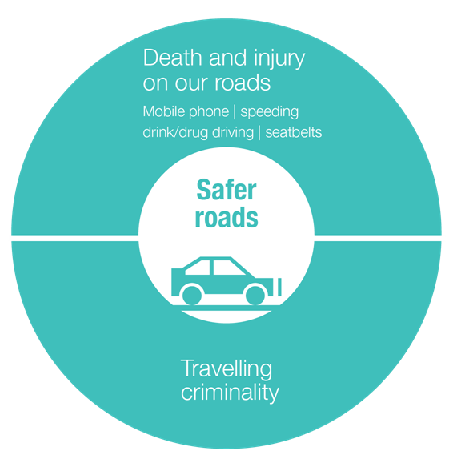





Delivering a high quality, consistent service to the public
1.1 Delivering victim satisfaction: Road Traffic Collision (RTC)
Quarter 2’s Performance
(Completely or very satisfied)
Quarter 2’s Performance by Service Stage
(completely or very satisfied: rolling 6-months)
Victims spoken to:
Qtr. 2
Previous Quarter: 91
Discrete Quarter
Initial Report
229
107
Target:
99
96%
81%
5%*
Satisfied
Satisfaction
53
Potential ‘eligible’ slight injury RTC incidents where police attended
(Previous Quarter: 86%)
Initial Actions
176
Rolling 6-months (Apr 21-Sept 21)
88%
Incidents excluded as missing contact details for 1 or more listed ‘involved parties’
Satisfaction
83%
2%*
Number of RTC incidents identified as suitable for surveying
Satisfied
Follow-up
(End of previous Quarter: (Jan – Jun 21) 85%)
60%
What went well…
What could be better…
Satisfaction
“The police officer arrived very quickly, assessed the situation and got it under control. She spoke to the ambulance crew and instigated a top to toe assessment on me….The officer kept coming back to me to check I was OK. The officer was very reassuring and said it would all be sorted out.”
“One of the officers was quite rude to me, I felt he was rushing me, and he wasn't very understanding of the circumstances. I was a bit concussed, and I almost felt he was pushy trying to get answers from me…”
Investigation
67%
“I was shocked at the lack of follow up. We have been left not knowing what is happening. The accident wasn't our fault, we would like peace of mind to know what the next steps are. My partner and I sustained life changing injuries…Considering the severity of the accident, I would have really liked a 'how are you?' welfare call or visit from the police…”
Satisfaction
“They treated me like a human and made me feel so much better. They could see I was upset and were very kind to me. They explained everything to me so I knew what could happen and made sure that I was safe to get home.”
Treatment
“PC *** was great, empathetic, competent and reassuring; she was also great with my 3 year old boy. I sent a letter of thanks to West Mercia Police and PC *** was just amazing in how she dealt with the RTC, she called me a few weeks after the RTC to see how I was doing.”
92%
Satisfaction
“I have never been in an RTC before and did not know what to expect. I have not been contacted recently and would like to know what is happening.”
Whole Experience
“The process has been explained to me, I understand it will take several months….She let me know that the cyclist was out of hospital having sustained bruising so I appreciated having that information.”
“It was about a month later that I received a letter saying the matter would be investigated. I was really surprised because the officers at the scene had given me the impression it was all OK and would just be recorded.”
83%
Satisfaction

Slide 7

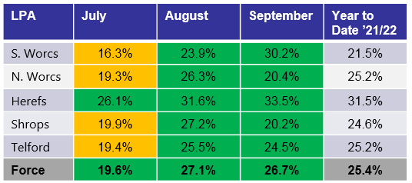
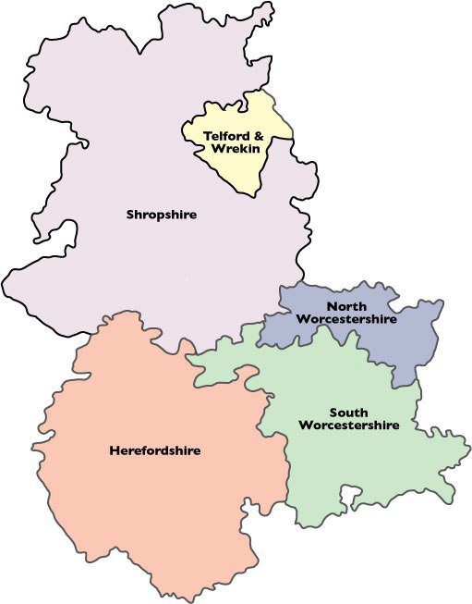
Delivering a high quality, consistent service to the public
1.1 Delivering victim satisfaction
Good looks like:
Victims’ Code Compliance
Referrals: 25%
WDGLL has been reviewed and agreed by the subject lead.
VAL referrals are an identified priority for Local Policing. The Delivery Plan sets out to increase referrals to 25% of victim-based crime by April 2021.
20-30%
15-20%
Under 15%
20.2%
24.5%
1.0
7.0
2.0
2.0
20.4%
Key Points
Minimal change in performance this month,
Just above WGLL at Force level (25.4%) despite dropping below this in July.
South Worcestershire and Herefordshire are performing above WDGLL.
5.9
1.9
6.3
2.0
2.0
2.0
33.5%
2.0
30.2%

Slide 8
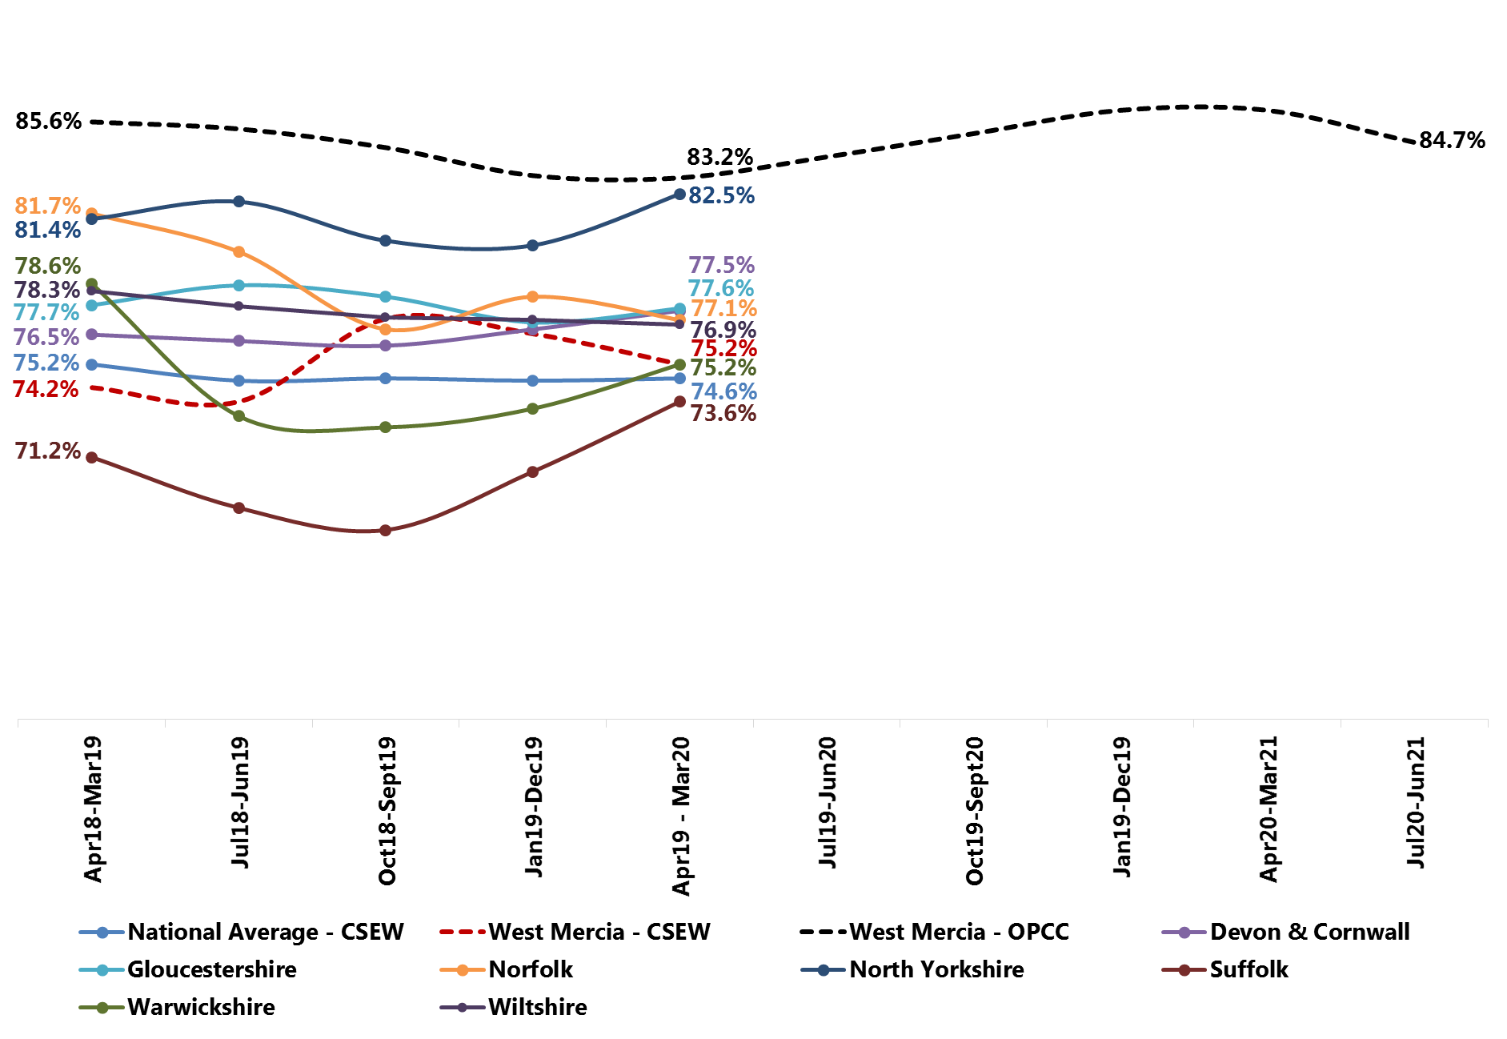
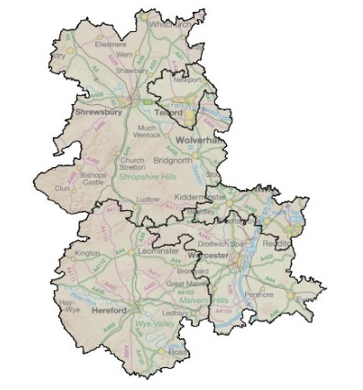
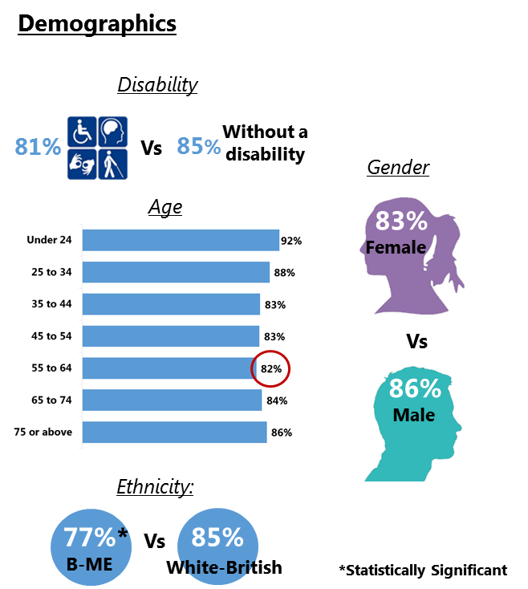
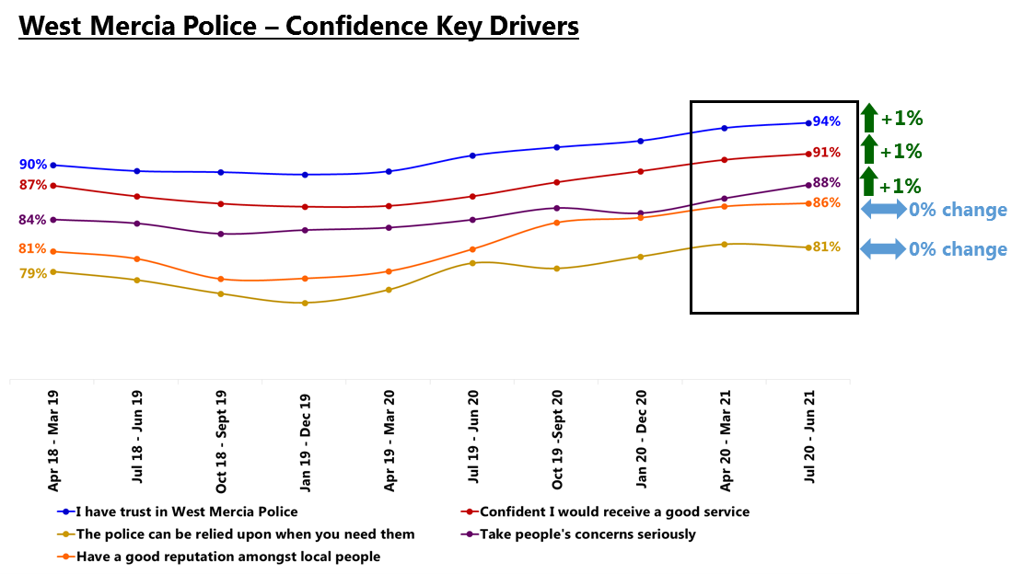
Delivering a high quality, consistent service to the public
1.2 Creating public confidence
Good looks like:
88%
Legitimacy – Requires Improvement
HMICFRS
27 Sept 2019
Confidence (Strongly Agree or Tend to Agree)
West Mercia data presented uses WMOPCC Perception Survey (rolling 12-months unless otherwise stated)
Trend Data
Discrete Quarter (Q1)
Rolling 12 months (Jun 21)
85%
84%
The Crime Survey England & Wales survey has been suspended since March 20 due to Covid.
83%
85%
-2%
-1%
86%
Confident
Confident
(Previous Quarter (Q4): 85%)
(Previous period: 86%)
84%
85%
Public Confidence and the Local Policing Charter
SP&I have identified 12 Safer Neighbourhood Areas (SNAs) with consistently high public confidence and 12 with consistently low public confidence. Learning will be identified from the high performing SNAs and applied – alongside other targeted activity – to the low confidence SNAs with changes in confidence evaluated from Quarter 3 onwards.
In Quarter 2, SP&I carried out analysis to explore possible causes of the lower than average levels of public confidence seen with people in the mid-age categories and B-ME individuals; this is due for circulation imminently.
The driver analysis will be used to inform the targeted activities recommended for the low confidence SNAs (see box above).
Note – It is possible for events reported in the media to influence confidence. These could include the death of George Floyd May 2020, the Dalian Atkinson trial which commenced 4th May 2021 and the death of Sarah Everard in March 2021.

Slide 9
3. Delivering an ethical service
3.1 Delivering our service legally and within regulations
Audit, Risk & Compliance – Overview of the recent audits completed by the force and risks presented.
Rape and Other Sexual Offences Audit– July 2021
Violence Against the Person Audit– May to July 2021
183 records assessed
110 records assessed
100%
100%
  183 safe incidents required a crime report
178 crimes recorded.
167 crimes were recorded within 24 hours.
96 crimes captured the victims’ ethnicity.
5 missing crimes included – Rape, Stalking, Causing Child to watch a sexual act and Actual Bodily Harm.
  110 safe incidents required a crime report
86 crimes recorded.
50 crimes were recorded within 24 hours.
24 missing crimes included – Common Assault, Stalking, S.4a Intentional Harassment, Alarm, Distress, Actual Bodily Harm, Malicious Communications, Harassment, Racially Aggravated Common Assault, Controlling and Coercive Behaviour, Criminal Damage and S.5 Public Order.
97%
88.5%
5%
8.5%
94%
5%
58%
4%
54%
5%
22%
2.7%
No victims of rape were missed. The two missing rape crimes were where both victims had reported 2 rapes, where only 1 rape had been recorded for each victim.
The appropriate scrutiny by OCC supervision and DDM’s is in place to ensure timely and accurate crime recording is evident in the audit results.
Contact logs will continue to be monitored for compliance.
The main ‘themes’ why crimes were missed were;
  where officers had failed to make the right crime recording decision based on the initial report on the Safe log and not providing evidence to negate the crimes
  Lack of understanding the law, particularly for Assaults, Stalking, Harassment and Public Order.
There is an improving picture with the compliance rate for CDI but recording needs to be consistently around 90% for VAP to be considered as “good”.
Audits will continue to focus on ASB and VAP weekly to monitor compliance.
Key Points
Key Points

Slide 10
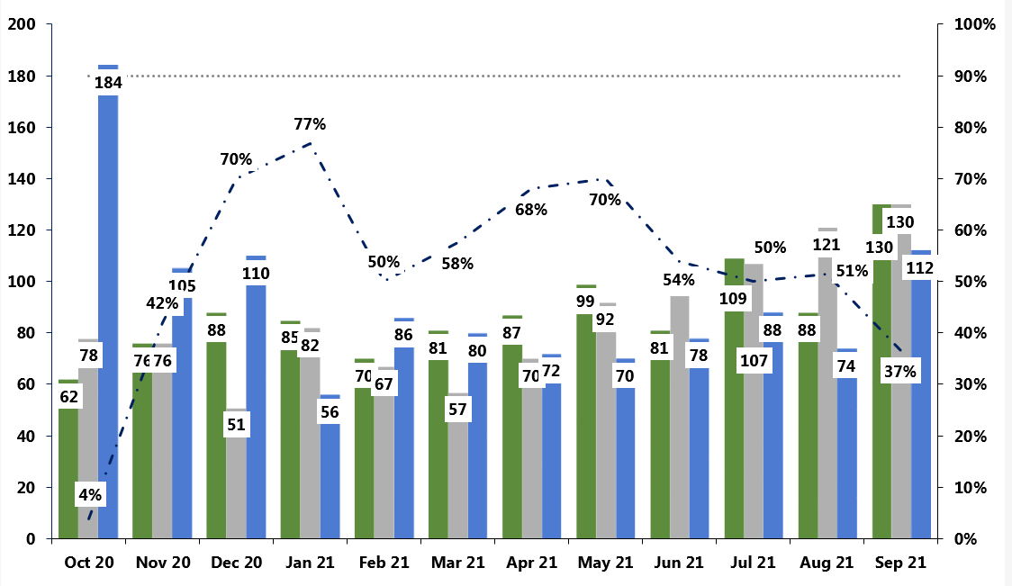

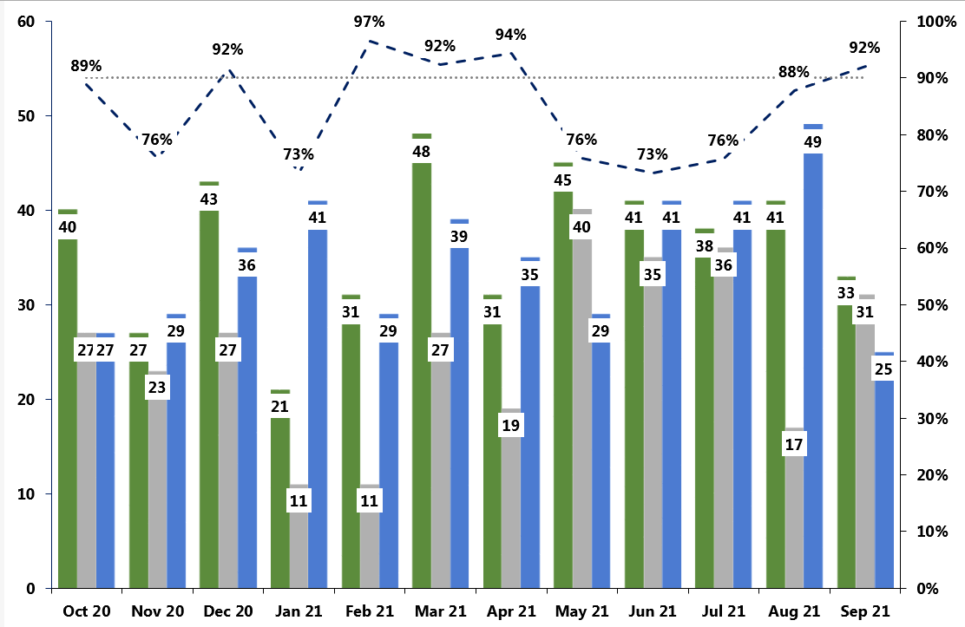
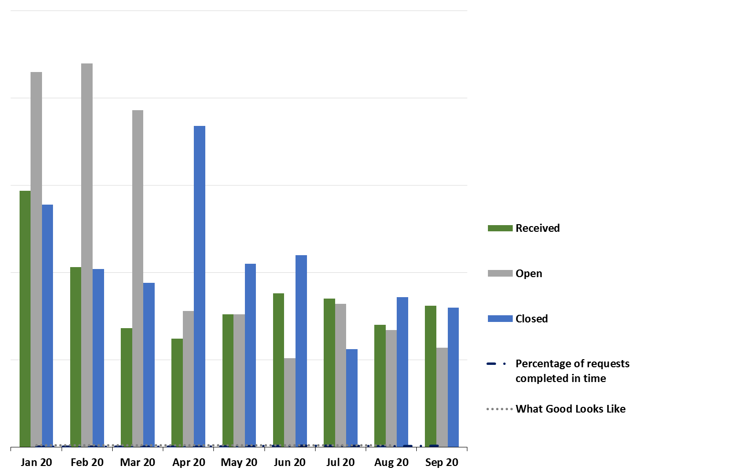
3. Delivering an ethical service
3.1 Delivering our service legally and within regulations
Timely response to Freedom of Information Requests
Completion of Mandatory Training
Timeliness has decreased since May 2021.
Volumes of received FOIS has increased steadily since February.
Introduction
Levels of compliance are stable and consistently above WGLL.
Training: 80% complete within time limit
Timely response to Subject Access Requests
Timeliness has improved since May 2021 and is now above WDGLL.
WDGLL has been reviewed and agreed by the subject lead.
Compliance is below WGLL and decreasing.
Good looks like:
Requests: 90% complete within time limit
Key:
WDGLL has been reviewed and agreed by the subject lead.
Notes:
Amy

Slide 11
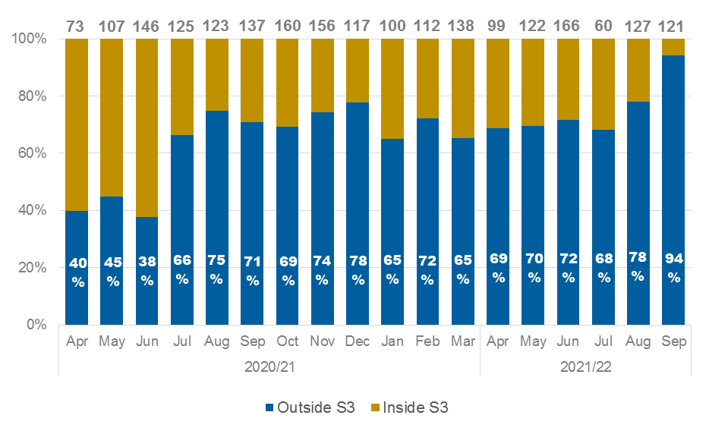
3. Delivering an ethical service
3.1 Delivering our service legally and within regulations
Complaints
Complaints Recorded Inside and Outside of Schedule 3
Introduction
Recorded complaints per month are varied at present and the decrease experienced in July can not be explained. The rolling 12 month average is just over 120 complaints per month.
The latest adjusted data for the percentage of complaints dealt with outside of schedule 3 shows that so far in 2021/22, the average for dealing with complaints outside of schedule 3 is 75%, which meets the aspirational target.
Each month the percentage for dealing with complaints inside schedule 3 is adjusted depending on the complainants wishes or the Force decision. The recent “decrease” in adjusted figures is not a “drop” in performance, just that more complaints had to be dealt with inside schedule 3 because the complainant wished or the Force/LPB determined they had to be.
Good looks like:
Consistent Progress made towards 75% Aspirational Target
Aspirational
Target
75%
WDGLL has been reviewed and agreed by the subject lead.
Vetting
Despite the increasing pending cases month on month the team continue to meet demand in terms of the Uplift programme and internal recruitment.
The pending cases have all been reviewed and are in hand with a large number generated as a result of the vetting review being conducted by the vetting supervisor.
UKSV are currently experiencing higher levels of demand, but appear to be managing this at present.
Notes:
Amy

Slide 12
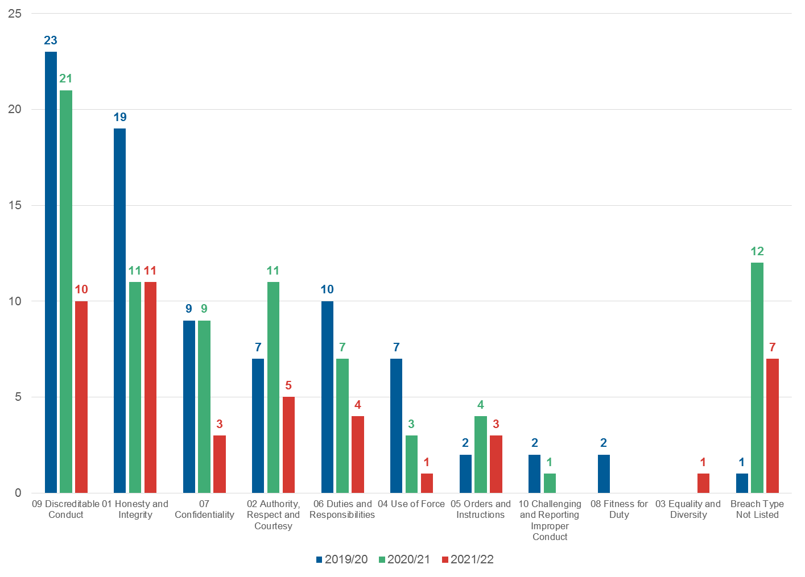
3. Delivering an ethical service
3.1 Delivering our service legally and within regulations
Recorded Conducts
Introduction
Conduct Cases recorded per Policing Year up to 11 October 21
Should the current rate of recorded conducts continue, it is likely by the end of 2021/22 conducts cases will exceed 80, which is a sharp increase on previous years.
Themes are domestic abuse, abuse of position for sexual purpose, other inappropriate behaviour (off and on duty) and use of force.
Notes:
Amy

Slide 13
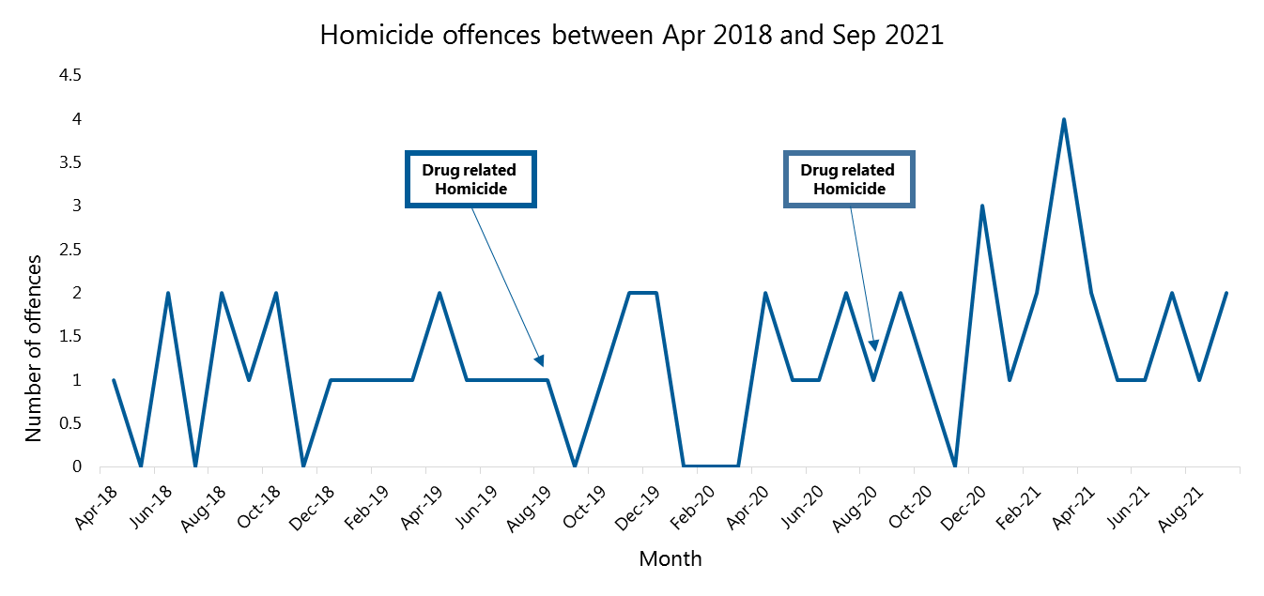
4. Delivering innovative, problem-solving practices and processes
4.1 Delivering effective core practices
National Crime and Policing Measures
Strategic Policing Requirement
Delivering strategic requirements
Key priorities: murder, serious violence, domestic abuse, neighbourhood crime and drug supply/county lines
Not numerical targets but key indicators to show improvement against; expectation of significant improvements within 3 years
Measure | Source | Change | Comment | Lead
Reduce murder and homicide | Police Recorded Crime |  | Same number as this quarter last year, however, the annual total has increased from 14 to 20 (to end September 2021) | ACC C&V
Reduce serious violence | National Health Service and PRC |  | 6 offences involving discharge of a firearm in the year to Sep 2021 Numbers of hospital admissions for assault with a sharp object are unavailable for August and September. There are always fewer than 8 each month (data available for last 3 years) | ACC C&V
Disrupt drug supply and county lines | PRC and Public Health England |  | There have been no drug-related homicides in last year (previous years - 1 death last year, 2 deaths previous year) | ACC C&V
Reduce neighbourhood crime | Crime Survey England and Wales |  | All acquisitive crimes are reducing. There is less consistent reduction in the robbery numbers, but many fewer offences. Data is currently from PRC as the CSEW data does not offer enough detail | ACC LP
Improve satisfaction among victims, with a particular focus on victims of domestic abuse | CSEW |  | Whole experience satisfaction is improving for hate crime, but not for burglary and no longer for violent crime. For victims of domestic abuse, numbers are insufficient to be able to come to any confident conclusion in relation to trends. | ACC LP
Tackle cyber crime | DDCMS |  | The data from the Dept. for Digital, Culture, Media and Sport is not available. Further police held proxy measures are being developed | ACC C&V

Slide 14
4. Delivering innovative, problem-solving practices and processes
4.1 Delivering effective core practices
Strategic Policing Requirement
The Strategic Policing Requirement sets out the threats that require a co-ordinated national policing response. The delivery of our response to this requirement to work collaboratively, and with other partners, to ensure such threats are tackled effectively, is collated and summarised below.
 |  | Capacity and Contribution | Capability | Connectivity
National Threats | Terrorism | Staffing gaps are minor as possible losses are projected and planned for. Small issues with security of supply due to time taken for vetting and training, however projection of vacancies and supply of assets from region help reduce impact. | Optimum training levels with surge capability if required. | Collaboration with partners is vital to enable West Mercia to deliver under the four P's detailed in the CONTEST Strategy and Action Plan. Relationships are maintained through regular contact, meetings and sharing of information.
 | Serious and Organised Crime | Some concerns surrounding the levels of staffing and time taken to train individuals, particularly within SOCU however, this impact is often limited due to the provision of the ROCU and the forces ability to prioritise resource. | Issues exist with limited surveillance capability. | With offenders active across borders it is vital West Mercia continue communications with partners/agencies not just across the UK but overseas as well. The force works closely with a number of agencies such as Gain, HMRC, airlines and Border Force to ensure intelligence and information is shared accordingly. The Force has an embedded Serious and Organised Crime Joint Action Group (SOCJAG) structure which brings together a host of partners on a regular basis to work to tackle Serious and Organised Crime collectively. The CPS is also a crucial partner who the force work closely with on a regular basis.
 | National Cyber Security Incident | The Cyber Crime Unit (CCU) has optimum staffing levels to enable response to cyber security incidents. | The CCU is fit for purpose and capability is constantly improving within the team to maintain good standards. Additional vehicles however are required. | The force work closely with the West Midlands regional Cyber Crime Unit along with all of the regional Cyber Crime Units. Also linked into the National Cyber Security Centre and the National Cyber Crime Unit to enable partnership working across the UK. Regular contact is established with National Fraud Intelligence Bureau (NFIB), Action Fraud and Get Safe Online.
 | Threat to Public Order and Public Safety | Optimum levels of staff with well above the nationally-specified number of trained officers. | Some issues may exist in the accreditation of roles in 2020, however officers are currently trained in line with national requirements. | For events, the force works with a variety of partners depending on the event taking place. For example, frequently events planners and coordinators will be in contact with safety advisory groups, local councils, sporting clubs and other event organisers.
 | Civil Emergencies | Number of resources are sufficient to maintain business as usual and respond to major emergencies, however in the event of a significant incident some BAU demand is disrupted due to low staffing levels. | Issues with equipment exist which limits capability when connecting and sharing information with partners. | Local Resilience Forums (LRFs) ensure collaborative working and are an integral part of the process in ensuring the production of contingency plans and individual agency plans for mitigation and response. The LRFs are a significant and vital element of working in partnership and taking a multi-agency approach to action.
 | Child Sexual Abuse (CSA) | Due to a recent uplift in resources there are optimum staffing levels available for contribution. | Issues exist with some interview locations and medical facilities not being fit for purpose. There are a limited number of fully trained and accredited investigators. | Problem Solving Hubs and Harm Assessment Units aim to support colleagues and external partners in reducing harm and risk through problem solving. The officers engage in partnership working using innovative and child-centred policing to proactively provide early intervention.

Slide 15
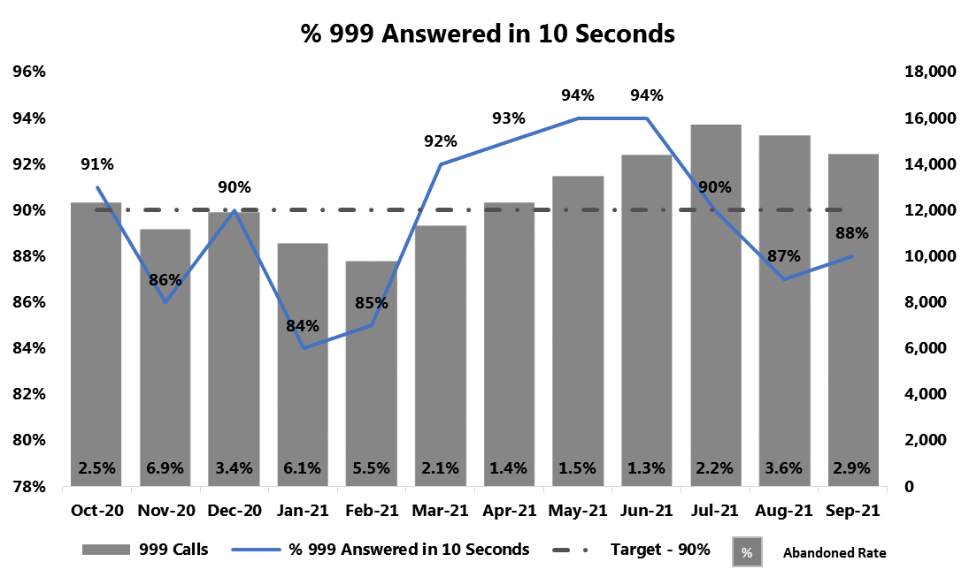
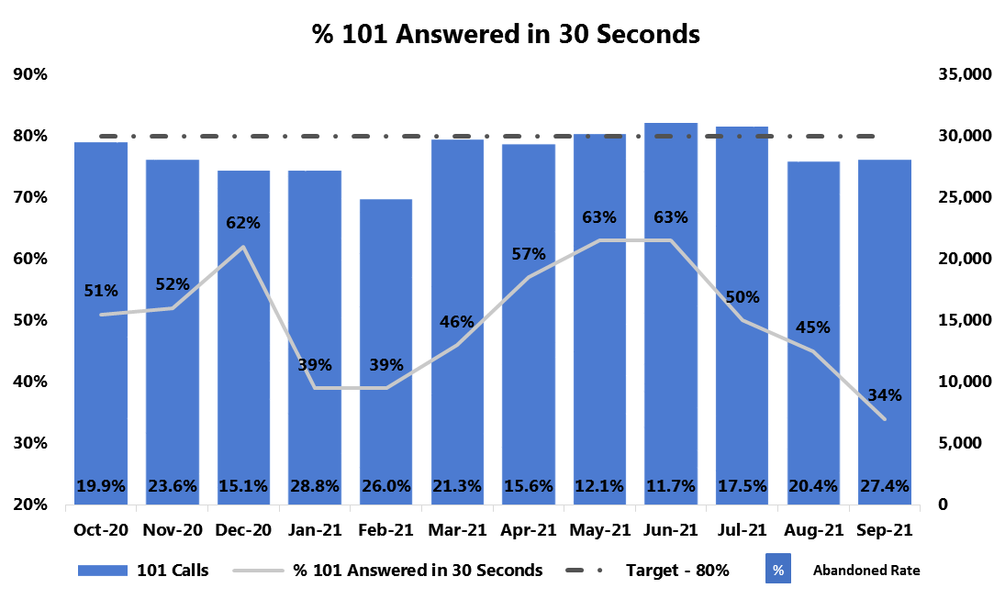
4. Delivering innovative, problem-solving practices and processes
4.1 Delivering effective core practices
Good looks like:
Response to calls for service
999 performance: 90% answered within 10 seconds
999 volumes: Maintain current levels in light of increasing national levels
101 wait times: 80% answered within 30 seconds
101 volumes: Continued sustained increase of online reporting on Single Online Home and an increase in website traffic to advice and information
WDGLL has been reviewed and agreed by the subject lead.
Introduction
999 Performance
999 demand increased by 13% between Q1 and Q2 which remains similar to Q2 2019/2020.
Affected by the increase, the OCC presented a 6% decrease in performance to 88% for the quarter compared with Q1.
The statutory 999 target of 90% was met in July however it was not achieved in the following two months. ICT and power failures rendered core OCC systems inoperable in all three months of Q2 which would affect performance outcomes including an increase in abandonment rate owing to the fact that presented calls simply could not be answered during these periods.
101 Performance
In Q2 there has been a 4% reduction in call demand from the previous Q1 and a significant reduction from Q2 last year (-21.5%). Non-emergency call demand has continued to be unpredictable.
Despite the reduction in demand, the OCC presented a 18% decrease in performance to 43% of non-emergency calls being answered within 30 seconds for Q2.
Overall performance within Q2 is difficult to compare owing to the impact from factors outside of the OCC’s control such as ICT and power failures which affected 999 performance.

Slide 16
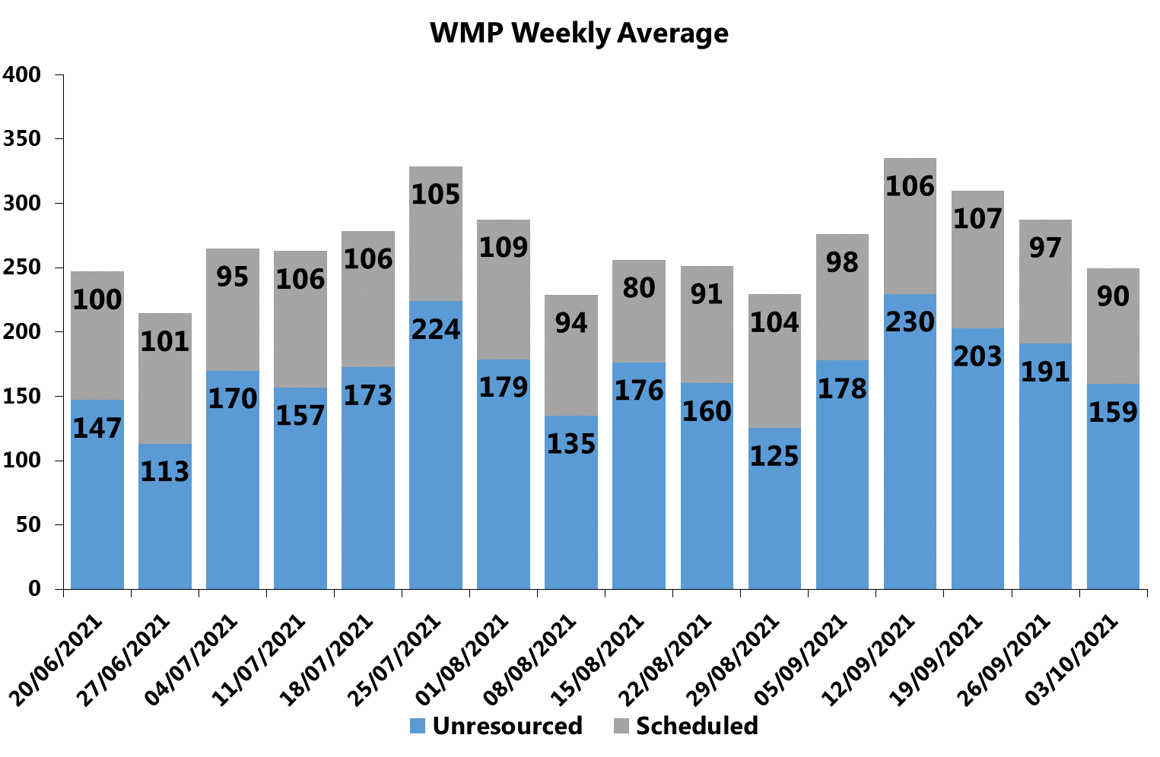
4. Delivering innovative, problem-solving practices and processes
4.1 Delivering effective core practices
Good looks like:
Unresourced: between 150-200 unresourced calls
WDGLL has been reviewed and agreed by the subject lead.
Response to calls for service
Unresourced
Force wide unresourced continues to fluctuate but has improved as we moved into Q3. A dedicated full time resource created by the OCC has placed full time scrutiny over volumes and efforts to ensure the deployment principles are adhered to has ensured greater volume of appropriate incidents are being given to appropriate teams at the first opportunity.
Unresourced is consistently highest in Shropshire throughout Q2, suggesting some issues with being able to allocate resources or an increased number of calls.
Diary Appointments fluctuate throughout the quarter.
Digital Demand
The ORLO social media platform went live within Q2. The staffing to monitor these channels taken from existing strength.
Online digital demand continues to grow with Single Online Home achieving its highest engagement since launch with 2103 engagements – a 20% increase from September 2020 and a 5% increase from last month. This growth in demand is expected to continue.
Emergency Response Times
The proposal and quotation has now been received by the OCC Programme from Saab.
Details of the full proposal and quotation were sent into the Business Change Team we are currently awaiting an impact assessment to be completed.

Slide 17
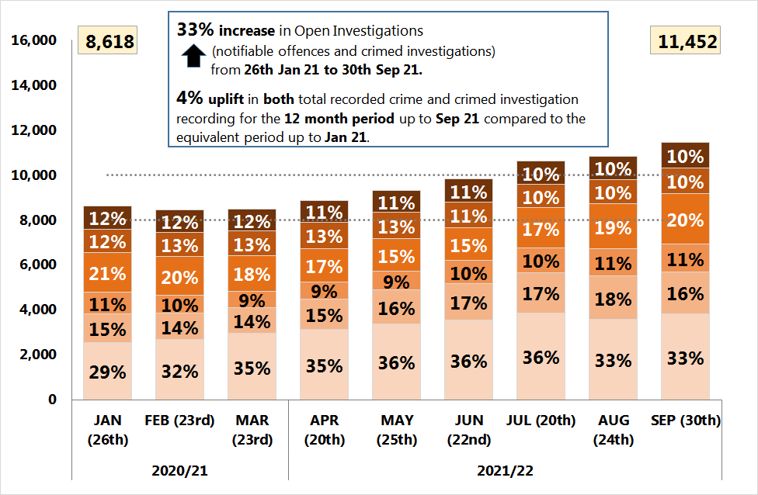
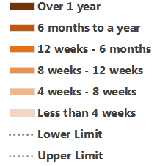
4. Delivering innovative, problem-solving practices and processes
4.1 Delivering effective core practices
Effectiveness – Requires Improvement
HMICFRS
27 Sept 2019
Crime Management
Key Points
Open investigations (O.I.s) increased by 33% compared to the previous point in time in January 2021.
For comparison there was a 4% uplift in both total crime and crimed investigations recorded for the 12 month period up to Sept 21 compared to the equivalent period up to Jan 21.
In last two months, the Open Investigation age profile has been getting older in the mid-range age brackets (8 weeks – 6 months).
Reinforced recording practises, staff turnover in key roles, high unresourced incident levels and staff attrition (training, annual leave and sickness) will all reduce the progression of investigations.
The Athena team suspect that there are 1,790 open investigations that look like they need to be closed down on the system.
  890 with the Designated Decision Maker (DDM) team.
  900 that are waiting to have an outcome applied.
  Due to long term sickness, there is one DDM short within the team, which creating a delay in investigations being closed down.
  This group of open investigations will be reviewed further.
It is probable that the increased caseloads of OICs will have a continual negative impact on outcoming levels over the coming months, especially for complex crime types.
Open Investigations – Age Profile (point-in-time view)
Age Profile
Bandings
Good looks
like:
An ‘optimum’ band is thought to be around 8,000-10,000 open investigations at current recording volumes. However, to avoid an incentive simply to close crime this marker would need to be hidden until further work is done to filter out:
1. ‘Normal’ volume of open investigations awaiting closure with the Designated Decision Makers (DDMs)
(currently 5-600)
2. Complex crime types with long average timeliness
3. A better “temperature gauge” of force crime is anticipated to come from combining some metrics: Open crime/ Volume in “baskets”/ Suspects outstanding/ “attrition” rates to some outcomes. This is to avoid over-focus on timeliness at the expense of quality investigations.
WDGLL has been reviewed and agreed by the subject lead.

Slide 18
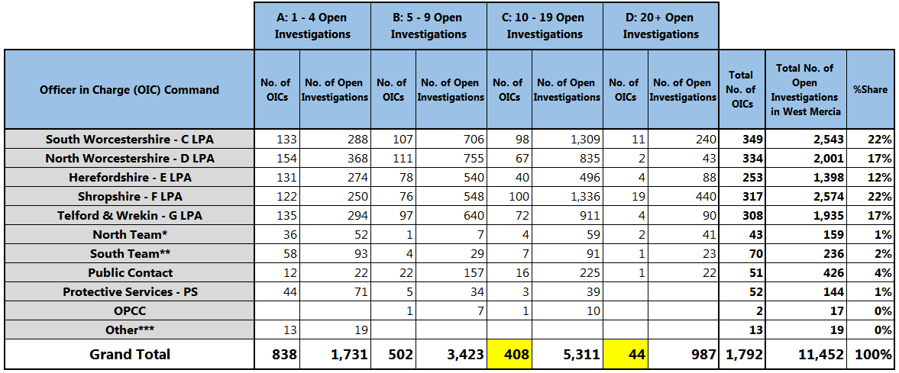
4. Delivering innovative, problem-solving practices and processes
4.1 Delivering effective core practices
One
Shropshire Patrol Officer 30 Open Investigations
Crime Management - Open Investigations and OIC Crime Baskets
Open Investigation Crime Baskets by Command
Activity underway since July 2021
Working with North Worcestershire and the Crime bureau to guide officers through the weekly trial of IMU direct.
Feedback is being sent out in relation to Newly promoted / Acting Sergeants’ Pre-read – a guidance document is moving towards the final stages of completion.
Work producing Newly promoted / Acting Inspectors’ guidance package has begun.
Work began on providing a new and effective process for officers, sergeants, inspectors and chief inspectors relating to Victim right to review requests with associated guidance to be delivered force wide.
Inspectors’ review guidance complete for uniform inspectors, work beginning on Detective Inspectors’ review guidance.
Reviewing the options for alternatives to STEPS packages for managing Part IV Bails and Court curfew checks .
Open investigations featured in the recent Quarterly Performance Review meetings across all local policing areas.
(Point-in-time view: 30th September 2021)
Key Points
There are clear discrepancies in approach between local policing areas.
100% increase in the number of OICs with 20+O.Is. between January 21 (22) to September 21 (44) with 987 (9%) of all O.I.s in their crime baskets.
  Shropshire - highest proportion of OICs (43%) with 19 OICs having 440 O.I.s in their crime baskets.
63% increase in the number of OICs with 10 – 19 O.Is. between January 21 (250) to September 21 (408) with 5,311 (46%) of all O.I.s in their crime baskets.
  Shropshire - highest proportion of OICs (25%) with 100 OICs having 1,336 O.I.s in their crime baskets.
It is highly probable that Open Investigations volumes will increase in the coming months due to an increase in crime recording and the growth in the size of officer crime baskets, as more officers have 10+ open investigations in their baskets.
North Team*: MIU North, Online CSE North, Shrops and T&W RPO & AFOs.
South Team**: MIU South, Online CSE South, Worcs Dogs Team, Worcs Prisons, Worcs MASH staff and Worcs RPO & AFOs.
Other***: Pre Athena, Ops and Other.

Slide 19
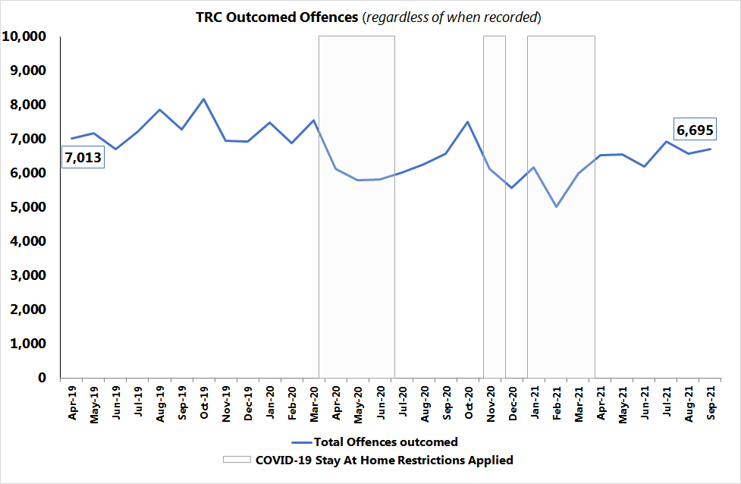
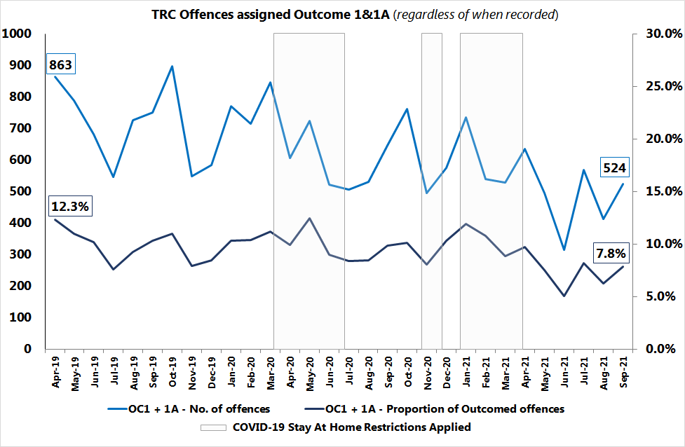
4. Delivering innovative, problem-solving practices and processes
4.1 Delivering effective core practices
Outcomes
TRC Outcomed Offences (regardless of when recorded)
‘Charge/ Summons’ Outcomed Offences (OC1 & 1A) (regardless of when recorded)
Key Points
Total Offences outcomed: Upward monthly growth trend since February 21.
Ongoing variable downward monthly trend for Outcome 1 - Charge/ Summonsed
Outcome 1A - Charge/ Summonsed other offence is showing a gradual decline. The affect of the new CPS disclosure guidelines is still having a negative impact due to increased scrutiny, leading to significant amount of additional work for most files to achieve a positive outcome. A reduction in ‘Action Taken’ outcomes was anticipated.
Other ‘Action Taken’ outcomes have remained lower in Q2 2021/22 when compared to the same quarter two years ago (Appendix One).
During the monthly SPI/ Crime Bureau meeting, no reports of emerging themes from the DDM’s. Two issues were raised:
  Continual lack of understanding regarding application of some Outcome results and work is still ongoing to try to improve this.
  Additional work is required in relation to Sgt/Supervisor reviews to ensure investigation are being managed and completed in a timely way.
Good looks
like:
Total Outcomes and Charge/ Summons measures:
  They have been reviewed but due to upcoming system changes, this will be reviewed again for Q3 2021/22.
WDGLL has been reviewed and agreed by the subject lead.

Slide 20
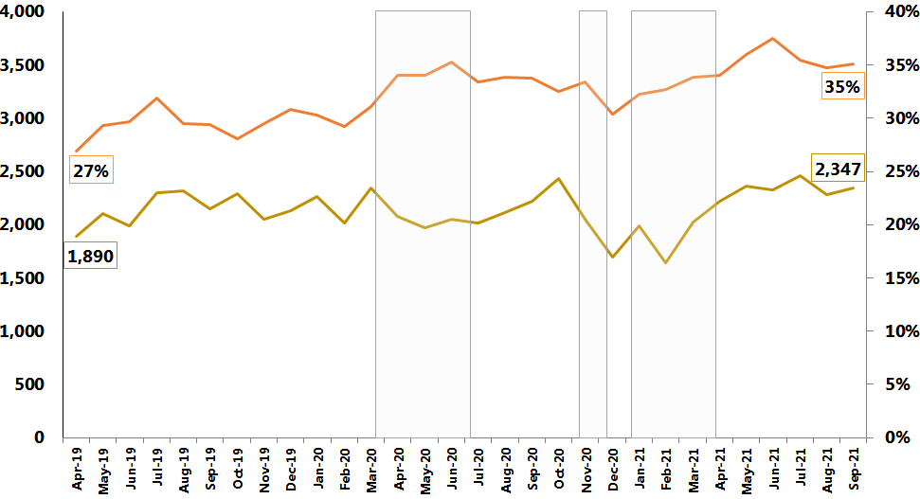
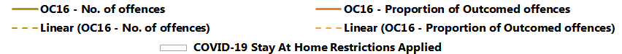
4. Delivering innovative, problem-solving practices and processes
4.1 Delivering effective core practices
Key Points
Since the growth peak in June 2021, there has been a reduction in the monthly proportion of Outcome 16 offences, although the volume of Outcome 16 offences has remained relatively stable.
Based on current levels, it is probable that the monthly proportion rate for Outcome 16 offences will remain between 34 – 36% over the coming months.
Outcome 17 - Prosecution time limit expired: Suspect identified - remains a cause for concern due to a 39% increase (+31) in offences in Q2 2021/22 when compared to the same quarter two years ago (refer to Appendix One).
  An Outcome audit has been commissioned which will include a review of Outcome 17 offences.
Outcome 12 - Prosecution prevented – Named suspect identified but is too ill (physical or mental health) to prosecute - remains a cause for concern due to a 57% increase (+48) in offences in Q2 2021/22 when compared to the same period two years ago (refer to Appendix One).
Outcomes
‘Evidential difficulties prevent further action; victim does not support police action’ Outcomed Offences (OC16)
(regardless of when recorded)
Evidential difficulties prevent further action; victim does not support police action
A reduction in the volume and proportion of offences assigned an Outcome 16 result.
Good
looks
like:
Prosecution time limit expired offences
A reduction in the volume and proportion of offences assigned an Outcome 17 result.
Quarterly results for all Outcomes types are featured in Appendix One.
WDGLL has been reviewed and agreed by the subject lead.

Slide 21
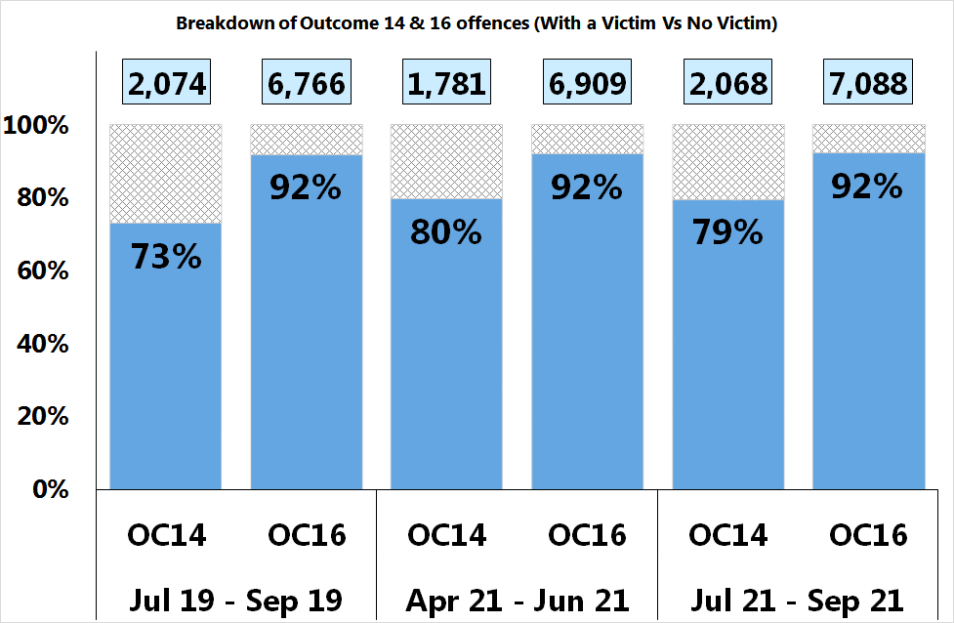
4. Delivering innovative, problem-solving practices and processes
4.1 Delivering effective core practices
Good looks like:
100% of Outcome 14 and 16 offences should have a victim linked to the offence.
WDGLL has been reviewed and agreed by the subject lead.
Outcomes
Outcome 14 – Evidential Difficulties Victim Based – Named suspect not identified: Victim either declines/ or is unable to support further police investigation
Key Points
Whilst there is an improvement, neither Outcome 14 or 16 offences have a victim assigned 100% of the time.
Small proportion of ‘victimless’ offences could relate to Involved Party roles – this being reviewed moving forward.
Outcome 16 – Victim does not support action
Proportion of Outcome 14 and 16 offences with a Victim/s
Based on Offences outcomed during the 3 month periods regardless of when they were recorded
Higher % is better

Slide 22
Crime types whose volumes are shown in a grey box have exceeded the upper control limit. If they are considered to require further investigation they feature later in the report.
All crime types featured in the table below are also monitored weekly and monthly.
4. Delivering innovative, problem-solving practices and processes
4.2 Managing demand – policing priorities
All Crime
Does not directly relate to crime recorded in the quarter.
Does not directly relate to crime recorded in the quarter.
Overall crime offences have stabilised in the last quarter although there has still been a 5% (1091) increase on the previous quarter and a 7% (1379) decrease on the same quarter in 2019/20.

Slide 23
4. Delivering innovative, problem-solving practices and processes
4.2 Managing demand – policing priorities
The Policing Priorities are reported on as standard each month and quarter.
They are reported on in further detail on following slides.
The upper and lower control limits are derived by calculating 2 points of Standard Deviation from the mean. The mean is fixed for the year and is based on volumes recorded in the previous financial year.
denotes above the upper control limit. denotes below the lower control limit.

Slide 24
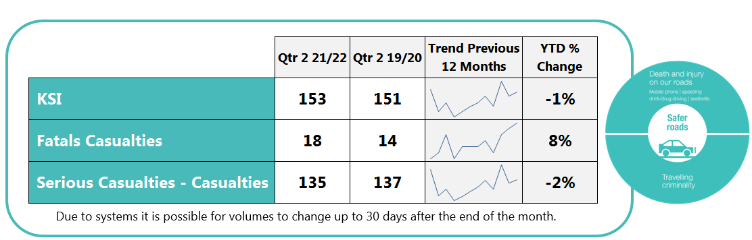
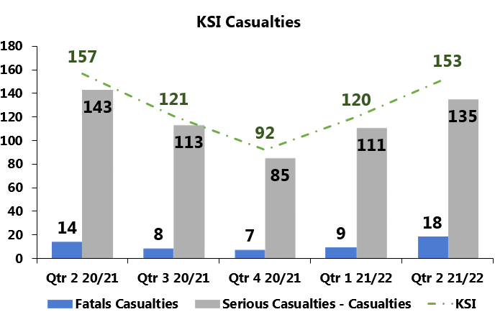


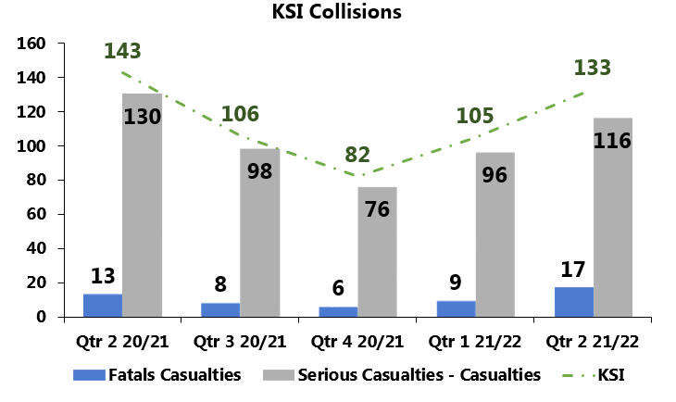
4. Delivering innovative, problem-solving practices and processes
4.2 Managing demand – policing priorities
Good looks like:
KSI: A sustained 5% reduction on 19/20
WDGLL has been reviewed and agreed by the subject lead.
Safer Roads
Key Points
In the last quarter, Killed or Seriously Injured (KSI) casualties saw a 30% (36) increase compared to the previous quarter. However figures remain similar to same quarter in 19/20 and YTD figures. This suggests some return to pre-lockdown figures but the sharp increase needs to be considered. It is probable that that this is driven by drivers who are out of practice and much larger numbers due to lockdown easing.
However, it is highly probable that KSI and collision volumes will increase over the coming months due to lockdown restrictions easing, increased alcohol consumption that comes with Christmas and the darker mornings/nights.
Pedal cyclist casualties continue to remain an area of concern due to an increase in new/inexperienced cyclists. In the last quarter cyclists accounted for 16% (25) of KSI casualties. Op Close Pass engaged 42 cyclists to press home safety messages with them. This will continue with ‘Be Safe, Be Seen’ campaigns in the coming months. Considering the potential issues with drivers could they be engaged with too?
Collisions on National speed limit roads for Q2 are at the highest level since 2017.
Upcoming Campaigns: October – December 2021
National NPCC
campaigns
Time period covering
communications
and enforcement
October
Tyre Safety Week TBC
November
Brake Road Safety Week – 16th Nov – 21st Nov
December
National Alcohol and Drugs Operation 1st Dec – 1st Jan
West Mercia Initiatives
October
NPCC Commercial Vehicle Week
Tyre Safety Month
A449 Average Speed Cameras Go Live
November
NPCC Operation Drive Insured
Road Safety Week
Be Safe Be Seen vulnerable road users
December
NPCC Alcohol & Drugs
Be Safe Be Seen vulnerable road users

Slide 25
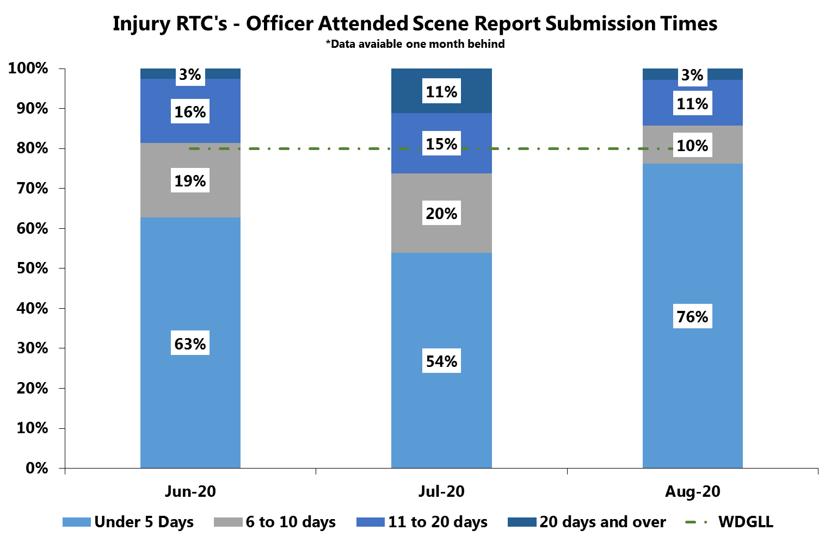
4. Delivering innovative, problem-solving practices and processes
4.2 Managing demand – policing priorities
Force policy and procedure requires collisions to be submitted to Criminal justice (TPU) for recording within 24 hours of attending the incident however;
Many officers will attend a collision prior to them starting their 4 rest days. Allowing 5 days makes the 80% target achievable.
Criminal justice staff do not work weekends. This makes it impossible for collisions occurring between Friday afternoon and Monday morning to be recorded within 24 hours unless entered onto CRASH.
Good looks like:
Collision Submission Times:
80%
of Submissions within 0 – 5 days.
80%
Killed & Seriously Injured – Submission Times
*Data available one month behind.
WDGLL has been reviewed and agreed by the subject lead.
Key Points
In August 76% of submissions were within 5 days.
Highest rate: 100% (2) of Telford & Wrekin’s reports (2) were submitted within 5 days.
Lowest rate: 66% (21) of South Worcestershire reports (32) were submitted within 5 days.

Slide 26

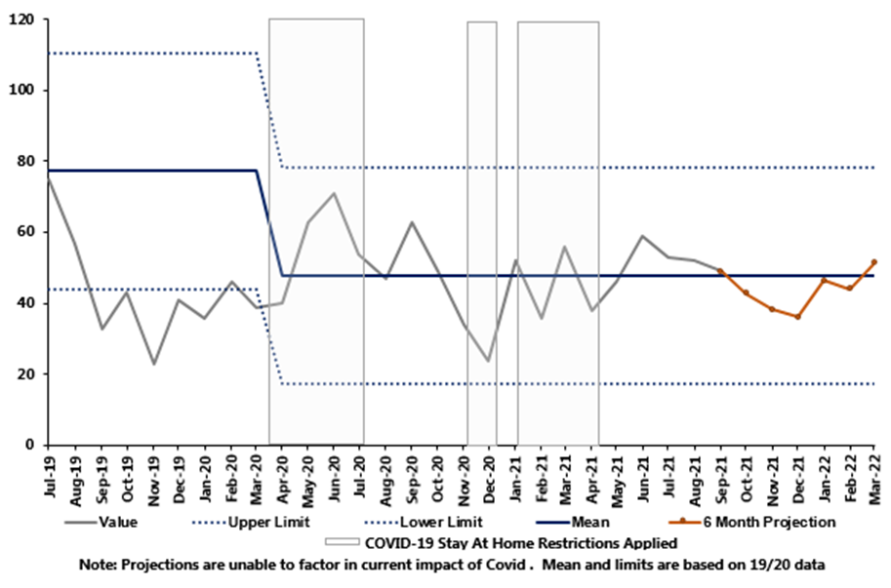
4. Delivering innovative, problem-solving practices and processes
4.2 Managing demand – policing priorities
Child Sexual Exploitation – Policing Priority
This data is generated from Athena where a ‘CSE’ crime keyword has been applied.
Following the relaxation of lockdown restrictions, the start of the school term and the introduction of the government NSPCC helpline on 1st April, volumes were expected to increase – after an initial increase in Q1 this has now decreased month on month but with a higher overall figure over the whole quarter; there being no significant increase with the start of the school term. An audit of keyword use may be required to check it is being correctly applied.
Key Points
Overall there was a 12% (17) increase in CSE related offences and crimed incidents compared to the previous quarter and a 7% (11) decrease on the same quarter 2019/20.
Good looks like:
CSE: Increased reporting*
We also need to use the correct markers to ensure the right people are directed to these incidents and so dealt with appropriately
The ongoing exploitation training should continue to see an increased recognition and reporting of CSE by all partners and agencies who have undertaken this training.
*Note: with the change in use of CSE marker (end of 2019), it is not possible to make valid comparisons between the previous 12 months.
WDGLL is being reviewed
The upper and lower control limits are derived by calculating 2 points of Standard Deviation from the mean.

Slide 27
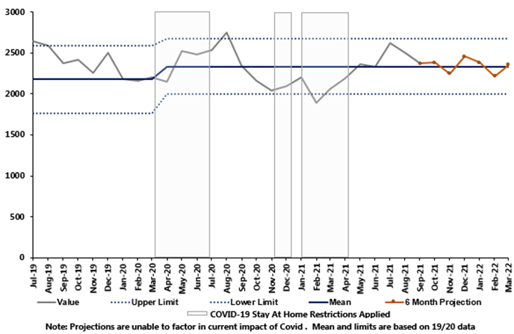
4. Delivering innovative, problem-solving practices and processes
4.2 Managing demand – policing priorities
Domestic Abuse:
Increased reporting; A reduction in DA repeat victims
Provide a timely response to all reports of DA.
Domestic Abuse – Policing Priority
Good looks like:
“Good” is better protection from harm, coupled with the best service we are able to achieve for victims of DA. Therefore, every DA report must be encouraged.
We will monitor repeat DA and, through intervening quickly, making proactive arrests as often as possible, using stringent bail and charge rather than DVPNs, should see a reduction in this metric.
WDGLL has been reviewed and agreed by the subject lead.
Key Points
Domestic abuse crimes and crimed incidents saw a 9% (618) increase on the previous quarter and a 1% (97) decrease on the same quarter 2019/20.
It is highly probable that volumes have continued to increase as a result of further easing of Covid restrictions specifically, with outdoor hospitality re-opening on 12th April.
Increased alcohol consumption due to lockdown ending and the warm summer months are likely to have contributed to an increase in incidents. The main increase being June to July with figures falling back to June levels. It is probable that this is driven by the Euros continuing into July and England losing the final.
Domestic Abuse crimes and crimed incidents are similar to 19/20 levels. Key aspects to monitor are the end of furlough and the Universal Credit reduction.
DVDS Applications have seen an increase of 11% (19) in Q2 driven by Right to Ask with a 18% (22) increase. This suggests that this service is becoming more widely known or that due to events of the last year there are higher concerns regarding Domestic Abuse.
Domestic Abuse Delivery Group (DADG) continues to drive the response to the DA Delivery Plan which is linked to the National Vulnerability Action Plan (NVAP) perennial issues. The overarching approach to NVAP will sit and report to Crime and Vulnerability and escalate to SIB to drive whole system approaches.
Strategic Vulnerability and Safeguarding maintain oversight of DA performance following Domestic Abuse Reality Testing (DART), via the DADG.
Performance will be assessed through policy compliance, practice and in developing the culture of positive action through the local policing delivery.
This data is generated from Athena where a ‘Domestic Abuse’ crime keyword has been applied.

Slide 28
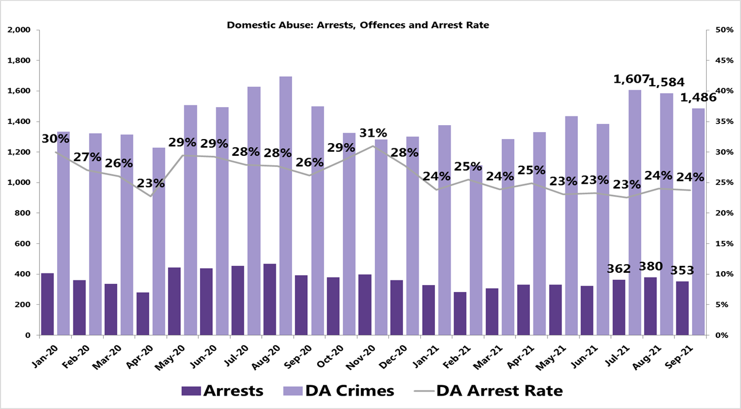
4. Delivering innovative, problem-solving practices and processes
4.2 Managing demand – policing priorities
Key Points
Increase in DA offences in the last quarter however a stable proportion when looking at arrest rates.
How DA arrest rates are calculated will be reviewed in the coming months when additional data sources are available.
Domestic Abuse Crime offences - Arrest Rates
Following an increased volume of DA offences in July; volumes decreased gradually throughout the rest of the quarter. Although this is still at an increase from Q1 of 11% (526). This increase in July was mirrored by a slight increase in the number of arrests. The overall DA arrest rate has risen with the offence rate by 11% (111), remaining at the consistent percentage with the rises and falls of DA offences.
This is an area of concern and was raised at the recent Quarterly Performance Reviews.
The increased number of offences is highly probably due to the warm summer months, opening of night-time economy and the Euros; with arrests rising to match the same rate. It is possible that in the next quarter there may be a drop in DA offences and arrests as the weather changes and based on the same period last year. However, the end of furlough and the universal credit reduction may possibly have an effect. Therefore it may be prudent to liaise with partner organisations to provide for families were this is a risk.
N.B. Key custody blocks were closed for periods in 2020
Offences in the last quarter were driven by:
Assault without Injury – 26% (1237)
Assault with Injury – 20% (920)
Stalking – 13% (625)
Malicious Communications – 10% (470)
Arrest Rate is calculated by dividing DA arrests by the number of DA offences. We are currently unable to link offences and arrests using Athena. This can present an issue at the local level which uses the detention location as suspects can be taken to a detention location outside their LPA due to the proximity.
This data is generated from Athena where a ‘Domestic Abuse’ crime keyword has been applied.
28

Slide 29
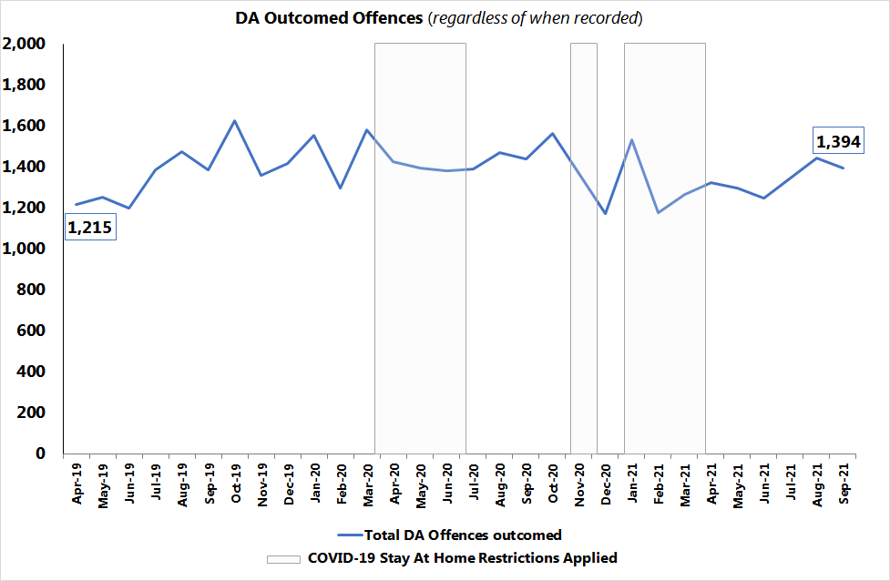
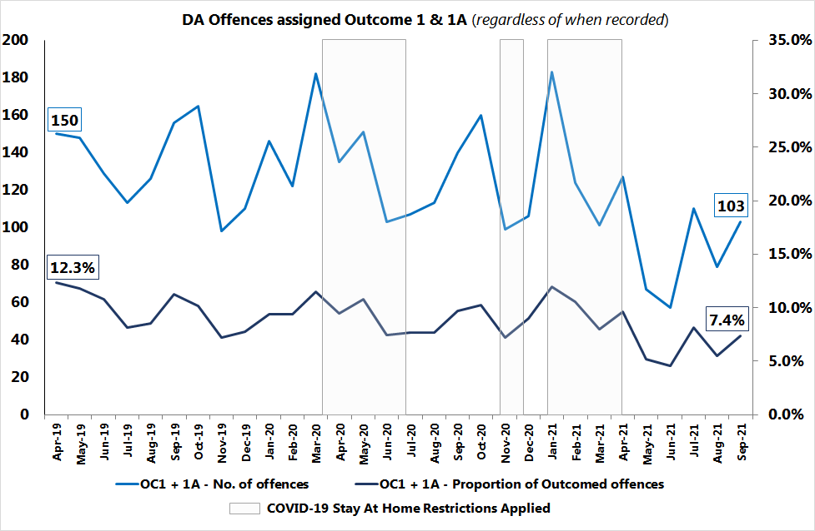
4. Delivering innovative, problem-solving practices and processes
4.2 Managing demand – policing priorities
Domestic Abuse Outcomes
DA Outcomed Offences
(regardless of when recorded)
‘Charge/ Summons’ Outcomed DA Offences (OC1 & 1A)
(regardless of when recorded)
Key Points
Total DA Offences outcomed: Upward monthly growth trend since February 21, despite the decrease in September 21.
‘Charge/ Summonsed’ offences: Ongoing variable downward monthly trend for Outcome 1. It is believed that the affect of the new CPS disclosure guidelines is still having a negative impact due to increased scrutiny, leading to significant amount of additional work for most files to achieve a positive outcome. A reduction in ‘Action Taken’ outcomes was anticipated.
Other ‘Action Taken’ outcomes have remained lower in Q2 2021/22 when compared to the same quarter two years ago (Appendix Two).
During the monthly SPI/ Crime Bureau meeting, no reports of emerging themes from the DDM’s. Two issues were raised:
  Continual lack of understanding regarding application of some Outcome results and work is still ongoing to try to improve this.
  Additional work is required in relation to Sgt/Supervisor reviews to ensure investigation are being managed and completed in a timely way.
Good looks
like:
Total DA Outcomes and Charge/ Summons measures:
  This has been reviewed but due to upcoming system changes, this will continue to be reviewed.
WDGLL has been reviewed and agreed by the subject lead.

Slide 30
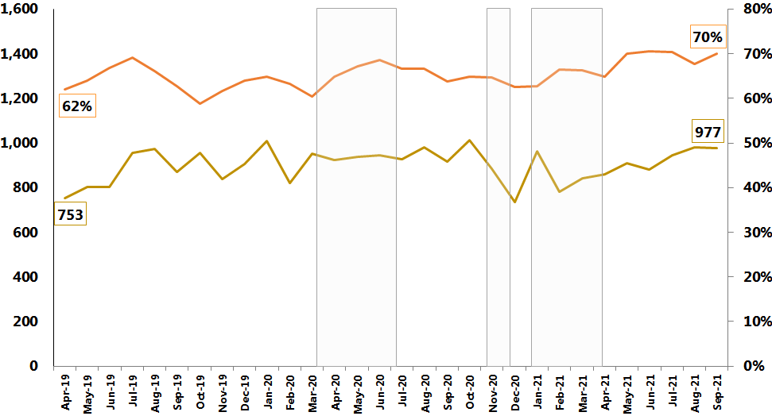
4. Delivering innovative, problem-solving practices and processes
4.1 Delivering effective core practices
Domestic Abuse Outcomes
Key Points
70% of all DA offences are assigned an Outcome 16 in September 21.
Since May 21, Outcome 16 monthly proportion rate levels have been exceeding 70%, despite the decrease in August 21. This is the highest levels ever seen for Outcome 16.
Based on current levels, it is highly probable that the monthly proportion rate for Outcome 16 offences will remain high over the coming months.
Outcome 17 - Prosecution time limit expired: Suspect identified - remains a cause for concern due to a 73% increase (+27) in offences in Q2 2021/22 when compared to the same quarter two years ago (refer to Appendix Two).
  An Outcome audit has been commissioned which will include a review of Outcome 17 offences.
‘Evidential difficulties prevent further action; victim does not support police action’ Outcomed Offences (OC16)
(regardless of when recorded)
Evidential difficulties prevent further action; victim does not support police action
A reduction in the volume and proportion of offences assigned an Outcome 16 result.
Good
looks
like:
Prosecution time limit expired offences
A reduction in the volume and proportion of offences assigned an Outcome 17 result.
Quarterly results for all Outcomes types are featured in Appendix Two
WDGLL has been reviewed and agreed by the subject lead.

Slide 31
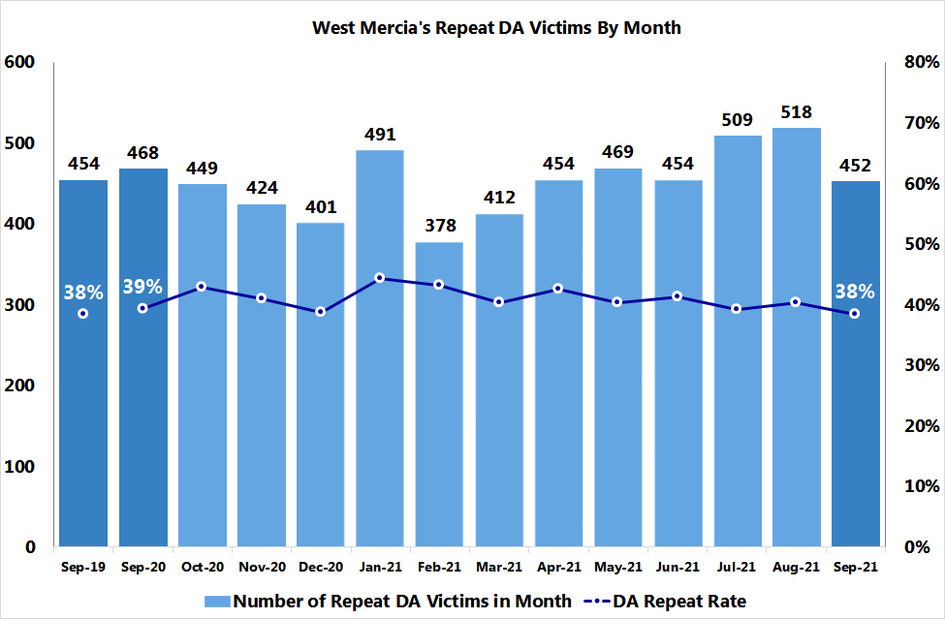
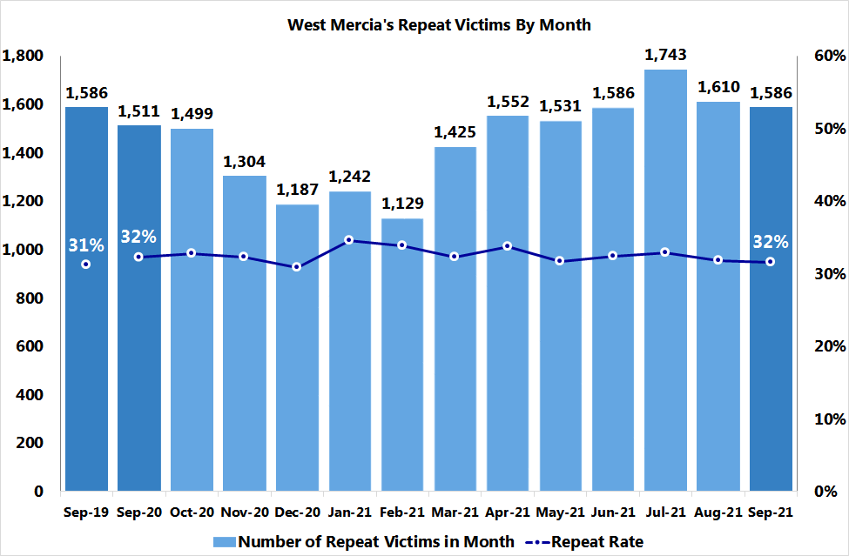
4. Delivering innovative, problem-solving practices and processes
4.2 Managing demand – policing priorities
A repeat victim is defined as an individual recorded as a victim in the current reporting month that has had at least one other offence in the preceding 12 months.
Repeat Victimisation
Repeat Domestic Abuse Victims per Month
Key Points
September 21 has seen a decrease in both the volume and repeat rate of Repeat victims for both total recorded crime and domestic abuse compared to the previous two months of July 21 and August 21.
Monthly repeat rates:
  Domestic Abuse repeat rate - 38% to 41%.
  Total Recorded Crime repeat rate – 32% to 34%
In September 21, a new Repeat Victim Segmentation model was launched to provide LPA Commanders, Early Intervention/Prevention teams, Problem Solving Hubs and SNT teams with a monthly tactical overview of high/low harm repeat ‘Victim’ nominals based on all crime types in their area, to inform policing and safeguarding activities.
This new activity has replaced the previous High Harm repeat nominal report during the Covid-19 pandemic to cover all crime types again based on the concept of recency, frequency and severity of offences for repeat victims.
Increased financial pressures on households could lead to a rise in domestic abuse and total recorded crime recording over the coming months, so it is highly probable that repeat volumes will increase too. These financial pressures are linked to the end of the Furlough scheme, the decrease of Universal credit and the increased costs of food, fuel and energy set against the backdrop of the upcoming Christmas period.
Repeat Victims per Month
This data is generated from Athena where a ‘Domestic Abuse’ crime keyword has been applied.
Good
looks
like:
Repeat TRC & DA Victims:
A reduction in ‘high frequency/ high severity’ repeat victims and a decrease in repeat rates
WDGLL has been reviewed and agreed by the subject lead.

Slide 32
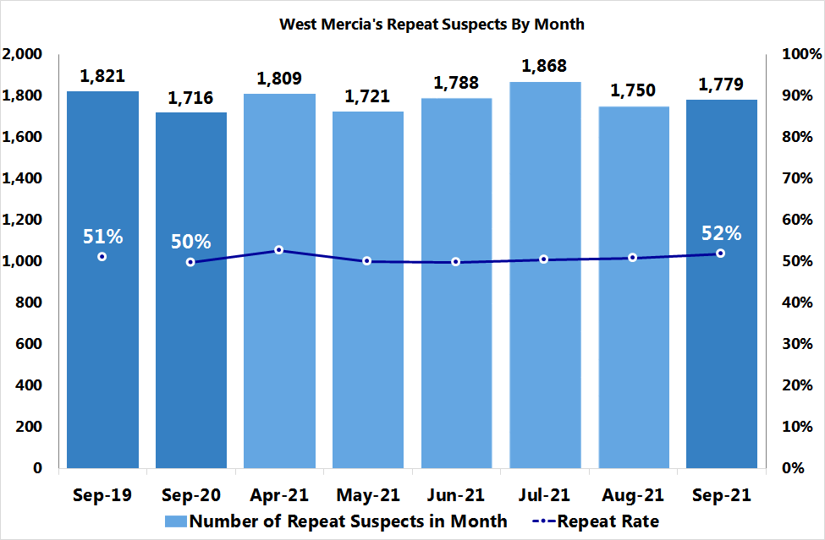
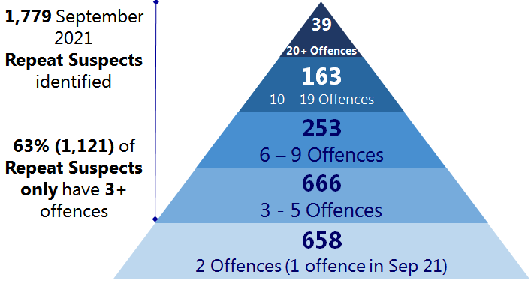
4. Delivering innovative, problem-solving practices and processes
4.2 Managing demand – policing priorities
A repeat suspect is defined as an individual recorded as a suspect in the current reporting month that has had at least one other offence in the preceding 12 months.
Recidivism
Key Points
Over the last 3 months, there has been an increase in the rate of Repeat suspects from 50% to 52% despite the lower numbers of Repeat Suspects in September 21 compared to July 21.
2% decrease in the number of Repeat Suspects in September compared to the same month two years ago.
This information is circulated across Problem solving teams, SMT/ Tasking and Local Policing commanders covering all crime types on a monthly basis to replace the previous high harm offence activity. A similar Repeat segmentation approach will be adopted moving forward, once user feedback from the victim model has been reviewed.
Increased financial pressures on households could lead to a rise in domestic abuse and total recorded crime recording over the coming months, so it is highly probable that repeat volumes will increase too. These financial pressures are linked to the end of the Furlough scheme, the decrease of Universal credit and the increased costs of food, fuel and energy set against the backdrop of the upcoming Christmas period.
Good looks like:
Repeat TRC & DA Suspects:
Less serial/ repeat DA offenders.
Decrease in ‘recurring’ repeat TRC suspects
Decrease in repeat rates
WDGLL has been reviewed and agreed by
the subject lead
Repeat Suspects per Month
55% (970) of the 1,779 Repeat Suspects are ‘Repeat Suspects’ Only in terms of their role type.
The remaining 45% (809) of Repeat Suspects are also linked to offences where their role type is classified as ‘victim’, during the last 12 months.

Slide 33
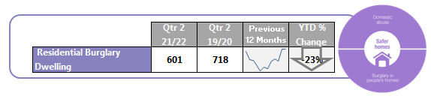
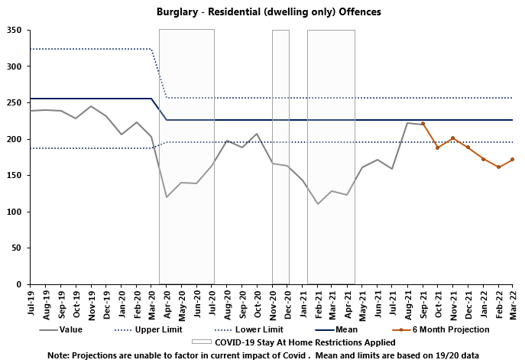

4. Delivering innovative, problem-solving practices and processes
4.2 Managing demand – policing priorities
Residential Burglary Dwelling – Policing Priority
Key Points
Residential Burglary Dwelling features despite being below the lower control limit due to being a Policing Priority.
Volumes in Residential Burglary Dwelling increased by 32% (154) compared to the previous quarter but remains 26% (117) lower than the same quarter two years ago.
It is probable that an volumes will raise in Q3 2021/2022 due to many returning to the office, alongside continued working from home.
Good looks like:
Residential Burglary Dwelling:
25% reduction in a post-Covid operating environment.
WDGLL is being reviewed with the subject lead.
The upper and lower control limits are derived by calculating 2 points of Standard Deviation from the mean.

Slide 34
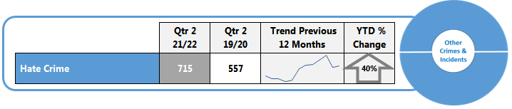

4. Delivering innovative, problem-solving practices and processes
4.2 Managing demand – policing priorities
Hate Crime & Crimed Incidents – Policing Priority
This data is generated from Athena where a hate crime keyword has been applied.
Key Points
Volumes of Hate Crime and Crimed Incidents has very similar volumes (+7) when compared to the previous quarter and a 28% (158) increase on the same quarter two years prior, exceeding the upper control limit.
July represented a high volume month, likely as a result of restrictions lifting and a return of night time economy.
It is highly probable that as the impact of these factors subside, a reduction in volumes will be observed as numbers have fallen since July.
Good looks like:
Hate Crimes & Crimed Incidents: Increased reporting
We also need to use the correct markers to ensure the right people are directed to these incidents and so dealt with appropriately.
WDGLL is being reviewed with the subject lead.
The upper and lower control limits are derived by calculating 2 points of Standard Deviation from the mean.

Slide 35


4. Delivering innovative, problem-solving practices and processes
4.2 Managing demand – policing priorities
Vulnerable Adult Crimes & Crimed Incidents
Key Points
Vulnerable Adult crimes and crimed incidents saw an 5% (226) decrease on the previous quarter and a 10% (359) increase on the same quarter 2 years prior and exceed the upper control limit.
Projections indicate a decrease in coming months, however it is probable that volumes will remain above the mean.
Good looks like:
Vulnerable Adult Crimes & Crimed Incidents: Increased reporting
We also need to use the correct markers to ensure the right people are directed to these incidents and so dealt with appropriately.
Demand work and significant efforts to manage partners and other professional bodies who create demand, alongside problem solving hubs, a centre of excellence and greater emphasis and resources put into tackling mispers and mental health issues will all contribute towards a reduction in incidents and demand.
However, a move towards dynamic and immediately accessible social media platforms by June 2021, on which contact can be made, will likely see a rise in demand.
WDGLL is being reviewed with the subject lead.
This data is generated from Athena where a “vulnerable” keyword has been applied.
The upper and lower control limits are derived by calculating 2 points of Standard Deviation from the mean.

Slide 36

4. Delivering innovative, problem-solving practices and processes
4.2 Managing demand – policing priorities
Child At Risk Crimes & Crimed Incidents – Policing Priorities
This data is generated from Athena where a keyword marker has been applied. This can relate to any crime type where a child is present
Key Points
Child at Risk crimes and crimed incidents saw a 12% (769) decrease on the previous quarter and a 1% (66) increase on the same quarter two years ago.
Child At Risk Crimes & Crimed Incidents: Increased reporting
Good looks like:
We also need to use the correct markers to ensure the right people are directed to these incidents and so dealt with appropriately
WDGLL has been reviewed and agreed by the subject lead.
Volumes are currently within the control limit region. As anticipated, volumes decreased substantially over the school summer holidays.
Shropshire makes up 21% (1229) of total crimes and crimed incidents, and South Worcestershire account for 23% (1341), while North Worcestershire and Telford & Wrekin account for 21% (1229) and 19% (1109) respectively. Herefordshire makes up 14% (803).
Leading offence category descriptions are Assault without Injury, Assault With Injury and Malicious Communications.
It is probable that volumes will increase in the coming months as children return to school.
The upper and lower control limits are derived by calculating 2 points of Standard Deviation from the mean.

Slide 37




4. Delivering innovative, problem-solving practices and processes
4.2 Managing demand – crime types that exceeded the upper control limit
4. Delivering innovative, problem-solving practices and processes
4.2 Managing demand
Other Sexual Offences
Public Order Offences
36% (232) of all offences relate to Sexual Assault on a Female Aged 13 and Over, with a further 19% (120) related to Sexual Activity Involving a Child Under 16.
A significant proportion of offences at 38% (242) of all OSO are non-recent. The increase has been anticipated and is likely to be a result of historic offences over the lockdown periods being reported. However since Q1 there has been a 6% decrease in the proportion of non-recent offences.
In September 22% (13) of offences that took place between 22:00 and 06:00 appear to be linked to the night time economy. This is a decrease from 36% (19) in August.
* Offences with a start time of 00:00 and 00:01 have been removed due to likely incorrect recording.
70% (1493) of all Public Order Offences are Public Fear, Alarm or Distress. Followed by 18% (385) Other Offences (Against the State and Public Order).
As anticipated when considering the reopening of the night time economy and good seasonal weather, public order offences have been sustained at high volumes. However it is projected that levels will decrease over the coming months back down towards the mean.
The upper and lower control limits are derived by calculating 2 points of Standard Deviation from the mean.

Slide 38







4. Delivering innovative, problem-solving practices and processes
4.2 Managing demand – policing priorities
Serious Organised Crime
Key Points
38 Disruptions – the lowest number recorded since Q1 2020/21 and a 24% reduction on the previous quarter.
97% of all disruptions this quarter were positive.
Disruptions for Q2 2021/22 have driven in the main by activity occurring in Telford & Wrekin and South Worcestershire.
6 additional disruptions added to Q1 2021/22 bringing a total of 50 disruptions - these were not included in reporting last quarter due to a change in ROCTA cut off dates.
Currently 28 active OCGs – down from 31 in March 2020.
69% of OCGs (including active and archived OCGs) have a primary crime type of drugs supply.

Slide 39




4. Delivering innovative, problem-solving practices and processes
4.3 Innovating and improving
Aspiration:
West Mercia to establish a position in the top National quartile of 43 forces, in regards to having the fewest Open recommendations, AFIs and Causes of concern
Good looks like:
Current Status of HMICFRS Inspections
Number of Recommendations
Number of Areas for Improvement
Number of Causes of Concern
Monthly Point-in-Time Readings
Age of West Mercia’s Recommendations, AFIs and Causes of Concern (Oct 21)
Key Points
There has been a significant reduction in numbers of recommendations across the board as HMICFRS have decided to close the 17 recommendations from the 2014 undercover policing report pending the investigation reaching its conclusions, at which point HMICFRS will reconsider how to address the findings.

Slide 40





5. Delivering a skilled, sustainable workforce in a constantly learning and improving environment
5.1 Establishing a skilled, flexible workforce
Good looks like:
Under national average
Under 10% for PCSOs
Attrition – No. of Leavers
Figures based on national average
West Mercia has a higher 12 month attrition rate than the national average for both Police Officers (6.6%) and Police Staff (10.9%)
PCSO 12 month attrition rates stands at 10.4%, substantially lower than the 16.9% national average.
Overall leaving numbers up 23% on Q1.
Police Officer leavers up 4.8% on Q1, Police Staff Leavers up 59% on Q1.
Exit Interviews completed for 44% of leavers in Q2. It is essential that is increased in order to gain more intelligence on reasons for departing. Staff (63%) have a much higher completion rate than officers (20%).
67% (6) of all those completed for Police Officers leaving reason was attributed to Personal/family reasons.
48% (21) of Police Staff leavers that completed the exit interview left the organisation to pursue career development opportunities.
Specials are the only employee group with a general downward trend in turnover.
WDGLL has been reviewed and agreed by the subject lead.
*The above represents new starters and does not reflect overall change in the month

Slide 41


5. Delivering a skilled, sustainable workforce in a constantly learning and improving environment
5.1 Establishing a skilled, flexible workforce
Good looks like:
Police Staff Wellbeing
Police Staff and Officer sickness levels below the Most Similar Group average (previous year).
This derived from I Quanta data which was updated in September 2021.
WDGLL has been reviewed and agreed by the subject lead.
Staff sickness Q2 2021/2022 saw on average a 1.35% increase on Q1 2021/2022. August and September scoring above ‘what good looks like’.
The reduction of covid absences has been offset by an increase in absences relating to respiratory conditions partially related to the unlocking of various measures on July 19 and the spreading of colds.
It is probable that with the continuing ease of national restrictions, these volumes will fluctuate, covid sickness and self isolation will therefore continue to have to be monitored going forward.
Police Officer Wellbeing
Officer sickness in Q2 2021/2022 saw on average a 2.1% increase on Q1 2021/2022. All three months scoring above ‘what good looks like’.
Covid absence has seen a month on month increase for Police officers in Q2. This together with an increase in absences relating to respiratory conditions partially related to the unlocking of various measures on July 19 and the spreading of colds has resulted in an overall month on month increase in overall sickness.
However it is likely that the ease of national lockdown restrictions may increase the infection rate within WMP communities.

Slide 42
5. Delivering a skilled, sustainable workforce in a constantly learning and improving environment
5.3 Establishing appropriate available tools
WDGLL has been reviewed and agreed by
the subject lead
Good looks like:
Reduction:
Avoidable accidents
Fleet
Accidents in force vehicles
Key Points
Whilst ‘Own Fault’ accounts for 48% of all accidents in the previous month this accounts for just over £1,000 of damage.
‘Own Fault’ accidents have been on a downward trend since April 2021.

Slide 43

Appendix One
Action Taken Outcomes – Quarterly Trends
Outcome Focus
Volume and Proportion of total outcomed offences by Outcome result
(regardless of when they were recorded)

Slide 44

Appendix One
Prosecution prevented or not in the public interest Outcomes – Quarterly Trends
Outcome Focus
Volume and Proportion of total outcomed offences by Outcome result
(regardless of when they were recorded)

Slide 45

Appendix One
Evidential Difficulties & Other Outcomes – Quarterly Trends
Outcome Focus
Volume and Proportion of total outcomed offences by Outcome result
(regardless of when they were recorded)
Evidential Difficulties (suspect identified; victim supports action):
Evidential Difficulties (victim does not support action):
‘Investigation Complete – No Suspect’:
‘Other’ Outcome results:

Slide 46

Appendix Two
Action Taken DA Outcomes – Quarterly Trends
Outcome Focus
Volume and Proportion of total outcomed DA offences by Outcome result
(regardless of when they were recorded)
This data is generated from Athena where a ‘Domestic Abuse’ crime keyword has been applied.

Slide 47

Appendix Two
Prosecution prevented or not in the public interest DA Outcomes – Quarterly Trends
Outcome Focus
Volume and Proportion of total outcomed DA offences by Outcome result
(regardless of when they were recorded)
This data is generated from Athena where a ‘Domestic Abuse’ crime keyword has been applied.

Slide 48

Appendix Two
Evidential Difficulties & Other DA Outcomes – Quarterly Trends
Outcome Focus
Volume and Proportion of total outcomed DA offences by Outcome result
(regardless of when they were recorded)
Evidential Difficulties (suspect identified; victim supports action):
Evidential Difficulties (victim does not support action):
‘Investigation Complete – No Suspect’:
‘Other’ Outcome results:
This data is generated from Athena where a ‘Domestic Abuse’ crime keyword has been applied.

Slide 49

Please forward any feedback in relation to this report to SPIPerformance@westmercia.pnn.police.uk

