Slide 1

West Mercia Police
Quarterly Performance Monitoring Report
January - March 2022
Purpose
The purpose of this product is to provide a monthly update to current and emerging performance issues relating to West Mercia.
GSC Level | Official
Date of publication | April 2022
Product Reference | SPI/2022/110
Version | Final
Purpose | Overview of Force Performance
Author | Performance Team, Strategy, Planning and Insight
Owner | DCC J. Moss
Handling Instructions:
This document must be handled and stored according to the Government Security Classifications guidance.
Neither the document nor any of its contents may be disseminated further without the permission of the Information Asset Owner.

Slide 2
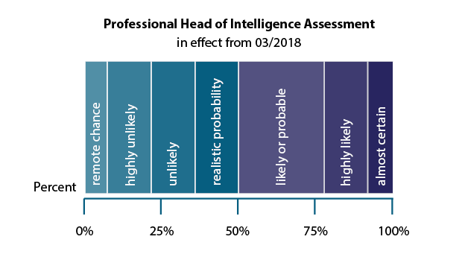
Introduction
The purpose of this report is to reflect a force wide picture of performance, specifically the keys issues faced by the force, particularly in relation to force priorities and key practices.
This report focusses on Gold level key performance indicators (KPI). The number of measures in this report will continue to be refined to ensure that they are key performance indicators.
Some indicators are under development and so do not feature as of yet.
Projections have been included in this report, however, it should be noted that due to their basis on volumes in previous years the impact of COVID-19 is likely to distort the projections. Factoring the impact of COVID-19 within projections continues to be reviewed.
Each metric is measured against ‘What Does Good Look Like’. They are set at the start of each financial year in consultation with the subject lead and only reviewed during the year following a change in reporting or process.
The Probability Yardstick is a scale used within the report to demonstrate broad ranges of
certainty or uncertainty to create consistent language and as a measure of the likelihood of
achieving ‘What Good Looks Like’ within the desired timescale.

Slide 3
West Mercia Police provides a quality policing service, protecting people from harm. We are visible and open to all, inspiring everyone to take pride in and feel ownership of their service.
Gold Balanced Scorecard
2021-2022
1. Delivering a high quality, consistent service to the public
2. Delivering an
efficient service
3. Delivering an ethical service
OUTCOMES
1.1 Delivering
victim
satisfaction
1.2 Creating
public
confidence
1.3 Handling complaints effectively and efficiently
1.4 Meeting The Victims Code
2.1 Delivering service to the agreed budge?
3.1 Delivering our
service legally and
within regulations
3.2 Meeting our corporate environmental responsibility
CONTROLS
4. Delivering innovative, problem-solving practices and processes
ACTIVITIES
4.1 Delivering effective core practices
4.2 Managing demand
4.3 Innovating and improving
5. Delivering a skilled, sustainable workforce in a constantly learning and improving environment
ASSETS
5.1 Establishing a skilled,
flexible workforce
5.2 Establishing high quality,
accessible knowledge
5.3 Establishing appropriate,
available tools
Public First Compassionate Courageous Ownership Inclusive

Slide 4
Summary
Strategic Objective | Key | Key Performance Question | KPI Ref | Key Performance Indicator | Police and Crime Plan |  | WDGLL for that section (made up of subsections) | Update | Likelihood of achieving What Good Looks Like by intended date | Page No
Delivering a high quality, consistent service to the public | 1.1 | To what extent are we delivering victim satisfaction? | 1.1.1 | % of victims satisfied with service | Putting victims and survivors first | 2 | Victims Completely / Very Satisfied DA - 80% Burglary - 80% Violent Crime - 70% Hate Crime - 70% | Rolling 12 months DA - 74% - 1% increase on previous Burglary - 71% - 1% decrease on previous Violent Crime - 60% - same as previous Hate Crime - 65% - 1% increase on previous | 25% - 35% Unlikely | 11
 | 1.2 | To what extent are we creating public confidence? | 1.2.1 | % of respondents that agree or strongly agree they have confidence in local policing | Reassuring West Mercia’s Communities | 38 | Public Confidence at 88% or over | Rolling 12 months 82% - 2% decrease on previous | 25% - 35% Unlikely | 14
 | 1.3 | How well are we handling complaints effectively and efficiently? | 1.3.1 | Volume of complaints from the public |  |  | Consistent progress towards aspirational target of 75% Outside Schedule 3 | Month on month, the number of recorded complaints continues to remain stable. | 95%-100% Almost certain | 15
 |  |  | 1.3.2 | % of complaints upheld |  |  |  | Consistently exceeded ‘What Good Looks Like’ over the previous six months.
 | 1.4 | How well do we meet The Victims Code? | 1.4.1 | Compliance with the Victims’ code (Inc. timeliness of updates etc.) | Putting victims and survivors first | 1 | Increase referrals to 25% of victim-based crime by April 2022. | Year end - 24.7% | 40% - 50% Realistic possibility | 16

Slide 5
Summary
Strategic Objective | Key | Key Performance Question | KPI Ref | Key Performance Indicator | Police and Crime Plan |  | WDGLL for that section (made up of subsections) | Update | Likelihood of achieving What Good Looks Like by intended date | Page No
Delivering an efficient service | 2.1 | To what extent is the service being delivered for the agreed budget? | 2.1.1 | % variance from budgeted expenditure |  |  | Remain within budget for financial year. | Figures not yet published. The end of year figures will be available in May 2022. | 55% - 75% Likely or probable | N/A
 |  |  | 2.1.2 | Assessment of financial position
Delivering an ethical service | 3.1 | To what extent are we delivering our service within legal and regulatory frameworks? • How robust is our management intervention? | 3.1.1 | % of staff who have completed mandatory training |  |  | 80% complete within time limit. | Managing Information - 90% Data Protection - 63% | 55% - 75% Likely or probable | 17
 |  |  | 3.1.2 | Freedom of Information and Subject Access Requests compliance |  |  | 90% complete within time limit. | FOI rate 59% SAR rate stable at 31% | 10% - 20% Highly unlikely | 18
 |  |  | 3.1.3 | Crime data integrity inspections |  |  | N/A | Audit on ASB carried out - 59% (24) crimes missed | Not applicable | 19
 |  |  | 3.1.4 | Internal CDI audits |  |  | N/A | Stalking & Harassment Audit - 17 of crimes missed. | Not applicable | 20

Slide 6
Summary
Strategic Objective | Key | Key Performance Question | KPI Ref | Key Performance Indicator | Police and Crime Plan |  | WDGLL for that section (made up of subsections) | Update | Likelihood of achieving What Good Looks Like by intended date | Page No
Delivering innovative, problem-solving practices and processes | 4.1 | How well does WMP bring offenders to justice? | 4.1.1 | % of positive action | Building a more secure West Mercia | 7 | An increase in the volume and proportion of offences assigned an Outcome 1 or 1A result. | 7.5% - slight increase compared to previous month | 55% - 75% Likely or probable | 21
 |  |  | 4.1.2 | Reduction in use of Outcome 16 ‘Evidential difficulties prevent further action; victim does not support police action’ |  |  | A reduction in the volume and proportion of offences assigned an Outcome 16 result. | 30% - Total Recorded Crime 62% - Domestic Abuse Both an increase on previous month | 40% - 50% Realistic possibility | 25
 |  | How well do we prevent crime? | 4.1.3 | Problem Solving Hub | Building a more secure West Mercia | 16 | Further 200 Staff to receive Problem Solving Training by end Sept 2022. |  | 40% - 50% Realistic possibility | 27
 |  |  | 4.1.4 | Suspected IOM re-offending data | Building a more secure West Mercia | 9 | To be determined | Increase in IOM suspect reoffending on previous month at 28% | To be assigned | 28
 |  |  | 4.1.5 | Volume / rate of repeat victimisation (including DA-specific victims) | Putting victims and survivors first | 5 | A reduction in ‘high frequency/ high severity’ repeat victims and a decrease in repeat rates. | Increase in Total Recorded Crime and Domestic Abuse repeat victim rates | 40% - 50% Realistic possibility | 29
 |  |  | 4.1.6 | Repeat DA offenders | Building a more secure West Mercia | 28 | A reduction in ‘high frequency/ high severity’ repeat suspects and a decrease in repeat rates. | Increase in Domestic Abuse repeat suspects rates | 40% - 50% Realistic possibility | 31
 |  | How well do we investigate crime? | 4.1.8 | Caseload and OIC Crime Baskets |  |  | An ‘optimum’ band is thought to be around 8,000-10,000 open investigations at current recording volumes | 10,673 Open investigations. A 1.2% decrease on previous month | 40% - 50% Realistic possibility | 32

Slide 7
Summary
Strategic Objective | Key | Key Performance Question | KPI Ref | Key Performance Indicator | Police and Crime Plan |  | WDGLL for that section (made up of subsections) | Update | Likelihood of achieving What Good Looks Like by intended date | Page No
Delivering innovative, problem-solving practices and processes | 4.2 | How does West Mercia ensure that public contact is managed effectively? | 4.2.1 | Volume of 999 calls | Reassuring West Mercia’s Communities | 40 | N/A | Highest volumes recorded since Oct 2021 | Not applicable | 36
 |  |  | 4.2.2 | Average call answer time for 999 calls | Reassuring West Mercia’s Communities | 40 | 90% answered within 10 seconds | 91% - Consistently above 90% over the previous six months | 95%-100% Almost certain
 |  |  | 4.2.3 | 999 Abandonment rate | Reassuring West Mercia’s Communities | 40 | N/A | 1.71% - a slight increase on previous month | Not applicable
 |  |  | 4.2.4 | Volume of 101 calls | Reassuring West Mercia’s Communities | 40 | N/A | Highest volumes recorded since November 2021. | Not applicable
 |  |  | 4.2.5 | Average call answer time for 101 calls | Reassuring West Mercia’s Communities | 40 | 80% answered within 30 seconds by June 2022 | 46% - continues to fluctuate. Lowest since October 2021. | 55% - 75% Likely or probable
 |  |  | 4.2.6 | 101 Abandonment rate | Reassuring West Mercia’s Communities | 40 | N/A | 21.11% - 3% increase on previous month. | Not applicable
 |  |  | 4.2.7 | Public demand via new platforms and technology | Reassuring West Mercia’s Communities | 41 | To be determined | 2183 - Highest recorded volumes. | To be assigned | 37
 |  |  | 4.2.8 | Response times by grade | Reforming West Mercia | 36 | To be determined when unit data is available | Work ongoing to progress data availability. | 0% - 5% Remote chance | 38
 |  |  | 4.2.9 | Unresourced | Reforming West Mercia | 37 | To be reviewed, meeting arranged for May. | Volumes on an upward trend since the start January 2022. | To be assigned | 38

Slide 8
Summary
Strategic Objective | Key | Key Performance Question | KPI Ref | Key Performance Indicator | Police and Crime Plan |  | WDGLL for that section (made up of subsections) | Update | Likelihood of achieving What Good Looks Like by intended date | Page No
Delivering innovative, problem-solving practices and processes | 4.2 | How well does WMP manage crime? | 4.2.10 | Volume of ASB incidents | Building a more secure West Mercia | 10 | N/A | Continued decrease from the high volumes recorded during lockdown. Year end - 9% decrease on 19/20 | Not applicable | 39
 |  |  | 4.2.11 | Volume of mental health incidents | Putting victims and survivors first | 6 | N/A | Volumes fluctuating. Year end - 35% decrease on 19/20 | Not applicable
 |  |  | 4.2.12 | Volume of Total recorded crime | Building a more secure West Mercia | 21 | N/A | Continued increase in volumes, Year end - inline with 19/20 | Not applicable
 |  |  | 4.2.13 | Volume of rural crime | Building a more secure West Mercia | 17 | To be determined | Proposal for force definition made. | To be assigned | 45
 |  |  | 4.2.15 | National policing measures: - Homicides; | Building a more secure West Mercia | 11 | N/A | Increasing trend: 6 offences in Q4 compared with 4 in Q3 of 2021 – 2022. Also remaining consistently higher than previous years. | Not applicable | 47
 |  |  | 4.2.16 | National policing measures: - Serious Violence (Inc. knife crime /gun crime); | Building a more secure West Mercia | 12 | N/A | 8 offences involving discharge of a firearm in 2020-21 (most 2 a month) Hospital admissions for assault with a sharp object are fewer than 8 each month – only detail shared. Six of these months have had none (last 2 years). Data has not been released for Q4 yet. | Not applicable
 |  |  | 4.2.17 | National policing measures: - Drug-related homicides / CLs; | Building a more secure West Mercia | 13 | N/A | 2 drug-related homicides in last two years. None in the latest quarter. | Not applicable

Slide 9
Summary
Strategic Objective | Key | Key Performance Question | KPI Ref | Key Performance Indicator | Police and Crime Plan |  | WDGLL for that section (made up of subsections) | Update | Likelihood of achieving What Good Looks Like by intended date | Page No
Delivering innovative, problem-solving practices and processes | 4.2 | How well does WMP manage crime? | 4.2.18 | National policing measures: - Neighbourhood crimes (burglary, robbery, vehicle offences and theft from a person); | Building a more secure West Mercia | 14 | N/A | All crimes are reducing in last two years (burglary - domestic and commercial, robbery, vehicle crime, theft from person). However thefts of and from a vehicle have increased in the previous 2 quarters. Data is currently from PRC as the CSEW data does not offer enough detail. | Not applicable
 |  |  | 4.2.19 | National policing measures: - Cyber crime. | Building a more secure West Mercia | 15 | N/A | The data from the Dept. for Digital, Culture, Media and Sport is not available. Further police held proxy measures are being developed. | Not applicable
 |  |  | 4.2.20 | Volumes of Domestic Abuse | Building a more secure West Mercia | 20 | Increased reporting | Increase in volumes. DA Arrest rate inline with previous month at 31%. | 40% - 50% Realistic possibility
 |  |  | 4.2.21 | Volumes of Residential Burglary |  |  | 25% reduction in a post-COVID operating environment | Continued increase in volumes. Year end - 9% increase on 19/20. | 0% - 5% Remote chance | 39
 |  |  | 4.2.22 | Volume of repeat Missing Persons |  |  | Reduce proportion of missing person incidents relating to repeat MISPERs | Increase on previous month but likely to increase in the summer months. | 40% - 50% Realistic possibility | 51
 |  | To what extent is WMP disrupting SOC? | 4.2.23 | Volume of SOC disruptions | Building a more secure West Mercia | 19 | To be determined | 29 Disruptions – predicted volume. | To be assigned | 52
 |  | How effective is WMP's activity to make the roads safer? | 4.2.24 | Volume of people killed | Building a more secure West Mercia | 32 | KSI: A sustained 5% reduction on 19/20 | Overall, increase on very low volumes recorded previous month as anticipated. | 25% - 35% Unlikely | 53
 |  |  | 4.2.25 | Volume of people seriously injured | Building a more secure West Mercia | 32 |  | Year end - 13% increase on 19/20.

Slide 10
Summary
Strategic Objective | Key | Key Performance Question | KPI Ref | Key Performance Indicator | Police and Crime Plan |  | WDGLL for that section (made up of subsections) | Update | Likelihood of achieving What Good Looks Like by intended date | Page No
 | 4.3 | To what extent are we improving the practices and processes that we undertake? | 4.3.2 | Volume and Average age of outstanding HMICFRS recommendations |  |  | We establish a position in the top National quartile of 43 forces, re having the fewest Open recommendations, AFIs and Causes of concern. | During the last 3 months, decrease in West Mercia numbers but national/ MSG average numbers have remained stable. | 10% - 20% Highly unlikely | 54
Delivering a skilled, sustainable workforce in a constantly learning, improving environment | 5.1 | To what extent are we developing our teams to ensure we have the required skills? | 5.1.1 | Mandatory Courses |  |  | Over 85% Completion rate for eLearning training courses | 44% (8) of all eLearning courses (18) have not reached the 85% completion rate. | 40% - 50% Realistic possibility | 55
 |  | How well does WMP manage staff and officer absence rates? | 5.1.4 | % police officer absence |  |  | Absence Levels below previous year Most Similar Group average. | Highest rates ever recorded. | 0% - 5% Remote chance | 56
 |  |  | 5.1.5 | % police staff absence |  |  | Absence Levels below previous year Most Similar Group average. | Highest rates ever recorded. | 0% - 5% Remote chance
 |  |  | 5.1.7 | Attrition rates |  |  | Better than national average attrition rates | Attrition rates continue to be above national average for Officers and Staff | 40% - 50% Realistic possibility | 57
 |  | Is a WMP a representative workforce? | 5.1.8 | Representative workforce |  |  | Women’s Representation at 50%, and 3.8% Ethnic Minority Representation in line with local community representation from Census. | Black, Asian and Other Ethnic Minority representation - Lower than national Female - Higher than national | 40% - 50% Realistic possibility | 58
 | 5.3 | To what extent do we have the most effective tools? | 5.3.2 | ICT managed assets | Reforming West Mercia | 33 | Develop Reporting Capabilities | This is a new area of reporting that is being developed. There are currently 2939 tickets and 136 work packages open. | To be assigned | 59
 |  |  | 5.3.3 | System availability and ICT outages | Reforming West Mercia | 34 | Develop Reporting Capabilities | In Q4 22/23 a total of 8918 issues were reported. | To be assigned
 |  |  | 5.3.4 | Fleet - Expenditure on accidents |  |  | Reduction in ‘Own Fault’ accidents. | Volume of ‘Own Fault’ accidents continues to fluctuate. | 0% - 5% Remote chance | 60

Slide 11
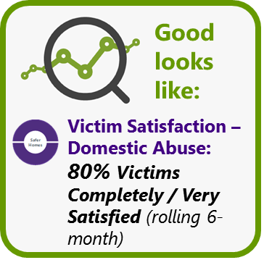
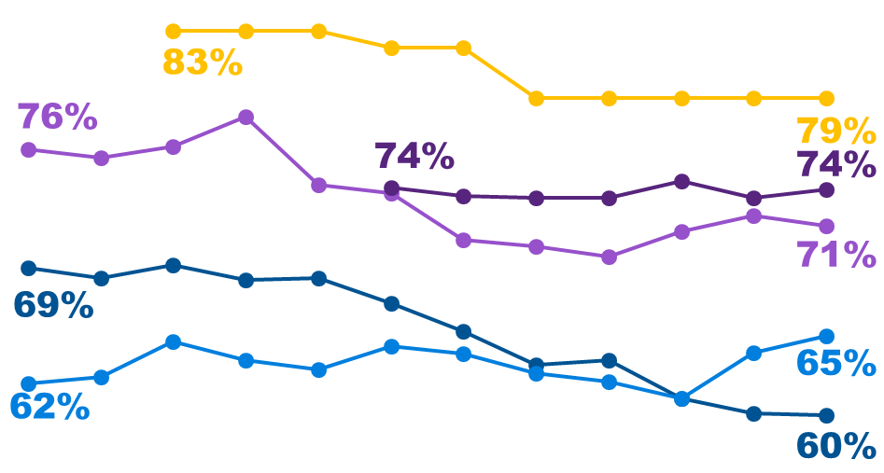

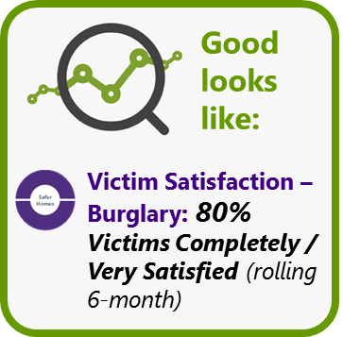

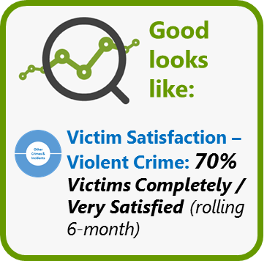


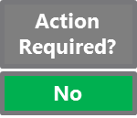
Delivering a high quality, consistent service to the public
1.1 To what extent are we delivering victim satisfaction? - Burglary, Violent, Hate
Number of victims spoken to:
Survey targets were not met during Quarter 4 due to staff abstractions and ICT issues.
Satisfaction Headlines
- None of the aspirational satisfaction levels have been achieved this financial year-end.
- Violent crime satisfaction levels have decreased at a statistically significantly level during the 2021/22 financial year, with a latest figure of 60% against the aim of 70%.
- Burglary satisfaction has decreased markedly this financial year, although this decrease is not statistically significant.
- Hate crime satisfaction has increased this financial year, although this increase is not statistically significant. Satisfaction levels continue to vary markedly by Local Policing Area.
- There has been no change in Domestic Abuse satisfaction since reporting began in September 2021.
Completely or Very Satisfied
(Rolling data (burglary and violent = 6 months rolling; hate crime = 12 months rolling; DA and RTC, building up to 12 months rolling))
Satisfaction Trends: Context
While burglary and violent crime satisfaction show marked downward trends this financial year, the longer-term context should be considered. When considering data trends going back to the start of the previous financial year – April 20 – satisfaction levels have shown a slight increase in the case of burglary while violent crime satisfaction levels have shown negligible change. This is also the case when looking back further – to April 19 and April 18.
The decreases seen this financial year are as a result of marked rises seen in satisfaction during the period spanning January 21 to June/July 21 (this was particularly evident with violent crime), with sustained falls seen thereafter. It should be noted that, due to the use of rolling data and the delay between crime record creation and interviewing taking place, the high satisfaction levels seen during the first half of 2021 are a product of feedback from victims surveyed in the six/eight-month period prior to that (spring – winter 2020) during which time exceptional circumstances existed due to Covid and the associated lockdowns, the effect of which (in terms of the interplay between changes in levels of demand, staffing, workload, morale and public perception) are still not understood.
RTC
Burglary
DA
Violent
Hate
60%*
Apr 21
*Change is statistically significant
Mar 22
Victim Satisfaction: Governance
From March 22, new Victim Satisfaction governance arrangements were put into place, with this being provided by a monthly Tactical Satisfaction Review Panel, chaired by C/Supt Local Policing and attended by all LPA Supts., and a quarterly Strategic Satisfaction Board, chaired by ACC Jones.
What drives satisfaction and how can we improve it?
- Reassurance is the strongest single driver of satisfaction – first and foremost, this encompasses the ‘how’ (officer/ staff behaviour (empathy, compassion, understanding)) with process (e.g. keeping victims informed) being secondary. Analysis shows changes in reassurance over the time period shown above, generally correlate with changes in satisfaction levels.
- Dissatisfaction with being kept informed causes dissatisfaction with the overall experience. However, satisfaction with being kept informed, on its own, is not strongly correlated with overall satisfaction with the service received.
Next Steps / Recommendations
A consideration around the strategic victim satisfaction actions to be prioritised and progressed in 22/23 should take place at the first Strategic Satisfaction Board (5th May 22).

Slide 12
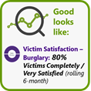
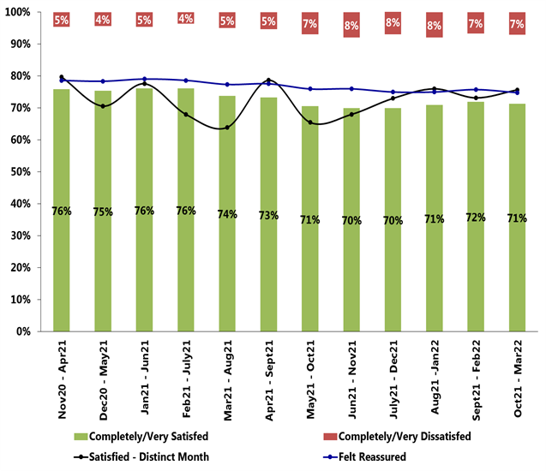
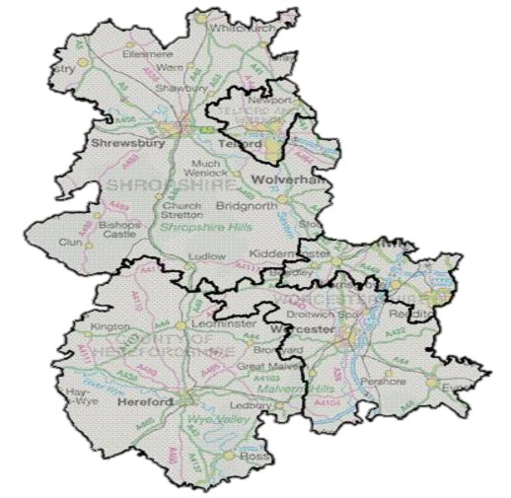
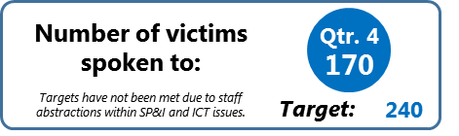
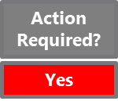

Delivering a high quality, consistent service to the public
1.1 To what extent are we delivering victim satisfaction?
Burglary Satisfaction Headlines
- The variation in burglary satisfaction existing between the five Local Policing Areas (LPAs) has decreased since last quarter, largely due to the increase seen in Shropshire (now 64%) alongside the decrease seen in Herefordshire (now 68%). Figures range from 64% (Shropshire) to 77% (Telford).
Burglary - LPA Performance
(Completely or Very Satisfied)
(Oct 21 – Mar 22)
Burglary - Force Performance
(Completely or Very Satisfied)
- At the financial year-end, none of the LPAs have achieved the aspiration of 80% satisfaction.
= change since end Qtr. 3
- Despite some marked changes in satisfaction between Quarters 3 and 4, none of these changes are statistically significant (it should be noted that statistical significance testing is affected by sample size which is low when analysing by LPA).
13%
64%
77%
10%
Next Steps / Recommendations
75%
2%
- Being managed through the monthly tactical Satisfaction Review Panel, a number of LPA-owned actions, which should support the delivery of enhanced victim satisfaction, were implemented in February 22. These include: prioritised Patrol attendance to residential burglary cases; reassurance follow up visit to victims within a week as a matter of course; issuing officers with WDBC aide memoire and reassurance process maps.
(Oct 21 – Mar 22)
71%
2%
11%
68%
72%
- A consideration around the strategic victim satisfaction actions to be prioritised and progressed in 22/23 should take place at the first Strategic Satisfaction Board (5th May 22).
Burglary satisfaction: latest learning and how we can improve it
- Due to the significant proportion that student officers comprise of the total officer establishment (as at December 21, over 50% of the victims spoken to through the satisfaction surveys had been dealt with by a student officer OIC, compared to 20% in September 19), SP&I have conducted in-depth analysis to identify any differences in satisfaction between victims having a student Vs non-student officer OIC. As at end December 21, there was an 8% satisfaction gap between these two groups in the case of burglary, with victims having student officer OICs having lower satisfaction; further, satisfaction levels for this cohort have declined significantly during the period Jan-Dec 21 while the same finding is not seen for victims where the OIC is a non-student officer. This finding will feed into the Strategic Satisfaction Panel chaired by ACC Jones.
What causes satisfaction…
What causes dissatisfaction…
“An officer arrived really swiftly within 15 minutes…[He] checked all the garden with his torch and went to speak to the neighbours, as well as advising us to get CCTV which we have. Although we decided to take NFA….the officer kept us fully informed and I understand that the parents were spoken to. The officer was really competent and reassuring.”
“Because we wanted practical advice in the moment, but didn't get any. They said they would send someone on three occasions that night when we called… I asked if there would be one out that week and she said “I can't say”. It was five days later when we saw someone from the local constabulary and the following day a woman came out, PC ****, with forensics and did a load of swabs. They said they found fingerprints, but we haven't heard anything about that since.”
“They…were nice, sympathetic and kind. I had a call from our local PCSO who said she would be coming by to check up on us and would put in extra patrols in the area, I found this really reassuring. I was not made to feel in any way that I was a nuisance.”
“The updates have been sparse, and since I made the second statement, I have not heard anything”

Slide 13
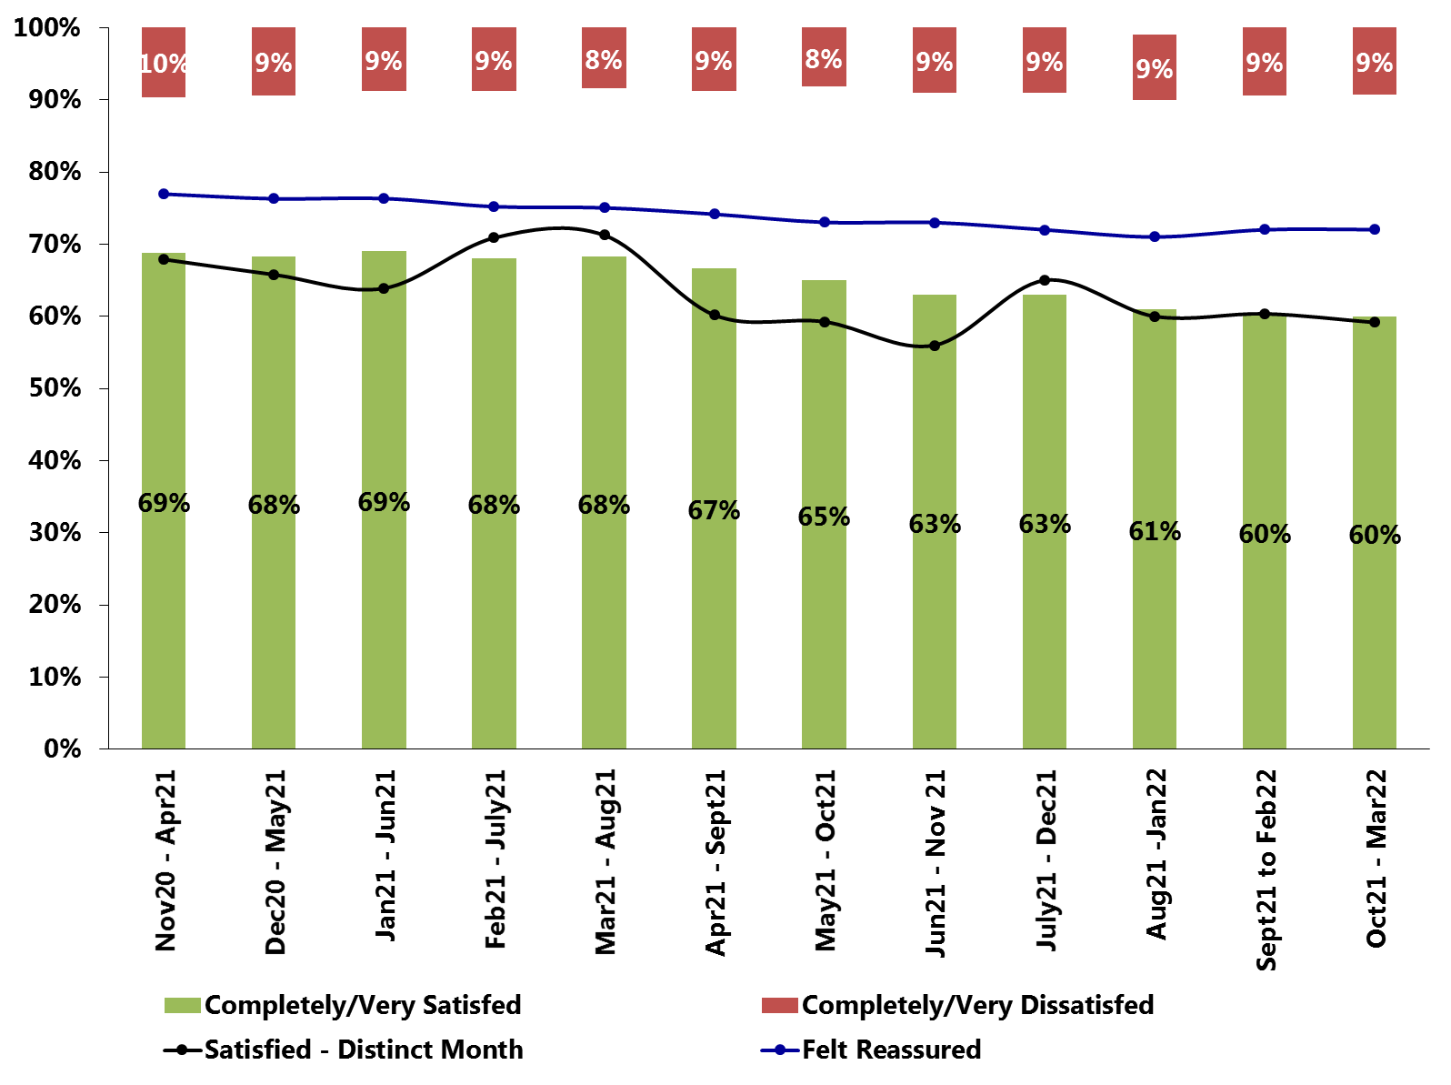
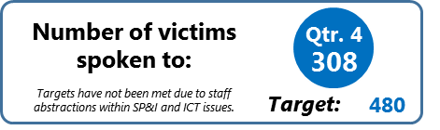
Delivering a high quality, consistent service to the public
1.1 To what extent are we delivering victim satisfaction?
Violent Crime Satisfaction Headlines
- The variation in violent crime satisfaction existing between the five Local Policing Areas (LPAs) has increased since last quarter, largely due to the decrease seen in Shropshire (although not significant) (now 51%); Herefordshire has the highest satisfaction levels (69%), albeit levels have fallen slightly since end December 21.
Violent - LPA Performance
(Completely or Very Satisfied)
(Oct 21 – Mar 22)
Violent - Force Performance
(Completely or Very Satisfied)
= change since end Qtr. 3
- At the financial year-end, none of the LPAs have achieved the aspiration of 80% satisfaction.
- Despite some marked changes in satisfaction between Quarters 3 and 4, none of these changes are statistically significant (it should be noted that statistical significance testing is affected by sample size which is low when analysing by LPA). However, the overall decreases in satisfaction seen across the force, and also in Shropshire, this financial year are statistically significant.
12%
51%
52%
7%
(Oct 21 – Mar 22)
60%
3%
60%
2%
Next Steps / Recommendations
- Being managed through the monthly tactical Satisfaction Review Panel, a number of LPA-owned actions, which should support the delivery of enhanced victim satisfaction, were implemented in February 22. These include: training and awareness delivered to all Patrol and SNT officers at the West Mercia CPD training sessions by L&D; violent crime victim focus and crime satisfaction feature at each monthly supervisor meeting held by C/Insps. with Insps. and Sgts.
3%
69%
64%
1%
- A consideration around the strategic victim satisfaction actions to be prioritised and progressed in 22/23 should take place at the first Strategic Satisfaction Board (5th May 22).
Violent crime satisfaction: latest learning and how we can improve it
- As per the previous slide, SP&I have conducted in-depth analysis to identify any differences in satisfaction between victims having a student Vs non-student officer OIC. As at end December 21, there was a 4% satisfaction gap between these two groups in the case of violent crime, with victims having student officer OICs having lower satisfaction; further, satisfaction levels for this cohort have declined significantly during the period Mar-Dec 21, while the same finding is not seen for victims where the OIC is a non-student officer. This finding will feed into the Strategic Satisfaction Panel chaired by ACC Jones.
What causes satisfaction…
What causes dissatisfaction…
“The officers arrived really quickly and made sure I was safe . The officers were patient with me as I was intoxicated and angry. The officers took me home which was reassuring. I felt they cared about me being safe.”
“I called 999 and the call handler said they would send someone out. I waited all night, but no one came. 24 hours later I had a call from an officer and he asked me to make a statement. I am a HGV driver and work all week in London, the officer said he would call me back on the Friday, but no one called and I have(n’t) heard anything since…”
“The officer was very kind, sympathetic, supportive and calming. The officer took the time to go through everything and explain things. It was reassuring that following the officer coming to see me, he went to see the suspect and arranged for the dogs to be removed that night.”
“What respect I had for the police has completely disappeared. I feel that I was treated like the person who had committed the crime. She (officer) seemed to be nit-picking at everything I said, rather than just listening to what I said and then responding. I felt that they (police) did not believe me.”

Slide 14

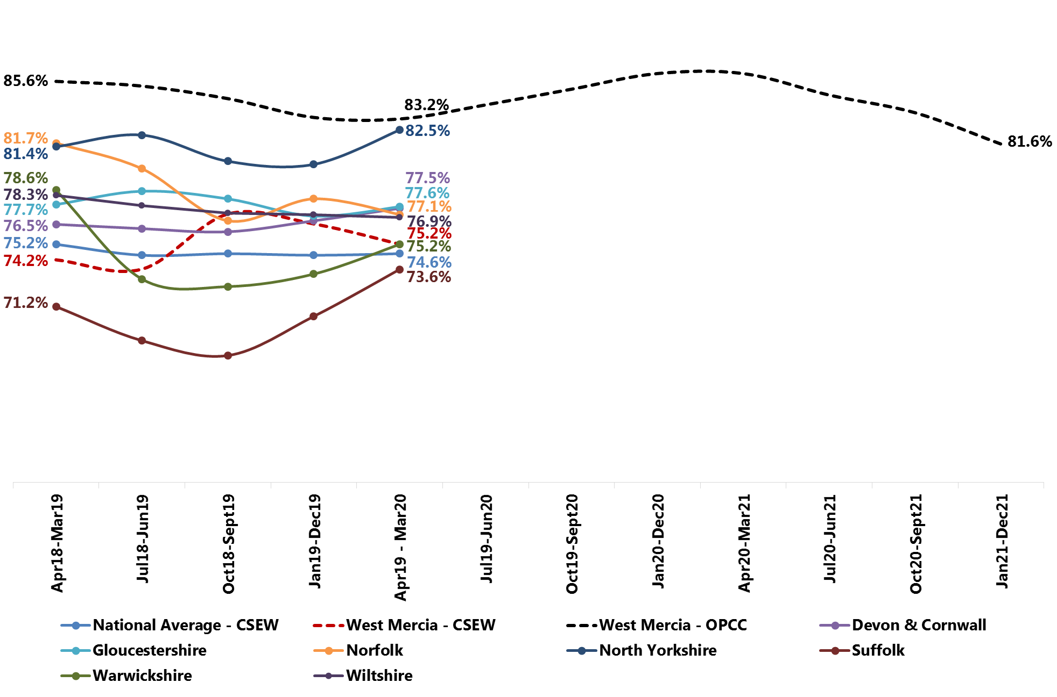
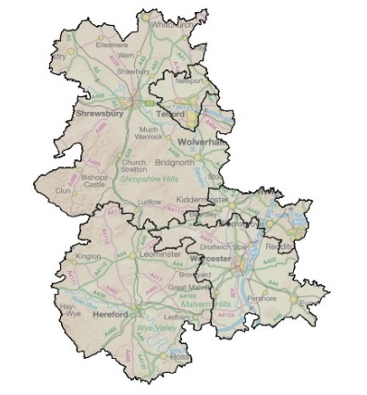
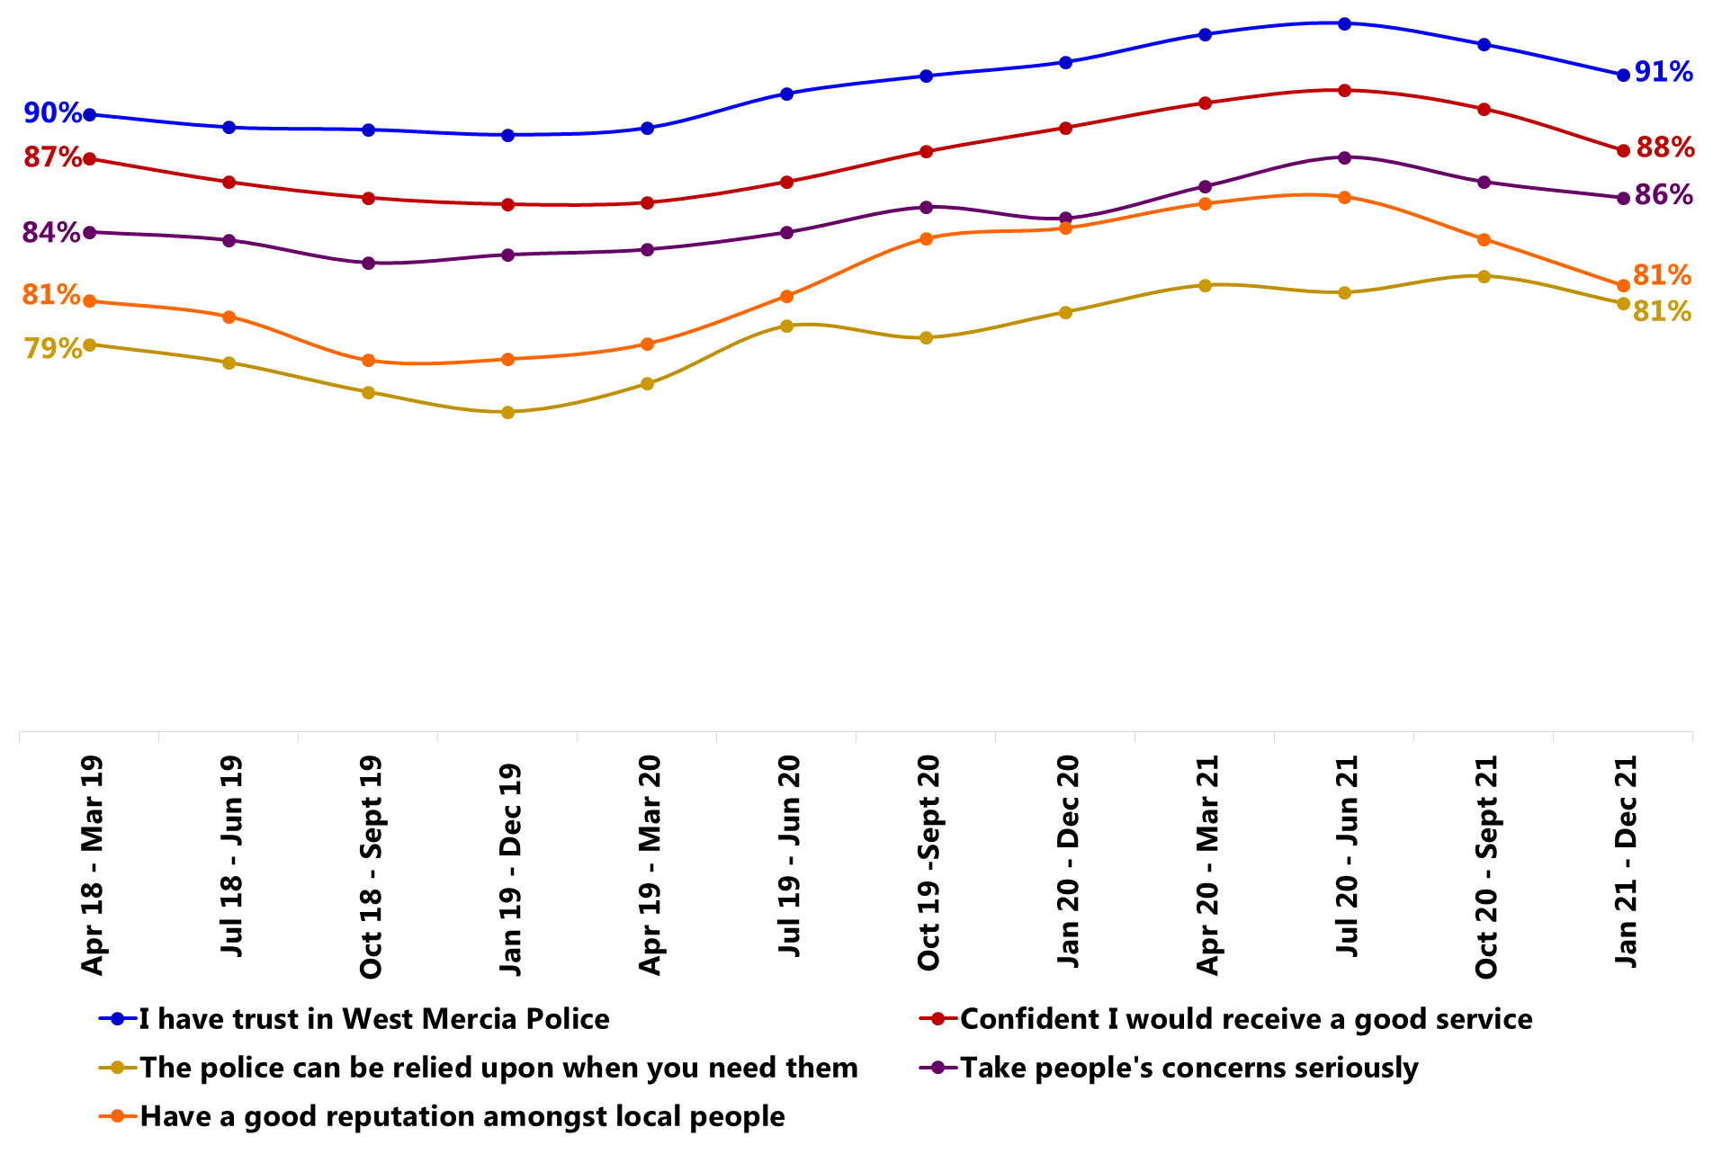
Delivering a high quality, consistent service to the public
1.2 Creating public confidence
Good looks like:
88%
Legitimacy – Requires Improvement
HMICFRS
27 Sept 2019
Confidence (Strongly Agree or Tend to Agree)
West Mercia data presented uses WMOPCC Perception Survey (rolling 12-months unless otherwise stated)
Trend Data
= change since end Qtr. 2
Discrete Quarter (Q3)
Rolling 12 months (Dec 21)
81%
The Crime Survey England & Wales survey has been suspended since March 20 due to Covid; the next set of results are expected to be available from April 22.
79%
76%
-6%*
82%
-2%*
86%
Confident
Confident
(Previous Quarter (Q2): 82%)
(Previous period: 84%)
82%
80%
*Change is statistically significant
Public Confidence Headlines
- As at end December 21, with a figure of 82%, the force is significantly below the aspirational figure of 88%.
- There has been a statistically significant reduction in public confidence this financial year – decreasing from 86% at end 20/21 – while levels have also decreased significantly since last Quarter. There is a remote chance that the force will achieve the 88% aim by the end of Quarter 4 21/22.
Public Confidence: LPA
West Mercia Public Confidence Board and Next Steps
-2%
- Compared to the previous Quarter, there have been no significant changes in public confidence by LPA.
- However, this financial year, South Worcestershire, Shropshire and Telford have all seen significant falls in public confidence (falling from 87%, 86% and 86% at end March 21, respectively).
Purpose of Board: Chaired by the DCC, the purpose of this new Board is as follows: to make building public confidence everyone’s business within West Mercia Police; to drive improvement in the confidence of those who live, work and visit within the West Mercia Police area; to coordinate activity to counter the local impact on confidence as a consequence of national / International events; to monitor, understand the drivers to confidence, report on trends in confidence levels and promote an evidenced based approach; to oversee public cooperation and encourage active citizen participation in policing within West Mercia Police; to ensure effective practice is captured both internally and from external sources and replicated across departments and LPAs.
-2%
0%
-3%
-1%
Confidence: Key Driver Diagnostics
Next steps include:
- Review the existing Confidence Strategy
- Review and refresh understanding around the drivers of public confidence
- Undertake analysis to understand reasons for falls in confidence this quarter and this financial year.
14

Slide 15
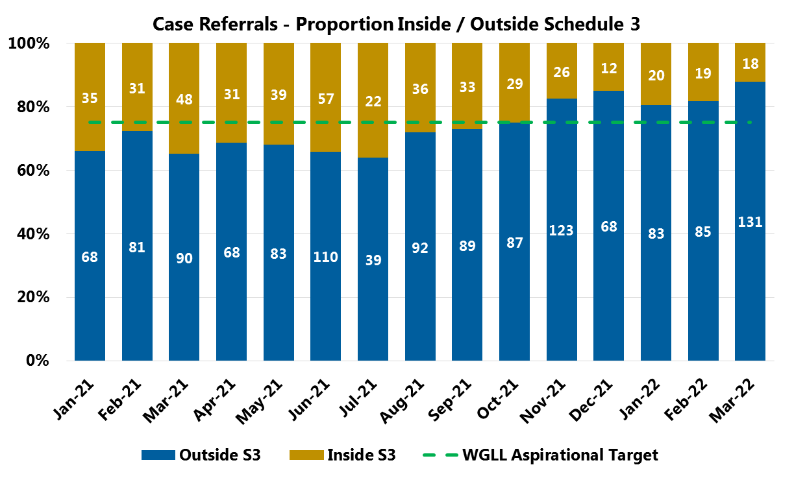

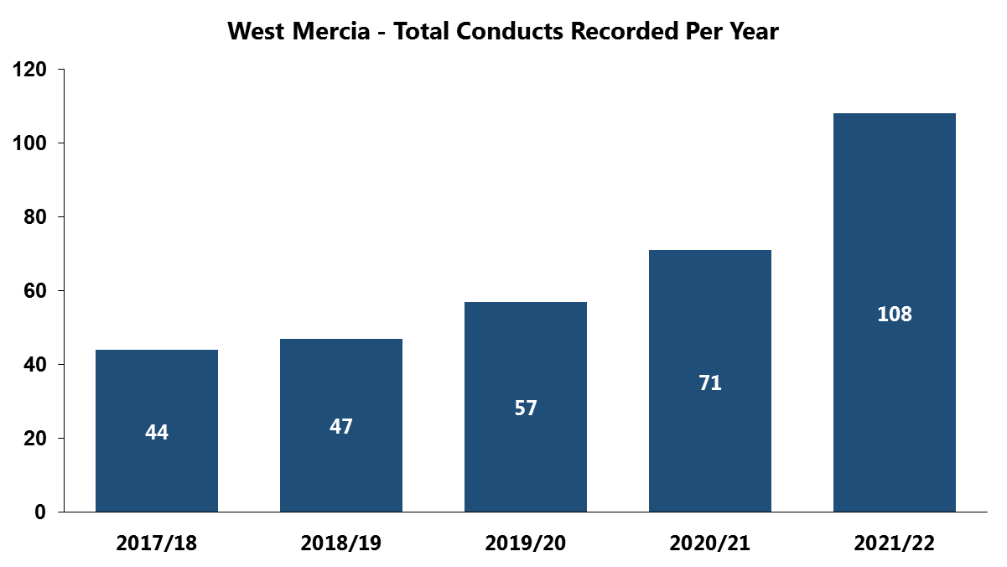
1. Delivering a high quality, consistent service to the public
1.3 How well are we handling complaints effectively and efficiently?
Key Points
Month on month, the number of recorded complaints continues to fluctuate; since December 2021, numbers recorded are steadily increasing, but have not exceeded the number of complaints recorded in June 2021.
During both Q3 and Q4, the proportion of complaints dealt with outside of schedule 3 exceeded ‘What Good Looks Like’ target.
Year on year increases in the raw number of recorded conducts are observed.
Good
looks like:
Consistent progress towards aspirational target of 75% Outside Schedule 3
Last reviewed by subject lead Oct 2021
What does this mean?
The key themes for the investigations recorded in the last 12 months are:
  Inappropriate Sexual/Suggestable Behaviour,
  Domestic Abuse, Abuse of Position for a Sexual Purpose,
  Dishonesty,
  Use of Force and
  Harassment.
Over the last 12 months, four members of staff have resigned under investigation and were subsequently dismissed and an additional six serving officers/members of staff were dismissed at misconduct hearings/meeting.
Next Steps / Recommendations
Action Required?
Continued to be monitored.
No

Slide 16
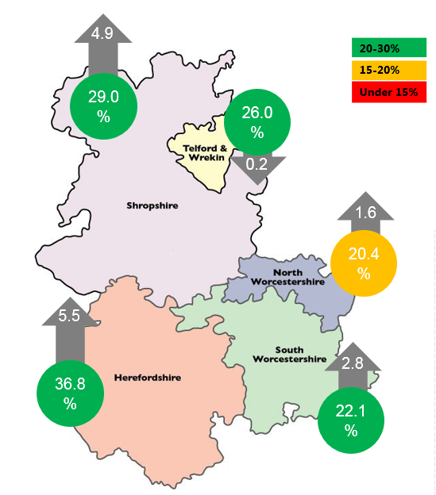

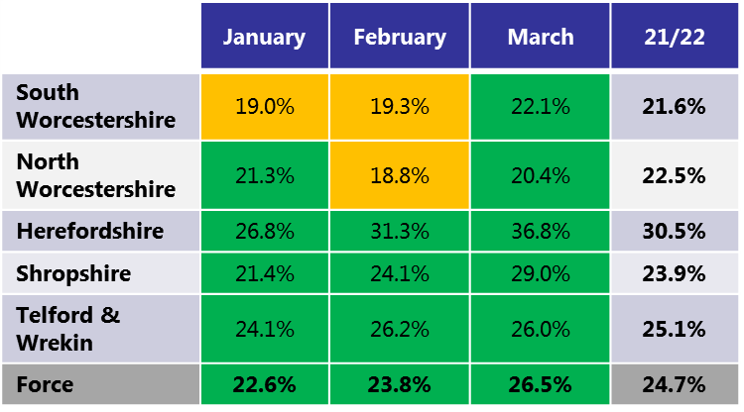
1. Delivering a high quality, consistent service to the public
1.4 How well do we meet The Victims Code?
Good
looks like:
Key Points
VAL referrals as a percentage of Victim-Based Crime are at 26.5% for last month, above What Good Looks Like Target
Cumulative Referral Rates for 21/22 are marginally below What Good Looks Like at 24.7%.
Increase referrals to 25% of victim-based crime by April 2022.
Last reviewed by subject lead April 2021
Next Steps / Recommendations
Develop focus to not just look at volume of
referrals but also quality.
Action Required?
Yes

Slide 17
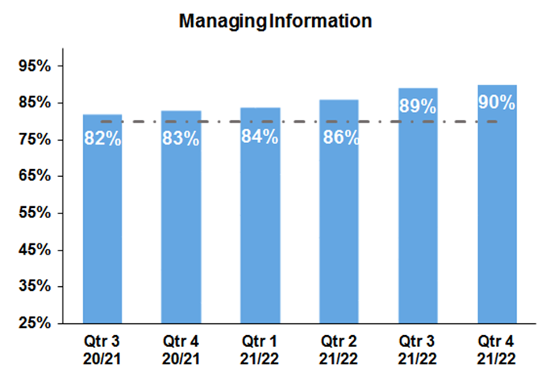
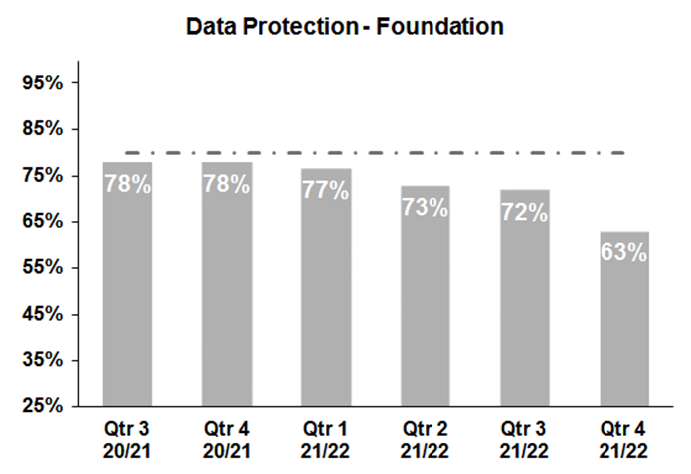

3. Delivering an ethical service
3.1 Delivering our service legally and within regulations
3.1.1 Completion of Mandatory Training
What does this mean?
Managing Information has seen a small increase in Q4 by one percentage point compared to Q3 to 90%.
Managing information training has been above ‘good looks like’ for a full year.
What does this mean?
Data Protection – Foundation has substantially decreased by 9 percentage points, following a gradual decrease below ‘what good looks like’ over the previous 3 quarters.
This is looked at in greater detail in section 5.1.1.
Good
looks like:
Good
looks like:
Training: 80% complete within time limit
Training: 80% complete within time limit
Next Steps / Recommendations
Continued to be monitored.
WDGLL has been reviewed and agreed by the subject lead
Next Steps / Recommendations
Recommend that a reminder is sent out to
to employees with out of date training and
their line managers.
Action Required?
Action Required?
WDGLL has been reviewed and agreed by the subject lead
No
Yes

Slide 18
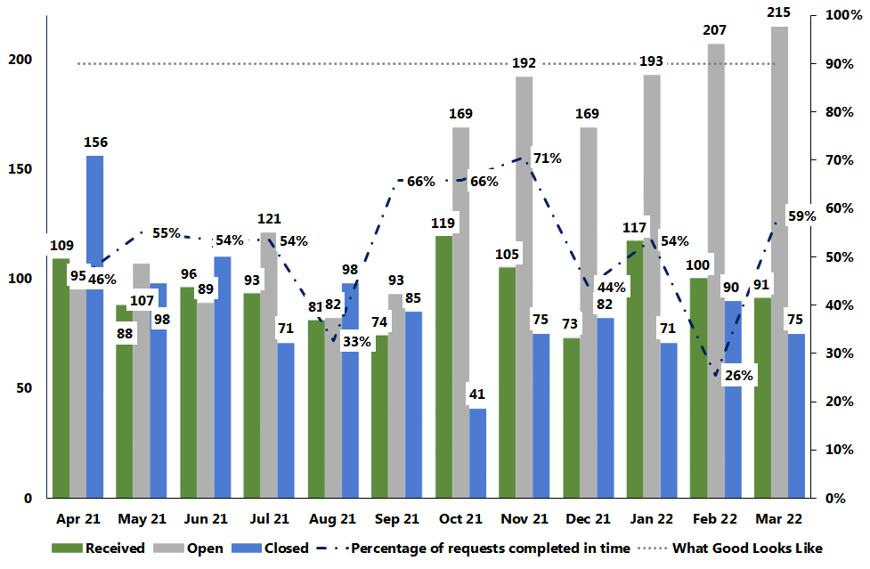
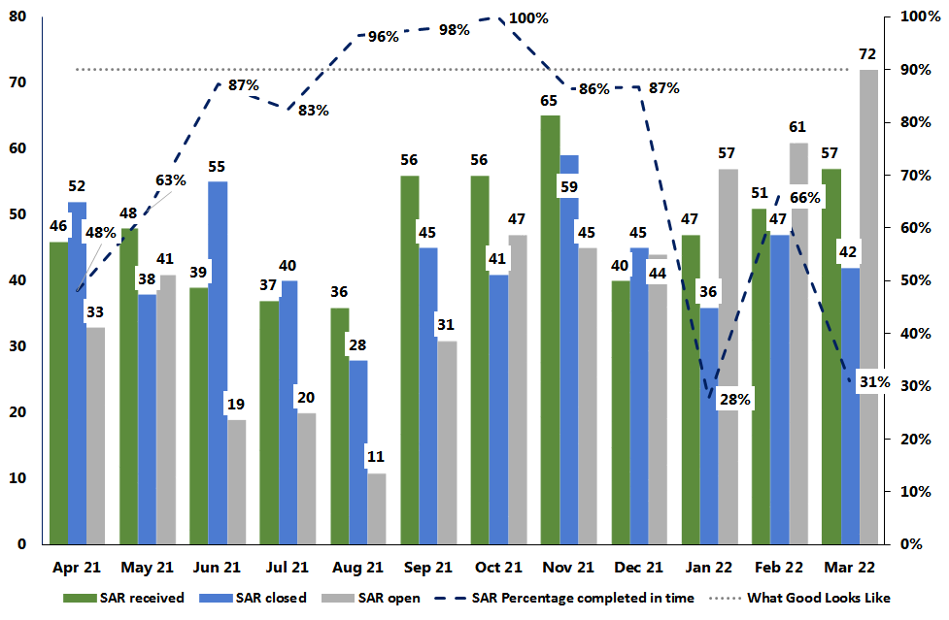


Delivering an ethical service
3.1 Delivering our service legally and within regulations
Timely response to Subject Access Requests
3.1.2 Freedom Of Information and Subject Access Request compliance
Timely response to Freedom of Information Requests
What does this mean?
There has been an decrease of 9% (9) in FOIs received last month compared to the previous month.
Decrease of 25% (25) in FOIs closed, but an increase of 91% (21) in FOIs closed within 20 days.
Open FOIs increased by 4% (8); the fourth consecutive month of increases.
Increasing complexity of requests resulting in taking longer to complete.
Demand management has been implemented where justified.
What does this mean?
The percentage of SARs completed on time has decreased by 35 percentage points to 31% in March from February.
Number of SARs received have increased by 12%(6).
Numbers closed and those closed within the deadline have decreased by 11% (5) and 58% (18) respectively.
Increasing complexity of requests resulting in taking longer to complete.
Demand management has been implemented where justified.
Good
looks like:
Good
looks like:
Requests: 90% complete within time limit
Requests: 90% complete within time limit
Next Steps / Recommendations
WDGLL has been reviewed and agreed by the subject lead
Next Steps / Recommendations
WDGLL has been reviewed and agreed by the subject lead
Action Required?
Action Required?
Action plan is in place to address backlog.
Continued to be monitored.
Continued to be monitored.
No
No

Slide 19
Delivering an ethical service
3.1 Delivering our service legally and within regulations
Key Points
Compliance is below the aspired 90%.
58% of crimes were recorded correctly in the first audit. This decreased to 41% in the most recent audit.
Missing crimes - x8 Harassment (neighbours), x1 Common Assault, x4 Malicious Communications, x8 Public Order and x3 Criminal Damage.
During February the number of Safe logs closed as ASB fell to 127 compared to 265 in January – this is significant & correct direction of travel.
New CR Malicious Communications and Public Order opening codes on Safe have been created allowing for greater scrutiny in the OCC which has resulted in 31% increase in Safe logs resulting in a crime being recorded as these crime types.
3.1.3 Crime data integrity inspections
ASB audits - 1st May 2021 – 28th February 2022
1st May 2021 – 31st August 2021
1st October – 31st December 2021
1st January – 28th February 2022
297
220
130
Incidents Reviewed
Incidents Reviewed
Incidents Reviewed
143
89
41
Required a Crime
Required a Crime
Required a Crime
83
50
17
What does this mean?
Updated aide memoirs have been provided to all Public Contact staff.
There has been increased supervisory scrutiny in Public Contact for ASB.
ASB or Crime training package planned to progress in May to provide on-line learning with assessment and monitoring of completeness.
LPA & Ops to support the ASB / Public Order Action Plan.
FCR internal ASB audits will re-commence April.
Crimes Recorded
Crimes Recorded
Crimes Recorded
60
39
24
Crimes Missed
Crimes Missed
Crimes Missed
Good looks like:
Next Steps / Recommendations
CDI Audits: 90% compliance or above on crime recording for CDI audits in general
(HMICFRS).
  Force Crime Registrar to ensure that key issues are shared with local policing areas.
Action Required?
Yes

Slide 20
Delivering an ethical service
3.1 Delivering our service legally and within regulations
3.1.4 Internal CDI audits
Key Points
For Stalking & Harassment, 93% of crimes were recorded correctly, however only 53% were recorded within 24 hours.
Of 100 Safe logs opened as Stalking, Harassment or Domestic Abuse, 50 required a crime, of which 40 (80%) crimes were recorded, of which 8 (20%) were recorded within 24hrs.
  Missing 10 crimes = x5 Stalking, x2 Harassment, x2 Malicious Communications, x1 Breach of Non-Molestation order.
There were 32 incidents where a diary appointment had been booked this delayed the recording of crime by over 24hrs meaning only 20% of incidents were recorded within compliance.
32 out of 47 crimes classified as Harassment which were DA partner on partner should have been classified as Stalking.
In 74 crimes the victim had responded positively to DASH Q.8, “Does (name) constantly text, call, contact, follow, stalk or harass you?”4 crimes had been missed, an improvement compared to 27 missed in previous audit.
1 out of 7 crimes audited as an ‘included classification’ (within the body of another crime) crime of Controlling Coercive Behaviour was missed.
Out of 14 Breach of Orders, 23 required a crime, of which 22 crimes were recorded. 1 crime of Stalking was missed. Multiple breaches can come from one order.
Stalking and Harassment Audit – January 2022
Stalking and Harassment Audit
242
Incidents Reviewed
238
Required a Crime
221
=93%
What does this mean?
Many officers (incl. Supervisors) do not know the difference between Stalking & Harassment and the heightened risk to victims subject to Stalking.
  CDI SPOCs to re-inforce this message
  CDI 10 Top Things covers this subject
Training has been provided to all Public Contact staff.
IMU are to scrutinise DASH Q.8 and create a crime where one should have been created but missed.
Student Officer training includes this subject, however 0 of the 38 student officers with nearly 12 months service asked said they were aware that course of conduct crimes are recorded as Stalking where its partner on partner.
Crimes Recorded
116
=53%
Recorded within 24 Hours
CDI Audits: 90% compliance or above on crime recording for CDI audits in general (HMICFRS).
Next Steps / Recommendations
Action Required?
Good
looks like:
  Ensure that there will be appropriate safeguarding for victims from Stalking predators in instances where IMU changes Harassment to Stalking.
Yes

Slide 21
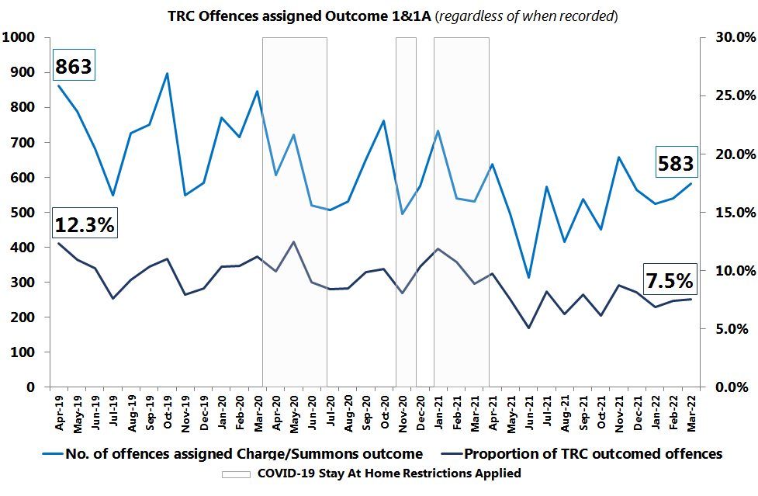

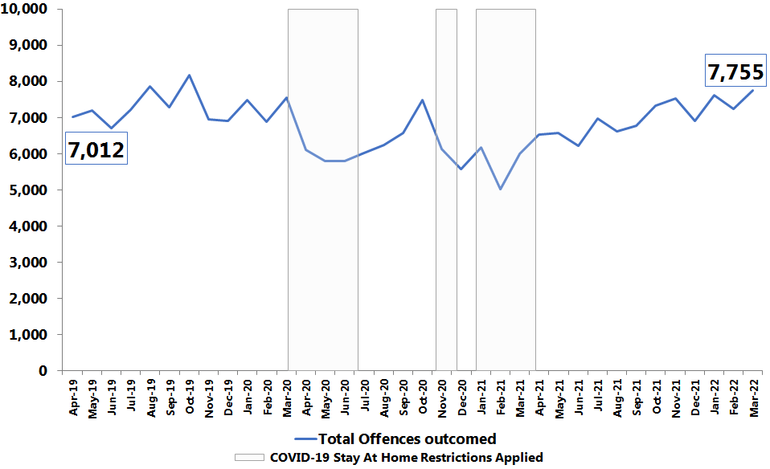
4. Delivering effective prevention and intervention
4.1 How well does West Mercia Police bring offenders to justice?
‘Charge/ Summons’ Outcomed Offences (OC1 & 1A) (regardless of when recorded)
4.1.1 % of positive action
Key Points
Usage of Charge/Summons has increased for the second month running, with the monthly outcomed proportion rate at 7.5% (583) for March 22; an increase of 0.1 percentage points.
Monthly view – 7.5% consists of:
  6.2% - Outcome 1 - Charge/ Summonsed
  1.4% - Outcome 1A - Charge/ Summonsed - alternate offences.
The volume increase is driven by a 11% rise in Outcome 1 from 432 offences in February 22 to 478 offences in March 22.
In contrast, the number of Outcome 1A offences have remained relatively stable from February 22 to March 22.
Total offences outcomed: 7% (503) increase on the previous month, and it is the highest monthly volume (7,755) seen since October 19, higher than January 22’s peak (7,619).
Good
looks like:
An increase in the volume and proportion of offences assigned an Outcome 1 or 1A result.
Last reviewed by subject lead Oct 2021
What does this mean?
Crime Bureau monthly input – There is no longer a Designated Decision Maker (DDM) backlog assisted by the DDM team now being at full establishment strength. As of 12th April , the Crime Bureau are at RAG rating ‘green’ with 44 crimes awaiting outcome.
It is probable that outcoming levels will continue to increase as:
  DA Deployment trial has been rolled out across all policing areas and regularly reported upon, with the aim of improvements in ‘positive outcome’ levels (Charge/Summons).
  Local Policing Area Outcome Action Plans and Op Riverport policing initiatives continue to be reinforced and will be influencing factors.
  Staff abstraction returns to normal over time. Current levels have been high from Covid/ Respiratory sickness or self isolation, as a result, current outcoming levels could have been even higher.
TRC Outcomed Offences (regardless of when recorded)
Next Steps / Recommendations
No comparison to MSG, National view or other Athena forces at this time due to differing data/counting rules.
This will change with the launch of ‘Clean and Relevant’ crime data universe
Action Required?
Continued focus on action plan delivery and continued monitoring via Crime Management Board.
No

Slide 22
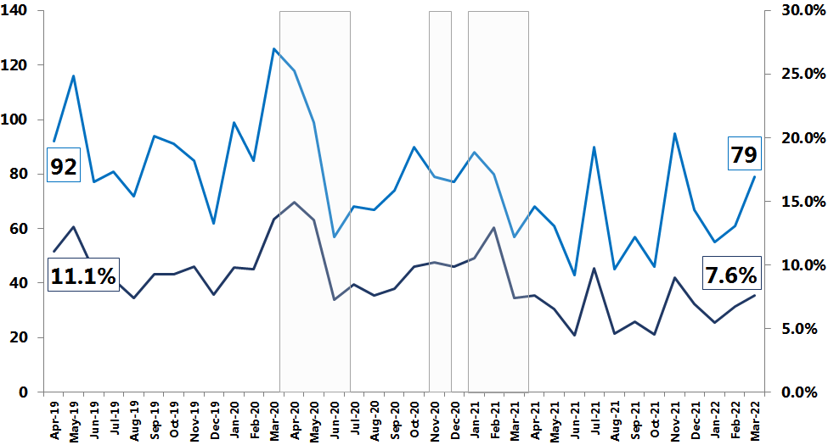
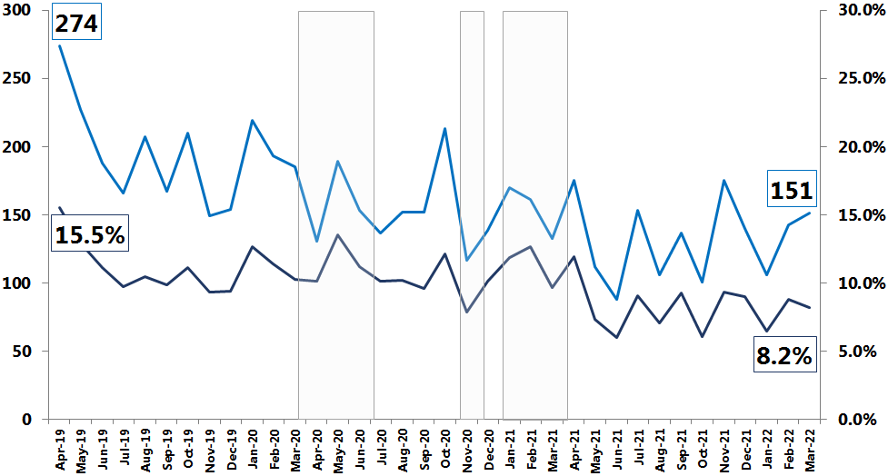
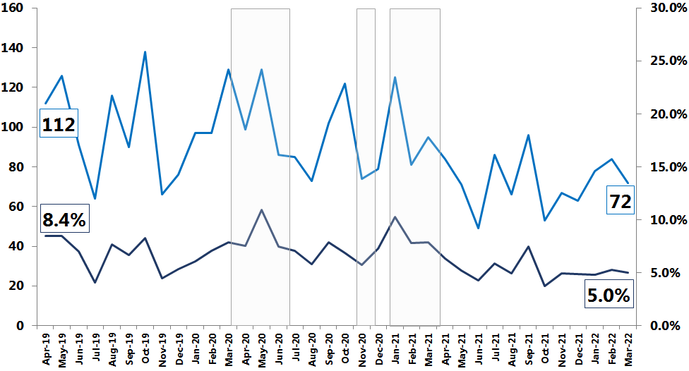
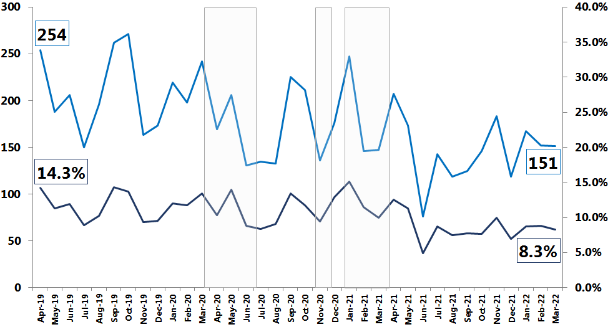
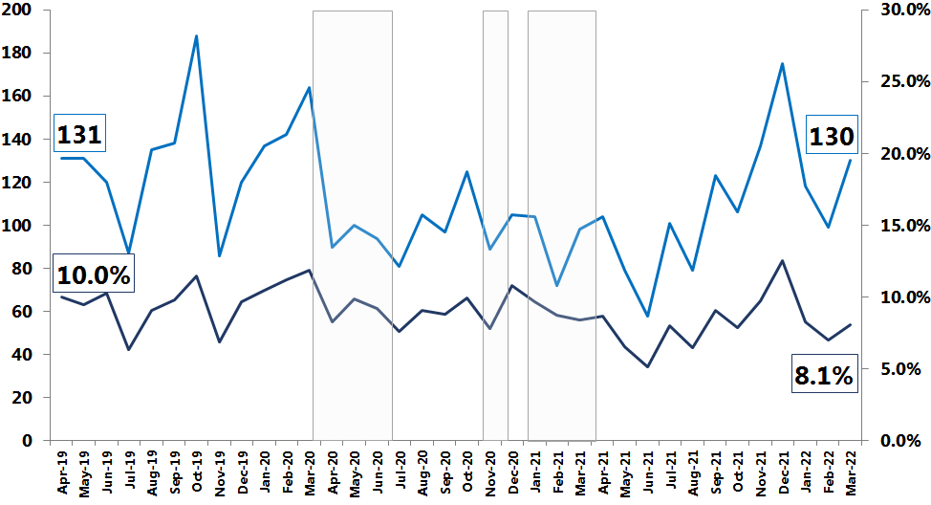
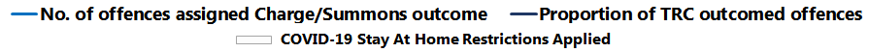
Most substantial volume and proportion rate increases seen in Telford & Wrekin and Herefordshire.
Remaining policing areas have seen proportion rate decreases in OC1 & 1A.
4. Delivering effective prevention and intervention
4.1 How well does West Mercia Police bring offenders to justice?
4.1.1 % of positive action by LPA
‘Charge/ Summons’ Outcomed Offences (OC1 & 1A) (regardless of when recorded)
Herefordshire
North Worcestershire
Shropshire
South Worcestershire
Telford & Wrekin

Slide 23
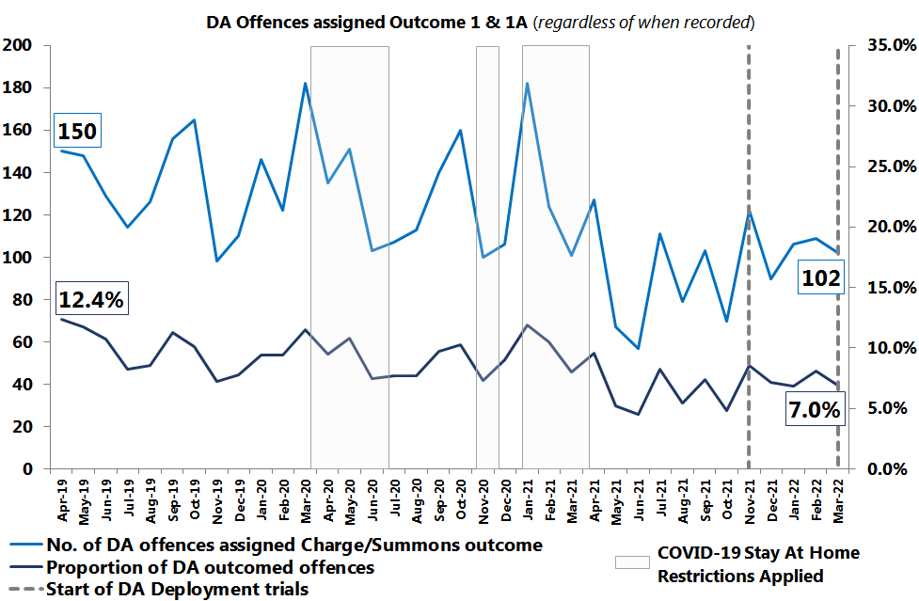
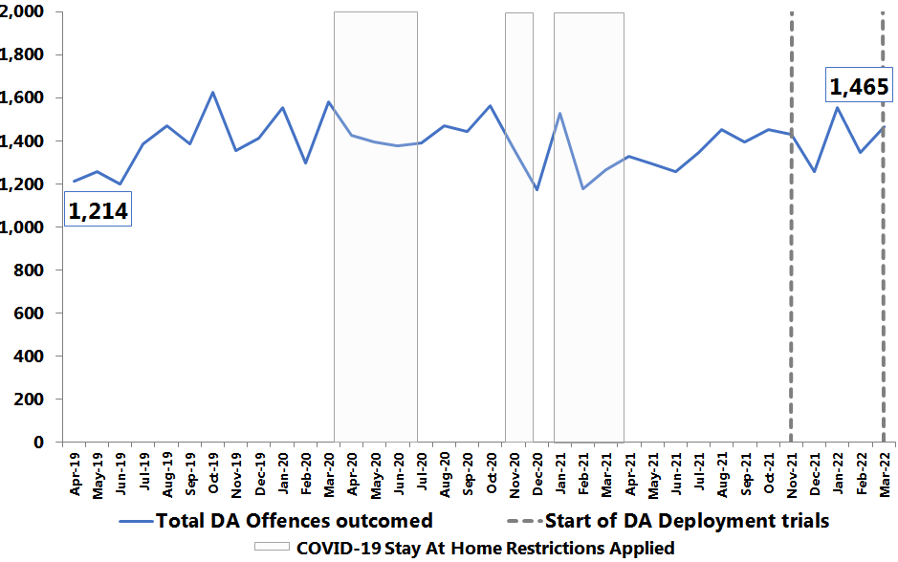
4. Delivering effective prevention and intervention
4.1 How well does West Mercia Police bring offenders to justice?
‘Charge/ Summons’ Outcomed DA Offences (OC1 & 1A) (regardless of when recorded)
4.1.1 % of positive action – DA outcomes
Key Points
Usage of Charge/Summons has remained stable over the last 3 months within a range from 100 to 110 ‘Charge/Summons’ DA offences per month.
The monthly outcomed proportion rate is 7.0% (102) for March 22; a decrease of 1.1 percentage points.
Monthly view – 7.0% consists of:
  4.7% - Outcome 1 - Charge/ Summonsed
  2.3% - Outcome 1A - Charge/ Summonsed - alternate offences.
Total DA offences outcomed: 9% (120) increase on the previous month, continuing the variable upward growth trend since February 21.
Good
looks like:
An increase in the volume and proportion of offences assigned an Outcome 1 or 1A result.
Last reviewed by subject lead Oct 2021
DA Outcomed Offences (regardless of when recorded)
What does this mean?
Crime Bureau monthly input – There is no longer a Designated Decision Maker (DDM) backlog assisted by the DDM team now being at full establishment strength. As of 12th April , the Crime Bureau are at RAG rating ‘green’ with 44 crimes awaiting outcome.
It is probable that outcoming levels will continue to increase as:
  DA Deployment trial has been rolled out across all policing areas and regularly reported upon, with the aim of improvements in ‘positive outcome’ levels (Charge/Summons).
  Local Policing Area Outcome Action Plans and Op Riverport policing initiatives continue to be reinforced and will be influencing factors.
  Staff abstraction returns to normal over time. Current levels have been high from Covid/ Respiratory sickness or self isolation, as a result, current outcoming levels could have been even higher.
Next Steps / Recommendations
No comparison to MSG, National view or other Athena forces as DA outcome data is not monitored.
Action Required?
Continued focus on action plan delivery and continued monitoring via Crime Management Board.
No

Slide 24
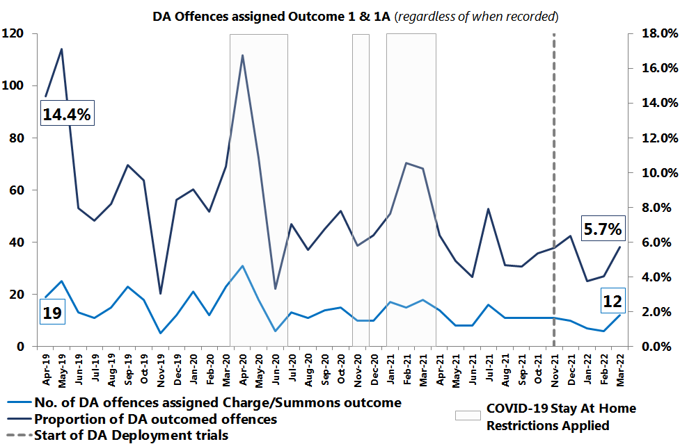
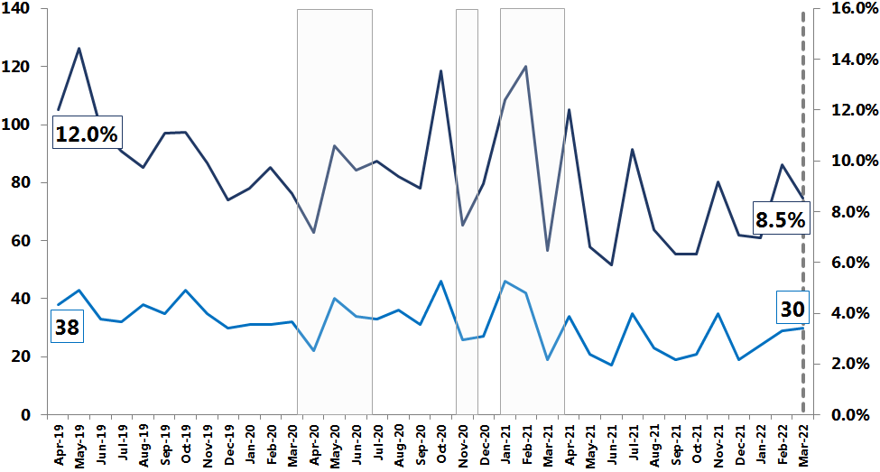
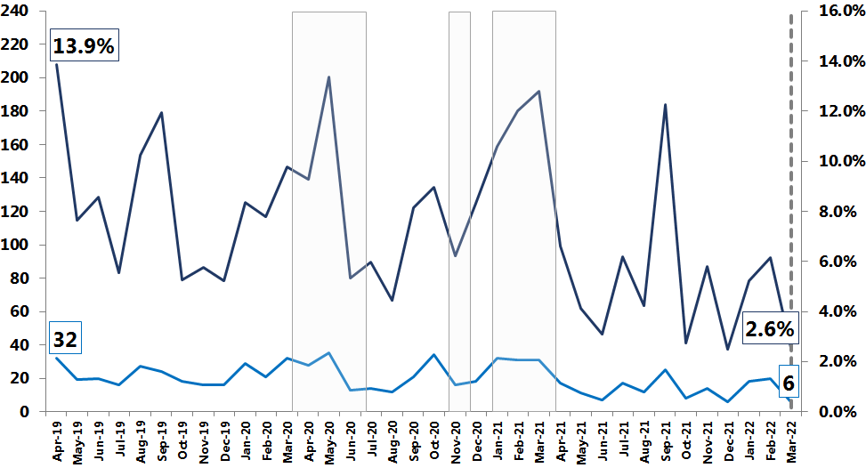
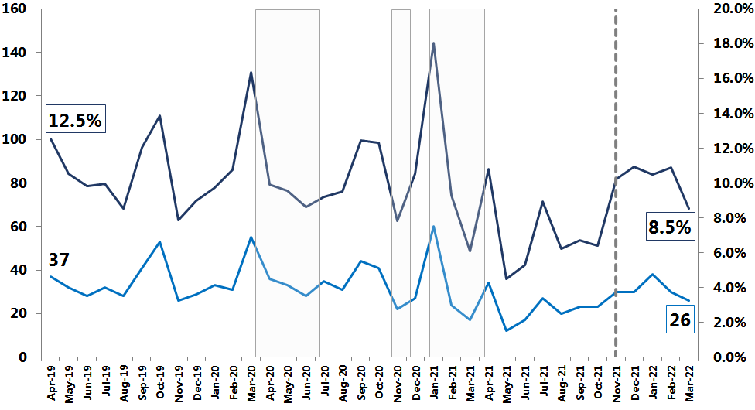
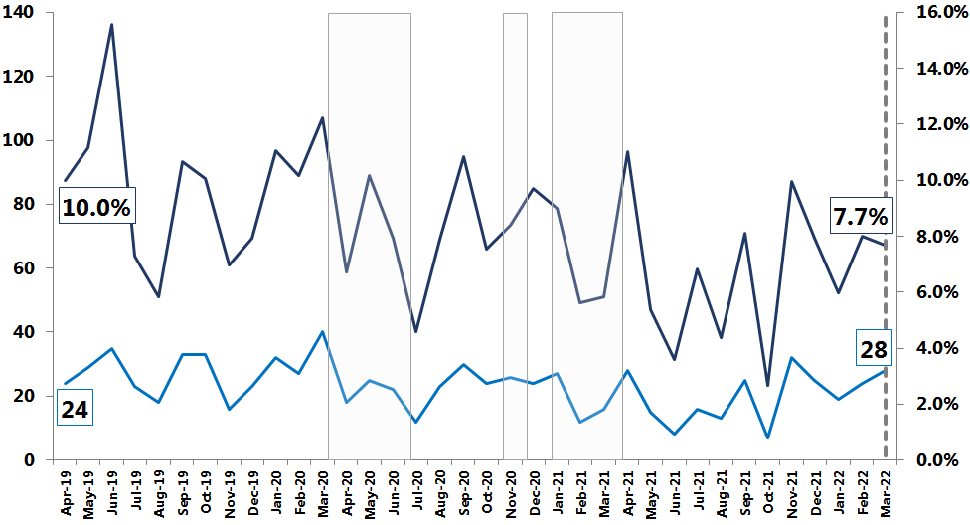
4. Delivering effective prevention and intervention
4.1 How well does West Mercia Police bring offenders to justice?
Herefordshire is the only policing area to see an increase in both OC1 & 1A volume and monthly proportion rate
An increase in OC1 & 1A volume but a dip in the monthly proportion rate is seen in North Worcestershire and Telford & Wrekin
4.1.1 % of positive action – DA outcomes by LPA
‘Charge/ Summons’ Outcomed DA Offences (OC1 & 1A) (regardless of when recorded)
Herefordshire
North Worcestershire
Shropshire
South Worcestershire
Telford & Wrekin
A decline in OC1 & 1A seen in South Worcestershire for the last two months, although small volumes.

Slide 25
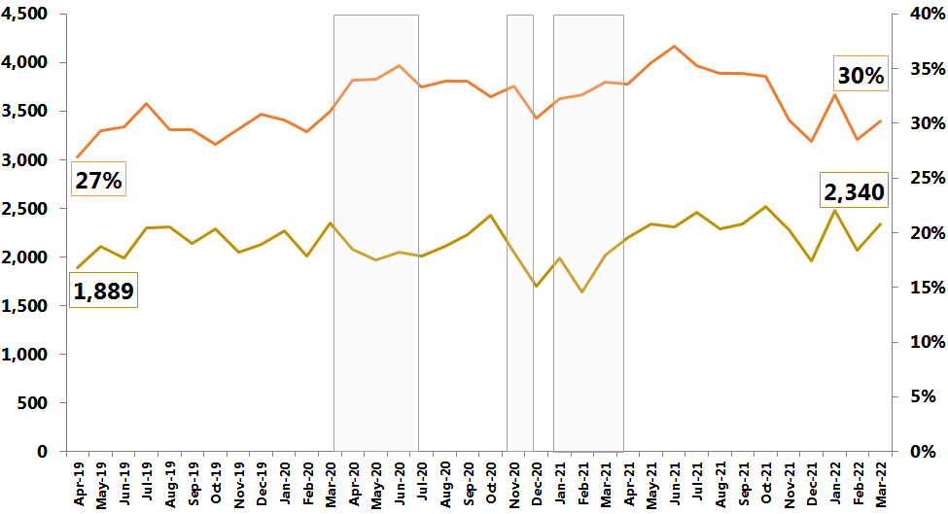
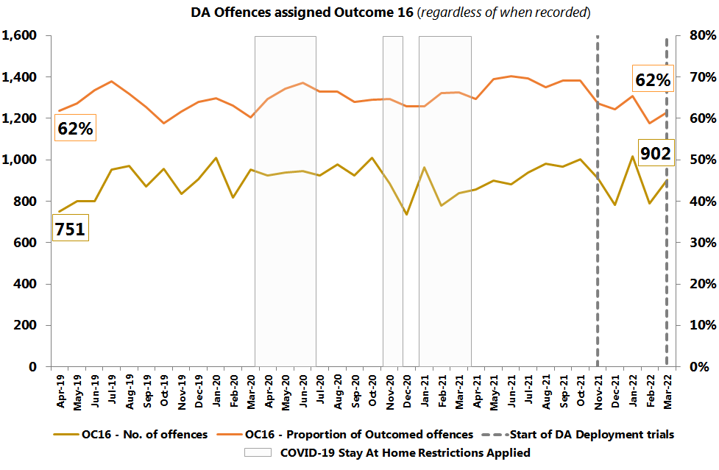
4. Delivering effective prevention and intervention
4.1 How well does West Mercia Police bring offenders to justice?
‘Evidential difficulties prevent further action; victim does not support police action’ Outcomed Offences (OC16)
Total Recorded Crime Offences
(regardless of when recorded)
4.1.2 Reduction in use of Outcome 16
Key Points
There have been increases in both the monthly proportion rate and volume for both total recorded crime offences and DA offences, yet volumes and rates are still lower than levels seen earlier in the year.
Total recorded crime
  13% increase in the volume of offences (2,340) assigned Outcome 16 in March 22 compared to February 22 (2,070).
  The proportion of offences assigned Outcome 16 has increased by 1 percentage point from 29% in February 22 to 30% in March 22.
DA offences
  14% increase in ‘Outcome 16’ DA offences (902) in March 22 compared to February 22 (791).
  3 percentage point increase in the proportion of offences assigned Outcome 16 from 59% in February 22 to 62% in March 22.
Good
looks like:
A reduction in the volume and proportion of offences assigned an Outcome 16 result.
Last reviewed by subject lead Oct 2021
Outcomed DA Offences (OC16)
(regardless of when recorded)
What does this mean?
Crime Bureau monthly input – There is no longer a Designated Decision Maker (DDM) backlog assisted by the DDM team now being at full establishment strength. As of 12th April , the Crime Bureau are at RAG rating ‘green’ with 44 crimes awaiting outcome.
It is probable that outcome 16 levels will start to decrease again as the LPA Outcome Action Plans and DA Deployment trial continue to take effect, leading to the more appropriate application of Outcome 16.
Next Steps / Recommendations
No comparison to MSG, National view or other Athena forces at this time due to differing data/counting rules.
This will change with the launch of ‘Clean and Relevant’ crime data universe.
Action Required?
Continued focus on action plan delivery and continued monitoring via Crime Management Board.
No

Slide 26
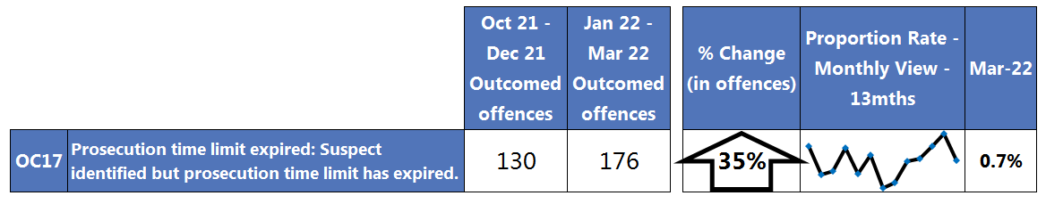
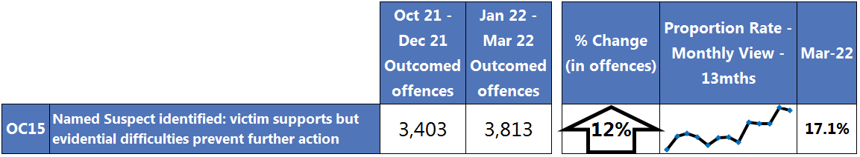
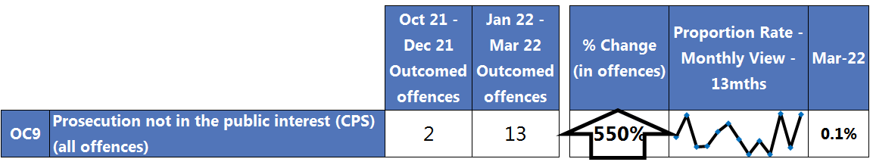
4. Delivering effective prevention and intervention
4.1 How well does West Mercia Police bring offenders to justice?
Headline Outcome Spotlight
Outcome 17 – Prosecution time limit expired offences
22% decrease in Outcome 17 offences in March 22 (51) compared to February 22’s peak (65).
35% (46) increase in Outcome 17 offences in Q4 2021/22 (130) compared to Q3 2021/22 (176), driven by increases in January 22 (60) and February 22 (65).
It is probable that this figure will remain high due to the number of investigations sitting in OIC crime baskets remaining high, leading to a greater propensity for timing out.
Next Steps /
Recommendations
Findings to be reported on in Crime Management Board and sent to Op Reset team.
Outcome 15 – Victim supports but evidential difficulties
prevent further action
5% increase in Outcome 15 offences in March 22 (1,328) compared to February 22 (1,259). 17% of all outcomed offences have been assigned Outcome 15 in March 22.
The highest monthly volume seen for the reporting timeframe starting in April 2019, an increase on last month’s peak (1,259).
12% increase in Outcome 15 offences in Q4 2021/22 (3,403) compared to Q3 2021/22.
It is probable that these figures will continue to increase due to the emphasis on the appropriate application of Outcome 16 on policing areas, along with the policing initiatives of Op Reset and Op Riverport which aim to improve standards of investigation at force level and policing area level.
Action Required?
No
Outcome 9 – Prosecution not in the public interest (CPS)
(all offences)
6 offences were assigned Outcome 9 in March 22 compared to February 22 (1) however, four relate to one individual and two linked incidents.
550% (11) increase in Outcome 9 offences in Q4 2021/22 (13) compared to Q3 2021/22 (2), driven by increases in January 22 (6) and March 22 (6).
It is probable that this figure will remain high until the policing initiatives of Op Reset and Op Riverport take effect.

Slide 27
4. Delivering effective prevention and intervention
4.1 How well do we Prevent Crime? – Problem Solving
4.1.3 Problem Solving Hub
Good
looks like:
Key Points
Problem Solving training continues – currently being rolled out to CID and Crime Scene Investigators. ‘Advanced’ problem solving workshops are also taking place.
In excess of 500 staff now trained. These are mainly Safer Neighbourhood Teams, Police Now and Specials.
Plans are being utilised particularly as a platform for the new intervention and prevention work. As a result there are currently a greater number of open plans than there have been previously.
Problem Solving Plans by Local Policing Area (Snapshot – 17.03.22)
Further 200 Staff to receive Problem Solving Training by end Sept 2022
Last reviewed by subject lead Apr 2022
What does this mean?
Problem Solving are encouraging team ownership of plans, driven by a supervisor and actions allocated out to the team and partners. This appears to be generating successful activity. The number of Unscored Plans are higher than typical levels due to the commencement of intervention and prevention officers using Problem Solving Plans to record their work. These plans are not scored.
The need to improve the ‘Assessment’ element of SARA within Problem Solving Plans has been identified, in order to be able to share good practice and build corporate memory. In order to achieve this, “assessment” will be introduced in phase 2 training, supervisor checks will be encouraged, reminders will be provided at meetings and best practice will be circulated. Greater assessment of problem solving activity is being marketed as the final part of the SARA process. The aim is to develop a push to improve this across the force, through plan owners and independent assessment / evaluation.
West Mercia problem solving activity, in general, produces positive results in terms of reduction of incidents and community satisfaction. In order to evidence this, the aim is to develop a university academic evaluation of some projects, with PCC to fund academic assessment of a project by Worcester University.
Next Steps / Recommendations
Action Required?
Contribute to the new Prevention Strategy.
Work with the OPCC and Worcester University in relation to developing the academic evaluation.
No

Slide 28
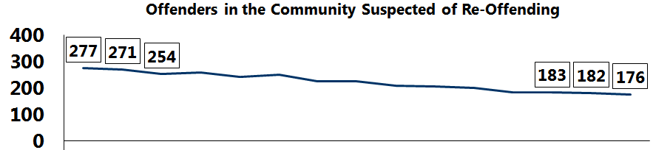
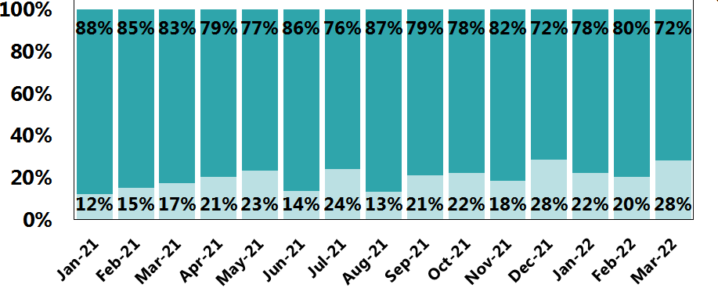
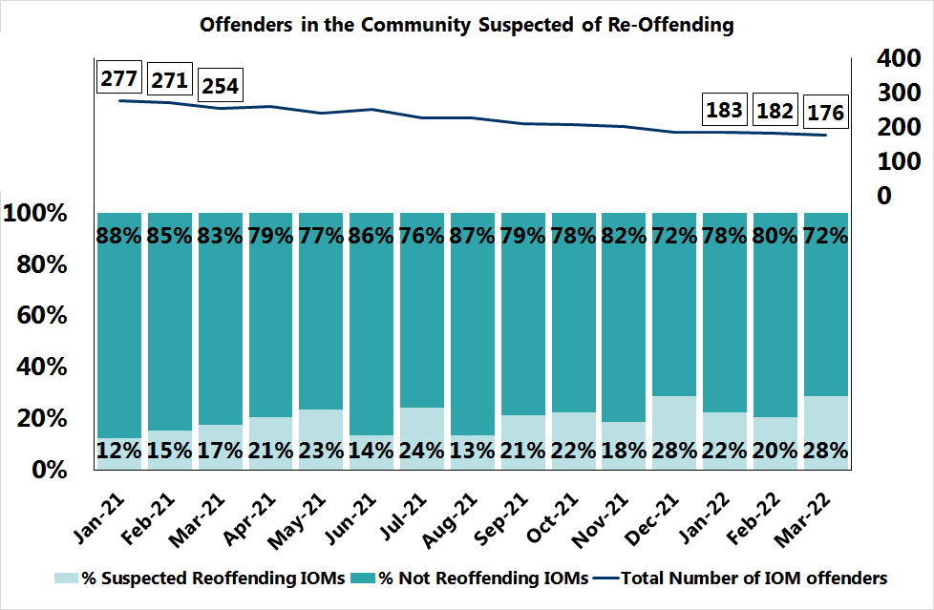
4. Delivering effective prevention and intervention
4.1 How well does West Mercia Police bring offenders to justice?
4.1.4 Reduction in reoffending – Integrated Offender Management (IOM)
Offenders in the community that are within the IOM cohort
Key Points
Total number of IOM offenders has been on a downward trend since January 21 from 277 IOM offenders to 176 in March 22.
March 22 re-offending rate was 28%.
Suspected re-offending rates have increased over the latter part of 2021/22.
Q4 2021/22 is showing a higher average re-offending rate (24%) than any other quarter throughout the year.
Offenders in the community suspected of re-offending
What does this mean?
Over the last year, a parameter was brought in whereby individuals who are given a sentence of longer than 2 years custody are automatically removed from the cohort, and after this time are re-referred by Probation if they are wanted back on the IOM scheme.
Additionally, since the introduction of the Fixed, Flex and Free Categories in October 2021, the threshold to be brought onto IOM is more stringent, so we have seen a decrease in the number of nominals without them being brought back on at the same speed.
Methodology
The data is based on IOM nominals who are linked to investigations recorded each month by way of a suspect role (irrespective of whether or not an arrest was made).
The numbers provided are based on nominals who show as in the community and custody at the end of each month, as those who are proved to re-offend at the beginning of the month, may be in custody at the time of reporting.
Next Steps / Recommendations
A priority but complicated issue is to define ‘What does Good look like?’.
The IOM team will be developing this during Q1 2022/23 but it is predicated by the imminent release of some national guidance.
Action Required?
No

Slide 29
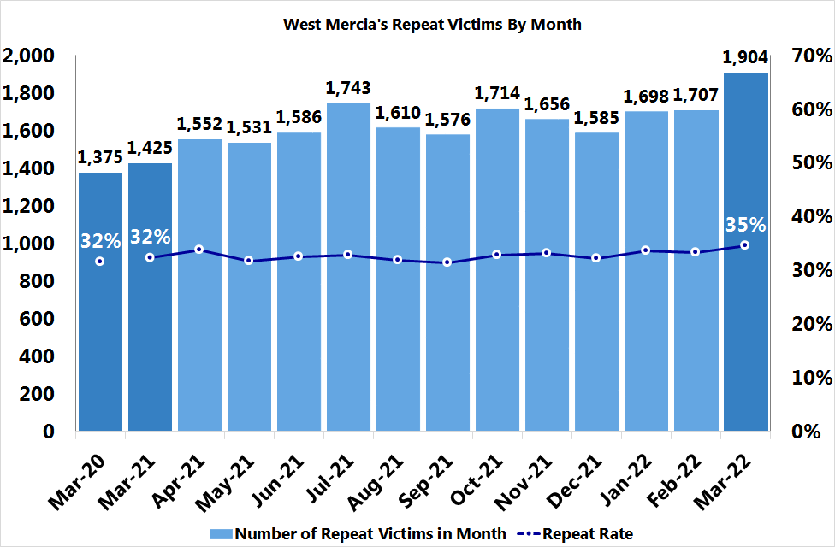
4. Delivering effective prevention and intervention
4.1 How well does West Mercia Police bring offenders to justice?
A repeat victim is defined as an individual recorded as a victim in the current reporting month that has had at least one other offence in the preceding 12 months.
4.1.5 Volume / rate of repeat victimisation (All victims)
Key Points
A sharp increase in Total Recorded Crime repeat victims has been seen in March and on previous years:
  12% increase (197) compared to February 22
  34% increase (479) on March 21
  38% increase (529) on March 20
The uplift last month is linked to the growth in overall crime recording.
35% Total Recorded Crime repeat victim rate has been seen in March:
  The highest rate seen since January 21 (35%)
  3 percentage points higher than the repeat rates seen in the same month for the previous years (32%)
Repeat Total Recorded Crime Victims per Month
Good
looks like:
A reduction in ‘high frequency/ high severity’ repeat victims and a decrease in repeat rates
Last reviewed by subject lead Oct 2021
What does this mean?
The growth in overall crime recording is driven by an increase in Violence without injury offences, specifically Assault without injury, Malicious Communications and Harassment offences.
A change in recording practices around Malicious Communications offences following improvements to SAAB ASB incident recording, has led to substantial growth in Malicious communications/ Harassment offences as opposed to an organic growth happening within our communities.
Over the coming months, increased financial pressures on households could lead to a rise in crime recording, so it is highly probable that repeat volumes will increase too. These pressures are linked to the cost of living crisis with increased costs of food, energy and fuel despite the reduction in fuel duty.
Next Steps / Recommendations
Continue to develop analysis to support Early Intervention and Help.
VAWG framework - The performance framework was published in April 2022. West Mercia to work towards delivery of this performance requirement.
Action Required?
Yes

Slide 30
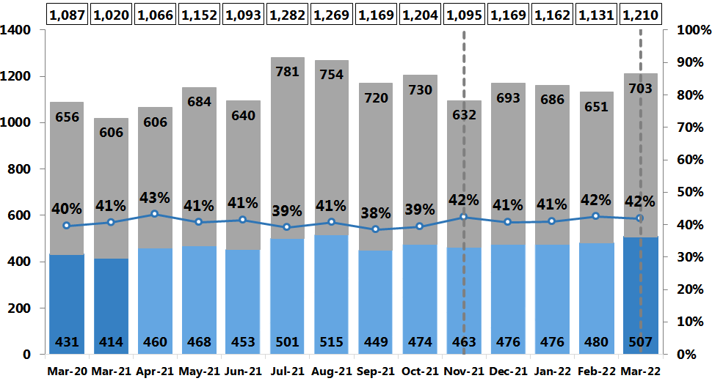
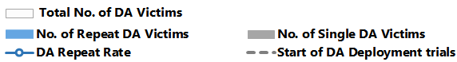
4. Delivering effective prevention and intervention
4.1 How well does West Mercia Police bring offenders to justice?
A repeat victim is defined as an individual recorded as a victim in the current reporting month that has had at least one other offence in the preceding 12 months.
4.1.5 Volume / rate of repeat victimisation (DA-specific victims)
Key Points
There has been an increase in the number of Domestic abuse (DA) single offence victims, repeat DA victims in March 22, although the DA repeat rate has remained relatively stable compared to February 22.
There are increased numbers of DA victims in March 22 compared to the same month in the two previous years.
Average monthly repeat rate range for the last 5 months during DA Deployment trial:
  DA repeat rate - 41% to 42%.
  It should be noted however that March 22 includes the roll out of the DA Deployment trial across North Worcestershire, Shropshire and Telford & Wrekin.
Repeat Domestic Abuse Victims per Month
Good
looks like:
A reduction in ‘high frequency/ high severity’ repeat victims and a decrease in repeat rates
Last reviewed by subject lead Oct 2021
What does this mean?
Over the coming months, increased financial pressures on households could lead to a rise in domestic abuse crime recording, so it is highly probable that repeat volumes will increase too.
These pressures are linked to the cost of living crisis with increased household costs of food, energy and fuel despite the reduction in fuel duty. There are areas of social deprivation within West Mercia which are among the 10% most deprived areas nationally (English Indices of Deprivation, 2019).
Further in-depth analysis is required to understand the turnover rate at which repeat DA victims leave West Mercia’s repeat DA victim cohort and are replaced with new repeat DA victims. This work should be scheduled dependent upon existing performance work commitments and resources.
This DA data is generated from Athena where a ‘Domestic Abuse’ crime keyword has been applied.
Next Steps / Recommendations
Continue to develop analysis to support Early Intervention and Help.
VAWG framework - The performance framework was published in April 2022. West Mercia to work towards delivery of this performance requirement.
Action Required?
Yes

Slide 31


4. Delivering effective prevention and intervention
4.1 How well does West Mercia Police bring offenders to justice?
A repeat suspect is defined as an individual recorded as a suspect in the current reporting month that has had at least one other offence in the preceding 12 months.
4.1.6 Volume / rate of repeat perpetrators (DA-specific suspects)
Key Points
There has been an increase in the number of Domestic abuse (DA) single offence suspects, repeat DA suspects in March 22, although the DA repeat rate has remained relatively stable compared to February 22.
Increased numbers of DA suspects in March 22 compared to the same month in the two previous years, although DA repeat rate remains the same compared to March 21.
Average monthly repeat rate range for the last 5 months during DA Deployment trial:
  DA repeat rate - 44% to 49%.
  It should be noted however that March 22 includes the roll out of the DA Deployment trial across North Worcestershire, Shropshire and Telford & Wrekin.
Repeat Domestic Abuse Suspects per Month
Good
looks like:
A reduction in ‘high frequency/ high severity’ repeat suspects and a decrease in repeat rates
Last reviewed by subject lead Oct 2021
What does this mean?
Over the coming months, increased financial pressures on households could lead to a rise in domestic abuse crime recording, so it is highly probable that repeat volumes will increase too.
These pressures are linked to the cost of living crisis with increased household costs of food, energy and fuel despite the reduction in fuel duty. There are areas of social deprivation within West Mercia which are among the 10% most deprived areas nationally (English Indices of Deprivation, 2019).
Further in-depth analysis is required to understand the turnover rate at which repeat DA suspects leave West Mercia’s repeat DA suspect cohort and are replaced with new repeat DA suspects. This work will be scheduled in dependent upon existing performance work commitments and resources.
This DA data is generated from Athena where a ‘Domestic Abuse’ crime keyword has been applied.
Next Steps / Recommendations
Continue to develop analysis to support Early Intervention and Help.
VAWG framework - The performance framework was published in April 2022. West Mercia to work towards delivery of this performance requirement.
Action Required?
Yes

Slide 32


4. Delivering effective prevention and intervention
4.1 How well does West Mercia Police bring offenders to justice?
20%
Since Apr 21
4.1.8 Open Investigations – Caseload and OIC Crime Baskets
Key Points
There has been a 20% decrease in Open Investigations (O.I.s) since April 21 and a 1.2% decrease compared to March 22.
Overall O.I. volumes have been stabilising in recent months with no significant decreases to return to the target range.
Over the last 3 months, the proportion of ‘Less than 4 weeks’ aged O.I.s has increased from 29% to 34%, driven by an uplift in crimes being recorded .
1.2%
Good
looks like:
Since Mar 22
Open Investigations – Age Profile (point-in-time view)
(Point-in-time view: 5th April 2022)
A target band is thought to be around 8,000-10,000 open investigations at current recording volumes
Age Profile
Bandings
Last reviewed by subject lead Oct 2021
What does this mean?
The Op Reset team has been set up to understand some of the broader investigative issues at force level. At this stage, it is too early to determine the impact upon open investigation volumes.
Policing area initiatives, e.g. Op Riverport, are in place and is stating to influence different areas of the process including reducing O.I. volumes.
Probable factors behind O.I.s remaining above target range:
  A change in recording practices around Public Order Offences and Malicious Communications offences following improvements to SAAB ASB incident recording, has led to substantial growth in Public Order offences and Malicious communications/ Harassment offences as opposed to an organic growth happening within our communities.
  Overall Staff abstraction remains high from Covid/ Respiratory sickness or self isolation.
It is probable that O.I.s will remain at this level in the short term, despite the new policing area initiatives, until staff abstraction improves.
The percentages represent the proportion of total O.I.s relating to each ‘age of investigation’ banding. The figures will amount to 100% for each ‘point-in-time’ month.
Next Steps / Recommendations
Continued to be monitored via Crime Management Board.
Implementation of Op Reset which aims to understand the full complexity of the crime pathways and seek out detailed solutions at force level.
Action Required?
No

Slide 33

4. Delivering effective prevention and intervention
4.1 How well does West Mercia Police bring offenders to justice?
25% increase in OICs with 20+O.I.s
(1st Mar 22 to
5th Apr 22)
One
North Team DC Online CSE North 34 O.I.s
One
Shropshire DC
Vulnerability Shift C
31 O.I.s
4.1.8 Open Investigations – Caseload and OIC Crime Baskets
(Point-in-time view: 5th April 2022)
Open Investigation Crime Baskets by Command
Internal change in reporting terminology where ‘workflows’ are now used to represent the number of unit/s linked an OIC’s Open Investigation crime basket, instead of the previous ‘multiple crime basket’ term.
It is possible that an OIC is linked to open investigations spanning multiple units across different police functions.
This situation is justifiable due to the long investigative process associated with complex crimes.
Continual monitoring is required of multi OIC workflows when linked to the rotation of student officers around different units.
Key Points
What does this mean?
Next Steps / Recommendations
South Worcestershire and Shropshire have seen a 6% to 7% increase in their number of O.I.s compared to the other policing areas which have seen a reduction since March 22.
There has been a 42% reduction in the number of OICs with multiple workflows from 01 Mar 22 (117) to 05 Apr 22 (68).
25% increase (7) in the number of OICs with 20+O.I.s. between 01 Mar 22 (28) to 05 Apr 22 (35) with 813 (8%) of all O.I.s in their crime baskets. This increase was driven by Shropshire with a substantial increase from 9 to 19 OICs with 20+O.Is representing 437 O.I.s.
  Student Officers with less than 2 yrs service represent 16% (3) of Shropshire’s 19 OICs with 20+O.I.s handling 71 O.I.s.
  North Team has maintained 4 OICs with 20+O.I.s since last month representing 102 O.I.s.
Shropshire has the highest ‘O.I. to OIC Workflow’ ratio (8.0) out of the OIC Commands.
The implementation of Athena Crime Management team’s new procedures for updating Athena investigations with new OIC or OIC unit has led to a reduction of OICs with multiple workflows within their crime basket.
It is highly probable that Open Investigations volumes will remain above the upper threshold whilst staff abstraction remains high from Covid/ Respiratory sickness or self isolation.
Continued to be monitored via Crime Management Board.
Monitor the progress of local initiatives to improve standards of investigation, e.g. Op Riverport.
Support to be given to Shropshire Command in order to focus attention on the increase in officers with 20+ O.I.s
Action Required?
Yes

Slide 34


4. Delivering effective prevention and intervention
4.1 How well does West Mercia Police bring offenders to justice?
4.1.8 Open Investigations – ‘Age of Investigation’ Vs Crime Categories
(Point-in-time view: 5th April 2022)
% Proportion
Key Points
25% of all O.I.s relate to violence without injury offences. 44% of these offences are ‘less than 4 weeks’ old.
Rape and Other Sexual offences have high proportion rates for offences that are ‘over 1 year old’ (19% to 23%). This is as would be expected due to complexity.

Slide 35

4. Delivering effective prevention and intervention
4.1 How well does West Mercia Police bring offenders to justice?
Key Points
9% of all O.I.s relate to non-crime investigations (6%) and NFIB fraud offences (3%).
Drug offences and miscellaneous crimes against society have higher proportions of offences that are ‘over 1 year old’ (24% to 29%).
Between 42% - 49% of criminal damage and arson, theft and public orders offences are ‘less than 4 weeks’ old. A return to traditional crime reporting pre-pandemic is being seen.
There has been a in change in recording practices around Public Order Offences following improvements to SAAB ASB incident recording. This has led to substantial growth in the recording of Public Order offences in the last 2 months as opposed to an organic growth happening within our communities. As a result, 64% of undetected Public Order offences are less than 8 weeks old.
4.1.8 Open Investigations – ‘Age of Investigation’ Vs Crime Categories
(Point-in-time view: 5th April 2022)
% Proportion

Slide 36



4. Delivering innovative, problem-solving practices and processes
4.2 How does West Mercia ensure that public contact is managed effectively?
What does this mean?
999 demand increases by 15% (1842) between February and March. This a was 28% (3147) increase on March 2020/21.
Demand is the highest since August 2021.
Performance decreased by 2 percentage points, the second month of decrease, though still above what Good Looks Like.
The abandonment rate increased by 0.1 percentage points to 1.7%, driven by increased demand.
Good
looks like:
What does this mean?
In March there has been a 13% (3036) increase in demand from February and an 13% (3902) reduction from March 2020/21.
Demand is the highest since November 2021.
Performance decreased by 6 percentage points, the second month of decrease.
101 abandonment increased by 4 percentage points to 21.1%.
Reduction in performance has been driven by levels of sickness and an increase in demand.
Good
looks like:
999 calls: 90% answered within 10 seconds
101 calls: 80% answered within 30 seconds by June 2022
Last reviewed by subject lead Jan 2022
Last reviewed by subject lead Jan 2022
Action Required?
Action Required?
No
No

Slide 37

4. Managing Demand
4.2 How does West Mercia ensure that public contact is managed effectively?
4.2.7 Public demand via new platforms and technology
Key Points
Digital contact via SOH saw a 19% (352) increase in March compared to February to the highest figure since launch.
Overall growth likely represents SOH as a regular contact channel of choice.
What does this mean?
The growth in digital demand is expected to continue as Public Contact explores greater accessibility and social media reporting channels.
Increase in March mirrors growth found in 999 and 101 calls for service to highest demand for several months.
Next Steps / Recommendations
Good
looks like:
What Good Looks Like needs to be determined.
To be reviewed by subject lead
Action Required?
Yes

Slide 38

4. Managing Demand
4.2 How does West Mercia ensure that public contact is managed effectively?
4.2.8 Response times by grade
4.2.9 Unresourced
Key Points
Successful testing following two new dimensions being added to SAAB Safe took place in March.
What does this mean?
There are still technical issues that need to be resolved due to the limitations of the system, but data is expected to be available for reporting from Q1 22/23.
However, due to SAAB being unable to back record convert data, meaningful analysis and insight will only be available from May 2022 onwards.
What does this mean?
Force wide unresourced fluctuated throughout March but saw an overall increase on February.
Daily scrutiny and use of available resources has kept unresourced below 200 incidents.
Demand is expected to increase in coming months due to likely seasonal trends.
There will be a recruitment drive in August to resolve staffing issues.
Good
looks like:
Meeting in place to discuss with subject lead.
Next Steps / Recommendations
Issues identified since testing that time
clocks do not adjust is to be rectified.
Data are rules to be agreed.
A dashboard is in development.
Action Required?
No
Next Steps / Recommendations
What Good Looks Like to be reviewed in line
with data changes.
Action Required?
No

Slide 39
4. Managing Demand
4.2 How well does West Mercia manage crime?
The upper and lower control limits are derived by calculating 2 points of Standard Deviation from the mean. The mean is fixed for the year and is based on volumes recorded in 2019/20 so that control limits are not influenced by the effects of Covid restrictions. This will change in reporting moving forward to being based on 21/22 volumes.
NB. It is possible for the previous month to be coloured differently from the month in 2019/20 even if volumes are similar. This is due to the upper and lower control limits changing annually based on volumes in the previous year.
Next Steps / Recommendations
Key Points
Action Required?
Continued strategic monitoring by performance.
Volumes of Violence Without Injury, Rape and Other Sexual Offences and Public Order are exceptional. Further analysis is included on pages 40 to 44.
No

Slide 40


4. Managing Demand
4.2 How well does West Mercia manage crime? – Exceptional Volumes
Key Points
Volumes of Violence Without Injury exceeded the upper control limit in March with an increase of 11% (254) from February 2020/21. This is the third month above the upper control limit.
12 month rolling average has remained steady since an increase in October.
Year to Date increase of 20% (4605) compared to 2020/21, and increase of 19% (4359) compared to 2019/20.
West Mercia sits 5th out of 8 in its Most Similar Group.
What does this mean?
The most frequent offence description at 40% (1028) is “Assault Without Injury”, followed by “Malicious Communications” at 21% (539).
The largest increase compared to the previous month was Threats to Kill 51% (25) with an increase of repeat addresses; one being a prison.
17% (425) of addresses were repeats; the largest repeat being 6. These refer to an incident in a primary school with six victims and the other being a repeat victim of DA and course of conduct offences.
Next Steps / Recommendations
Action Required?
Continued strategic monitoring by performance.
No

Slide 41


4. Managing Demand
4.2 How well does West Mercia manage crime? – Exceptional Volumes
Key Points
Volumes of Rape Offences exceeded the upper control limit in March with an increase of 10% (13) from February 2020/21 the third consecutive month of increases.
12 month rolling average has remained stable since an increase in September and October.
Year to Date increase of 25% (297) compared to 2020/21, and increase of 19% (237) compared to 2019/20.
West Mercia sits 3rd out of 8 in its Most Similar Group.
What does this mean?
Overall 62% (85) relate to non recent offences meaning the offence was committed over 28 days previous to reported date.
Approximately 12% may relate to the Night Time Economy. This is difficult to identify due to a large volume majority being given a start date of midnight.
There were 12 repeat victims, 4 of which were victims of 3 Rape offences. There were 2 repeat suspects.
2 offences involved spiking, both of which are non recent.
Next Steps / Recommendations
Action Required?
Recommend communications in relation to the need for accurate recording of ‘offence committee time’ in Athena, as this
would enable more accurate reporting on the Night Time Economy.
Yes

Slide 42


4. Managing Demand
4.2 How well does West Mercia manage crime? – Exceptional Volumes
Key Points
Volumes of Other Sexual Offences exceeded the upper control limit in March with an increase of 24% (50) from February 2020/21. In the last year only two months were below the upper control limit
12 month rolling average has increased over the last 7 months.
Year to Date increase of 33% (645) compared to 2020/21, and increase of 20% (428) compared to 2019/20.
West Mercia sits 3rd out of 8 in its Most Similar Group.
What does this mean?
The most frequent offence description at 41% (104) in March is “Sexual Assault on a Female Aged 13 and Over”, followed by “Sexual Activity Involving a Child Under 16” at 17% (44).
Overall 35% (90) relate to non recent offences meaning the offence was committed over 28 days previous to reported date.
There are 9 repeat victims and 8 repeat suspects.
2 offences involved spiking. This was an incident where the suspect spiked two victims.
Next Steps / Recommendations
Action Required?
Continued strategic monitoring by performance.
No

Slide 43


4. Managing Demand
4.2 How well does West Mercia manage crime? – Exceptional Volumes
Key Points
Volumes of Misc. Crimes Against Society exceeded the upper control limit in March with a decrease of 2% (3) from February 2020/21.
12 month rolling average has been steadily increasing with a slight decline over the last two months.
Year to Date increase of 7% (102) compared to 2020/21, and increase of 4% (61) compared to 2019/20.
West Mercia sits 6th out of 8 in its Most Similar Group.
What does this mean?
Misc. Crimes Against Society is made up of a combination of varied crime types there for it can be difficult to identity a key driver.
However, the majority of offences remain Obscene Publications, Etc. And Protected Sexual Material, accounting for 55% (83), consistent with pervious months.
Of these 28% (23) were recorded in Telford & Wrekin.
There are five repeat addresses, all for Obscene Publications.
There are no repeat victims and 1 repeat suspect.
Next Steps / Recommendations
Action Required?
Continued strategic monitoring by performance.
No

Slide 44


4. Managing Demand
4.2 How well does West Mercia manage crime? – Exceptional Volumes
Key Points
Volumes of Public Order offences significantly exceeded the upper control limit. This represents a substantial increase of 64% (347) offences compared to March 2020/21 (within lockdown period), and an increase of 19% (144) on February 2021/22 volumes.
Opening Code “CR – Public Order” Added to SAAB
What does this mean?
It is probable that recording practices around Public Order Offences have improved following changes to SAAB in the last two months resulting in increased volumes of Public Order Crime Offences, as opposed to an organic increase in crime offences happening within our communities.
Incidents with an opening classification code of “CR – Public Order” make up a substantial proportion of the combined total of ASB & Public Order incidents since February, when the opening code “CR – Public Order Offence” was added to SAAB.
Following the introduction of this opening code, volumes of Public Order crime offences have also increased substantially, while the combined total of ASB & Public Order incidents has remained relatively stable.
West Mercia sits 4th out of 8 in its Most Similar Group.
Opening Code “CR – Public Order” Added to SAAB
Next Steps / Recommendations
Action Required?
Continued strategic monitoring of incident classification by performance.
No

Slide 45
4. Managing Demand
4.2 How well does West Mercia manage crime?
West Mercia Rural Crime Comparison to Previous Years
4.2.13 Rural Crime
Key Points
The definition of Rural Crime has been considered but not agreed. For the purpose of this report, rural crime has been defined as any crime which takes place in a "rural" Output Area (OA). OAs have been classified as rural/urban on the basis of the 2011 ONS Rural-Urban Classification for Small Area Geographies.
West Mercia has seen a 9% (143) increase in volumes of rural crime when compared to the previous month, and an 8% (135) increase when compared to March 2021.
The largest increases have been seen in North Worcestershire with a 31% (54) increase on the previous month, however only a 6% (13) increase when compared to last year.
Shropshire has seen a 20% (85) increase on the previous month and a 21% (87) increase on March 2021.
Both Herefordshire and Telford & Wrekin have seen a decrease when compared to the previous month and to March 2021.
West Mercia Rural Crime Comparison to Previous Months
What does this mean?
It is likely that there will be increases in rural crime as the weather improves over the spring/summer months as this trend has been seen consistently in the past 3 years with the exception of March 2020, highly likely due to Covid restrictions.
Due to the increase in fuel prices and living costs, it is possible that related crime could increase such as petrol theft and theft of solar panels/ other renewable energy sources.
Next Steps / Recommendations
Action Required?
Recommendation to formally agree that a geographical definition of Rural Crime for use across the force moving forward.
Yes
Good
looks like:
In Development

Slide 46

4. Managing Demand
4.2 How well does West Mercia manage crime? 4.2.20 – Domestic Abuse
Key Points
Volumes of Domestic Abuse Crimes and Crimed Incidents increased by 11% (222) compared to similar levels in January after a decrease in February.
This is driven by an increase in Crimed Incidents 17% (101) which was reduced last month due to the fewer number of days.
Increase of 13% (253) compared to March 2020/21.
Year to Date increase of 1% (188) compared to 2020/21, and decrease of 4% (1138) compared to 2019/20.
Good
looks like:
Increased Reporting
Last reviewed by subject lead Jan 2022
What does this mean?
Rolling 12 month figure for 2021/22 demonstrated continued stability in volumes with a slight increase in the last few months.
31% (474) of crimes in March related to Stalking and Harassment, an increase of 9% (40) from February and an increase of 8% (35) from March 2020/21.
35% (7) of all homicides in 2021/22 relate to Domestic Abuse. This is a decrease from 2020/21 where 42% (8) of homicides related to Domestic Abuse.
Most Similar Group and national figures are being looked into but forces can record DA differently therefore we are unable to add any additional context presently.
Next Steps / Recommendations
Future comms to also include other DA relationship dynamics
(child on parent, female on male etc.) in line with the force’s approach
to inclusivity.
Action Required?
Yes

Slide 47
4. Managing Demand
4.2 How well does West Mercia manage crime?
Key priorities: murder, serious violence, domestic abuse, neighbourhood crime and drug supply/county lines
Not numerical targets but key indicators to show improvement against; expectation of significant improvements within 3 years
Measure | Source | Change | Comment
Reduce murder and homicide | Police Recorded Crime |  | Increasing trend: 6 offences in Q4 compared with 4 in Q3 of 2021 – 2022. Also remaining consistently higher than previous years.
Reduce serious violence | National Health Service and PRC |  | 8 offences involving discharge of a firearm in 2020-21 (most 2 a month) Hospital admissions for assault with a sharp object are fewer than 8 each month – only detail shared. Six of these months have had none (last 2 years). Data has not been released for Q4 yet.
Disrupt drug supply and county lines | PRC and Public Health England |  | 2 drug-related homicides in last two years. None in the latest quarter.
Reduce neighbourhood crime | Crime Survey England and Wales |  | All crimes are reducing in last two years (burglary - domestic and commercial, robbery, vehicle crime, theft from person). However thefts of and from a vehicle have increased in the previous 2 quarters. Data is currently from PRC as the CSEW data does not offer enough detail
Improve satisfaction among victims, with a particular focus on victims of domestic abuse | CSEW |  | Whole experience satisfaction is improving since its reintroduction however the number of victims participating is much fewer than pre COVID-19. Currently none of the aspirational satisfaction levels will be achieved by the end of the financial year for any of the crime types. Satisfaction with the police among victims of domestic abuse is stable with follow-up consistency lower than other areas of the victim journey.
Tackle cyber crime | DDCMS |  | The data from the Dept. for Digital, Culture, Media and Sport is not available. Further police held proxy measures are being developed
Notes:
in

Slide 48
4. Managing Demand
4.2 How well does West Mercia manage crime?
The Strategic Policing Requirement sets out the threats that require a co-ordinated national policing response. The delivery of our response to this requirement to work collaboratively, and with other partners, to ensure such threats are tackled effectively, is collated and summarised below.
 |  | Capacity and Contribution | Capability | Connectivity
National Threats | Terrorism | Staffing gaps are minor as possible losses are projected and planned for. Small issues with security of supply due to time taken for vetting and training, however projection of vacancies and supply of assets from region help reduce impact. | Optimum training levels with surge capability if required. | Collaboration with partners is vital to enable West Mercia to deliver under the four P's detailed in the CONTEST Strategy and Action Plan. Relationships are maintained through regular contact, meetings and sharing of information.
 | Serious and Organised Crime | Some concerns surrounding the levels of staffing and time taken to train individuals, particularly within SOCU however, this impact is often limited due to the provision of the ROCU and the forces ability to prioritise resource. Teams within SOCU are often small. | Issues exist with limited surveillance capability. Limited funding available for enhanced equipment. | With offenders active across borders it is vital West Mercia continue communications with partners/agencies not just across the UK but overseas as well. The force works closely with a number of agencies such as Gain, HMRC, airlines and Border Force to ensure intelligence and information is shared accordingly. The Force has an embedded Serious and Organised Crime Joint Action Group (SOCJAG) structure which brings together a host of partners on a regular basis to work to tackle Serious and Organised Crime collectively. The CPS is also a crucial partner who the force work closely with on a regular basis.
 | National Cyber Security Incident | The Cyber Crime Unit (CCU) has optimum staffing levels to enable response to cyber security incidents. | The CCU is fit for purpose and capability is constantly improving within the team to maintain good standards. Additional vehicles however are required. | The force work closely with the West Midlands regional Cyber Crime Unit along with all of the regional Cyber Crime Units. Also linked into the National Cyber Security Centre and the National Cyber Crime Unit to enable partnership working across the UK. Regular contact is established with National Fraud Intelligence Bureau (NFIB), Action Fraud and Get Safe Online.
 | Threat to Public Order and Public Safety | Optimum levels of staff with well above the nationally-specified number of trained officers. | Some issues may exist in the accreditation of roles in 2020, however officers are currently trained in line with national requirements. National commitment to mobilise response but not enough vehicles to fulfil this. | For events, the force works with a variety of partners depending on the event taking place. For example, frequently events planners and coordinators will be in contact with safety advisory groups, local councils, sporting clubs and other event organisers.
 | Civil Emergencies | Number of resources are sufficient to maintain business as usual and respond to major emergencies, however in the event of a significant incident some BAU demand is disrupted due to low staffing levels. | Issues with equipment exist which limits capability when connecting and sharing information with partners. | Local Resilience Forums (LRFs) ensure collaborative working and are an integral part of the process in ensuring the production of contingency plans and individual agency plans for mitigation and response. The LRFs are a significant and vital element of working in partnership and taking a multi-agency approach to action.
 | Child Sexual Abuse (CSA) | Moderate staffing issues exist due to recruitment issues, particularly for specialists, attributed to the severity of offences. Despite this, the supply of officers as a whole is not an issue. | Issues exist with some interview locations and medical facilities not being fit for purpose. There are a limited number of fully trained and accredited investigators. | Problem Solving Hubs and Harm Assessment Units aim to support colleagues and external partners in reducing harm and risk through problem solving. The officers engage in partnership working using innovative and child-centred policing to proactively provide early intervention.
Notes:
out

Slide 49

4. Managing Demand
4.2 How well does West Mercia manage crime? 4.2.20 – Domestic Abuse
Key Points
In March the arrest rate stayed the same as February. The number of offences increased by 9% (121) with a corresponding increase in arrests by 9% (38).
Herefordshire (one of the initial trial areas), Shropshire and Telford & Wrekin have seen an increase in the arrest rate.
Herefordshire have achieved a 58% arrest rate, a 9 percentage point increase from February. There was an increase in arrests of 15% (15) with a decrease in offences by 3% (7).
North Worcestershire and South Worcestershire have seen a decrease in their arrest rates. Both have seen a decrease in arrests and increase in offences with South Worcestershire having an increase of 35% (93).
What does this mean?
The second highest arrest rate is Shropshire 33% with a increase in offences of 41% (29).
South Worcestershire saw the largest decrease in arrest rates with a 12 percentage point decrease where in the previous month it had the second highest arrest rate.
No homicide offences have been recorded with a DA marker in March.
Diary car has been reinstated for 24 hour periods at LPA level.
It is hoped that a new methodology for calculating arrest rates will be live in the coming weeks.
Weekly reporting continues
There is potential to move to a new methodology in relation to how
Domestic Abuse arrest rates are calculated in the coming weeks.
Methodology
This data is generated from Athena where a ‘Domestic Abuse’ crime keyword has been applied.
Arrest Rate is calculated by dividing DA arrests by the number of DA offences.
We are currently unable to link offences and arrests using Athena.
This can present an issue at the local level which uses the detention location as suspects can be taken to a detention location outside their LPA due to the proximity.
This methodology will be reviewed as soon as data from other sources becomes available.
Next Steps / Recommendations
Action Required?
No

Slide 50

4. Managing Demand
4.2 How well does West Mercia manage crime? 4.2.20 – Domestic Abuse

Slide 51

4. Managing Demand
4.2 How well does West Mercia manage crime?
4.2.22 Repeat Missing Persons
Key Points
The monthly proportion of Missing Person reports relating to repeat MISPERs has increased since the previous month from 22% to 34%.
All areas have seen an uplift in volumes in the last month, however this trend has been seen in 2020/21 and 2021/22 with both years seeing very similar levels.
Repeat MISPERS
Good
looks like:
Reduce proportion of missing person incidents relating to repeat MISPERs
Last reviewed by subject lead Oct 2021
What does this mean?
It is probable that monthly volumes will increase in the coming months.
This is likely due to reinforced recording practices and high levels of mental health issues to due covid/ restrictions.
A change in SAAB will also mean COMPACT records will be created automatically which will most probably cause an increase in reports.
Next Steps / Recommendations
Action Required?
Continued strategic monitoring by performance.
No

Slide 52






4. Delivering innovative, problem-solving practices and processes
4.2 Managing demand
4.2.23 Volume of SOC disruptions
Key Points
29 Disruptions were recorded in the last quarter – a significant increase of 81% (13) from the previous quarter, and in line with projected.
Of the disruptions 83% (24) were Pursue disruptions and 17% (5) were Prevent.
72% of all disruptions this quarter were positive.
Currently West Mercia has 30 active OCGs – down from 31 in March 2020.
What does this mean?
When considered in the context of the 2 year view, figures for Q4 are level with the forecasted number of disruptions, but remain below the quarterly average for the force for the past 2 years (40 per quarter) and continue the downward trend in positive disruptions being recorded since Oct 2019. The downward trend in disruptions means that Q3 is now no longer considered an outlier.
A response to this is being put in place with both internal and external partners.
The provisional forecast for Q1 2022/23 (Apr to Jun 2022) is based on the West Mercia trend for the past 2 years up to Mar 2022.
Next Steps / Recommendations
Action Required?
Continue to be monitored.
No

Slide 53



4. Managing Demand
4.2 How effective is WMP's activity to make the roads safer?
4.2.24 Volume of killed and 4.2.25 Volume of seriously injured
Key Points
KSI casualties have increased 37% (10) from the previous month and KSI collisions have increased 52% (12). Both had seen a significant decrease in February.
Last month collisions were most likely to occur in Shropshire 23% (8).
Collisions are most common on weekdays with Wednesday being the worst day for collisions with 10 being recorded, 1 being fatal. Peak times for collisions are 12:00-13:00 and 16:00-18:00.
The five fatalities were 3 drivers, 1 motorcycle rider and 1 E-scooter rider.
Vulnerable road users such as Pedestrians accounted for 16% (6) of KSI casualties in the last month; with pedal cyclists accounted for 13% (5) of all KSI casualties.
Good
looks like:
Flooding and beginning of fuel price increases
KSI: A sustained 5% reduction on 19/20
Gradual easing of COVID restrictions
Last reviewed by subject lead Jan 2022
What does this mean?
Compared to last month March saw a significant increase in KSI. However, March still saw a decrease than previous months. This is probably due to flooding that occurred in February and an increase in fuel prices causing decreased road usage.
Year to Date KSI has increased 13% (62) on 2019/20, driven by a 25% (11) increase in fatalities. KSI has also increased by 25% (112) on 2020/21.
This indicates that volumes have returned to pre covid levels.
Flooding and beginning of fuel price increases
Gradual easing of COVID restrictions
Next Steps / Recommendations
Continue to be monitored
Action Required?
No

Slide 54


4. Innovating and improving
4.3 To what extent is West Mercia Police improving its practices and processes?
4.3.2 Volume and average age of outstanding HMICFRS recommendations
Good
looks like:
Key Points
During the last 3 months West Mercia numbers for recommendations decreased slightly from 80 to 76 whereas the national average/MSG has stayed the same.
West Mercia’s Area’s for Improvement have also seen a decrease over the last 3 months from 19 to 12.
Number of Recommendations
Number of Areas for Improvement
Number of Causes of Concern
We establish a position in the top National quartile of 43 forces, re having the fewest Open recommendations, AFIs and Causes of concern.
Last reviewed by subject lead Jan 2022
What does this mean?
HMICFRS volumes have been stable in the last month. Largely due to very limited publication activity from HMICFRS and West Mercia’s PEEL 2021/22 and Custody inspection report.
The final PEEL report for West Mercia is due publication April 13th, so it is probable that an increase across all three areas (CoCs, Recs and AFIs) will be seen.
Following that we may see a slight reduction for all forces as HMICFRS are giving consideration as to whether some of the older recommendations/ AFIs remain relevant or should be closed down.
Age of West Mercia’s Recommendations, AFIs and Causes of Concern (Apr 22)
Next Steps / Recommendations
Action Required?
Continued strategic monitoring by performance.
No

Slide 55

5. Delivering a skilled, sustainable workforce in a constantly learning, improving environment.
5.1. To what extent are we developing our teams to ensure we have the required skills?
5.1.1 eLearning – Mandatory Courses – Under 85% Completion rate
eLearning Courses – Under 85% Completion rate
(Point-in-time view: 31st March 2022)
Key Points
44% (8) of all eLearning courses (18) have not reached the 85% completion rate.
Operation Plato is the newest training course and so it is anticipated that it would have the lowest completion rate (29.3%).
Good
looks like:
Over 85% Completion rate for
eLearning training courses
Last reviewed by subject lead Apr 2022
What does this mean?
With demands on policing areas increasing, it is probable that it may be more difficult for protected time to be provided to officers and staff.
Completion rates for Data Protection package requires renewal after 2 years. All officers and staff may not be aware of this requirement.
Next Steps / Recommendations
Learning & Development to continue to provide departmental leads with data.
Departmental leads to utilise data to manage completion rates focussing on mandatory packages.
Action Required?
%
No

Slide 56


5. Delivering a skilled, sustainable workforce in a constantly learning, improving environment.
5.1.4 – 5.1.6 How well does WMP manage staff and officer absence rates?
Key Points
Rates are at the highest ever recorded for both Officers and Staff. This is driven by both COVID sickness and respiratory conditions.
Respiratory conditions increased by 75% (52) on the previous month.
Staff absence levels have seen a 1.64 percentage point increase when compared to the previous month and a 3.2 percentage point increase when compared to the same month last year.
Officer absence levels have seen a 1.29 percentage point increase when compared to the previous month and a 4.23 percentage point increase when compared to the same month last year.
Good
looks like:
Police Officer and Staff Absence Levels below previous year Most Similar Group average.
Last reviewed by subject lead Jan 2022
What does this mean?
It is probable that with the continuing spread of Omicron, these volumes will continue to rise heading into the new financial year.
It is also likely that psychological disorder will increase if the rising Covid and respiratory sickness continues to impact low staffing levels increasing pressure and stress on staff.
Next Steps / Recommendations
Action Required?
Recommendation to include Covid sickness within the weekly report to give a more representative overview sit in line with absence reporting within Gold.
Yes

Slide 57




5. Delivering a skilled, sustainable workforce in a constantly learning, improving environment.
5.1.7 Attrition rates
Key Points
West Mercia has a higher attrition rate than the national average for:
  Police Officers (8%),
  Police Staff (13.6%)
West Mercia has a lower attrition rate than the national average for:
  PCSOs (10.4%)
13.1% (309) of all Police Officers have less than 2 Years Service.
Good
looks like:
Better than national average attrition rates
* These Officers will have had limited experience policing a full night time economy as a result of Covid restrictions.
Last reviewed by subject lead Jan 2022
What does this mean?
There is a substantial cohort of Police Officers with little to no policing experience prior to Covid restrictions. As a result, as Crime and ASB volumes return to typical levels, this may represent a risk to Officer retention.
Volumes of Assaults on Police Officers are currently similar to figures observed in previous years however, this will continue to be monitored as a potential contributing factor to officer resignations.
Next Steps / Recommendations
Action Required?
Continued strategic monitoring by HR and performance.
No

Slide 58

5. Delivering a skilled, sustainable workforce in a constantly learning, improving environment.
5.1.8 Is a WMP a representative workforce?
Key Points
Black, Asian and Other Ethnic Minority representation in West Mercia compares favourably to Most Similar Group Average, but is substantially lower than National Average.
Female representation in West Mercia compares favourably to Most Similar Group Average, and is above National Average.
Good
looks like:
Women’s Representation at 50%, and 3.8% Ethnic Minority Representation in line with local community representation from Census.
Last reviewed by subject lead Jan 2022
What does this mean?
Black, Asian and Other Ethnic Minority representation exceeds the Most Similar Group Average (2.8%) with 3%, but is below National Average (7.3%).
Female officer representation exceeds the national average (31%) with 34.6%, however is below What Good Looks Like Target.
The Ranks of Constable, Superintendent, Chief Superintendent and Chief Officer all exceed the national average of female representation.
* New Census Data is expected in “Early Summer 2022”
Next Steps / Recommendations
Action Required?
Continued strategic monitoring by HR and performance
No

Slide 59

5. Delivering a skilled, sustainable workforce in a constantly learning, improving environment.
5.3 To what extent do we have the most effective tools?
5.3.4 Fleet - Expenditure on collisions
Good
looks like:
Key Points
Overall volume of collisions per month continues to fluctuate.
Volume of ‘Own Fault’ accidents also continues to fluctuate.
Reduction in ‘Own Fault’ collisions.
Last reviewed by subject lead Oct 2021
What does this mean?
‘Own Fault’ collisions regularly remain above 50% of all collisions.
At present there is a remote chance that ‘Own Fault’ collisions will reduce in a controlled way to meet What Good Looks Like.
A greater understanding around the collisions may assist.
Next Steps / Recommendations
Action Required?
New Telematics PIA to look into drivers of ‘Own Fault’ collisions once in post – not expected before June 2022.
Yes

Slide 60



5. Delivering a skilled, sustainable workforce in a constantly learning, improving environment.
5.3.1 To what extent do we have the most effective tools? – Digital Services
Key Points
Notable Incidents affecting a substantial number of officers and staff within Q4 2021/22 included
  Force Desktop Issues,
  Direct Access Connection,
  Stuck Citrix sessions and
  performance issues with PNC.
A substantial number of Events occurred within category of “Other Issue”, with folder access also a frequent theme.
Total number of events was 8918
Good
looks like:
Develop Reporting Capabilities
Last reviewed by subject lead Apr 2022
What does this mean?
In order to improve understanding of this area, the following metrics are being developed:
  Theme of tickets – Top 5 incidents. This metric will show the items which are attracting the highest volume of tickets, which may be different from any notable incidents listed under the Customer focused metrics
  Number of items (e.g. laptops, BWV, Mobiles etc.) with a ticket against them against the number of these items required in force.
Next Steps / Recommendations
Action Required?
Continue to develop reporting capability in this area.
No

Slide 61

Please forward any feedback in relation to this report to SPIPerformance@westmercia.pnn.police.uk

