Slide 1


West Mercia Police
Quarterly Performance Monitoring Report
October – December 2022
Purpose
The purpose of this product is to provide a quarterly update to current and emerging performance issues relating to West Mercia.
GSC Level | Official
Date of publication | January 2023
Product Reference | SPI/2023/018 – Public version
Version | Final
Purpose | Overview of Force Performance
Author | Performance Team, Strategy, Planning and Insight
Owner | DCC A. Murray
Handling Instructions:
This document must be handled and stored according to the Government Security Classifications guidance.
Neither the document nor any of its contents may be disseminated further without the permission of the Information Asset Owner.

Slide 2
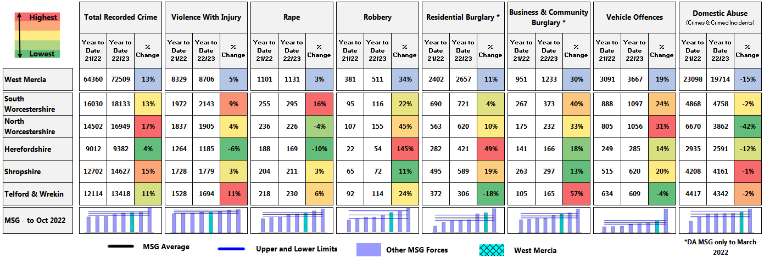
Force KPIs - Key Crimes
Year To Date runs to last day of the previous month.
* National methodology used. This incorporates burglary of a shed or other out building not connected to the main property in to Residential Burglary instead of Business & Community Burglary. This is inline with national reporting practises.
MSG to end of October 2022 other than DA which is to end of March 2022.

Slide 3
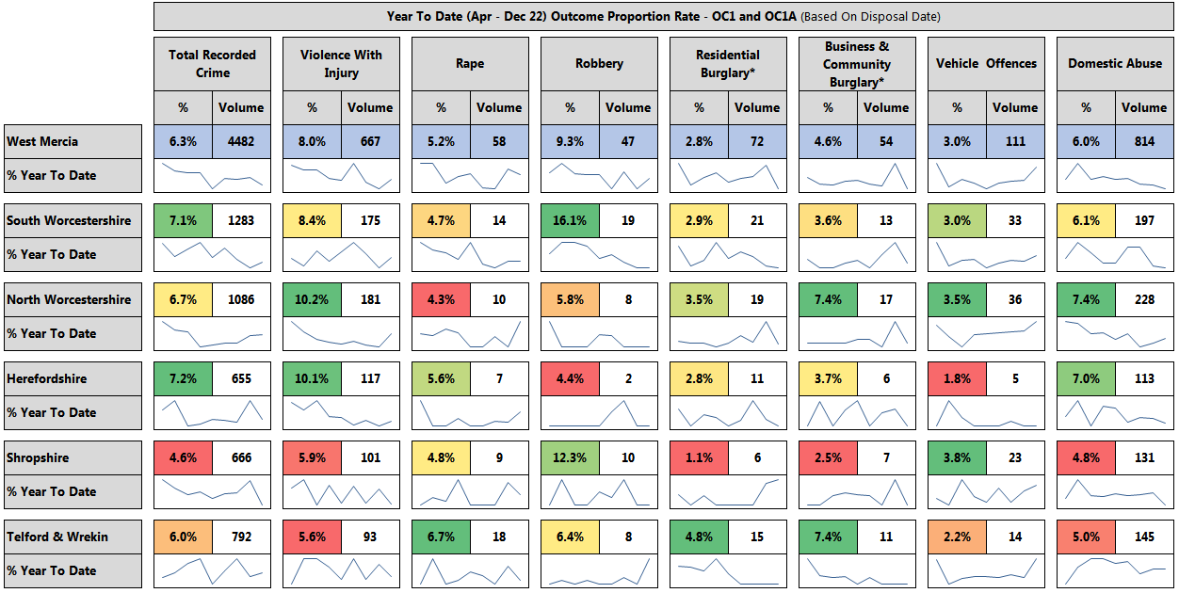
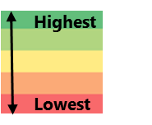
Key crimes - OC1/1A - Charge Summons
* National methodology used. This incorporates burglary of a shed or other out building not connected to the main property in to Residential Burglary instead of Business & Community Burglary. This is inline with national reporting practises.
* Outcome rates have been calculated using LPA Geography not OIC Command.

Slide 4
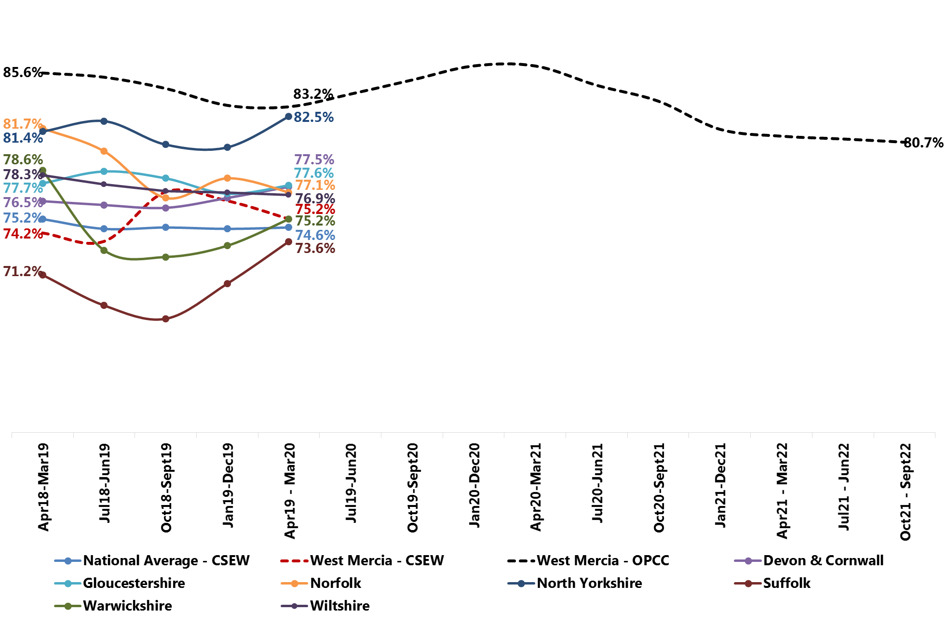
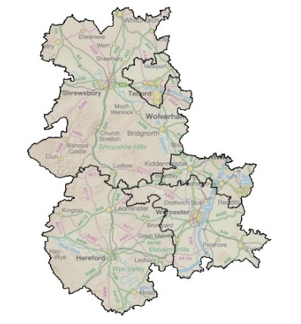
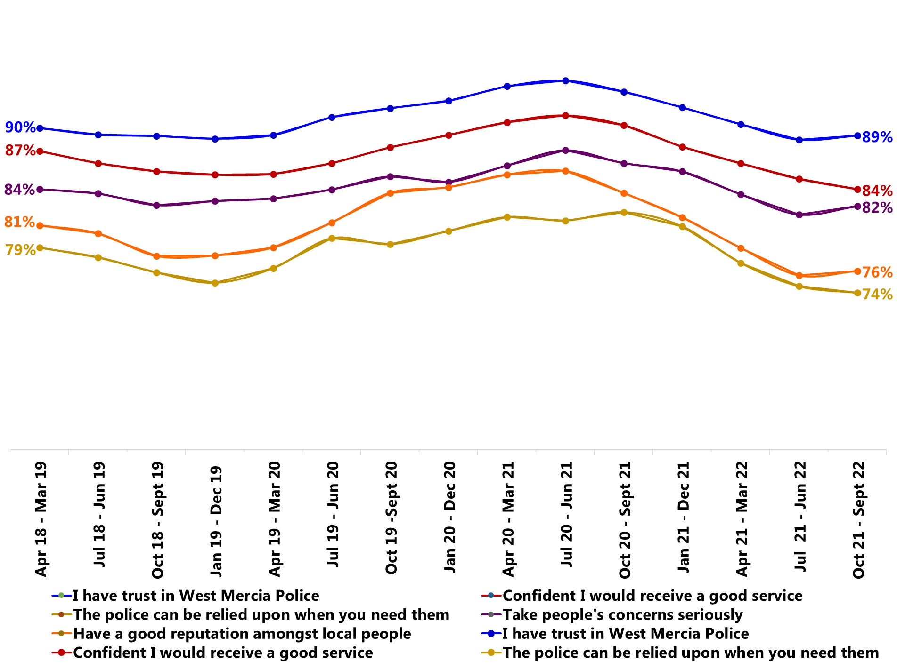

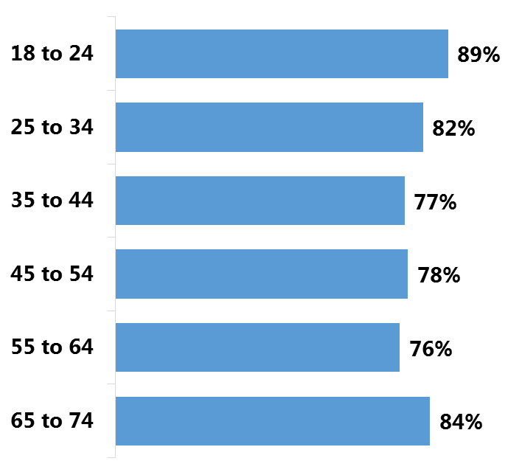


Public Confidence
Confidence (Strongly Agree or Tend to Agree)
West Mercia data presented uses SMSR Perception Survey (rolling 12-months unless otherwise stated)
Trend Data
= change since end Qtr. 1
Discrete Quarter (Q2)
Rolling 12 months (Sept 22)
79%
79%
The Crime Survey England & Wales survey has been suspended since March 20 due to Covid.
81%
1%
81%
84%
Confident
Confident
(Previous Quarter (Q1): 82%)
(Previous period: 81%)
81%
80%
*Change is statistically significant
Public Confidence Headlines
- As at end September 22, with a figure of 81%, the force remains significantly below the aspirational figure of 88%.
- From the period ending March 2021, there is a statistically significant decline in public confidence – decreasing from 86%. Whilst the rolling confidence level has remained the same this quarter there is a slight decrease in the discrete quarterly figure (82%) in comparison to the previous discrete figure.
- Analysis into falling confidence levels has been carried out by SP&I and findings shared with the Confidence Board.
Disability
Demographics
Public Confidence: Drivers
Ethnicity
81%
77%
81%
- From the period ending June 2021, there has been a statistically significant decline in all drivers.
+1%
Vs
-1%
Vs
B-ME
White-British
Without a disability
81%
-1%
Age
Gender
Acorn Type
81%
67%
Female
67%
Vs
Acorn Type 32
Educated families in terraces, young children
81%
Male

Slide 5


2. Public Contact and Call Handling - Emergency Response Times by Grade
Grade 1
Median Time
Dec-22 | 13 mins
Grade 2
Median Time
Dec-22 | 57 mins
Key Points
73% of Grade 1 incidents were attended within the target last month.
This is the same as the previous month.
This is 17 percentage points below WGLL.
West Mercia Attended within target %
Grade 1 - Target 20 minutes
Last month’s attended %
80%
What does this mean?
Encouragingly Grade 2 median dispatch time has reduced for five months consecutively and has recorded the lowest median time last month since March 2022.
hh:mm:ss
76%
74%
70%
63%
Due to SAAB being unable to back record convert data, analysis and insight is only available from March 2022 onwards.
West Mercia Attended with target %
Grade 2 - Target 2 hours
Last month’s attended %
hh:mm:ss
65%
64%
62%
61%
60%

Slide 6
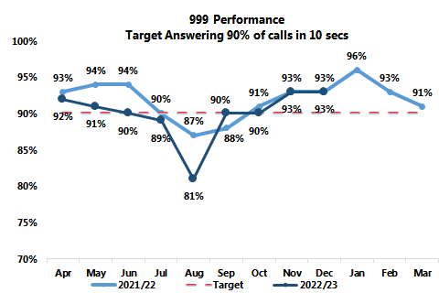
2. Public Contact and Call Handling
999 Performance – Internal Data
Key points
In December 2022 the OCC observed a 0.7% decrease in 999 call demand compared to November 2022 and a 3.8% increase compared to December last year.
93% of 999 calls were answered within 10 seconds – no change against performance last month.
6 calls passed onto buddy forces – 10 fewer than last month. Note that Buddy call data has a one month lag.

Slide 7
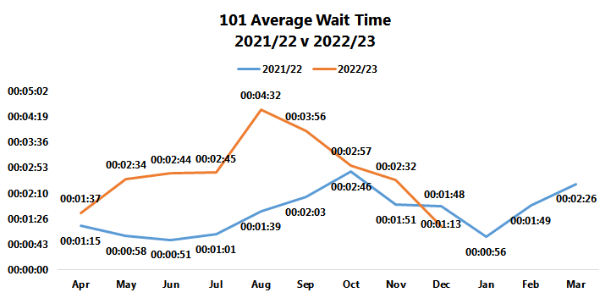
2. Public Contact and Call Handling
101 Average Wait Time
Data relates to answered and abandoned calls.
Key points
December 2022 wait time was 1 minutes 13 seconds, a 79 second decrease on the previous month.
There is a downward trend with average wait times reducing week on week since its peak in the Summer.
This can be attributed to:
  an overall more stable IT.
  less sickness and leave resulting in more staff availability.

Slide 8
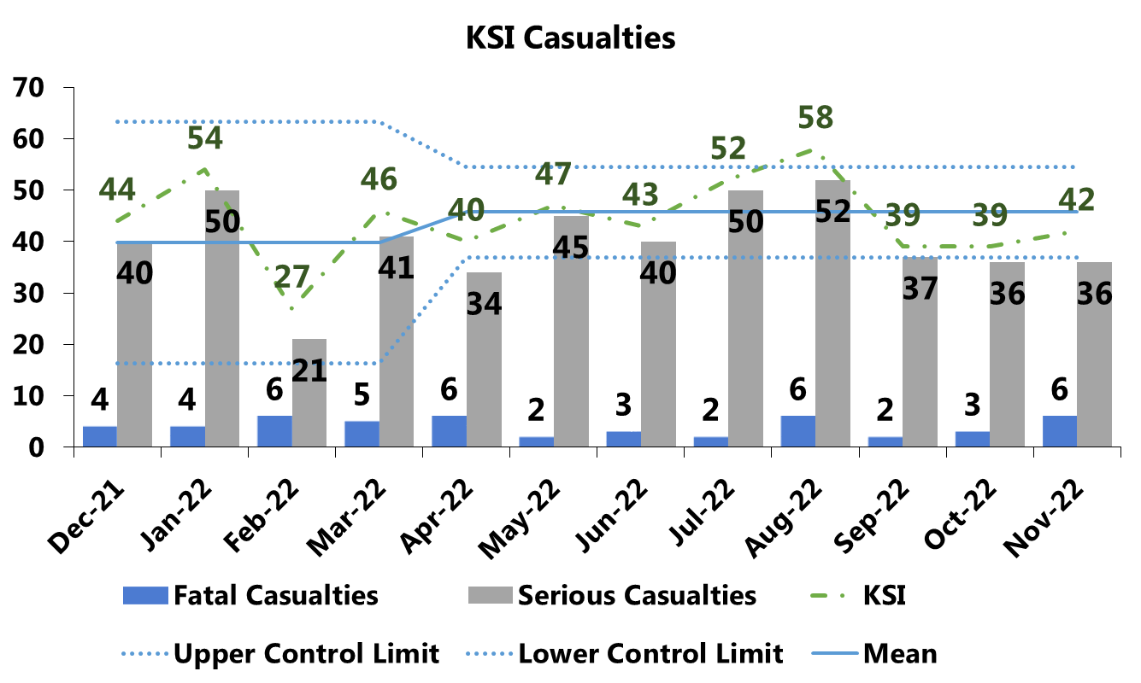
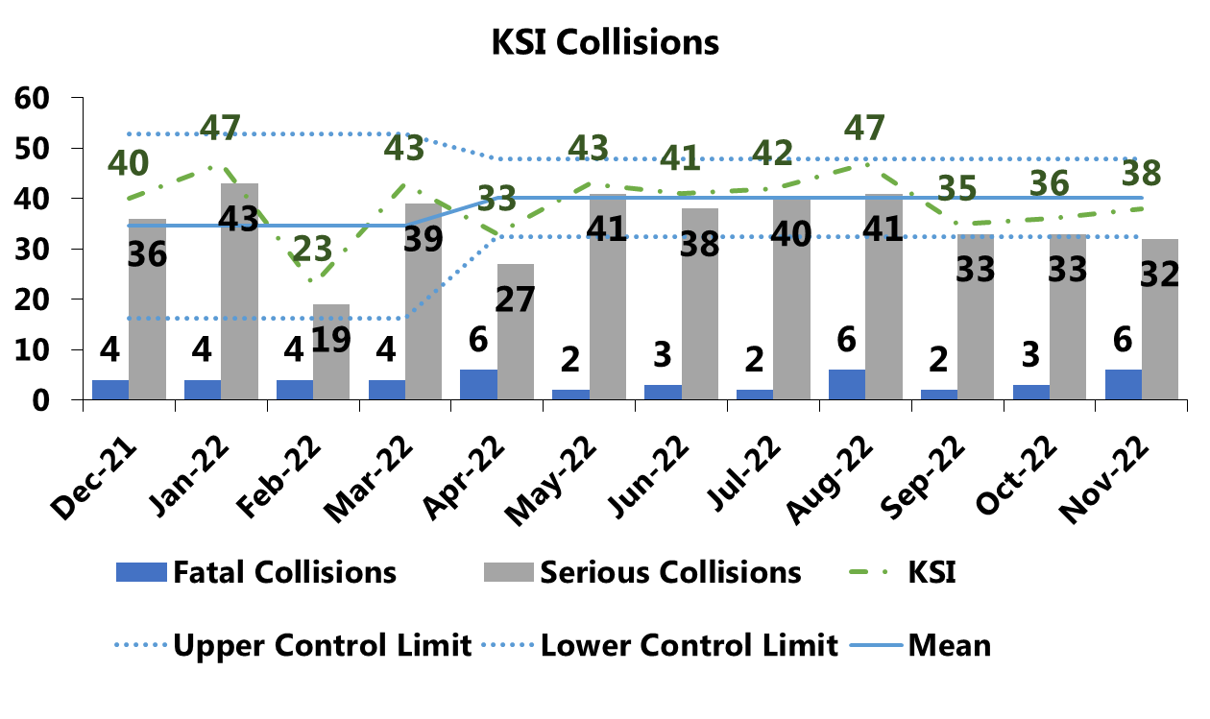
3. Road Safety – Killed and Seriously Injured
KSI reporting a month behind going forward due to delay between collisions and data being available.
Key Points
KSI casualties have increased 8% (3) from last month.
KSI collisions have increased 6% (2) from last month.
YTM 2022/23 40% (13) of fatalities are motorcyclists.
What does this mean?
13% (5) of collisions involved a motorcyclist, of which 3 occurred in Shropshire and 2 in Telford & Wrekin in the previous month.
  - There were no repeat locations.
  - 2 collisions occurred on the weekend.
The Department for Transport’s latest report in January 2023 on road usage shows that, generally, national road usage is in line with pre Covid-19 levels.
Therefore it is probable that the increase in fuel costs are not impacting road usage.

Slide 9
Upper Limit Value
Exceeds Upper Limit
5. Crime and Detections
Total recorded crime – West Mercia
Lower Limit Value
Exceeds Lower Limit
The upper and lower control limits are derived by calculating 2 points of Standard Deviation from the mean. The mean is fixed for the year and is based on volumes recorded in 21/22. It is possible for the previous month to be coloured differently from the month in 2022/23 even if volumes are similar. This is due to the upper and lower control limits changing annually based on volumes in the previous year. It should be noted that pandemic restrictions were still in place during May 2021, which will have affected volumes of certain crime types.
Key Points
Most crimes types have decreased from the previous month.
Volumes of Business & Community Burglary and All Other Theft have exceeded the upper control limit.

Slide 10
Upper Limit Value
Exceeds Upper Limit
5. Crime and Detections - Total recorded crime – South Worcestershire
Lower Limit Value
Exceeds Lower Limit
The upper and lower control limits are derived by calculating 2 points of Standard Deviation from the mean. The mean is fixed for the year and is based on volumes recorded in 21/22. It is possible for the previous month to be coloured differently from the month in 2022/23 even if volumes are similar. This is due to the upper and lower control limits changing annually based on volumes in the previous year. It should be noted that pandemic restrictions were still in place during May 2021, which will have affected volumes of certain crime types.
Key Points
Volumes of Possession of Weapons and Misc. Crimes Against Society have exceeded the upper control limit.

Slide 11
Upper Limit Value
Exceeds Upper Limit
5. Crime and Detections - Total recorded crime – North Worcestershire
Lower Limit Value
Exceeds Lower Limit
The upper and lower control limits are derived by calculating 2 points of Standard Deviation from the mean. The mean is fixed for the year and is based on volumes recorded in 21/22. It is possible for the previous month to be coloured differently from the month in 2022/23 even if volumes are similar. This is due to the upper and lower control limits changing annually based on volumes in the previous year. It should be noted that pandemic restrictions were still in place during May 2021, which will have affected volumes of certain crime types.
Key Points
Volumes of Shoplifting and All Other theft Offences have exceeded the upper control limit.

Slide 12
Upper Limit Value
Exceeds Upper Limit
5. Crime and Detections - Total recorded crime – Herefordshire
Lower Limit Value
Exceeds Lower Limit
The upper and lower control limits are derived by calculating 2 points of Standard Deviation from the mean. The mean is fixed for the year and is based on volumes recorded in 21/22. It is possible for the previous month to be coloured differently from the month in 2022/23 even if volumes are similar. This is due to the upper and lower control limits changing annually based on volumes in the previous year. It should be noted that pandemic restrictions were still in place during May 2021, which will have affected volumes of certain crime types.
Key Points
Volumes of Personal Robbery and Residential Burglary offences have exceeded the upper control limit.

Slide 13
Upper Limit Value
Exceeds Upper Limit
5. Crime and Detections - Total recorded crime – Shropshire
Lower Limit Value
Exceeds Lower Limit
The upper and lower control limits are derived by calculating 2 points of Standard Deviation from the mean. The mean is fixed for the year and is based on volumes recorded in 21/22. It is possible for the previous month to be coloured differently from the month in 2022/23 even if volumes are similar. This is due to the upper and lower control limits changing annually based on volumes in the previous year. It should be noted that pandemic restrictions were still in place during May 2021, which will have affected volumes of certain crime types.
Key Points
Volumes of Residential Burglary, Theft from Person and All Other Theft Offences have exceeded the upper control limit.

Slide 14
Upper Limit Value
Exceeds Upper Limit
5. Crime and Detections - Total recorded crime – Telford & Wrekin
Lower Limit Value
Exceeds Lower Limit
The upper and lower control limits are derived by calculating 2 points of Standard Deviation from the mean. The mean is fixed for the year and is based on volumes recorded in 21/22. It is possible for the previous month to be coloured differently from the month in 2022/23 even if volumes are similar. This is due to the upper and lower control limits changing annually based on volumes in the previous year. It should be noted that pandemic restrictions were still in place during May 2021, which will have affected volumes of certain crime types.
Key Points
No crime types have exceeded the upper control limit in December.

Slide 15
5 . Crime and Detection – National Policing Measures
Key priorities of the Beating Crime Plan: murder, serious violence, domestic abuse, neighbourhood crime and drug supply/county lines.
Not numerical targets but key indicators to show improvement against; expectation of significant improvements within three years.
Measure | Source | Change | Comment
Reduce murder and homicide | Police Recorded Crime |  | Decrease in homicide figures: seven offences in Q2 2022 – 2023, compared with five in Q3 2022 - 2023. Homicide rate remains above 20 per year per million, and increase on the post pandemic average.
Reduce serious violence | Hospital admissions for assault with a sharp object: National Health Service (NHS) Digital Offences involving the discharge of a firearm: Police Recorded Crime |  | Hospital admissions for assault with a sharp object have increased since late 2021. This is a return to pre pandemic levels. The last three quarters have seen an increase in PRC offences with a firearms.
Disrupt drug supply and county lines | Police Recorded Crime and Public Health England |  | There was one drug related homicide recorded in Q3 2022 – 2023, compared with two in Q2 2022 - 2023. There were zero drug-related homicides for the same period last year. Total drug crime volumes are 2% down on pre-pandemic levels.
Reduce neighbourhood crime | Police Recorded Crime |  | Business and community burglaries have increased in Q3 2022 – 2023 compared with Q2 and Q1. Residential burglaries follow the same pattern, with fewer offences occurring during the summer months (Q2), and the highest number of burglaries in the winter months, as anticipated in demand assessments. Robberies follow a different trend compared with burglaries, with fewer offences in Q3, and the most offences occurring during Q2 in the summer months. There are more robberies in total in 2022 – 2023 compared with 2021 – 2022. Robberies particularly increased in Q2, rising by 57%. Vehicle thefts increased in Q3 of 2022 – 2023, by 12% compared with Q2. This corresponds with burglary trends, with the most offences occurring in the winter months, and fewer in the summer months. Theft from a person decreased in Q3 of 2022 – 2023, compared with Q1 and Q2. Offences are higher this year than in 2021 – 2022 as of January 2023.
Improve satisfaction among victims, with a particular focus on victims of domestic abuse | Crime Survey for England and Wales |  | Q3 showed an average of 62.7% of satisfied victims of domestic abuse. This is the lowest average for DA satisfaction compared with Q2 (70.6%) and Q1 (71.5%). For all crime victim satisfaction for the whole experience, Q3 also recorded as the lowest average compared with Q2 and Q1. 60.9% was the average satisfied for Q3, whereas Q2 was 62.4% and Q1 was 63.4%. The number of respondents was lowest for Q3, and highest for Q1.
Tackle cyber crime | Department for Digital, Cultural, Media and Sports |  | The data from the Department for Digital, Culture, Media and Sport is not available. Further police held proxy measures are being developed.

Slide 16
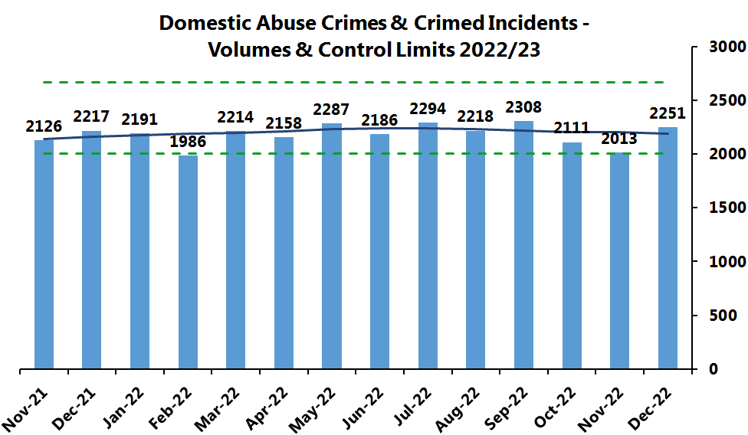
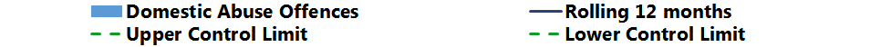
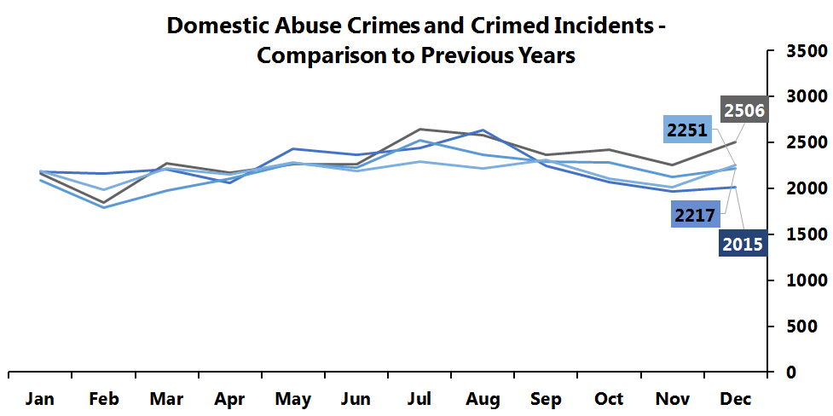
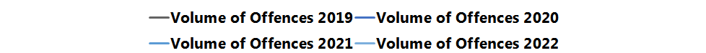
6. Domestic Abuse
Volume of DA Crimes / Crimed Incidents
Key Points
Domestic Abuse Crimes and Crimed Incidents volumes remain stable having increased by 12% (238) from last month.
32% (6) of all homicides in 2022/23 relate to Domestic Abuse, as at the end of December 2022.
Increases in Assault with Injury across West Mercia 27% (77) suggests probable escalation of violence.
What does this mean?
North Worcestershire saw an increase of 18% (80) last month, driven by Domestic Abuse Investigations, 27% (35) increase from the previous month and Assault with Injury with a 37% (22) increase on the previous month.
Shropshire also saw an increase of 18% (71) last month, also driven by Domestic Abuse Investigations 32% (39) increase from the previous month and Assault with Injury 58% (31) increase from the previous month.
17% (386) of crimes relate to Stalking and Harassment, a decrease of 6% (25) from the last month.
Most Similar Group Comparison – Most Recent Data to March 2022
Lowest Volume of Crime per 1000 people
WMP
Highest Volume of Crime per 1000 people
MSG Average
Notes:
Include PCC feedback in paper

Slide 17
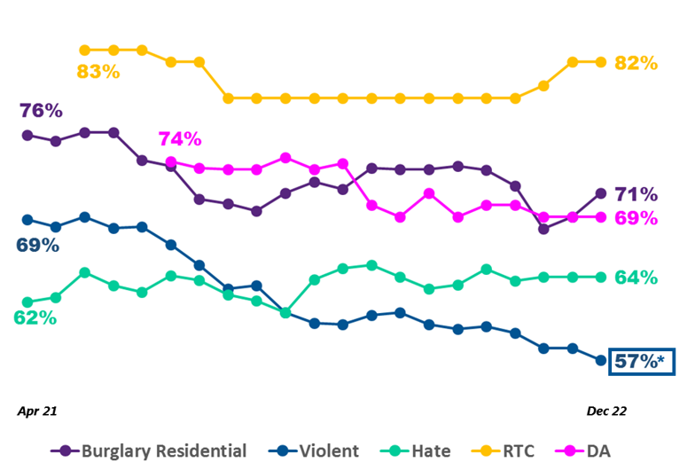
9. Service Users - Satisfaction
All Charts: % Completely or Very Satisfied
Rolling data (burglary and violent = 6 months rolling; hate crime = 12 months rolling; DA = building up to 12 months rolling).
West Mercia
* Change over reporting period shown is statistically significant

Slide 18
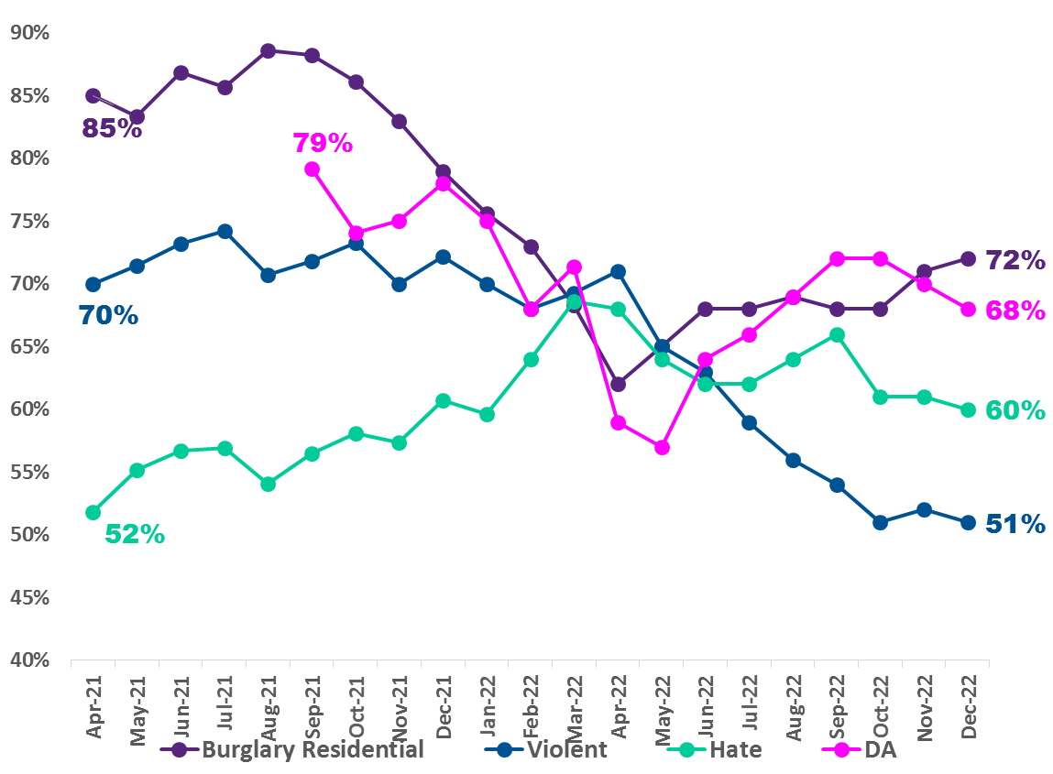
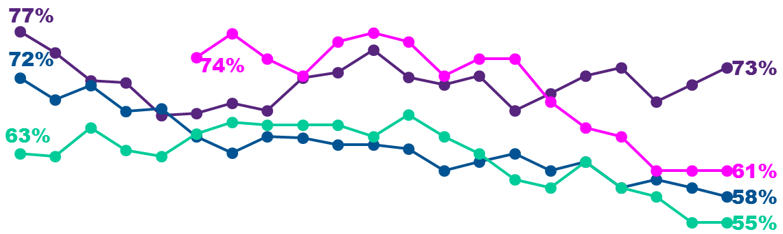
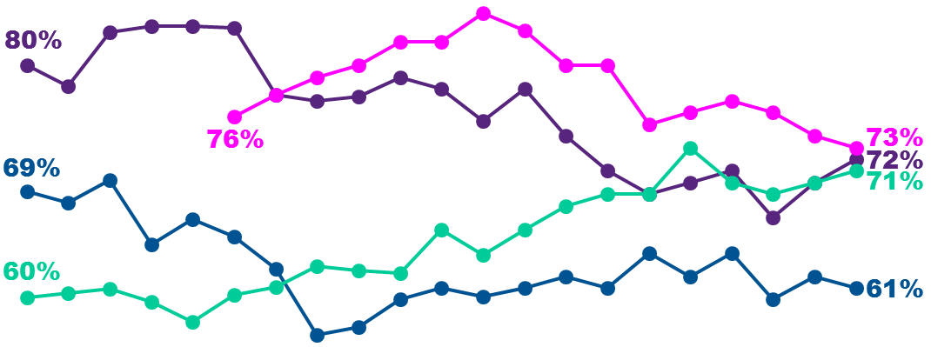
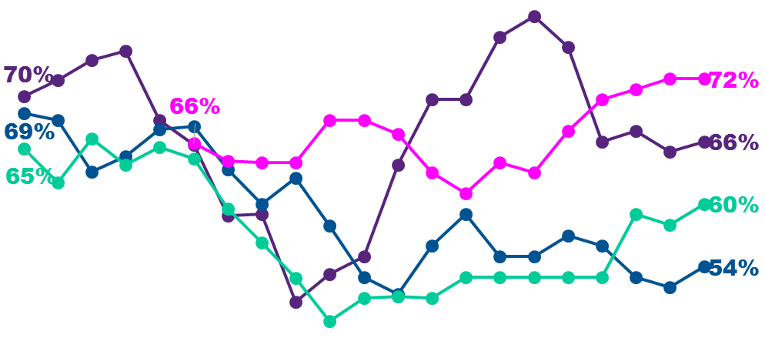
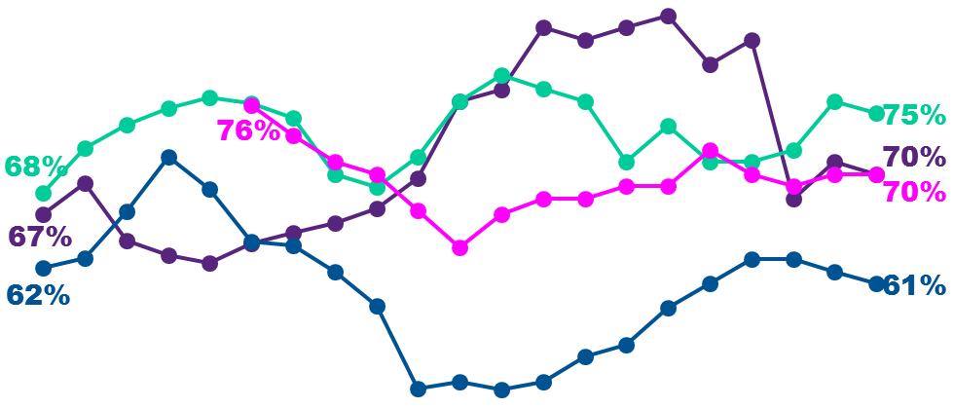
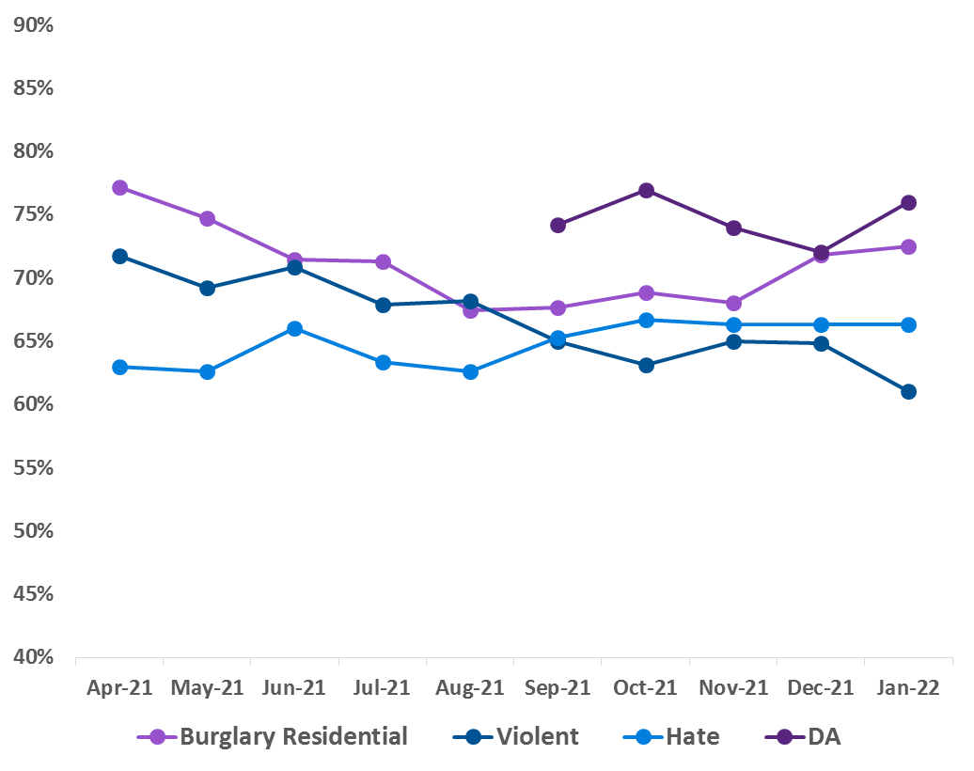
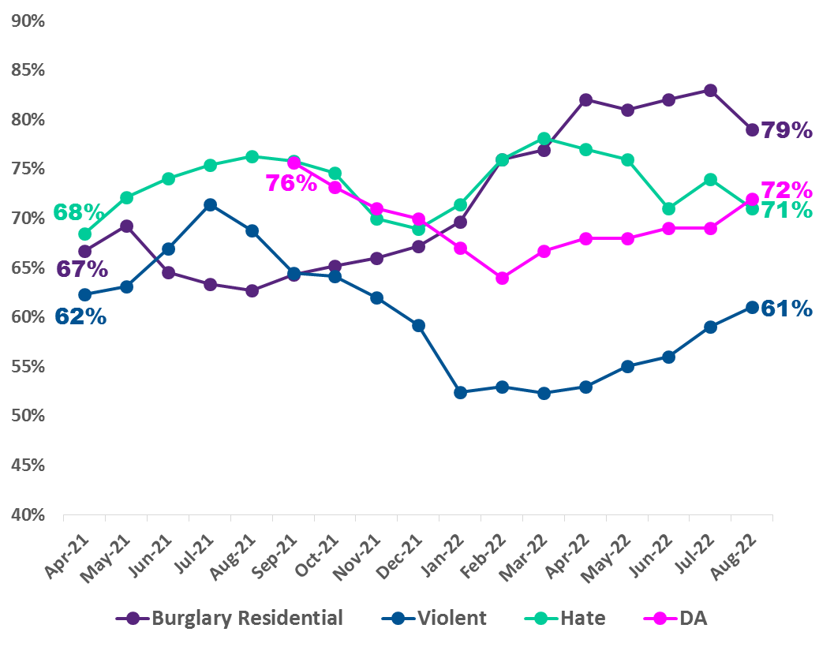
9. Service Users - Satisfaction
All Charts: % Completely or Very Satisfied
Rolling data (burglary and violent = 6 months rolling; hate crime = 12 months rolling; DA = building up to 12 months rolling).
South Worcestershire
North Worcestershire
Herefordshire
*
*
Apr 21
Dec 22
Apr 21
Dec 22
Apr 21
Dec 22
Shropshire
Telford & Wrekin
Apr 21
Dec 22
Apr 21
Dec 22
* Change over reporting period shown is statistically significant

Slide 19

Please forward any feedback in relation to this report to SPIPerformance@westmercia.pnn.police.uk

