Slide 1






Public Views and Perceptions of Policing in West Mercia
2023/24 Survey Quarter 2 Results Presentation

Slide 2
Section One
Introduction & Methodology, Summary & Respondent Breakdown

Slide 3
Introduction & Methodology
West Mercia Police (WMP) & the Police and Crime Commissioner, John Campion, seek to obtain the views of residents, including their confidence in WMP, to inform the PCC’s plan priorities and support decision making around the Safer West Mercia agenda
WMP & the OPCC commissioned SMSR, a third party research agency, to conduct surveys over the phone and face to face with West Mercia residents and victims of crime
The questionnaire includes key questions taken from the Crime Survey for England and Wales (CSEW) and the 2018 Report on Public Perceptions of Policing in England and Wales (PPPEW)
Where relevant, comparisons with CSEW AND PPPEW are displayed. Comparisons with CSEW include the average score of forces included in West Mercia Police’s most similar group (MSG)**. Where comparisons have been made, results have been consistently analysed in accordance with this external reporting. Comparisons with CSEW are based on the most recent results available (March 2020)
Over the 12 month period (October 2022 – September 2023) SMSR have interviewed a representative sample of over 3000 residents – 600 across each of the 5 Local Policing Areas (LPA): Hereford; Shropshire; Telford & Wrekin and North & South Worcestershire
Results have been weighted to accurately represent the population size of each LPA
The report tracks changes in perception levels, identifies high performing areas and those with need for improvement
*CSEW commissioned by Office for National Statistics. PPPEW commissioned by HMICFRS
**CSEW MSG Includes: Devon & Cornwall, Gloucestershire, Norfolk, North Yorkshire, Suffolk, Warwickshire and Wiltshire

Slide 4
Summary – Overall Views
More than 8 in every 10 agree they have confidence in West Mercia Police (82%); a similar percentage say they are confident they would receive a good service from the force (81%).
Three-fifths (62%) say that West Mercia Police are doing either a good or excellent job.
Visibility
A fifth of residents (19%) report that they see an officer or PCSO at least once a week and three-fifths (61%) are satisfied with the levels of policing in their local area.
The majority (77%) feel there has been no change in the level of policing; a tenth (10%) say there has been a decrease and fewer (6%) believe there has been an increase.
A tenth (11%) have spoken to an officer or PCSO from their local policing team in the past 12 months.

Slide 5
Interaction / Access
Almost nine-tenths (88%) are confident that they could access WMP in an emergency with fewer (70%) confident they could do so in a non-emergency.
The majority (77%) continue to say they would prefer to contact West Mercia Police by telephone for a non-emergency issue.
More than half find out about crime and policing issues from the media in general (56%) or from social media (52%), Around half (51%) are informed about what WMP is doing in their local area.
Effectiveness
Almost three-quarters (72%) agree WMP understand the issues in their community; around a fifth (22%) say that they crime and ASB is a problem in their area.
Three-quarters (75%) say that crime and ASB had remained the same compared to 12 months ago; more than a tenth (14%) report an increase. More than three-quarters (76%) agree that WMP are dealing with crime and ASB.

Slide 6
Trust / integrity
The vast majority (93%) continue to say that WMP has their support, and they have trust in the force (88%). More than 8 in every 10 said that WMP act with integrity (84%), and agree they treat everyone fairly, regardless of who they are (90%). Three-quarters agree WMP use their powers appropriately (78%), take people’s concerns seriously (77%) and can be relied to be there when you need them (72%).
Three-fifths (64%) are confident West Mercia Police use their stop and search power fairly and respectfully. A small percentage disagree with this statement (2%).

Slide 7
Respondent Breakdown
Gender
Age
LPA
48%
33%
52%
28%
26%
12%
14-24
25-44
45-64
65+
Ethnic Group
Disability
98%
2%
White
BME
12%
Yes
Results have been weighted to accurately represent the population size of each LPA

Slide 8
Section Two
Visibility / Presence

Slide 9
A fifth see an officer or PCSO at least once a week
Q1 Thinking about your local area. How often would you say you see a police officer or Police Community Support Officer (PCSO)?

Slide 10

Younger people more likely to see officers weekly
Key Insights
Those residing in Telford & Wrekin and Shropshire more likely to see an officer or PCSO at least weekly
Older residents are less likely to see officers or PCSOs on a weekly basis, more than a third of young people see officers at least weekly (36%)
Males more likely than females to see an officer or PCSO at least weekly
Q1 Thinking about your local area. How often would you say you see a police officer or Police Community Support Officer (PCSO)?

Slide 11
Three-fifths satisfied with the levels of policing in their local area
61%
PPPEW – Net Satisfied
Q2 How satisfied are you with the level of policing in your local area?
PPPEW Question: How satisfied or dissatisfied are you with your local police force?

Slide 12
Younger people more likely to be satisfied with levels of policing
Key Insights
Young people, aged 14-24 most likely to be satisfied with policing levels in their local area. Those aged 45 or over are less likely to be satisfied.
Females less likely to be satisfied with levels of policing compared to males
Residents in Telford and Wrekin most likely to be satisfied
Victims of crime significantly less likely to be satisfied with policing levels compared to non-victims
Q2 How satisfied are you with the level of policing in your local area?

Slide 13
A tenth have spoken to an officer or PCSO from their local policing team
Q3 In the past 12 months, have you spoken to one or more of the police officers or PCSO’s who form the local policing team in your area?

Slide 14
Victims of crime most likely to have spoken to members of their LPT
Key Insights
Victims of crime most likely to have engaged with officers from their LPT
BAME respondents more likely to have spoken to local policing team
The likeliness of speaking to members of LPT increases with age.
Residents of South Worcestershire least likely to have spoken to their local policing team
Those in North Worcestershire and Telford & Wrekin most likely to have spoken to their local policing team
Q3 In the past 12 months, have you spoken to one or more of the police officers or PCSO’s who form the local policing team in your area?

Slide 15
Three-quarters felt there had been no change in the level of policing
Q4 Compared to the last 12 months do you feel there has there been a change in the level of policing in this area?

Slide 16
Three-quarters felt there had been no change in the level of policing
Key Insights
Under 24’s and victims of crime were more likely to notice an increase in levels of policing
Increase in perception that levels of policing has decrease the older the age group
However, victims of crime are also more likely to believe there has been a decrease in levels of policing
Residents of North Worcestershire most likely to notice an increase in policing
Q4 Compared to the last 12 months do you feel there has there been a change in the level of policing in this area?

Slide 17
Section Three
Interaction / Access

Slide 18
Three-quarters said they would prefer to contact the police by telephone for a non-emergency
Key Insights
Older residents more likely to choose telephone contact but remains the most universally approved method of contact
Younger residents <45 years more likely to prefer electronic contact methods than older residents
Q5 If you had a non-emergency issue that you wanted to let the police know about, how would you prefer to contact them?

Slide 19
Nearly nine-tenths confident they could access the police in an emergency
25%
63%
PPPEW – In an emergency
Q6 How confident are you, if at all, that you could easily speak to or access police services in your local area if you (or someone else) needed help in an emergency / non-emergency?
PPPEW Question: How confident are you, if at all, that the police in your local area would be easy to access/speak to if you (or someone else) needed help in an emergency

Slide 20
Nearly nine-tenths confident they could access the police in an emergency
Key Insights
Those under 65 show higher levels of confidence they can access WMP in an emergency than those aged 65 or over
Confidence in contacting WMP both in an emergency and non-emergency generally decreases with age
Residents from an ethnic minority background less confident in an emergency compared to white people
Q6 How confident are you, if at all, that you could easily speak to or access police services in your local area if you (or someone else) needed help in an emergency / non-emergency?

Slide 21
Over half said they found out about crime and policing from the media – just under half from social media
Key Insights
Almost three-fifths of males get information from the media in general compared to half of females.
However, females are more likely to access information through social media channels
Almost all residents aged <25 years old say they access information through social media compared to a fifth of those aged 65+. Social media use decreases with age
Less than a fifth of those aged <25 years old access information through the general media
The majority of those who mentioned ‘other sources’ mentioned word of mouth or that they do not hear anything
Q7 How do you most frequently find out about local policing and crime?

Slide 22
Around half do not feel informed about what WMP are doing
14%
37%
PPPEW – Net Informed
Q8 Overall, how well informed do you feel about what West Mercia Police is doing in your local area?
PPPEW Question: Overall, how well informed do you feel about what the police in your local area are doing?

Slide 23
Around half do not feel informed about what WMP are doing
Key Insights
Those aged 65+ least likely to feel informed about what WMP is doing compared to other age groups
Those aged 25-44 most likely to feel informed
Victims of crime more likely to feel informed
Residents from Telford and Wrekin most most informed about what the police are doing in their local area; those from Herefordshire least informed
Q8 Overall, how well informed do you feel about what West Mercia Police is doing in your local area?

Slide 24
Low levels of participation amongst residents in watch schemes, volunteering and community meetings
Key Insights
Half were aware of local ‘watch’ schemes; less than a tenth have taken part
Two fifths are aware of police volunteering opportunities with less than a percent of those interviewed confirming they had taken part
A fifth say they are aware of community meetings and a small percentage have taken part
Q9 Are you aware of or have you taken part in any of the following activities in the last 12 month?

Slide 25
Around a tenth have been a victim of, or witness to, a crime
Q10 And can I ask whether you have been a victim of, or witness to, crime in the past 12 months, or you've had to contact West Mercia Police for any other issues?

Slide 26
Around a tenth have been a victim of, or witness to, a crime
Key Insights
Residents in North Worcestershire more likely to have encountered crime in some form
Those in Herefordshire least likely to have been involved in crime as a victim, witness or other
Less than a tenth of those under 25 say they have witnessed or been a victim of crime
BAME respondents nearly twice as likely to have been victims of crime compared to White respondents
The vast majority (94%) of residents who had been a victim of crime said they reported this to the police
Q10 And can I ask whether you have been a victim of, or witness to, crime in the past 12 months, or you've had to contact West Mercia Police for any other issues?

Slide 27
Section Four
Effectiveness

Slide 28
Almost three-quarters felt WMP understands issues in their community
5%
67%
CSEW MSG Average -
Net Agree
Q13 How much would you agree or disagree that West Mercia Police understand the issues that affect your community? *Don’t know option has been excluded from calculation to make question comparable to CSEW
CSEW Question: They (the police in this area) understand the issues that affect this community

Slide 29
Almost three-quarters felt WMP understands issues in their community
Key Insights
Residents aged <25 years most likely to agree WMP understand the issues in their area
Residents South Worcestershire most likely to agree the police understand the issues in their area
Significant drop in levels of agreement since Q1
Residents from an ethnic minority background more likely to agree WMP understand issues compared to White people
Q13 How much would you agree or disagree that West Mercia Police understand the issues that affect your community? *Don’t know option has been excluded from calculation to make question comparable to CSEW

Slide 30
Around three-quarters do not feel crime and ASB is a problem in their local area
20%
56%
PPPEW -
Not much / Not a problem
Q14 How much of a problem, if at all, do you think crime and anti-social behaviour are in your local area?
PPPEW Question: How much of a problem, if at all, do you think crime and anti-social behaviour are in your local area?

Slide 31
Around three-quarters do not feel crime and ASB is a problem in their local area
Key Insights
Almost half of victims feel that crime and ASB is a problem in their area
BAME respondents more likely than White respondents to say crime and ASB is a problem
Females also more likely to say crime and ASB is a problem compared to males
Younger people aged 14-24 and those over 65+ are less likely to feel that crime and ASB is a problem
Residents in Herefordshire least likely to say crime and ASB was a problem; those in Telford & Wrekin most likely
Q14 How much of a problem, if at all, do you think crime and anti-social behaviour are in your local area?

Slide 32
Three-quarters felt crime and ASB levels had remained the same – more than a tenth felt there was more
Q15 Compared to 12 months ago, would you say there is now more crime and ASB in the area you live in, less crime and ASB or about the same?

Slide 33
Three-quarters felt crime and ASB levels had remained the same – more than a tenth felt there was more
Key Insights
Victims of crime most likely to feel that crime and ASB levels had risen in the last 12 month
Females more likely than males to say that crime and ASB has increased
Those aged 45-64 more likely to feel there has been an increase in crime over the past 12 months than other age groups
Q15 Compared to 12 months ago, would you say there is now more crime and ASB in the area you live in, less crime and ASB or about the same?

Slide 34
Over three-quarters agreed WMP are dealing with crime and ASB
23%
Key Insights
More than three-quarters agree WMP are dealing with crime and ASB
Just under three-quarters say WMP respond effectively to emergencies; less than a tenth disagree
Almost two thirds say WMP are policing the roads, however, more than a quarter disagree
Fewer agree that WMP are protecting children and vulnerable people and tackling organised crime, however, there are low levels of disagreement towards these aspects
Around a fifths disagree WMP are bringing offenders to justice
54%
CSEW MSG Average - Dealing with crime and ASB
Q16 To what extent do you agree or disagree that West Mercia Police are:
*Don’t know option has been excluded from calculation to make question comparable to CSEW
CSEW: Do you agree or disagree that the police and local council are dealing with the anti-social behaviour and crime issues that matter in this area?

Slide 35
Section Five
Trust / Integrity

Slide 36
Nearly two-thirds confident WMP use their stop and search power fairly and respectfully
Q17 Please say how much you agree or disagree with the following statement: I am confident that West Mercia Police use their stop and search powers fairly and respectfully?

Slide 37
Nearly two-thirds confident WMP use their stop and search power fairly and respectfully
Key Insights
Confidence in stop search procedure decreases with age
Almost four-fifths of those aged 14-24 say they are confident in the process
Residents from an ethnic minority background less likely to say they are confident the process includes fairness and respect compared to White people.
Q17 Please say how much you agree or disagree with the following statement: I am confident that West Mercia Police use their stop and search powers fairly and respectfully?

Slide 38
9 in every 10 say that WMP have their support and that they have trust in WMP
Key Insights
More than 9 out of every 10 residents say that WMP have their support and believe WMP treat everyone fairly, regardless of who they are
The vast majority say they have trust in WMP and act with integrity
More than three-quarters say that WMP use powers appropriately and take people’s concerns seriously
Highest levels of disagreement attributed to reliability and admitting mistakes
Two thirds say that WMP have a good reputation.
21%
69%
CSEW MSG Average – Treat everyone fairly
15%
57%
CSEW MSG Average – Can be relied on when needed
Q18 Thinking about West Mercia Police, to what extent do you agree or disagree that...?
*Don’t know option has been excluded from calculation to make question comparable to CSEW
CSEW Questions: They (the police in this area) can be relied on to be there when you need them / The police in this area treat everyone fairly regardless of who they are

Slide 39
Section Six
Confidence in West Mercia Police

Slide 40
Four-fifths confident they would receive a good service from WMP
Q19 If you were to report a crime or incident in the future, how confident are you that you would receive a good service from West Mercia Police?

Slide 41
Four-fifths confident they would receive a good service from WMP
Key Insights
More than 9 in every 10 aged 14-24 are confident they would receive a good service from WMP compared to three-quarters of those aged 65+
Residents in Telford & Wrekin and Herefordshire most confident they would receive a good service
Victims of crime significantly less confident than non-victims
Q19 If you were to report a crime or incident in the future, how confident are you that you would receive a good service from West Mercia Police?

Slide 42
Three-fifths felt the police were doing either an excellent or a good job
3%
59%
CSEW MSG Average – Excellent / Good job
Q20 In general, how good a job do you think West Mercia Police are doing in your local area?
*Don’t know option has been excluded from calculation to make question comparable to CSEW
CSEW Question: Taking everything into account, how good a job do you think the police in this area are doing?

Slide 43
Three-fifths felt the police were doing either an excellent or a good job
Key Insights
Those aged 14-24 significantly more likely to feel the police were doing an excellent or good job compared to other age groups
Reduction in percentage of people from an ethnic minority background who feel the police are doing a good job during Q2
Residents in South Worcestershire least likely to say WMP were doing an excellent or good job
Those in Shropshire and North Worcestershire are most likely to say WMP were doing either an excellent or good job
Victims of crime less likely to feel the police were doing either an excellent or good job
Q20 In general, how good a job do you think West Mercia Police are doing in your local area?
*Don’t know option has been excluded from calculation to make question comparable to CSEW

Slide 44
More than 8 out of 10 say they have confidence in WMP
5%
77%
CSEW MSG Average – Net Agree
Q21 Please say how much you agree or disagree with the following statement: Taking everything into account I have confidence in West Mercia Police?
*Don’t know option has been excluded from calculation to make question comparable to CSEW
CSEW Question: Taking everything into account I have confidence in the police in this area

Slide 45
More than 8 out of 10 say they have confidence in WMP
Key Insights
Those aged 14-24 more likely to have confidence in WMP compared to other age groups
Victims of crime less likely to agree they have confidence in WMP than non-victims
People from an ethnic minority background less likely to say they are confident compares to White residents
Residents of Shropshire have the lower levels of confidence compared to other LPAs
Q21 Please say how much you agree or disagree with the following statement: Taking everything into account I have confidence in West Mercia Police?
*Don’t know option has been excluded from calculation to make question comparable to CSEW

Slide 46
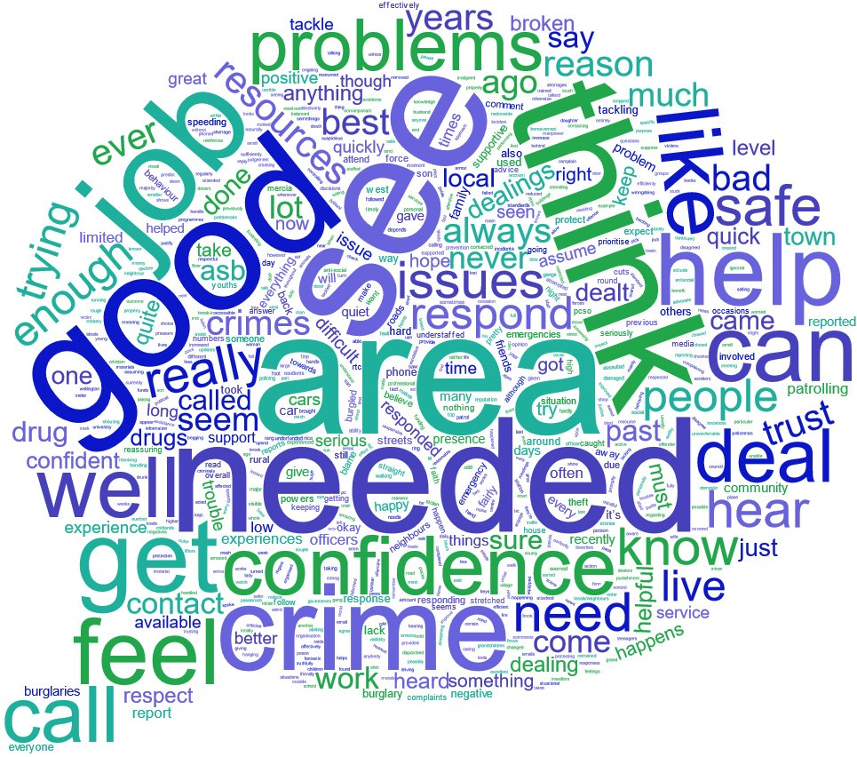
Factors influencing confidence
Q22 Why do you say that?

Slide 47
Less than a tenth have experienced an event that negatively affected their confidence in the police
Q23 Has any particular event affected your confidence in the police in the last 12 months?

Slide 48
Victims more likely to be affected in both a positive and negative way
Key Insights
Victims of crime were most likely to say they experienced an event that negatively affected their confidence; however, victims were also more likely to be affected in a positive way
Those who experiences a negative event increases with age
Those living in Shropshire were more likely to have experienced an event that positively affected their confidence in WMP
Q23 Has any particular event affected your confidence in the police in the last 12 months?

Slide 49
More than a tenth of respondents said they are aware of the Police and Crime Commissioner
Q25 Do you know who the current elected Police and Crime Commissioner is for your area?

Slide 50
More than a tenth of respondents said they are aware of the Police and Crime Commissioner
Key Insights
Males are more likely to be aware of the PCC compared to females
No-one aged <25 years say they are aware of the Police and Crime Commissioner
The older the respondent the more likely they were to be aware of the PCC
Perceptions surveys typically record awareness of 8-15% based on previous research conducted by SMSR.
Q25 Do you know who the current elected Police and Crime Commissioner is for your area?

Slide 51
Section Seven
LPA & Victim Comparisons

Slide 52
LPA Key Question Overview
*Don’t know option has been excluded from calculation to make question comparable to CSEW

Slide 53
LPA Key Findings - Herefordshire
Key Findings Compared With Other NPTs
Least likely to see an officer or PCSO at least weekly (20%)
Least informed about what WMP are doing in their local area (48%)
Least likely to have experienced crime over the past year (10%)
Least likely to feel WMP understand issues in their community (70%) joint with Telford and Wrekin
Least likely have said crime and ASB is a problem in their area (15%)
Least confident that WMP use stop and search powers fairly and respectfully (62%) joint with Shropshire
Most confident they would receive a good service from WMP (82%) joint with Telford & Wrekin
Most likely to have confidence in WMP (83%) joint with South Worcestershire and Telford & Wrekin
Highest awareness of the PCC (15%) joint with South Worcestershire
*Don’t know option has been excluded from calculation to make question comparable to CSEW

Slide 54
LPA Key Findings - Herefordshire
*Don’t know option has been excluded from calculation to make question comparable to CSEW

Slide 55
LPA Key Findings - Shropshire
Key Findings Compared With Other NPTs
Most likely to see an officer or PCSO at least weekly (20%) joint with Telford and Wrekin
Least confident that WMP use stop and search powers fairly and respectfully (62%) joint with Herefordshire
Most likely to feel the police were doing either an excellent or good job (63%)
Least likely to have confidence in WMP (80%)
Lowest awareness of the PCC (13%)
*Don’t know option has been excluded from calculation to make question comparable to CSEW

Slide 56
LPA Key Findings - Shropshire
*Don’t know option has been excluded from calculation to make question comparable to CSEW

Slide 57
LPA Key Findings - Telford & Wrekin
Key Findings Compared With Other NPTs
Most likely to see an officer or PCSO at least weekly (20%) joint with Shropshire
Most satisfied with the levels of policing in their local area (64%)
Most likely to have spoken to an officer or PCSO from their local policing team (14%)
Most confident they could access the police in a non-emergency (72%)
Most informed about what WMP are doing in their local area (53%)
Least likely to feel WMP understand issues in their community (70%) joint with Herefordshire
Most likely to think that crime and ASB was a problem in their local area (27%)
Most confident that WMP use stop and search powers fairly and respectfully
Most confident they would receive a good service from WMP (82%) joint with Herefordshire
Most likely to have confidence in WMP (83%) joint with South Worcestershire and Herefordshire
*Don’t know option has been excluded from calculation to make question comparable to CSEW

Slide 58
LPA Key Findings - Telford & Wrekin
*Don’t know option has been excluded from calculation to make question comparable to CSEW

Slide 59
LPA Key Findings - North Worcestershire
Key Findings Compared With Other NPTs
Most likely to have experienced crime over the past year (14%)
Most likely to feel the police were doing either an excellent or good job (63%)
*Don’t know option has been excluded from calculation to make question comparable to CSEW

Slide 60
LPA Key Findings - North Worcestershire
*Don’t know option has been excluded from calculation to make question comparable to CSEW

Slide 61
LPA Key Findings - South Worcestershire
Key Findings Compared With Other NPTs
Least satisfied with the levels of policing in their local area (59%)
Most confident that WMP understands the issues in their community (74%)
Least likely to feel the police were doing either an excellent or a good job in their local area (58%)
Most likely to have confidence in WMP (83%) joint with Herefordshire and Telford & Wrekin
Highest awareness of the PCC (15%) joint with South Worcestershire
*Don’t know option has been excluded from calculation to make question comparable to CSEW

Slide 62
LPA Key Findings - South Worcestershire
*Don’t know option has been excluded from calculation to make question comparable to CSEW

Slide 63
Victim of Crime Comparisons
Key Insights
In general, Victims who reported crime were more positive towards WMP than those that did not report their crime
*Don’t know option has been excluded from calculation to make question comparable to CSEW

